Slide 1
Florida State University Payroll Services
Twelve Month Payment Option for
Nine- and Ten- Month Faculty
Job Aid

Slide 2
Using the Optional Estimated Deduction Calculator
An optional Estimated Deduction Calculator is available to assist you in determining the amount(s) to be deducted from each of your fall/spring paychecks in order to maintain a fairly consistent net pay over 24 pay periods.
Because the first paycheck of fall term and the last paycheck of spring term for faculty are usually not full bi-weekly amounts, no deductions related to this program will be withheld from said paychecks.
The schedule for the deductions and repayment period are listed on the enrollment form.
A new enrollment form must be submitted each academic year.
It is recommended that you keep a copy of the enrollment form for your personal records.

Slide 3
Using the Optional Estimated Deduction Calculator
For seven pay periods each spring term, certain premiums for your elected benefits are doubled and withheld from your paychecks to cover the cost of your summer month benefits.
These include, but are not limited to insurance plans such as health, dental, vision, long-term disability, and life.
The Estimated Deduction Calculator is a tool that provides an estimated deduction amount for the non-double deduction period and a lower deduction amount during the double deduction period.
The results of the calculator are only estimates and net pay may change due to salary increases, changes to deductions during open enrollment, and annual changes to the federal income tax rates.
All deductions/benefits are listed on your pay advices under three categories: Before Tax Deductions, After Tax Deductions (both paid by the employee) and Employer Paid Benefits. The employer paid benefits are not needed for the calculation of the suggested deduction amounts.

Slide 4
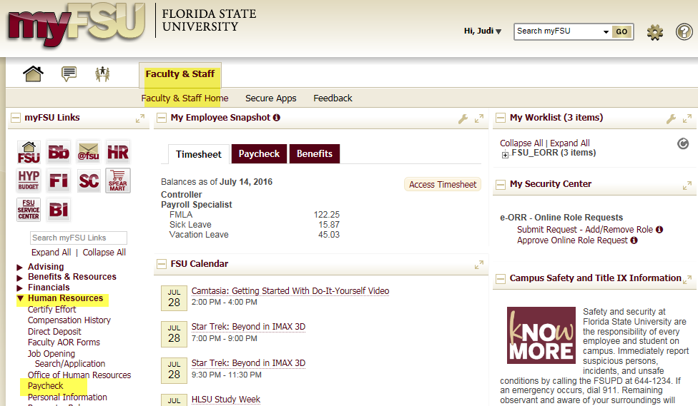
Using the Optional Estimated Deduction Calculator
You will need copies of your pay advices for the second paycheck in January and the first paycheck in February. To download a copy of your pay advices log onto my.fsu.edu. On the Faculty and Staff tab click on the arrow next to Human Resources on the left side of the screen, then select Paycheck:

Slide 5
Using the Optional Estimated Deduction Calculator
Locate and review both pay advices. You will need to note the net pay on the January paycheck.

Slide 6
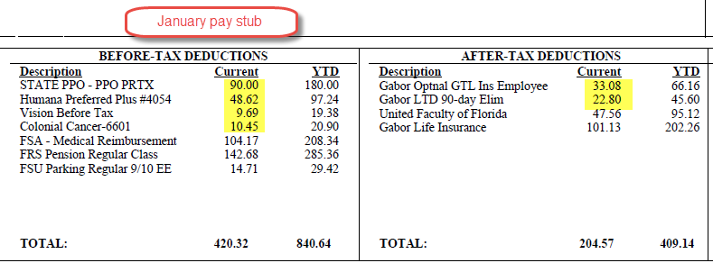
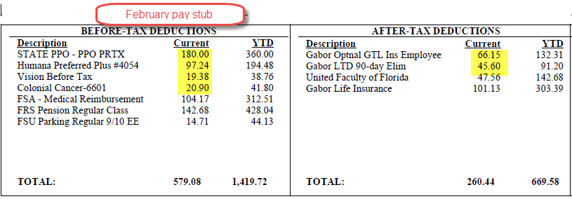
Using the Optional Estimated Deduction Calculator
Compare the Before-Tax and After-Tax deductions of the January and February paychecks and note the deductions with double premium amounts.

Slide 7
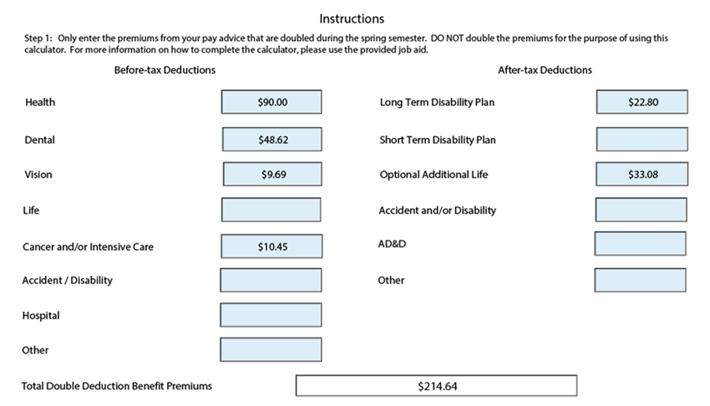
Using the Optional Estimated Deduction Calculator
On the Estimated Deduction Calculator, enter the regular premium amounts for those deductions that are affected by the double deduction period. Do not enter the doubled premium amount.

Slide 8
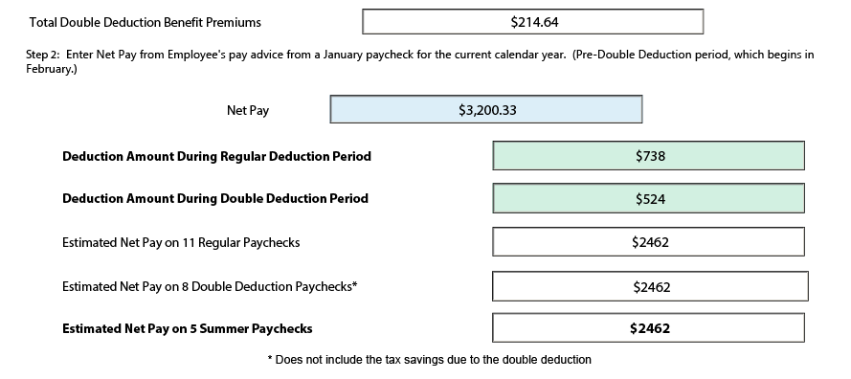
Using the Optional Estimated Deduction Calculator
Enter the net pay from your January pay advice and the calculator will figure your suggested, estimated deduction amounts:

Slide 9
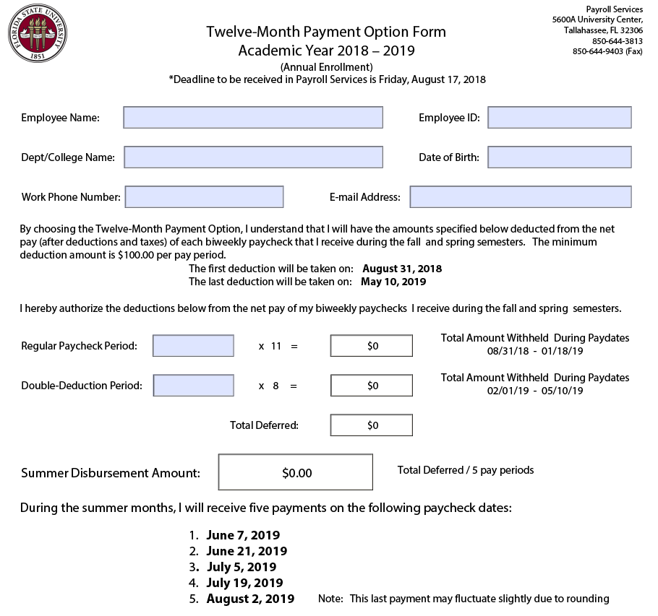
Using the Optional Estimated Deduction Calculator
You may use the suggested deductions from the Optional Estimated Deduction Calculator to complete the enrollment form OR enter another amount. You may use the same deduction amount throughout the year.
Please complete all requested information on the form.

Slide 10
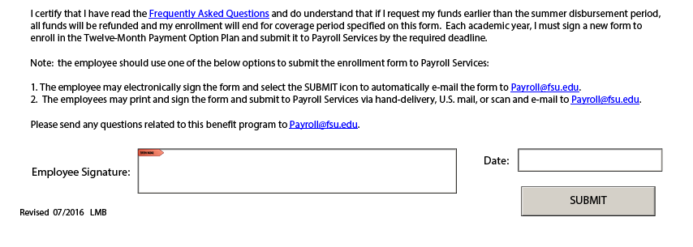
Using the Optional Estimated Deduction Calculator
Sign and date the enrollment form using an electronic signature. Click on the submit button to send the form to Payroll Services
If you do not have electronic signature set up, you may print the form, sign it and email it to Payroll Services at Payroll@fsu.edu or fax to 850-644-9403.

