Slide 1
FY22 UBIT KICK-OFF
Presented by:
Tax & Compliance
Notes:
Welcome, we hope you find this slide presentation helpful.

Slide 2
Why is this important?
Notes:
All Universities exempt under section 501 (c)(3) of the Internal Revenue Code are required to file an IRS Form 990-T, “Exempt Organizations Business Income Tax Return”.

Slide 3
What is UBIT?
“Income from a trade or business, regularly carried on, that is not substantially related to the charitable, educational or other purpose that is the basis of the organization’s exemption.”
The following three criteria must be present:
A trade or business
Regularly carried on
Not substantially related
Notes:
The term “trade or business” generally includes any activity carried on for the production of income from selling goods or performing services.
Regularly carried on - If an activity shows a frequency and continuity and is pursued in a manner similar to comparable commercial activities of nonexempt organizations.
Substantially related:
Is the activity substantially related to our exempt purpose?
FSU’s exempt purpose is to promote education, research, public service and to lessen the burden of government.
If the activity is substantially related, it would not be considered UBI.
The activity must meet all 3 required criteria to be UBI.

Slide 4
Annual UBIT Survey
Notes:
The Annual UBIT Survey is a form located on the Controller’s website, Forms > Tax Administration Forms.
The survey should be completed by any department with an auxiliary budget that has received revenue in the prior fiscal year.

Slide 5
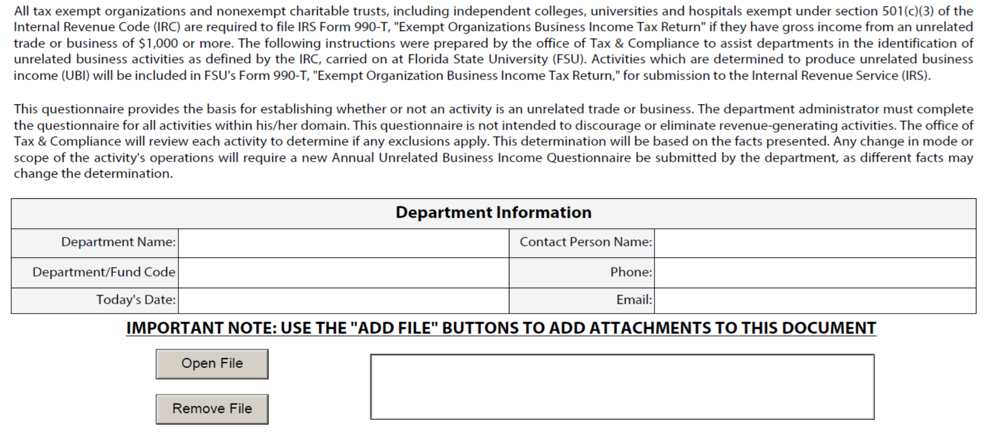
Notes:
Page 1 – Enter departmental contact information.
The empty box is the location where uploaded attachments are stored. If at any point after attaching a file you need to open to review, or to remove, you will do so using these buttons.

Slide 6
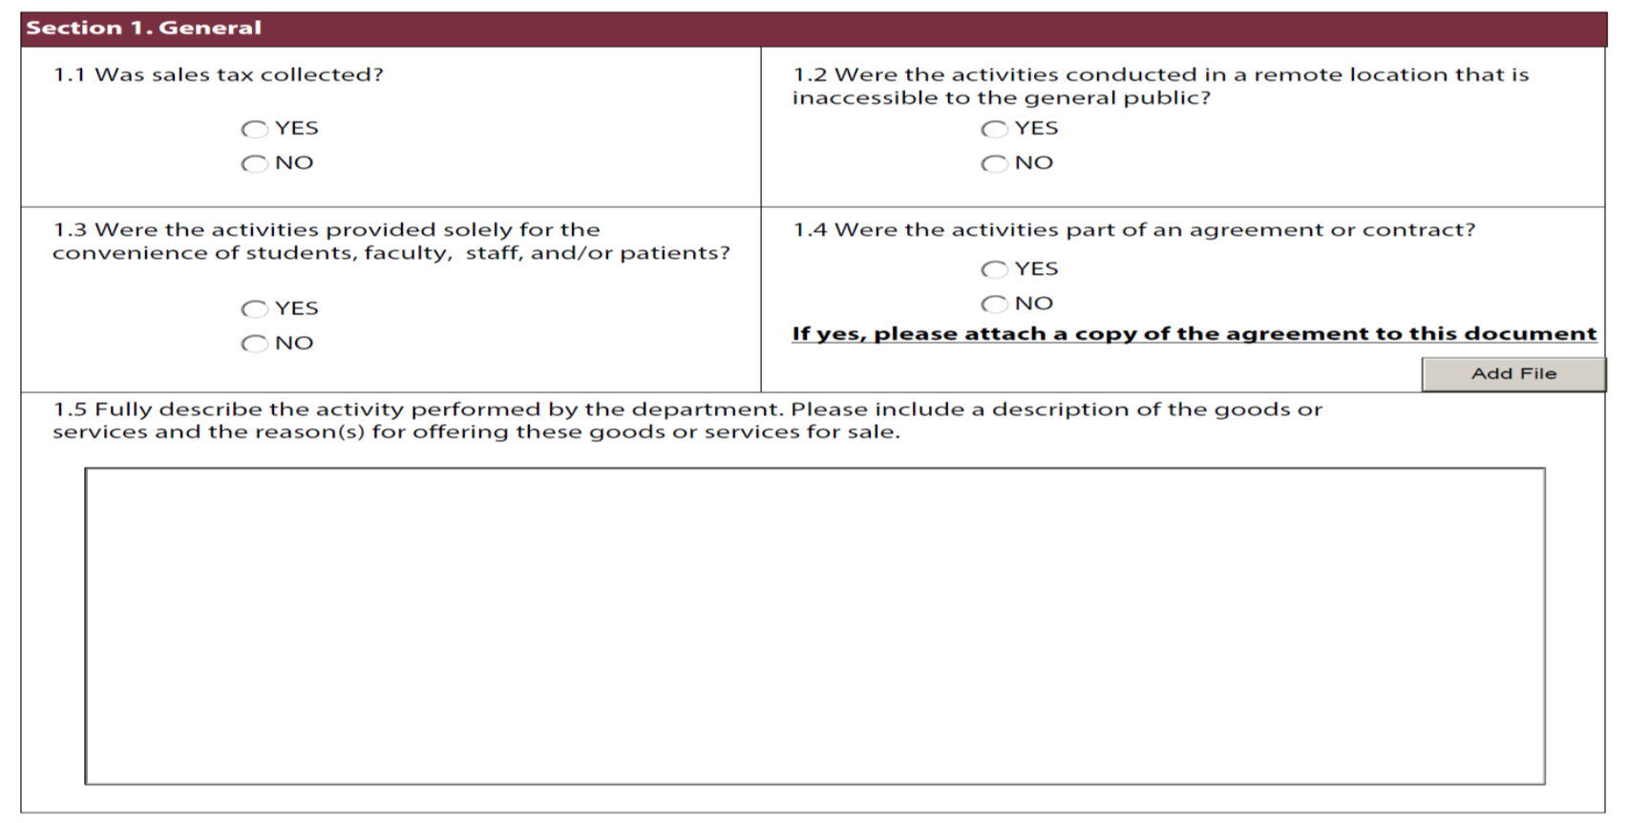
Notes:
Section 1 should be completed by everyone.
Question 1.2 - Were the activities conducted in a remote location that is inaccessible to the general public?
The department should ask themselves “would it be nearly impossible for the general public to attend?”
Question 1.3 - Were the activities provided solely for the convenience of students, faculty, staff, and/or patients?
When the activity was established, was it done so primarily for the FSU community? Not that the general public is not allowed, but who was the intended audience?
Question 1.4 - If yes, attach that agreement or contract here.
Question 1.5 – Please provide as much detail as possible here.

Slide 7
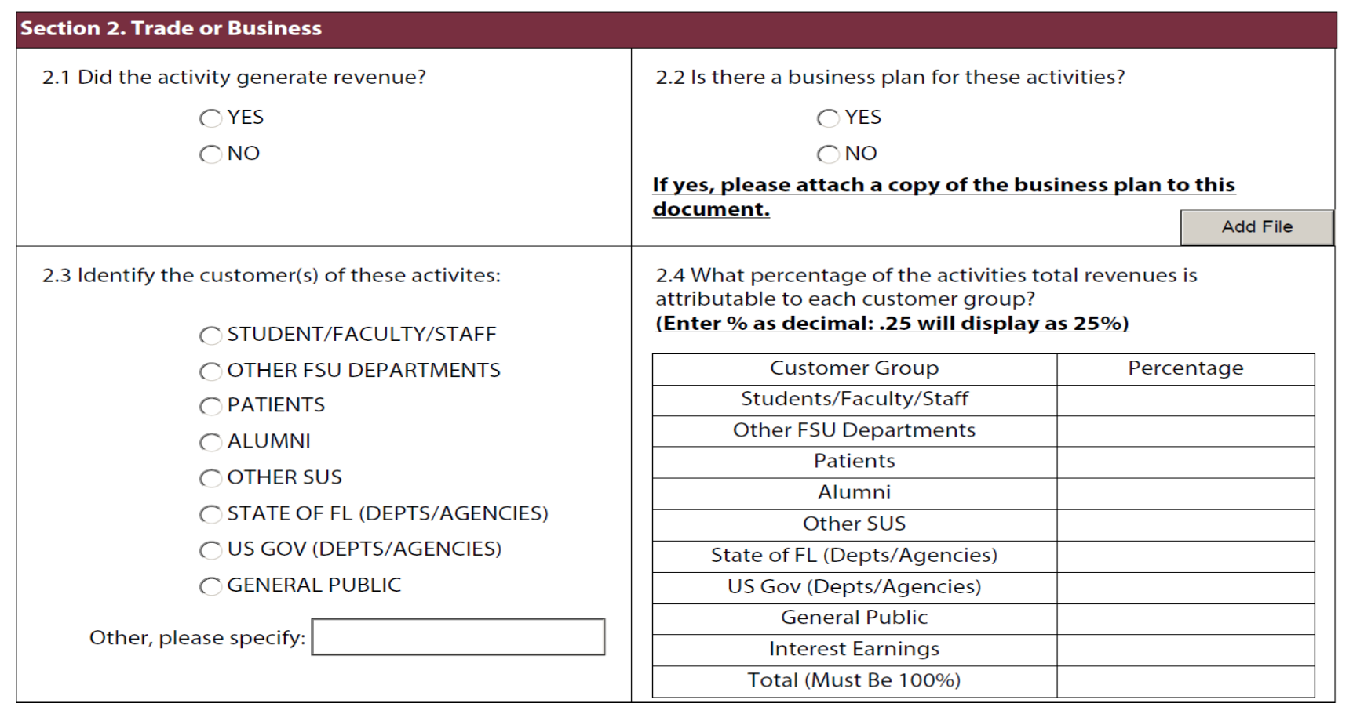
Notes:
Section 2 should be completed by everyone.
Question 2.2 – It is recommended that each department have a business plan.
If the UBI activity continues to generate a loss, then the business plan assists in determining whether the department will be able to carry forward any losses and use them to offset any future gains.
Question 2.3 and 2.4 go together. Whichever customers are selected in 2.3 need to have a percentage entered in the chart in 2.4.

Slide 8
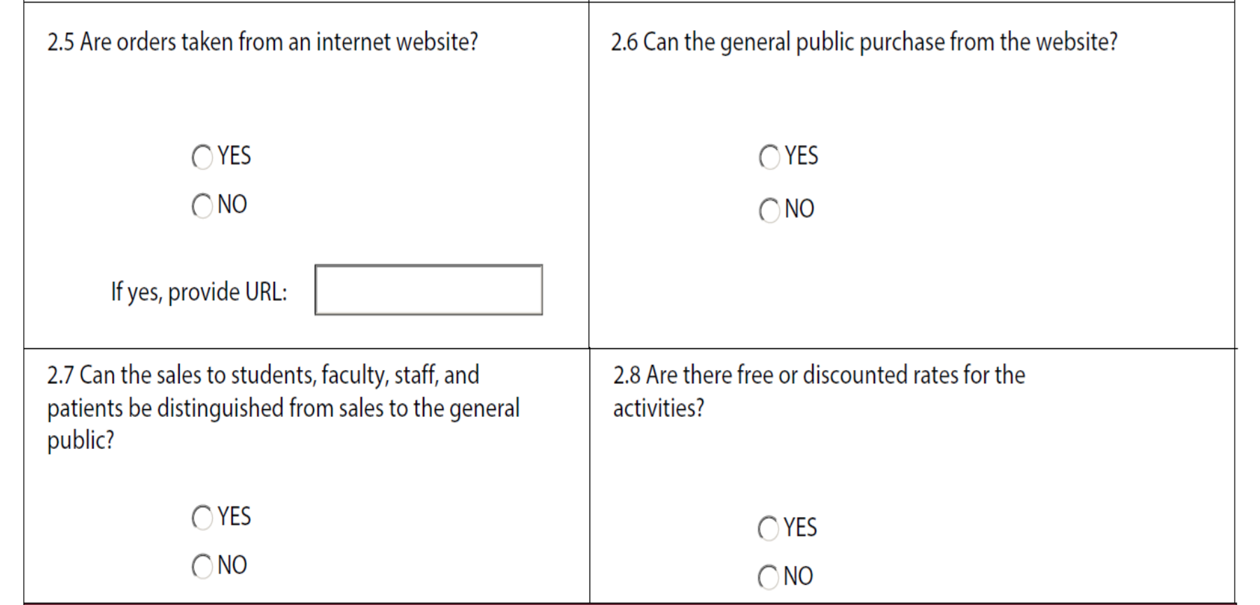
Notes:
Questions 2.5 through 2.8 should be answered by everyone.
Question 2.8 – Are there different activity rates depending on who your customer (staff/student/general public) is?

Slide 9
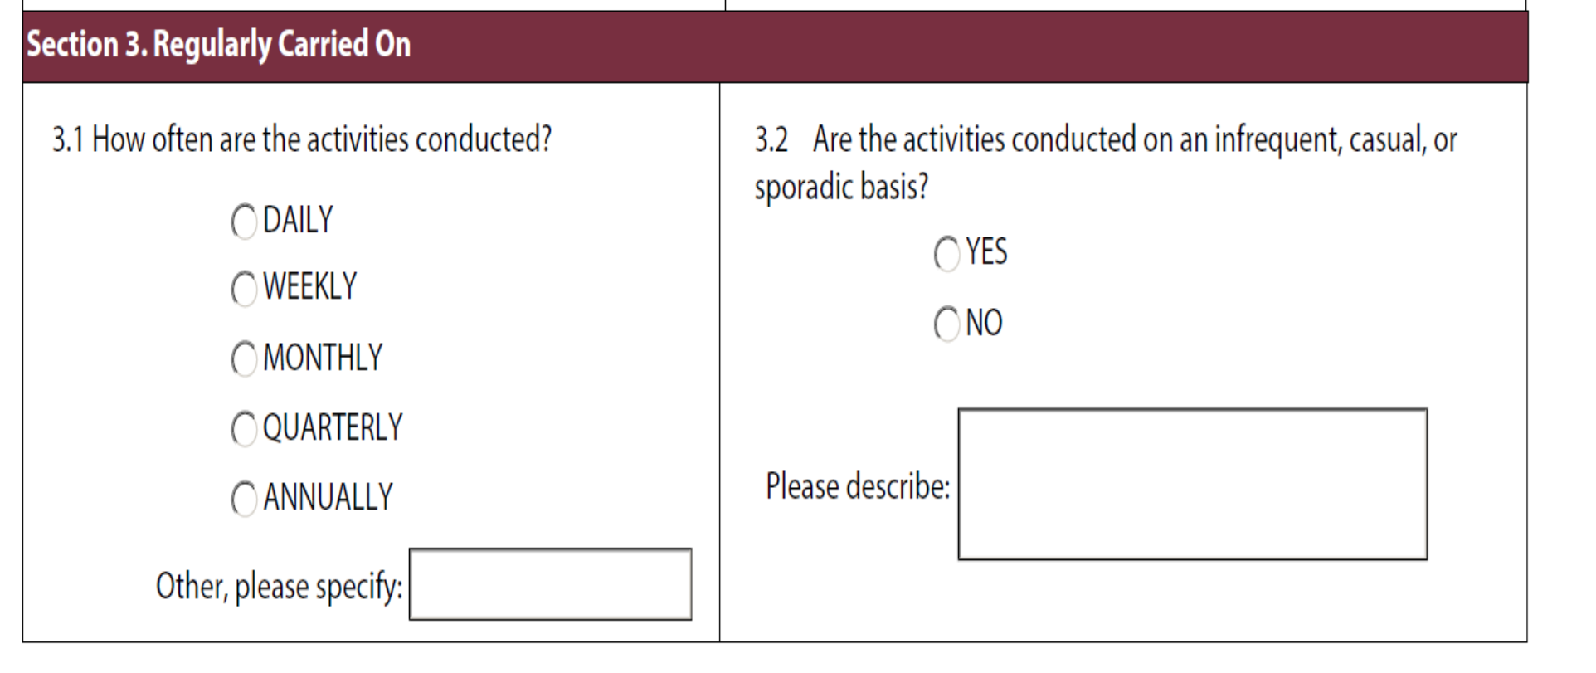
Notes:
Section 3 should be completed by everyone.

Slide 10
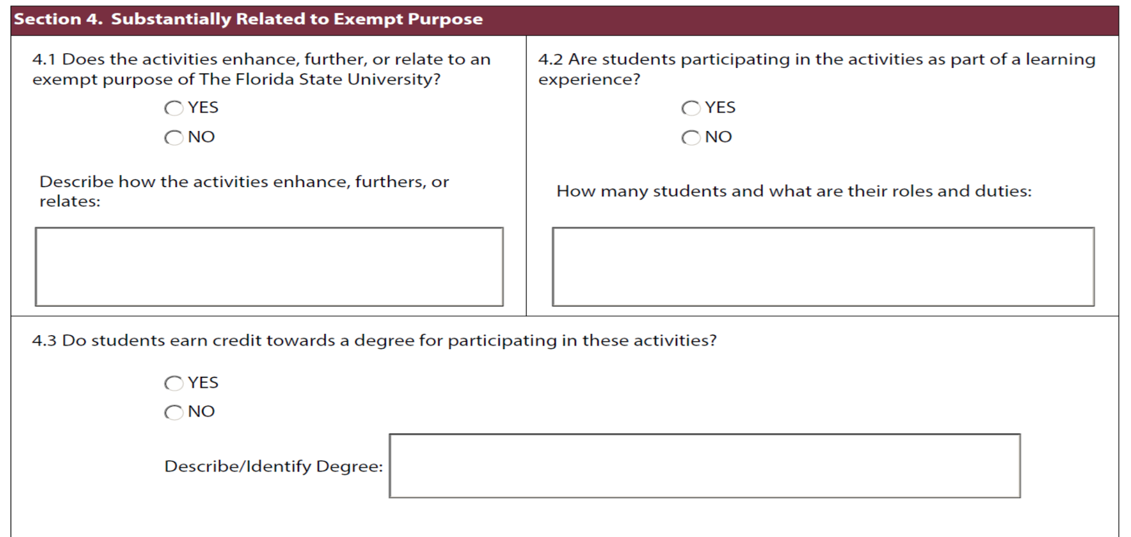
Notes:
Section 4 should be completed by everyone
FSU’s exempt purpose is to promote education, further research, provide a public service, and to lessen the burden of government.
Question 4.1 – In the text box, please explain how your activity is related to FSU’s exempt purpose.
Question 4.2 - In general, if students are involved in the activity than the activity would be related to our exempt purpose.
Question 4.3 - Additionally, if the students earn credit toward their degree by participating, that provides additional support that the activity is related to FSU’s exempt purpose.

Slide 11
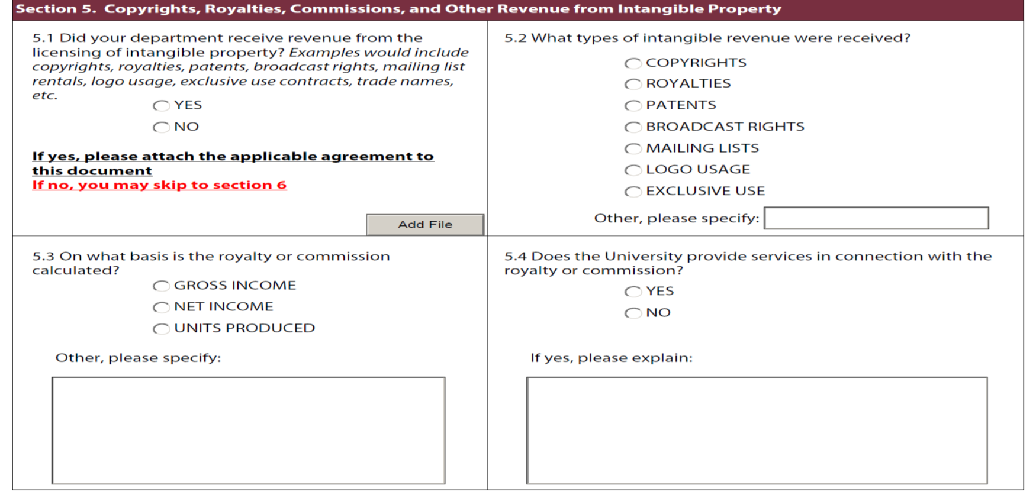
Notes:
Question 5.1:
If yes, please attach any contracts or agreements that your department has with other companies, where the department will receive payments for Copyrights, Royalties, Commissions, or revenue from any other intangible property.
If no, move on to section 6.
Question 5.3 – How the royalty or commission is calculated?
Contract wording is very important.
Please consult the Tax & Compliance department prior to any of these types of agreements being entered into. Even very minor contract word changes can change tax treatment.

Slide 12
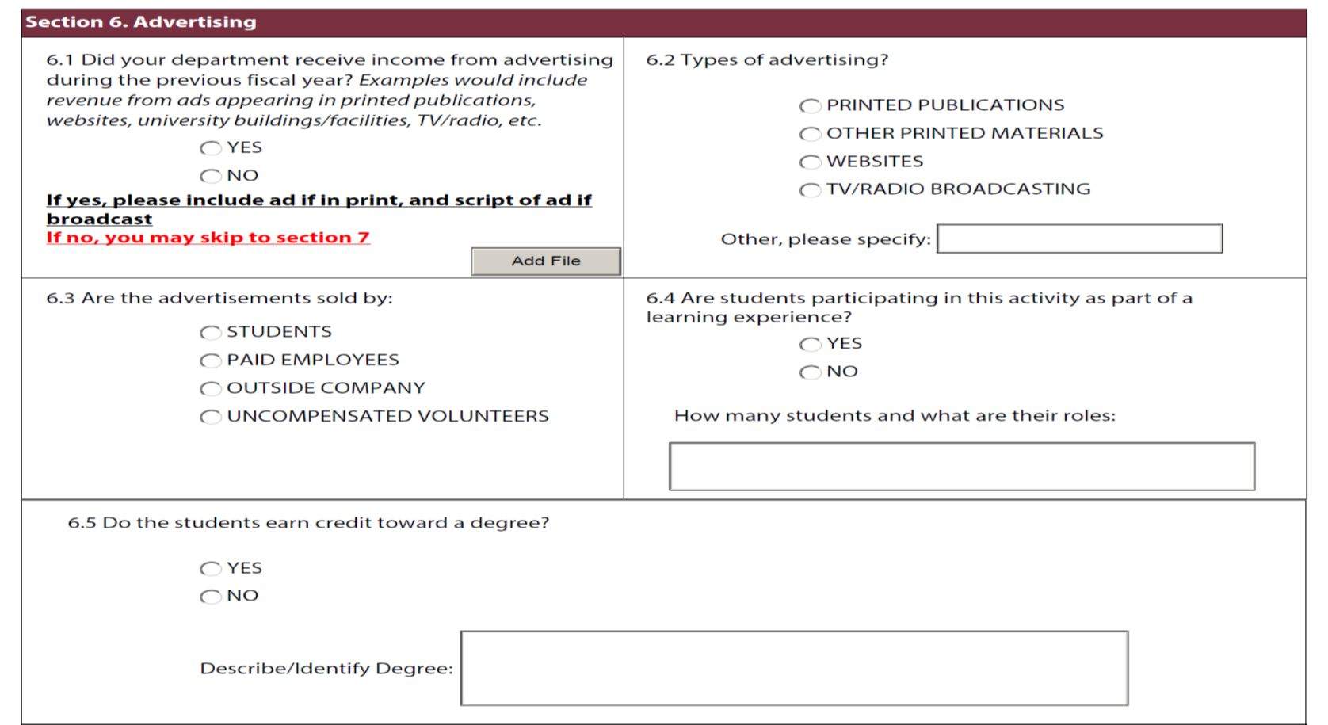
Notes:
Section 6 – Advertising
Advertising is almost always UBI.
Advertising is also something that can be easily overlooked.
Question 6.1:
If yes, please attach copies of all ads, including transcripts of broadcast ads.
If no, move on to Section 7.
Questions 6.3 – 6.5 – student involvement might make a difference it the tax treatment of the advertising.

Slide 13
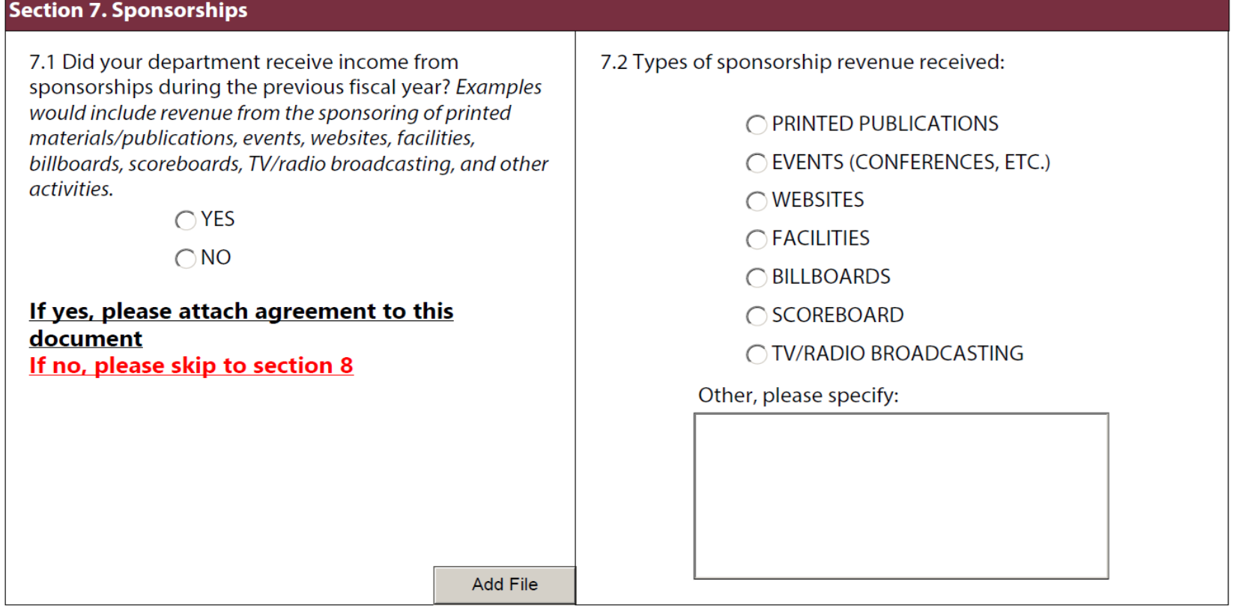
Notes:
Section 7 – Sponsorships
Sponsorship payments are generally exempt from UBI taxes if they are truly a qualified sponsored payment, AND if there isn’t what the IRS calls a substantial return benefit to the sponsor.
The Tax & Compliance Department will make the determination regarding if there is a substantial return benefit.
The sponsorship agreement assists in that determination.
Question 7.1:
If yes, please attach all sponsorship agreements.
If no, move on to Section 8.

Slide 14
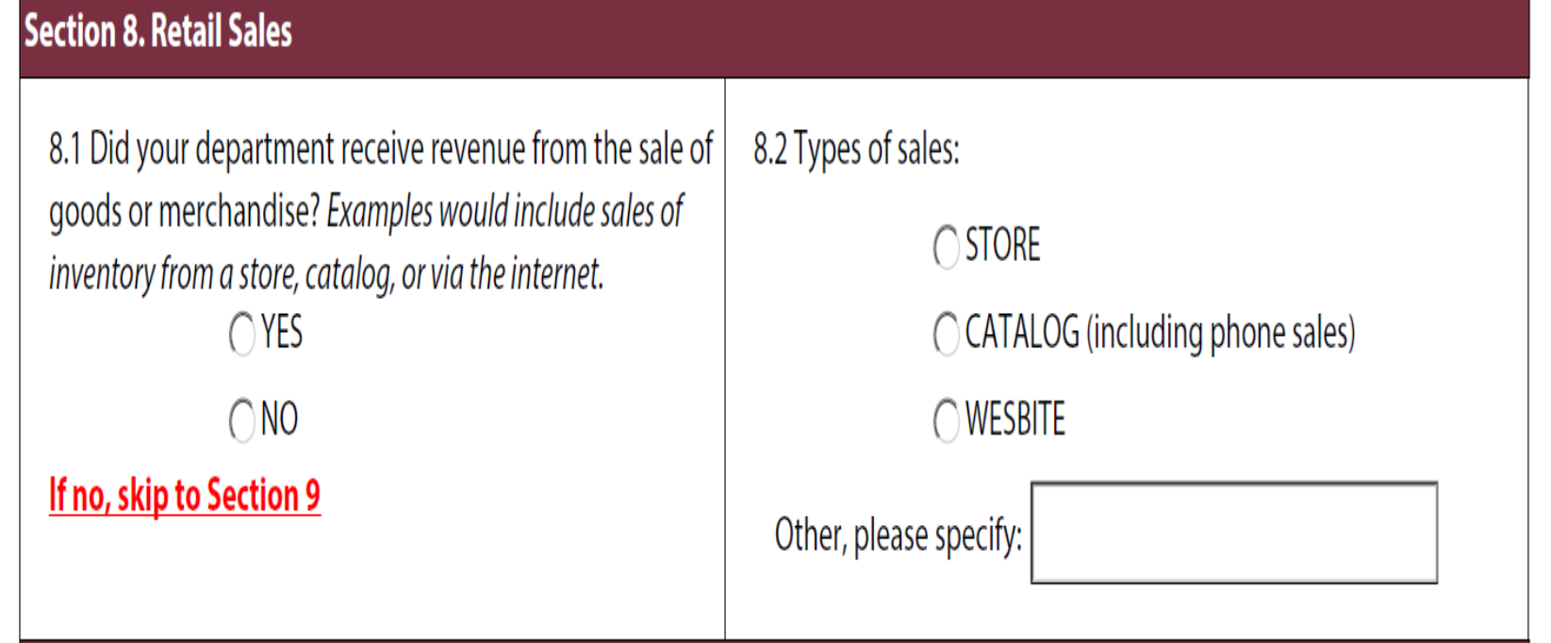
Notes:
Question 8.1:
If yes, please answer question 8.2.
If no, move on to Section 9.

Slide 15
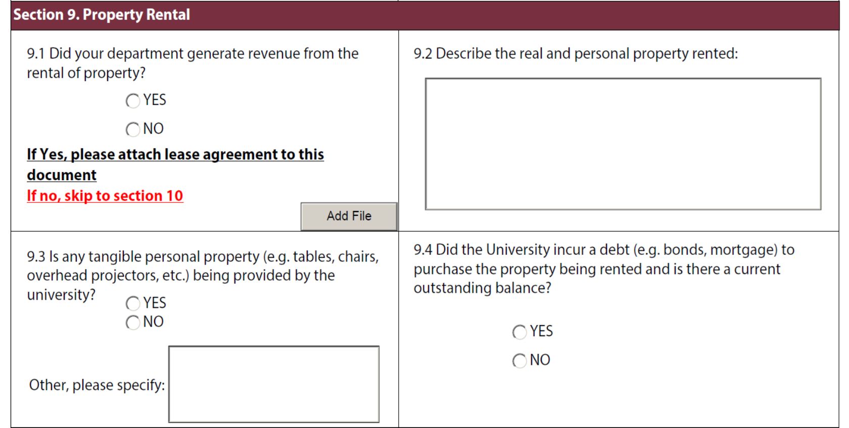
Notes:
Section 9 - property rental
Many of the university’s outside sales are in property rental.
The rental of real property is exempt from UBI.
If there are any services that offered as a convenience to the renter, the activity likely is no longer exempt.
If there is any personal property offered that is not customary to this type of rental, the amount of the exemption may change.
Question 9.1:
If yes, please attach all lease agreements.
If no, move on to Section 10.

Slide 16
Notes:
The Tax & Compliance department does need to know about all rental activity regardless of its tax status.

Slide 17
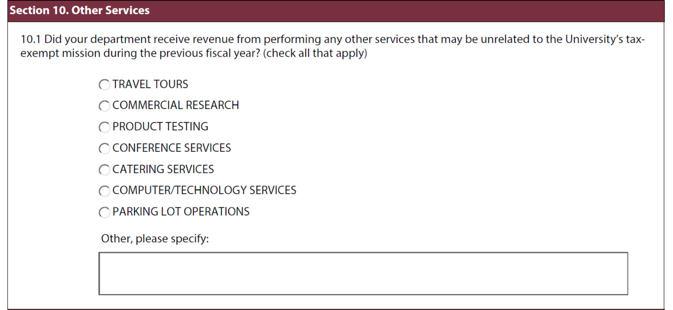
Notes:
Section 10
These activities are not commonly found on our campus, but they do happen occasionally.
Please mark all that apply.
Tax & Compliance department will reach out for more information.
If none of these apply, please skip question 10.1 and move on to Section 11.

Slide 18
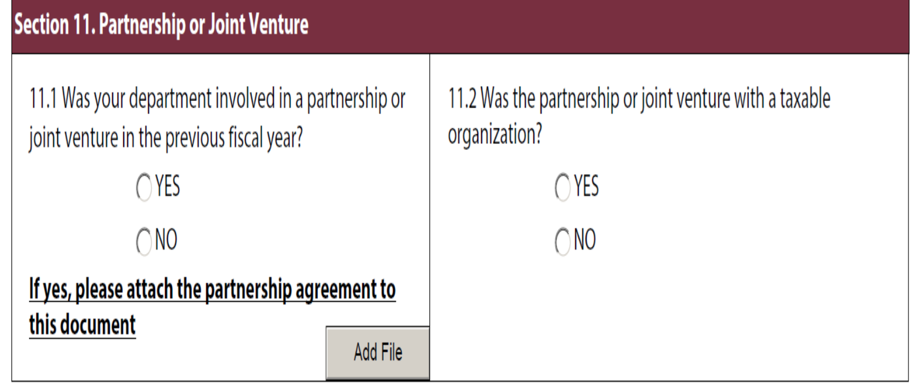
Notes:
Section 11 – Partnership or Joint Venture
Did your department enter into an agreement that created a new entity in which FSU now owns a percentage of? This is not a collaboration or shared services agreement.
Question 11.1:
If yes, please attach all partnership agreements.
If no, move on to end of survey.
If you’re unsure of whether to answer yes or no, please attach the agreement and the Tax & Compliance department will review it.

Slide 19
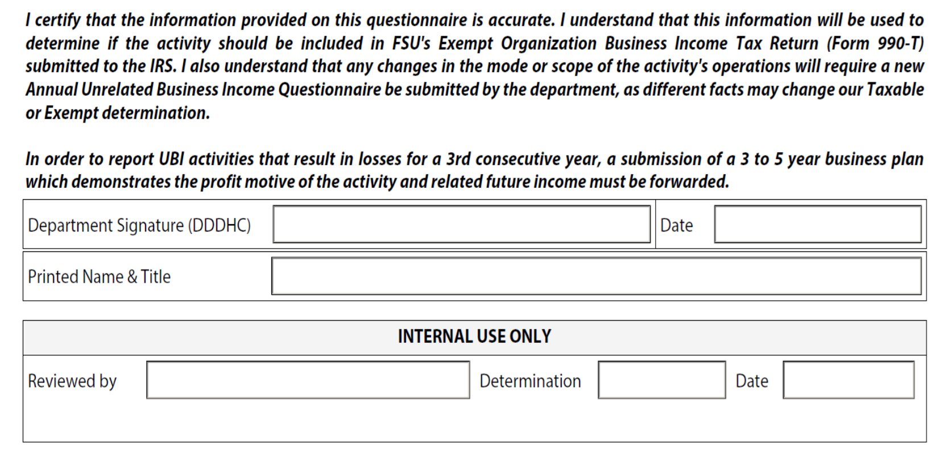
Notes:
This survey works best if Adobe is used for the signature.
Please do not use Docusign to obtain the signature as it has been proven to cause issues with the form.
Once the survey is complete and signed, please scroll back to the very top of the survey and click the “submit” button in the top right corner. The form will then be e-mailed directly to Tax & Compliance.
Internal Use Only section is for the Tax & Compliance department.

Slide 20
Contact
Gayla Burdick
Tax & Compliance
https://controller.vpfa.fsu.edu/
Email: CTL-Tax@fsu.edu
Phone: (850) 644-9480

