Slide 1
2016 Controller’s Office Training
Topics on security, compliance, university system governance, and more

Slide 2
Objectives
Introduction
Software Tips
IT Support
Compliance and Governance
Work Station & Data Security

Slide 3
Introduction & Software Tips
Excel Tip & Adobe tips, Employee Resources, and more

Slide 4
Quality Assurance
Formally:
Review, design, and implementation of policies and processes
Analysis of operational systems
Documentation and flowcharting of processes
University-wide training design and delivery
Informally:
Website questions/updates
Forms
Security questions/concerns

Slide 5
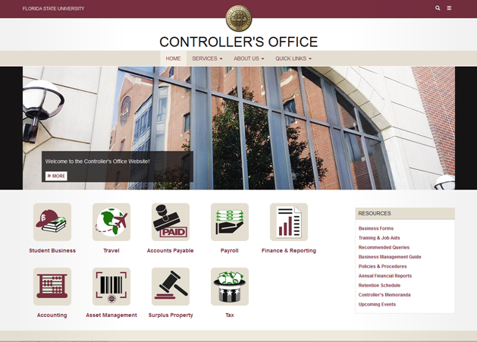
Website Walkthrough
Summer 2015
Trouble finding something? Ask QualityAssurance@admin.fsu.edu

Slide 6
Website Progress
EZ Publish:
https://web.archive.org/web/20150629095006/http://controller.vpfa.fsu.edu/
Drupal:
https://web.archive.org/web/20150827065125/http://controller.vpfa.fsu.edu/

Slide 7
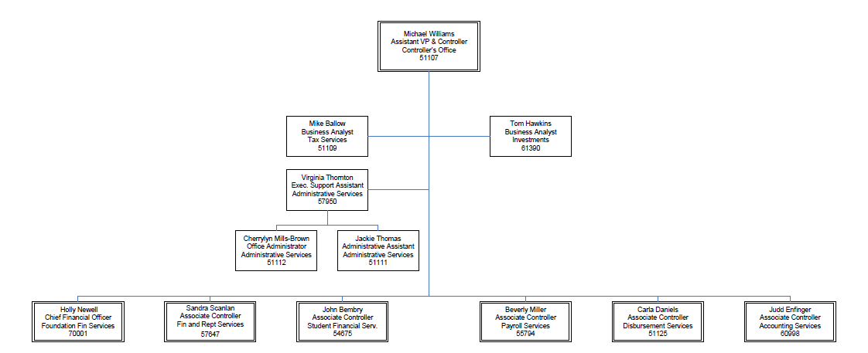
Organizational Chart
Full chart available here

Slide 8
Adobe Tips & Tricks
Redaction
Text Recognition
Commenting and Markups
Form Creation and adjustment
Adobe LiveCycle
QA assists with form editing
QualityAssurance@admin.fsu.edu

Slide 9
Office 365
portal.office.com
Sign in with full email address (including @fsu.edu) and domain/myfsu password
Limited functionality versions of Office applications
No direct access to local storage, files must go through OneDrive
Mail
Calendar
Excel
Word
PowerPoint

Slide 10
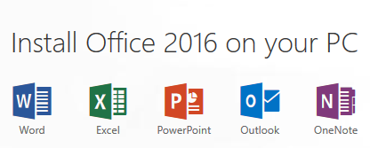
Office 365 ProPlus
Free Downloads of Office Applications for Faculty and Staff.
Can install on up to five personally-owned computers, five phones and five tablets.
Additional Info:
http://its.fsu.edu/Software/Office-365/Microsoft-R-Office-365-ProPlus-for-Employee-Personal-Machines

Slide 11
Outlook
Turn off Clutter (done through Office365 web app)
Define Inbox Rules
Categorize Emails
Task Flags

Slide 12
Word
Mail Merge to Create Emails, Letters, Labels from contact lists and report results
Track Changes to monitor and control document revisions

Slide 13
Excel
Filters
Freeze Panes
Text to Column
Pivot Tables
Spreadsheet Compare

Slide 14
Contact Information
Daniel Pearce – Quality Assurance
dpearce@fsu.edu
645-4908
Lauren Barrett– Quality Assurance
lmbarrett@fsu.edu
645-8611
Slides available at: http://controller.vpfa.fsu.edu/training

Slide 15
CRM
http://its.fsu.edu/ITS-Service-Desk
Case input from website and E-mail
Case input from Customer Perspective
Case input from Analyst Perspective
CRM from Customer and Analyst Perspective
CRM - Query Viewer

Slide 16
Governance
Information about the State Government, Board of Education, Board of Governors, and more

Slide 17
FSU- Governance
The Florida Board of Education consists of 7 members appointed by the Governor. The Board is the implementing and coordinating body for public education in Florida.
The Commissioner of Education is the chief educational officer of the state, and is responsible for giving full assistance to the Board of Education in enforcing compliance with the mission and goals of the seamless K-20 education system.
The Florida Department of Education is the administrative and supervisory agency under the direction of the Board of Education. Within the Florida Department of Education is the State University System, which is headed by the Chancellor of the State University System of Florida.

Slide 18
FSU- Governance Con’t
The Florida Board of Governors coordinates the State University System. It also strengthens and supports the function of the 12 individual University Boards of Trustees.
Board of Trustees - The FSU Board of Trustees is the 13-member governing board for the University
It sets policy for the institution and serves as the institution's legal owner and governing board.
University President - http://president.fsu.edu/
Senior Administrative Team - http://president.fsu.edu/Senior-Staff

Slide 19
Compliance
Information about the university goals, federal regulations, university regulations, division policies, and more

Slide 20
Compliance- Mission of University
http://www.fsu.edu/about/mission_vision.html
Preserving, expanding, and disseminating knowledge
Excellence in teaching, research, creative endeavors, and service
Instilling the strength, skill, and character essential for:
lifelong learning
personal responsibility
sustained achievement within a community that fosters free inquiry and embraces diversity

Slide 21
Compliance- Federal Regulations
Constitution of the United States of America
https://www.law.cornell.edu/constitution
Code of Federal Regulations
http://www.higheredcompliance.org/matrix/
Payment Card Industry Data Security Standards
https://www.pcisecuritystandards.org/document_library

Slide 22
Compliance- State Regulations
Constitution of the State of Florida Article 9 Section 7
http://archive.flsenate.gov/Statutes/Index.cfm?Mode=Constitution&Submenu=3&Tab=statutes#A09S07
Florida Statutes (Ch. 1001-1013, spec. 1001.70-1001.92)
http://www.leg.state.fl.us/Statutes/index.cfm?App_mode=Display_Index&Title_Request=XLVIII#TitleXLVIII
Florida Board of Governors
http://www.flbog.edu/
http://www.flbog.edu/about/regulations/

Slide 23
Compliance- University Regulations
FSU regulations:
http://regulations.fsu.edu/
http://regulations.fsu.edu/Adopted-Regulations
Division Policies:
Financial: http://policies.vpfa.fsu.edu/policies2.html#fin
Faculty & Staff: http://policies.vpfa.fsu.edu/policies2.html#HR
Technology: http://policies.vpfa.fsu.edu/policies2.html#tech

Slide 24
Surplus Property Sites / Processes
Internal Catalog
https://controller.intranet.fsu.edu/Lists/Surplus%20Property/Available%20for%20Dept_DataSheet.aspx
Public Auction
http://publicsurplus.com/sms/fsu,fl/list/current?orgid=12575

Slide 25
Employee Resources
Lynda
http://its.fsu.edu/Computing/Training/lynda.com
MS at Home Program
http://its.fsu.edu/Employees
http://its.fsu.edu/Software/Office-365/Microsoft-R-Office-365-ProPlus-for-Employee-Personal-Machines
EAP
http://vpfa.fsu.edu/eap

Slide 26
Employee Resources
HR Discounts
http://hr.fsu.edu/?page=benefits/benefits_perks/benefits_perks_seminole_savings
Retirement Information
http://hr.fsu.edu/?page=benefits/retirement/retirement_home
Certificate Programs
http://hr.fsu.edu/?page=training/training_home
http://hr.fsu.edu/?page=training/certificates/certificates_home

Slide 27
Contact Information
Geoffrey Adams
gdadams@fsu.edu
645 - 7758
Slides available at: http://controller.vpfa.fsu.edu/training

Slide 28
Workstation & Data Security

Slide 29
Official use of FSU IT Resources
4-OP-H-6 USE OF UNIVERSITY INFORMATION TECHNOLOGY RESOURCES Responsible Division: Finance and Administration Approving Official: Kyle Clark Effective Date: January 1, 2014 Last Revision Date: Unrevised at this time.
OBJECTIVE: This policy statement is intended to support appropriate and effective use of information technology (IT) resources at Florida State University (FSU), while providing guidelines for allowable use.
Website: http://policies.vpfa.fsu.edu/bmanual/itpolicy.html

Slide 30
Highlights of Policy 4-OP-H-6
From OVERVIEW:
Item 2. - Appropriate business use of IT resources includes instruction, research, and the official work of the offices, departments, recognized student and campus organizations, and other agencies of the University. Priority for resources may be granted to certain users or certain groups of users in support of the University's mission.
Item 5. - This and all policies and procedures associated with FSU IT resources are not intended to abridge academic freedom, constitutional guarantees of free speech, or freedom of expression. The use of IT resources is available to all members of the University community. While the rights of academic freedom and intellectual creativity are recognized, the interests of the University, students, faculty, and staff must be protected. In addition to consideration of legal liability issues, the institutional image and reputation of FSU as a major research institution are valuable assets requiring protection.

Slide 31
Highlights of Policy 4-OP-H-6
From REQUIREMENTS AND PROHIBITED USES:
Item 1. - All uses of University IT resources are subject to applicable rules, policies and procedures of the University and/or governing boards as well as Florida Statutes governing computer fraud, misuse of state equipment resources, public information, and related criminal offenses
Item 7. - To help maintain the proper functioning of computer and networking hardware and software, the University will take reasonable steps to ensure its computing resources are free of deliberately destructive software, such as viruses. Individuals must share responsibility for protecting University computers and should ensure the integrity of any electronic media they introduce

Slide 32
4-OP-H-5 INFORMATION SECURITY POLICY
Appropriate Use of Information Technology Resources:
All FSU desktops, laptops, and mobile devices must employ a screensaver or inactivity lock of no more than 15 minutes, and require a password or pin for unlocking
University computer users shall have unique user accounts
Accounts that have administrator permissions must not be used as a user’s default account
All FSU computers must enable up-to-date anti-malware protection
Website: http://policies.vpfa.fsu.edu/bmanual/its_info.html

Slide 33
Highlights of Policy 4-OP-H-5
Personal use of University IT resources:
must not interfere with the performance of the member’s job duties or other FSU responsibilities
must not result in additional cost to the University
must not consume significant amounts of IT resources (e.g., bandwidth, storage)
must not violate this policy
Individual University units may implement additional limits on personal use of University IT beyond the parameters in this policy. Any additional limits must be documented by the unit and shared with unit members and the Information Security and Privacy Office

Slide 34
Workstation Security - Best Practices
NEVER give out your password, or offer to log in as yourself on someone else’s PC
If you feel your password has been compromised, change your password right away
Also consider changing your password every 3 months or so
Always consider a password that is completely different from any personal account passwords
Press the Windows Key + L to lock your desktop right away. Please remember it is official Controllers Office Policy that your screensaver is enabled and set to lock your workstation automatically.
TIP: You can get to screensaver settings by right clicking on your desktop and selecting Personalize

Slide 35
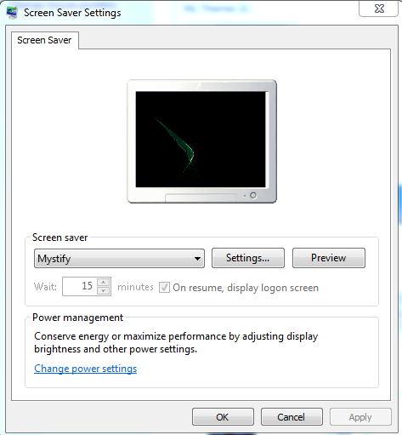
Workstation Security - Best Practices
All Controllers Office workstations now have Screensaver, with station lock, permanently enabled and set to activate in 15 minutes. You can select which screensaver to use, but you cannot change the timing or disable this feature.
If a stranger calls on the phone and asks for any information relating to files, folders, our network, your computer or any of your account information DO NOT answer any of their questions. Refer them to your supervisor and notify your supervisor right away

Slide 36
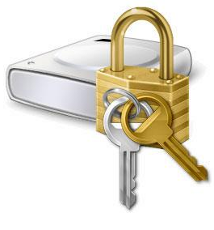
Mobile Data Security
No university data files should be loaded onto a USB stick or mobile hard drive to be taken home. Even if you would like to take work home with you to load on your home PC, this is not a secure practice
If you would like to take computer related work home, you can request the use of one of our short-term sign-out laptops
Controller’s Office laptops & tablets have all the latest security updates installed, and they are protected with advanced hard drive data encryption

Slide 37
Workstation Security – Email Abuse
If you receive a suspicious email, please feel free to report it to our ITS Security Department
*The example above shows the true web address when placing the mouse curser over the clickable link.
The best method for reporting these types of emails can be found in our “K:\CTL-Shared\Email Abuse Reporting Procedure” folder. This process shows how to create a proper abuse report, which includes reporting the offending email’s header information
TIP: There is no need to report a phishing email that’s in your Junk email folder. MSTS already knows about it; links in a Junk email have been disabled

Slide 38
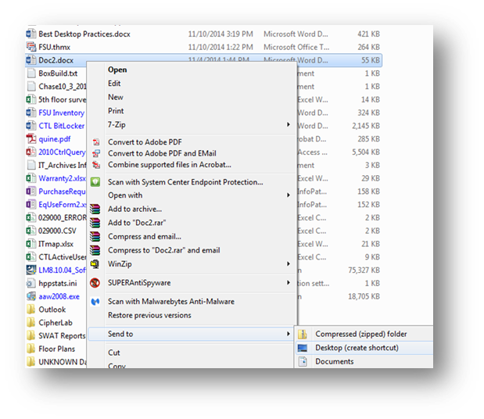
Securing Desktop Files
Storing files & folders directly on your desktop can be a costly practice. Desktop files are stored on your local C drive and may not be recovered in the event of a total hard drive failure
You can still have file shortcut Icons on your desktop… just store the files on your L drive, right click on file, select Send to and then select Desktop ( create shortcut )…

Slide 39
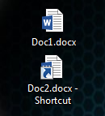
Once a file shortcut has been created and placed on your desktop you will see an arrow added to the desktop icon to show that it is a shortcut and not an actual file
If we look at the 2 desktop icon examples below we can see Doc1 is a file saved directly on the desktop and Doc2 is a shortcut to a file stored elsewhere
( notice the arrow added to the icon )...
TIP: You can right click a shortcut, click Properties and that will show you exactly where the file is actually stored

Slide 40
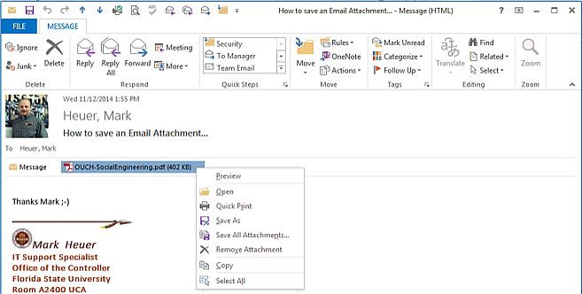
Securing Email Attachments
Don’t forget to first save a copy of any email attachments before you start to make changes to it
Open the email with the attachment and right click on the attachment itself. From there you can select Save As and pick where you would like to save the file…

Slide 41
Helpful Keyboard Security Shortcuts
Windows Key + D will minimize all of your open programs so you can see all of your desktop
Windows Key + E will open Windows Explorer so you can see all of your drives
Windows Key + L will lock your computer right away
ALT + F4: This keyboard combination can be used to immediately close any unwanted Programs or Windows. This can be a very handy shortcut if something pops open in your browser. Just make sure Windows has the focus on it (in other words the window needs to be the current “active” window)

Slide 42
Helpful Keyboard Security Shortcuts
CTL + SHIFT + DELETE: Opens the Delete Browsing History tool if you’re in Internet Explorer, and in Firefox it will open the Clear Recent History tool
ALT + TAB: Switch to another running program (hold down the ALT key and then press the TAB key to view the task-switching window)
TIP: There are many more helpful keyboard shorts for Windows, check out “http://support.microsoft.com/kb/126449” if you would like to see more!

Slide 43
ITS Windows Security Updates
Periodically ITS pushes Windows Security updates to all our of our computers. This can be seen via an icon on your Taskbar.
You do not have to do anything for the updates to install as they will install within a week or so. However there are some simple steps you can take to speed up the process...
You can click on the ITS update icon and then click on “View Required Software”.

Slide 44
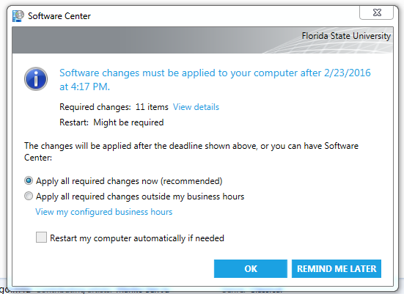
Next you should see the screen below. You can choose to apply updates now, but do not check the box to restart your computer automatically. You can restart the PC later, when it’s more convenient for you…
Shortly after clicking OK on the above window the ITS update Icon will switch to a downloading icon. This shows that ITS updates are now downloading & installing on your PC.

Slide 45
Once the ITS updates have downloaded and installed, the icon will change again to a green restart request icon and you should see a message like the one below…
Lastly, and when its convenient for you, click on the green reboot request icon and select Restart Now.
Once you log back in from your PC restart, you can relax and enjoy the fact you now have the very latest in FSU Windows Security Updates!

Slide 46
Stealthy Malware & Virus ( some basic definitions )
Computer Virus: is a malware program that, when executed, replicates by inserting copies of itself into other computer programs, data files, or the boot sector of the hard drive; when this replication succeeds, the affected areas are then said to be "infected". Viruses often perform some type of harmful activity on infected hosts, such as stealing hard disk space or CPU time, accessing private information, corrupting data, displaying messages on the user's screen, spamming their contacts, logging their keystrokes, or even rendering the computer useless. However, not all viruses carry a destructive payload or attempt to hide themselves—the defining characteristic of viruses is that they are self-replicating computer programs which install themselves without user consent.
Malware: short for malicious software, is any software used to disrupt computer operations, gather sensitive information, gain access to private computer systems, or display unwanted advertising. Malware is defined by its malicious intent, acting against the requirements of the computer user. Using the term Malware, includes reference to Computer Viruses.

Slide 47
Scareware: is a type of malware designed to trick victims into purchasing and downloading useless and potentially dangerous software. Scareware, which generates pop-ups that resemble Windows system messages, usually purports to be antivirus or antispyware software, a firewall application or a registry cleaner.
Ransomware: is a type of malware that restricts access to the infected computer system in some way, and demands that the user pay a ransom to the malware operators to remove the restriction. Some forms of ransomware systematically encrypt files on the system's hard drive, which become difficult or impossible to decrypt without paying the ransom for the encryption key, while some may simply lock the system and display messages intended to coax the user into paying. Ransomware typically propagates as a Trojan, whose payload is disguised as a seemingly legitimate file.
* Definitions contributed to by Wikipedia

Slide 48
Stealthy Malware & Virus
We simply can not stress enough the caution needed today when accessing Internet web sites . Even the most public, thought to be safe website can in fact be infected! A server hosting a website or even just an ad on a website could in fact be a virus loader just standing by to infect your device
Consistently we see reports from what we thought to be normal and safe websites actually attempting to infect our workstations
Due to his ever growing threat, you should always be asking yourself the following when accessing the Internet…
“Where am I going, and what am I using to get there?”

Slide 49
About twice a week we see reports from our campus Malware & Virus alert manager – SCEP ( System Center Enterprise Protection )
These reports show our staff member's workstations and what threat was just avoided…
Example:
Configuration Manager Endpoint Protection has detected malware on one or more computers in your organization:
Malware Name: Exploit:JS/Axpergle.BO
Number of infections: 1
Last detection time(UTC time): 1/28/2016 3:31:31 PM
These are the infections of this malware:
1. Computer name: CTL-UCA-XXXX-1.fsu.edu
Domain: FSU
Detection time(UTC time): 1/28/2016 3:31:31 PM Malware file path: webscript:_http://www.chickensaladchick.com/apalachee
Remediation action: Quarantine
Action status: Succeeded

Slide 50
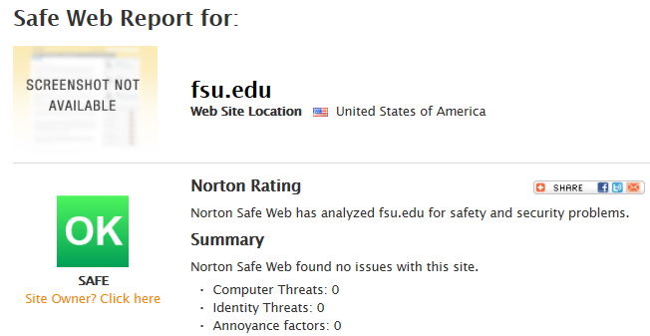
You can use Norton’s “Safe Web” site to check a website for Malware before you visit the web site itself: https://safeweb.norton.com/
When in doubt… CHECK IT OUT!

Slide 51
From our Latest FSU Cyberhero Alert…
Think before clicking email and website links. We know we sound like a broken record, but this is the most important precaution we can stress. Never click a link that looks suspicious. Before clicking, hover over a link to display the true URL and see if it is linking to a reputable website. Safer yet, type the URL in your browser to access the page.
Use a secure, trusted Wi-Fi network for sensitive browsing. Just because Starbucks has Wi-Fi doesn’t mean it should be used to check bank balances. Whenever dealing with personally identifiable information—such as bank accounts, credit cards or university records—be sure to use a secure network, like FSUSecure.
Use a strong password. Not your cat’s name. Get creative and find the right balance between something memorable and something no one else will guess. Use letters, numbers and symbols, and mix them together to avoid using common words. For example: Seminole becomes $e^^iN01e. Also, NEVER share your password with anyone.

Slide 52
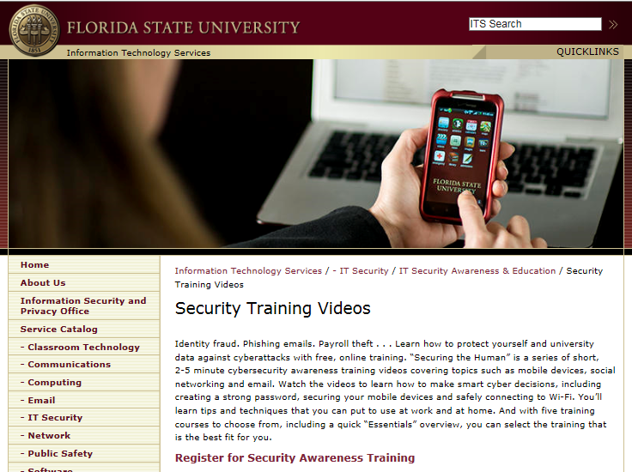
Learn more about protecting yourself and FSU with free training videos at:
http://its.fsu.edu/IT-Security/IT-Security-Awareness-Education/Security-Training-Videos

Slide 53
Free Security Tools for your PC at Home
Are you logging into FSU Email or updating your OMNI timesheet from home? Are you going to the Controllers Office Website and accessing SharePoint from home? How safe is your personal laptop or PC at home?
Many new computers & laptops come with professional antivirus, which is ONLY good for a few months! After that time you must pay for the product updates or you will no longer be protected from the latest threats
There are many FREE antivirus programs that work extremely well…

Slide 54
Free Antivirus Protection
Currently one of the best free antivirus programs is:
Avast - https://www.avast.com/en-us/index
TIP: When installing new antivirus protection uninstall your old antivirus program, then install your new one, update it and do a FULL scan just as soon as you can
Another important free tool for home or laptop is called a Malware Scanner. This type of program scans, identifies and removes additional malicious software from your PC. This type of tool should be run monthly in case something slips past your antivirus program

Slide 55
2 Powerful Free Malware Scanners
Malwarebytes is one of the best Malware Scanners out there
https://www.malwarebytes.org/
SUPERAntiSpyware is another useful Malware Scanner
http://www.superantispyware.com/
Feel free to install & use BOTH these scanners, they each use different techniques of detection and each may find something on your PC that should be removed

Slide 56
Contact Information
Mark Heuer
Mheuer@admin.fsu.edu
645-7753
Charles Fernandez
Cafernandez@fsu.edu
645-9136

Slide 57
Information Technology, & Technical Support
Contact procedures, future technology, and credential management

Slide 58
Contacting I.T. Support
In the event of an emergency, or a service need arises the following steps should be taken:
Email from requester (you), or
Email from Supervisor, or
Phone call to Controller’s I.T. Department
Emails should be sent to both Mark Heuer Mheuer@admin.fsu.edu and Charles Fernandez Cafernandez@fsu.edu
If email/ computer is not accessible ask co-worker or managerial support to contact Controller’s I.T. Department

Slide 59
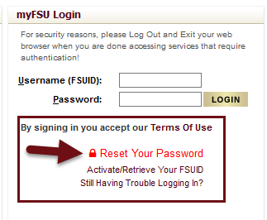
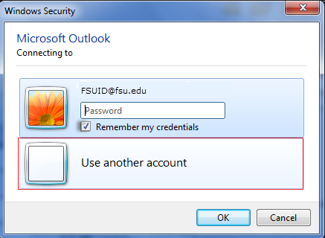
Credential Management
Ensure any mobile device with Email is in Airplane Mode
Changing your FSU Password:
See the “Reset Your Password” link on my.fsu.edu
Follow the steps to verify identity
Confirm password change, document if necessary
Save work, Restart PC
Turn on PC (if Shutdown), login with new password
If prompted for credentials for Outlook/ Skype
confirm new password as seen
Change password on mobile device (if applicable), and
take off Airplane Mode

Slide 60
Windows 10
Projected deployment for FSU Campus is unknown at this time. Currently in evaluation period
Try Windows 10

Slide 61
Microsoft Office 2016
Microsoft Office 2016 will be included with any install of Windows 10 by our department
Shared Features: Tell Me box, Smart Lookup/Help powered by Bing, Improved Versioning History, Sharing Files (pending arrival of SharePoint Online)
Office 2016 Quick Start Guides can be located at the Microsoft Office Support site here: https://support.office.com/en-us/article/Office-2016-Quick-Start-Guides
Detailed list of what’s new and improved in Office 2016 available here: https://support.office.com/article/95c8d81d-08ba-42c1-914f-bca4603e1426

Slide 62
Contact Information
Charles Fernandez
Cafernandez@fsu.edu
645-9136
Slides available at: http://controller.vpfa.fsu.edu/training

