Slide 1
Intermediate University Accounting
BTAC02
Notes:
Edited 4/24/24

Slide 2
Class Objectives
Accounting Basics
GL Account Overview
Reporting Tools
Notes:
Do introductions – name, department, role, how long at university
Remind participants to please ask questions. If you have a question about something I am saying, it is likely your neighbor does too.

Slide 3
Accounting Basics

Slide 4
Accounting Basics
The main accounting record of the university is called the general ledger
The general ledger is used to create the university’s financial statements and is the official record of financial transactions
Transactions get recorded to the general ledger by journal entries
Notes:
General ledger – sometimes just referred to as the ledger
it is the record keeping system for the university’s accounting transactions
All financial transactions are recorded in the general ledger (GL)
Proper recording of transactions is important for:
The university’s financial statements
Proper and accurate use of funds/budget

Slide 5
Accounting Basics
Journal Entries
Used to record ALL transactions in the ledger
Sources
OMNI Systems
“Third Party” Systems
Direct Journal Entries
Journal ID
Journal Source
FSU_DPT_CODES_GL_SOURCE
Notes:
Journal entries are used to record ALL transactions in the Ledger
Three potential sources of Journals:
OMNI Systems - FI
“Third Party” Systems – Systems other than PeopleSoft, for example Concur, Transact
Direct Journal Entries – Manually keyed or uploaded journals
Each Journal Entry is assigned a unique Journal ID
10 Characters
Journal Source provides clear indication of where JE originated
All but direct journals have an alpha prefix
2 or 3 characters
Some examples of Journal Sources are
PAY for payroll journals
EX for travel expenses interfaced from Concur
DOL for journal corrections
AP for accounts payable entries
FSU_DPT_CODES_GL_SOURCE provides a complete list
Covered in more detail in BTAC03

Slide 6
Accounting Basics
The basis for all entries in the general ledger is the double-entry system
Every entry has both a debit and a credit
Debits must equal credits
Debit – an entry in the left column of the ledger
Credit – an entry in the right column of the ledger
Notes:
Double entry bookkeeping – A set of rules for recording financial information in a financial accounting system in which every transaction has at least two entries
Double entry accounting has been around since the Romans, but the first documentation of the modern version was 1494
Double-entry bookkeeping means that a debit entry in one account must be equal to a credit entry in another account to keep the equation balanced

Slide 7
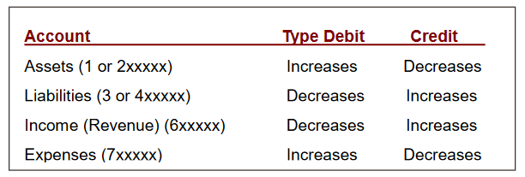
Accounting basics
Notes:
This chart comes from the accounting basics document on the Controller’s website
Additional information is in that document if you want to learn more about the mechanics of accounting
This slide gives non-accountants a cheat sheet to remember how each basic account type is increased and decreased (whether DR or CR)
Remember from BTAC01 that at FSU you can tell what kind of account it is by the number that it starts with, assets start with1, revenue starts with 6, expenses start with 7
In a nutshell, every accounting entry in the general ledger contains both a debit and a credit
Debits must equal Credits
OMNI does not allow out-of-balance journal entries
Note that there is also equity or aka fund balance account type (starts with 5) but these are only generated by system entries at FYE
As an example – when FSU pays an invoice that affects cash and expense. So the system will DR the expense (increase the expense number) and it will CR the cash (decrease the cash account) since we sent money to the vendor.

Slide 8
Accounting Basics GL Accounts
Accounting Concepts
Account Type | Example | 1st Digit | Increase | Decrease
Current Assets | Cash, Receivables | 1 | Debit | Credit
Non-current Assets | Fixed Assets | 2 | Debit | Credit
Current Liabilities | Accounts Payable | 3 | Credit | Debit
Non-current Liabilities | Loans Payable | 4 | Credit | Debit
Equity or Fund Balance | Unrestricted Net Assets | 5 | Credit | Debit
Revenues | Auxiliary Sales | 6 | Credit | Debit
Expenses | Salaries, Office Supplies | 7 | Debit | Credit
Notes:
This slide is another cheat sheet to remember how each basic account type is increased and decreased (whether DR or CR)
If you are trying to find the correct account to use, the Controller’s Office has GL Account Lists on our website
Data Dictionary = ALL Accounts
Short List = Most commonly used accounts
FSU_DPT_CODES_CATEGORY_BY_ACCT query for Procurement Code (aka commodity code) to Exp Account Code crosswalk

Slide 9
Accounting basics
T-Account Revenue
T-Account Expense
Notes:
This slide illustrates an accounting entry using debits and credits.
DR Cash, an asset, increases cash, and is entered on the left side of the account

Slide 10
Accrual Accounting
Accrual accounting is a method of accounting where events are recorded when the transaction occurs rather than when the payment is made
Revenue is recorded when it is earned
Expenses are recorded when incurred
Notes:
Two methods of accounting – cash and accrual
FSU uses accrual accounting
We will work through a couple examples

Slide 11
Accrual Accounting Revenue
Revenue is recorded when earned
Example: The Ohio State University calls the FSU Chemistry Department to order some consumable chemistry supplies.
FSU gathers the supplies that have been ordered and ships them off to The Ohio State University on October 15, 2020.
Payment is received from OSU on 11/20/2020.

Slide 12
Accrual Accounting Revenue
FSU sends an invoice to The Ohio State University (10/15/2020)
Debit: 151300 Accounts receivable
Credit: 623001 Sales/Svc Other Extrn
FSU receives payment from The Ohio State University (11/20/2020)
Debit: 112000 Cash
Credit: 151300 Accounts receivable

Slide 13
Accrual Accounting Revenue

Slide 14
Accrual Accounting Expenses
Expenses are recorded when incurred
Example: The Controller’s office places an order for 15 laptops on 9/26/2020.
An encumbrance is created in KK ledger at the time the order is placed and the purchase order is created
The laptops are received by the Controller’s Office on 10/15/2020.
The invoice is received from Dell on 10/20/2020.

Slide 15
Accrual Accounting Expenses
Accounting entries:
When the department receives on the purchase order:
Debit: 741153 Equip Computer/IT Expendable
Credit: 311000 Accounts payable
When accounts payable sends payment to the vendor
Debit: 311000 Accounts payable
Credit: 112xxx Cash
Other common examples – payroll liabilities

Slide 16
Accrual Accounting Expenses

Slide 17
General Ledger Account Overview

Slide 18
GL Accounts Cash
Cash (112000)
Especially important for auxiliaries to monitor
Should always be positive
Budget vs. Cash
For E&G departments, cash should follow budget
Cash transfers are recorded weekly by the Controller’s Office to match budget transfers
For auxiliaries and others, cash and budget will almost never match due to timing
Notes:
Cash (112000)
Almost every journal/transaction affects cash in some way
Especially important for Auxiliaries
Does everyone know what an auxiliary is?
Auxiliaries are revenue generating business type activities that support the mission of the institution and provide essential services to the campus community
Cannot have negative cash in your auxiliary
OMNI uses cash to balance journals at Dept/Fund level
When an expense is recorded the other side of that entry would be cash, the system does that automatically
Cash is reconciled at university level by the Controller’s Office
Budget vs. Cash
For E&G departments, cash should follow budget
Cash transfers are recorded weekly by the Controller’s Office to match budget transfers
For auxiliaries and others, cash and budget will almost never match due to timing
When the budget is prepared it is for an entire year, however most auxiliaries earn revenue and pay expenses throughout the year – not just at one time.
Transferring cash between departments in the same fund is generally okay; almost never okay between funds

Slide 19
GL Accounts Other Balance Sheet
Accounts Receivable (15xxxx)
Due From Component Units (167000)
Accounts Payable (311000)
Notes:
Accounts receivable is money that is owed to the university for goods or services delivered but not yet paid for by the customer
For example, FSU’s chemistry department sells some chemicals to another University. We ship it to them before they have paid for it.
**Mention that the two main sources are AR (Student or Auxiliary)
Need to contextualize why we are talking about this
Depts won’t necessarily be doing journal entries but important they understand the entries that the system is making
For the most part, want folks to understand so when balances “stick” on ledgers they will notice and do something about it
There are a few different types of accounts receivable at FSU
151000/151200 – General AR accounts generally only used by Controller’s Office
151005 AR – Employee Advances
Discuss travel advance/personal exp process
Should clear out when employees process their expense reports151300 – Auxiliary AR processed through OMNI AR/Billing
151010/151011 Employee or vendor overpayment
151100 AR fees
Depts should ensure they receive class fees and other student fees for which they are entitled
This should clear out when payment is collected from students
Due from component units
Component units is an accounting definition, but generally this includes entities that FSU is financially accountable for
In BTAC01 we discussed our structure including our DSOs – so this would include the FSU Foundation and FSU Research Foundation for example
Accounts payable is money that is owed by the university to a vendor
For example, when you order an IT item from Dell, they ship it to us before we pay for it. But we still owe them that money

Slide 20
GL Accounts Revenue Accounts
6xxxxx
Auxiliary Revenues – Internal vs. External
Internal – Received from any entity with an FSU six-digit DeptID
External
All other auxiliary revenues received from any non-FSU dept
Includes students, employees and related organizations like FSUF
Notes:
Revenue is recorded in accounts that start with a 6
Auxiliary Revenues
Important to classify as internal vs. external correctly for the university’s financial statements to be correct
This is really important
Internal
Revenue received by one FSU dept from another FSU dept
E.g. utility charges, ITS charges
Eliminated at the university level for financial statements
External
All other auxiliary revenues received from any non-FSU dept
Includes students, employees and related organizations like FSU
Some other common revenue you may see
Sponsored Research (C&G) Revenue – Managed by SRA
Fee Revenue – Tuition as well as other fees paid by students for specific purpose (restricted in use)
Includes lab/material/equipment and other class-specific fees
Also includes student activity, technology, distance learning, etc.
Recorded in Campus Solutions via codes that drive student accounting called Item Types

Slide 21
GL Accounts Expense Accounts
Budgetary high-level categories
71 – Salary and benefit expenses
72 – OPS expenses
74 – All other operating expenses
76 – Capital expenditures (aka OCO)
78 – Transfers out
Notes:
Budgetary high-level categories
71 – Salary and benefit expenses
72 – OPS expenses
74 – All other operating expenses
76 – Capital expenditures (aka OCO)
Capital expenditures are purchases of real, personal, or intangible property that has a cost equal to or greater than $5,000 and a useful life beyond one year.
An example of a capital expenditure would be the purchase of a vehicle.
It is important that if a purchase meets the $5,000 and one year test then it needs to be recorded to a 76 account and not a 74 account.
78 – Transfers out

Slide 22
GL Accounts Expense Accounts
Expense Short List
Account names standardized so they can be sorted and grouped together (Account Codes are all over the place)
E.g. all student tuition & fee accounts begin with “Stdnt Aid”
Account Use Description provides significantly more detail
Expenditure Guidelines – Lays out which types of expenditures can be made on different funds
Notes:
If you are processing an ePRF (an electronic payment request) for an item that is not being paid for by a purchase order and you are uncertain which account to use, it is helpful to pull up the expense short list.
The expenditure guidelines tell you which kinds of funds can pay for which kinds of expenditures.

Slide 23
Reporting Tools

Slide 24
Reporting Tools Overview
OMNI Financials
Queries
Best for up-to-the-minute data or specific info (e.g. a listing of Journal Sources)
Recommended Queries listing available on Controller’s website https://controller.vpfa.fsu.edu/recommended-queries
Static Departmental Ledgers
“Canned” PeopleSoft reports
Notes:
OMNI Financials
Queries
A query is a request for data results from your database
Static Departmental Ledgers
“Canned” PeopleSoft reports
PS Query (in OMNI Financials)
Data is “live”
Very specific data
Important to choose the right query
Best for up-to-the-minute data or specific info (e.g. a listing of Journal Sources)
Recommended Queries listing available on Controller’s website https://controller.vpfa.fsu.edu/recommended-queries

Slide 25
Reporting Tools Overview
Oracle Business Intelligence (BI)
Link from myFSU portal page
FSU’s data warehouse reporting tool
Firefox is strongly recommended
Data loaded nightly from OMNI
Numerous dashboard reports available
Notes:
Oracle Business Intelligence (BI)
Link from myFSU portal page
Data warehouse tool
RECOMMEND THEY USE FIREFOX WHEN IN BI
Select data from PeopleSoft loaded nightly
Numerous dashboard reports available
The data in BI is loaded from OMNI Financials nightly so it reflects yesterday’s activity
Numerous dashboard reports available that drill to the detail support in OMNI

Slide 26
OMNI Queries
What are they?
Which one?
http://controller.vpfa.fsu.edu/query
How do I run them?
OMNI FI > Transactions and Reporting > Reporting > Query Viewer
Notes:
Queries
Ad hoc (literally “for this”) request of information from a database
Allow direct access to specific data about a particular transaction type
Provides detail of transactions that may not be available in BI
Downloadable to Excel
Additional access required to run queries in HR or SC
Which query??
Thousands of queries in OMNI FI
Controller’s Office Recommended Query List
http://controller.vpfa.fsu.edu/query
Open this and run one query (maybe fund code list one)
Other central office queries
Human Resources (in OMNI HR)
Sponsored Research
Budget Office
Use others at your own peril
Contact appropriate central office if you can’t find what you need
All FSU employees have access to query tool in Financials
OMNI FI > Transactions and Reporting > Reporting > Query Viewer
Wildcards - %
Running Queries tutorial available
Run a query to excel vs. running a query to html – pick a query from the recommended query page on the website
Add a query to favorites – so don’t have to go look up
Pause for questions

Slide 27
BI Reports Budget and Transaction
Intended to be a “one stop shop”
Each tab/report structure has its own intended use
Prompts on Exec Overview tab carry over to E&G Detail, Aux Detail, and C&G Detail NOT other tabs
Notes:
Give a general overview of BI
Prompts vary by report
Go to dashboards to show the list
Show how to search for a particular department – more/search
Go to settings
Each tab/report structure has its own intended use
E&G/Auxiliary/Designated Summary – Available Balance & Available Cash for each E&G, Auxiliary, and/or Designated DeptID
FSUF Department Summary
Below E&G/Aux/Designated Summary section
Total available budget at FSUF DeptID level
SRAD Summary – Available Balance for each SRAD Project ID
FSUF Project Summary – Available Balance for each FSUF Project ID
Run for 074 ALL (NOTE THIS WILL TAKE A GOOD BIT SO BEST IF RUN BEFORE CLASS TO CACHE)

Slide 28
BI Reports Budget and Transaction
Executive Overview
Intended for DDDHs to see their financial situation at a glance
Info on ALL funding sources for department(s) selected
Formatted for printing to PDF
SRAD summary section may take some time to load if department has many sponsored projects
Notes:
Executive Overview
Prompts on Exec Overview tab carry over to E&G Detail, Aux Detail, and C&G Detail NOT other tabs
Should give your mgmt. a pretty complete picture of the funding sources they have available to them (non-SRAD Sponsored Projects excluded b/c $ are totally restricted)
formatted well for printing to PDF (POINT OUT EXPORT FUNCTIONALITY)
Separate sections/formats for E&G/Aux, SRAD, FSUF – both at Dept level (below E&G summary) and at FSUF project level (below SRAD Summary)
Warn them that it could take a few minutes to run SRAD summary if have a lot of sponsored projects in depts.
Can click into Foundation Detail tab from any individual FSUF Project hyperlink

Slide 29
BI Reports Budget and Transaction
E&G Detail
Carryover of high-level Available Balance/Cash summary
Encumbrance balances by GL Account, Supplier, or Source
Expense month-to-month trend with totals
All encumbrance/expense amounts link to detail
Aux/Designated Detail – Contains same information as E&G Detail report PLUS:
Profit & Loss summary information
Revenue trend information (in addition to expense trends) that hyperlinks to relevant detail/backup
Notes:
E&G Detail
Carryover of high-level Available Balance/Cash summary
Encumbrance balances by GL Account, Supplier, or Source
Encumbrance balances view can be changed with drop down at top
Encumbrance by Source = by individual PO, T-Auth, Jrnl WITH HYPERLINKS
Expense month-to-month trend with totals
All encumbrance/expense amounts link to detail
By default, exp detail has rolled up salary info but can be displayed by individual salary account using drop down menu at top of that section
SEE NOTE AT VERY BOTTOM OF TREND LEDGERS
Aux/Designated Detail – Contains same information as E&G Detail report PLUS:
Profit & Loss summary information
Revenue trend information (in addition to expense trends) that hyperlinks to relevant detail/backup
All the same options available in trend and encumbrance reports

Slide 30
BI Reports Budget and Transaction
C&G/SRAD/PI Support Detail
Provides high level available balance information on ALL open Sponsored Research projects
Broken down into 4 sections
Other SRAD – Projects NOT identified as “research support” in the name
SRAD Research Support – “Research support” in name
Sponsored Salary Account(s) – Projects from any C&G fund ID’d with “salary” in the name
Other Sponsored Research
All other open C&G Projects with a link from each Project to detailed information (also available from “Sponsored Project Lookup”)
Yellow highlights mean project deadline past but still open
Notes:
C&G/SRAD/PI Support Detail
Provides high level available balance information on ALL open Sponsored Research projects
Broken down into 4 sections
Other SRAD – Projects NOT identified as “research support” in the name
SRAD Research Support – “Research support” in name
Sponsored Salary Account(s) – Projects from any C&G fund ID’d with “salary” in the name
Other Sponsored Research
All other open C&G Projects with a link from each Project to detailed information (also available from “Sponsored Project Lookup”)
Yellow highlights mean project deadline past but still open

Slide 31
BI Reports Budget and Transaction
Sponsored Project Lookup
“Lookup” for any individual sponsored Project ID
Same reporting information available as hyperlink from C&G Detail report
4 sections:
Award Attributes – Lists researchers and sponsor
Sponsored Project Summary (and “Burn Rate”) – Available Balance and “burn rate”
Sponsored Project Expense Trend – Expense totals by Account, FY, or Period
Sponsored Project Encumbrances – Same options as E&G/Aux

Slide 32
BI Reports Budget and Transaction
Foundation Detail
A Project ID must be selected for the report to run
High level Available Balance summary at FSUF Project level
Just like E&G Detail:
Encumbrance balances by GL Account, Supplier, or Source
Expense month-to-month trend with totals
All encumbrance/expense amounts link to detail
Trial Balance
For E&G, Carryforward, Auxiliary/Designated funds only
Should mirror FSU_DPT_TRIAL_BALANCE query
Can be used to monitor balance sheet accounts such as AP and AR
Notes:
Can run for project 06411 - WFSU

Slide 33
BI Reports Transaction Details
Same data as is linked to from Budget & Transaction report
Downloadable to Excel or CSV
Prompts available for Optional Chartfields (not an option in Budget & Transaction)
Hyperlinks to OMNI pages and backup attachments
Notes:
RUN FOR 075
Preferable to similar data available in Budget & Transaction when want to lookup by CF1-3 or need to see ALL transactions of a particular type
Bud & Trnx requires drill on each account to see detailed activity
Hyperlinks for all exp & rev (!) activity available if need additional detail/underlying support (invoice, receipts, etc.)
Also note that SF journals will now link you to the SF Transaction Details BI report for expense or revenue activity
Best practice to uncheck the box in the “Department” prompt
Demo the exclude columns and sort abilities; also point out ability to save preferences and set defaults
Be sure to also demo the expansion to all rows button at bottom of report and to demo export to Excel (and talk about difference between export to Excel and export to CSV)
Cash detail will give almost all activity for period (other than unpaid liabilities, uncollected revenues, and FSUF balance increases) Liability detail is where increases to FSUF unearned revenues will show up (when available balance changes are interfaced into OMNI from FSUF nightly)
Other Assets will primarily be AR activity

Slide 34
BI Reports Transaction Details
Separate reports by transaction type
Expense
Encumbrance
Cash (will display most period activity)
Revenue
Liabilities (shows available balance changes for FSUF funds as changes to unearned revenues)
Other Assets (primarily AR activity)
Customization/saved preference options available
Notes:
Customization
You will click “Save Customizations” in BI first and then next time you want to use the saved version you click “Apply Saved…”
Can check it to be the default
Walk through these steps

Slide 35
BI Reports Expense Data Mining
To be used in researching specific expense data
ALL the prompts
Can break expense data down into smaller parts, e.g.
ID vouchers associated with particular PO
Then run again for those vouchers w/out PO to ID unencumbered freight
Notes:
Many departments use this to:
Search for a specific supplier
Search for expense history
Best practice to uncheck the “Select Dept ID” box in the Dept ID – on this report and on some others or they won’t run
Show the available balance report and that you can drill to the various levels
What are some questions you have been asked to look up?
Some examples
Your dean asks you for a listing of all IT expenditures for last fiscal year

Slide 36
Questions?

Slide 37
Resources
Controller’s Office Website – controller.vpfa.fsu.edu
Other central office websites
Budget Office
Procurement Services
Sponsored Research
Human Resources
Financial Policies & Procedures
Notes:
Business Management Guide
Training & Job Aids
Accounting Concepts
Forms
General Account Lists
Recommended Query Listing

Slide 38
Contacts
Accounting & Reporting Services
GeneralAccounting@admin.fsu.edu
644-5010
CTL-Communication@fsu.edu
Slides available at http://controller.vpfa.fsu.edu/training
Located under General Ledger training materials

Slide 39
Presenters
Betsy Miller
bcmiller@fsu.edu
850-644-0292
Carla Daniels
ccdaniels@fsu.edu
850-644-1851

Slide 40
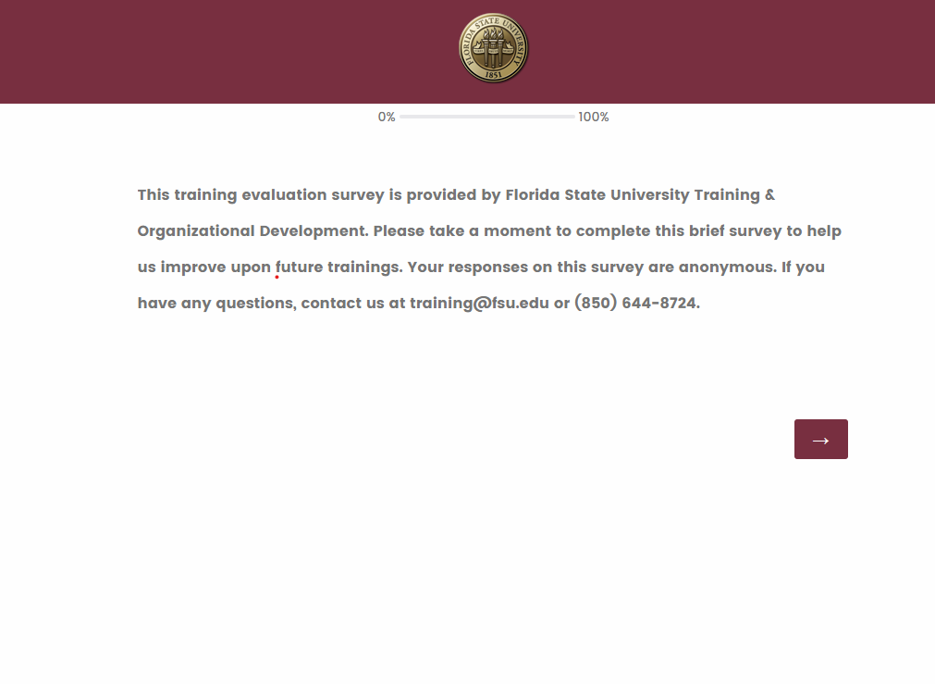
We want your feedback!
1: Scan the QR Code
2: Visit fla.st/23SBS9WQ
Note: Make sure to select Intermediate University Accounting in the survey drop-down!
Florida State University | Continuous Improvement & Training | Contact us at training@fsu.edu with any questions!

