Slide 1
Advanced University Accounting
BTAC03
Notes:
Edited 4/24/24

Slide 2
Agenda
Accrual Accounting Review
GL Account Deep Dive
Journal Sources

Slide 3
Accrual Accounting
Accrual accounting is a method of accounting where events are recorded when the transaction occurs rather than when the payment is made
Revenue is recorded when it is earned
Expenses are recorded when incurred

Slide 4
General ledger accounts

Slide 5
GL Accounts Asset Accounts
Cash (112xxx)
Departmental cash activity/balances
Almost every Source/transaction
Transferring cash between departments in the same fund is generally okay; almost never okay between funds
OMNI uses cash to balance journals at Dept/Fund level
Reconciled at university level by the Controller’s Office

Slide 6
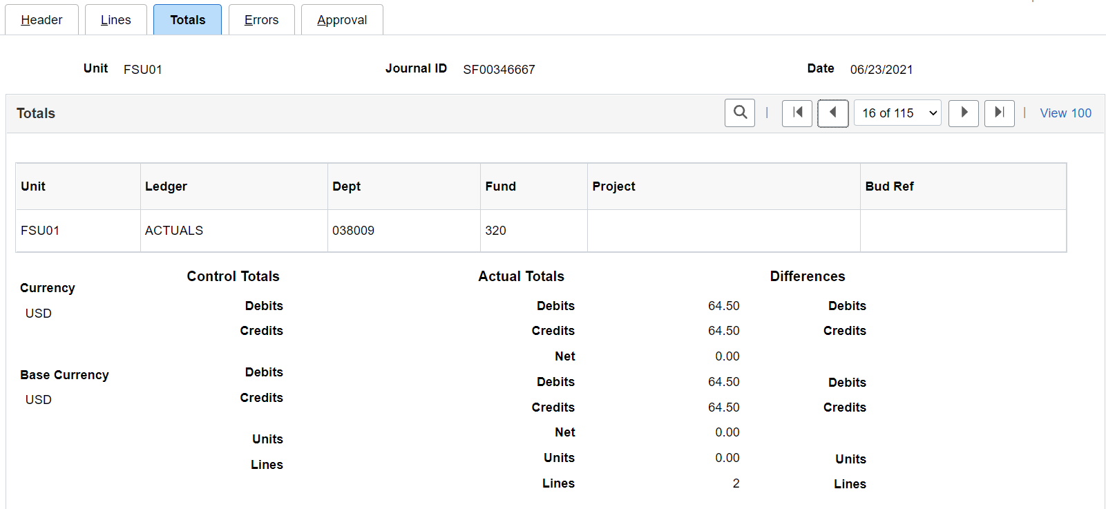
Journal Entry – No Cash

Slide 7
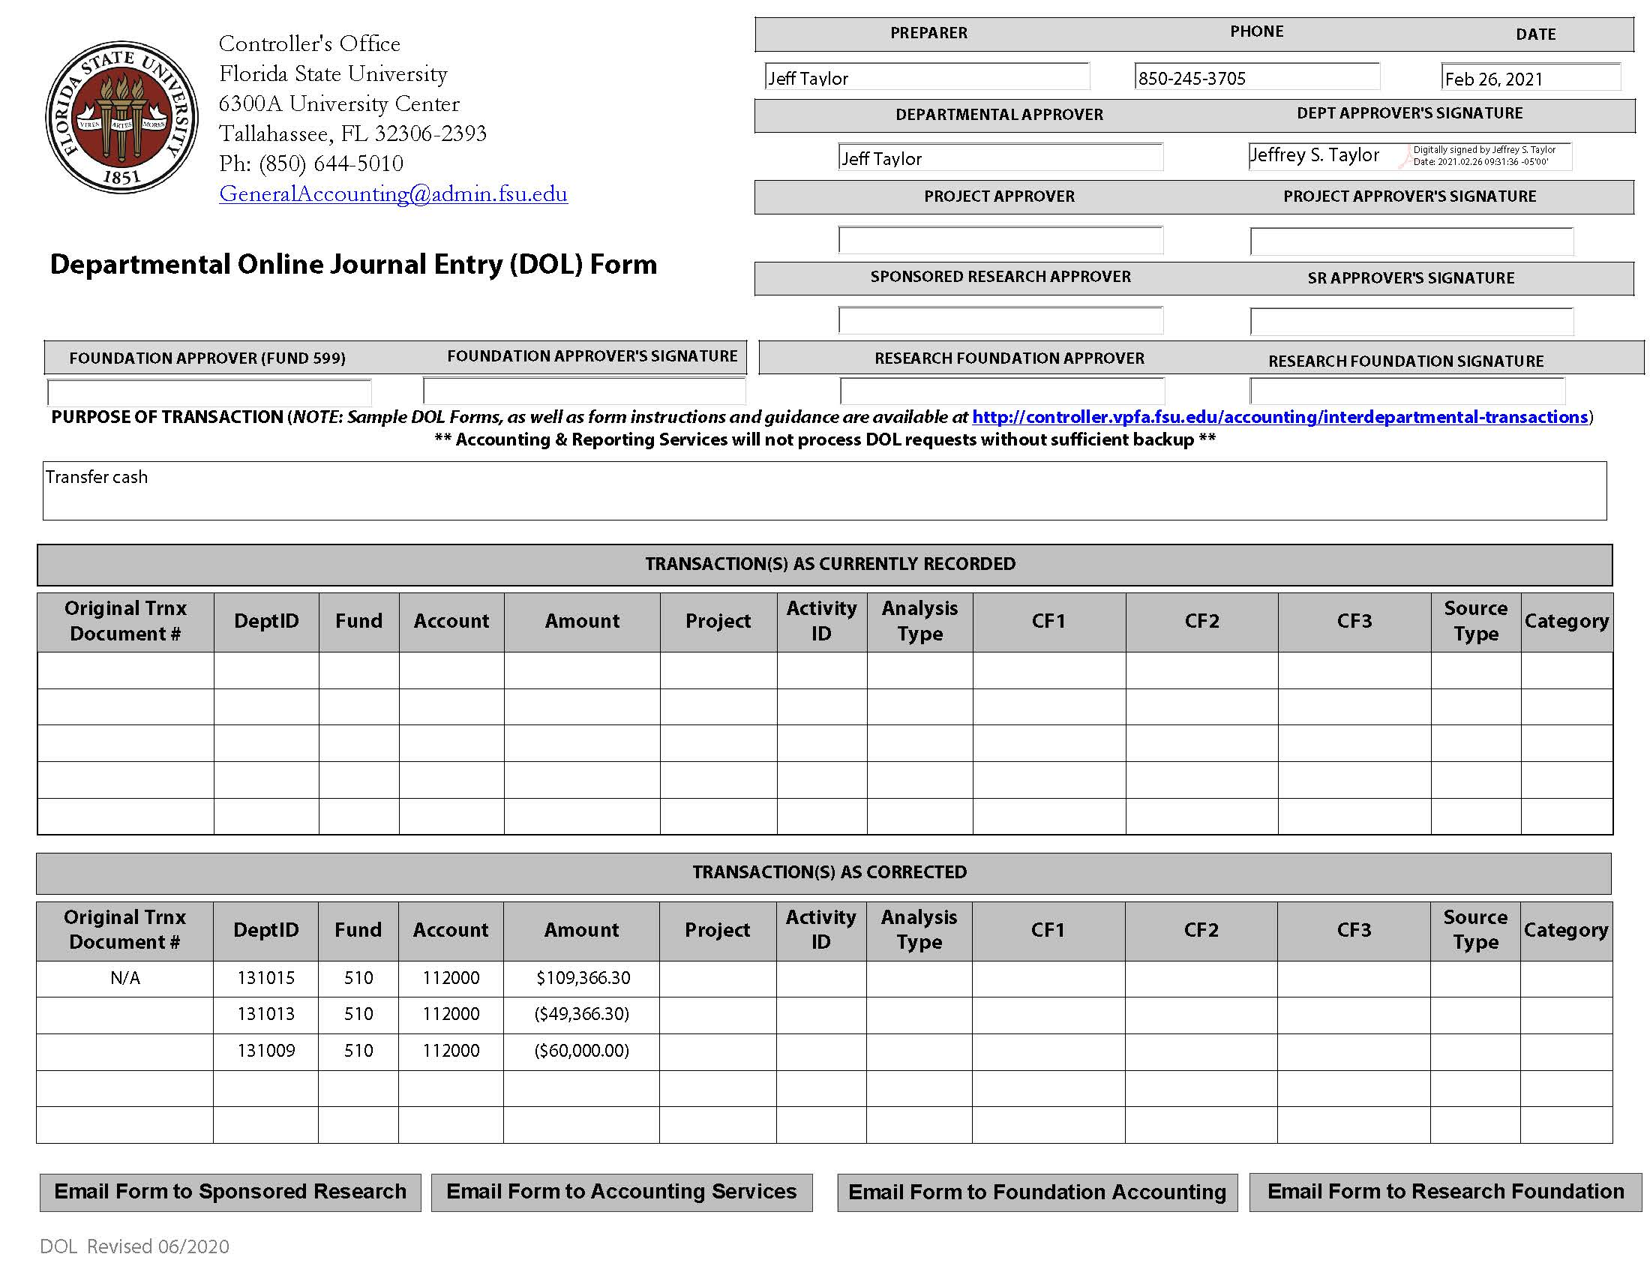
DOL – Only Cash

Slide 8
GL Accounts Asset Accounts
ePayables Cash (112999)
Liability Account
Departments can treat just like cash
Stale balances should be monitored; contact Accounts Payable

Slide 9
112999 Balance

Slide 10
GL Accounts Asset Accounts
Accounts Receivable (15xxxx)
151000/151200 – AR accounts generally only used by Controller’s Office
151005 – Travel advances
Balances should only ever appear on Fund 499 and home department of traveler
Stale balances should be monitored; contact Travel

Slide 11
GL Accounts Asset Accounts
Accounts Receivable (15xxxx)
151010/151011 –
Payroll-related overpayments
Should only process through Payroll and SF journals
151100 – Student fee AR processed through SF
151300 – Auxiliary AR processed through OMNI AR/Billing
155000/155001 –
C&G AR processed by SRA
Should only appear on Funds 520-570

Slide 12
GL Accounts Asset Accounts
Due From (16xxxx)
167000 – Due from Component Units
Departmental FSUF funds recorded here and in unearned revenue (389000) until funds are spent
At that point, Controller’s Office invoices FSUF (every 2 weeks)
When FSUF pays FSU, the due from is decreased and a reclassification from unearned to earned revenue (663028) is made

Slide 13
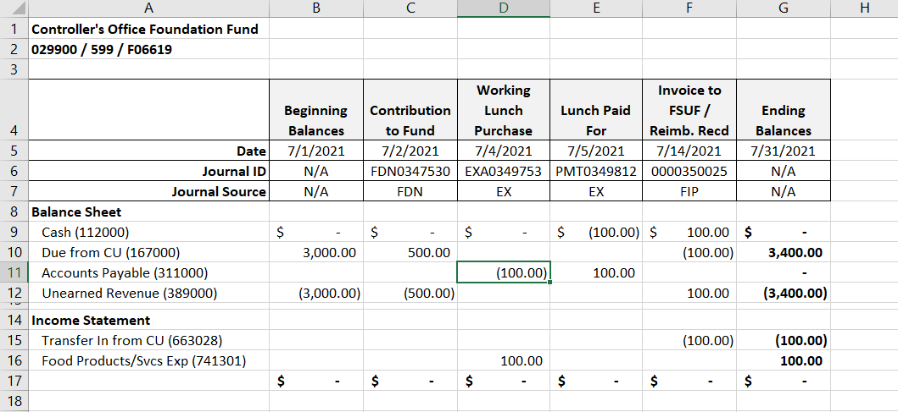
Due From 167000

Slide 14
GL Accounts Asset Accounts
Due From (16xxxx)
168300/168400 – Employee cash advances processed through AP
Permanent/Temporary
Balances are associated with an EmplID

Slide 15
Employee Cash Advance

Slide 16
GL Accounts Asset Accounts
Prepaid Expenses (19100x)
Future expenses paid in advance
Most commonly used for purchase of gift cards for research participants
Sometimes also used to record large, multi-year maintenance contracts
Fixed Assets & Related (2xxxxx)
Capital purchases are recorded to 76xxxxx accounts (for budget purposes)
Controller’s Office confirms purchase is capital and creates the asset record in OMNI AM

Slide 17
GL Accounts Asset Accounts
Fixed Assets & Related (2xxxxx)
This asset addition in OMNI generates AM journal that credits an offset account 799999
In this way, the expense affect is zero on the GL but OCO budget is decreased
Depreciation journals are auto generated in AM monthly
These journals hit depreciation expense (790000) but have no budget effect

Slide 18
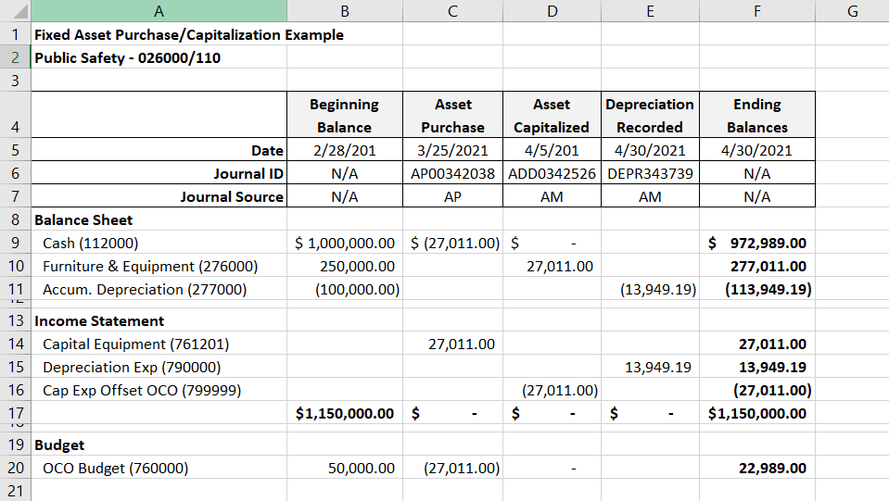
Flow of Fixed Assets

Slide 19
Flow of Fixed Assets
Expense for Vehicle Purchase hits Ledger
Vehicle Capitalized as an asset

Slide 20
Flow of Fixed Assets (Cont.)

Slide 21
GL Accounts Liability Accounts
Accounts Payable (311000)
Main AP account processed through AP
If balances do not clear, contact Accounts Payable
Payroll AP (All other 311xxx)
Payables for payroll-related liabilities processed through these accounts and managed centrally
Includes vendor payments, e.g. taxes to IRS and retirement contributions to Division of Retirement

Slide 22
GL Accounts Fund Balance Accounts
Fund Balance/Net Assets (5xxxxx)
Fund balances (aka retained earnings)
Relate to the net income/loss from the prior year that closes to these accounts as part of year-end close process
Balance should only change at year-end as part of FYE closing process

Slide 23
GL Accounts Revenue Accounts
6xxxxx
Auxiliary Revenue
Internal
Revenue received by one FSU dept from another FSU dept
e.g. utility charges, ITS charges
Eliminated at the university level for financial statements
Any entity with a six-digit DeptID
External
All other auxiliary revenues received from any non-FSU dept
Includes students, employees and related organizations like FSUF

Slide 24
GL Accounts Revenue Accounts
Sponsored Research (C&G) Revenue – Managed by SRA
Fee Revenue – Tuition as well as other fees paid by students for specific purpose (restricted in use)
Includes lab/material/equipment and other class-specific fees
Also includes student activity, technology, distance learning, etc.
Recorded in Campus Solutions via codes that drive student accounting called Item Types

Slide 25
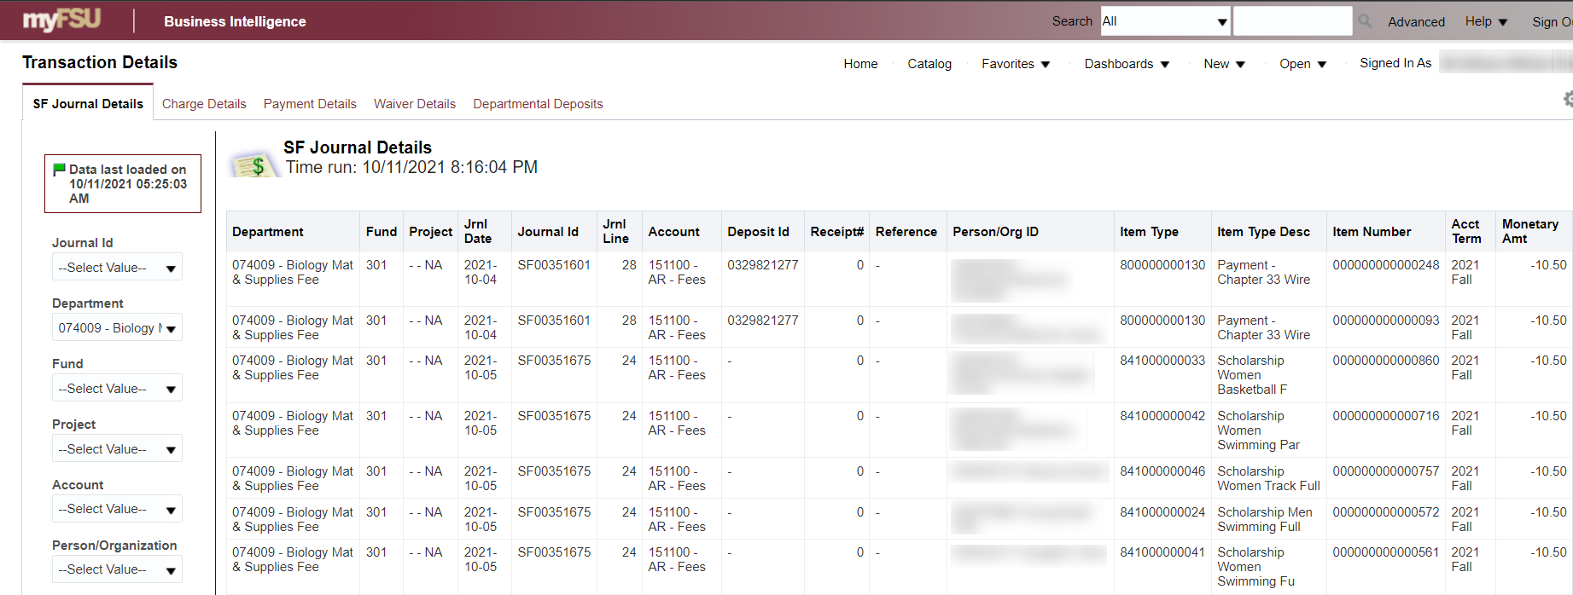
Material Fee Transaction Detail

Slide 26
GL Accounts Revenue Accounts
Interest Revenue
Recorded monthly by Controller’s Office based avg daily cash balance and applicable rates from previous month
Allocated by fund and, for auxiliaries and some other funds, further allocated down to the Department level
Component Unit Revenue
Most activity runs through 663028 as discussed earlier
Capital donations are recorded in OMNI AM in 663031
Other Revenues – Should only be used by or in conjunction with the Controller’s Office

Slide 27
GL Accounts Revenue Accounts
Deposit Guidance
Guidance on how to properly record certain miscellaneous deposits received by departments
Revenue Account Short List / Dictionary
General account categorization included in last column

Slide 28
GL Accounts Expense Accounts
Budgetary high-level categories
71 – Salary and benefit expenses
72 – OPS expenses
74 – All other operating expenses
76 – Capital expenditures (aka OCO)
78 – Transfers out

Slide 29
GL Accounts Expense Accounts
Expenses vs. Transfers
Expenses involve an exchange of goods/services
Transfers are recorded when cash is moved from one department to another (discussed further later)
No exchange of goods/services
e.g. OBS moves cash from one OBS auxiliary to another
If an expense is being shared by multiple departments this should be recorded as an operating expense on each
Preferably, this would be done on the front end with a split PO/voucher rather than an after-the-fact expense transfer

Slide 30
GL Accounts Expense Accounts
Salary Reimbursements
Generally, if a payroll funding correction is needed it should be done through a Retroactive Distribution of Funding (RDF) form via Payroll
ALL recurring funding changes should be done via RDF
In limited situations, departments can use specific salary reimbursement accounts; more information on Controller site

Slide 31
GL Accounts Expense Accounts
Resale expense accounts – Should only be used by auxiliaries when buying inventory to sell
Expense Short List / Dictionary
Account names standardized so they can be sorted and grouped together (Account Codes are all over the place)
E.g. all student tuition & fee accounts begin with “Stdnt Aid”
Account Use Description provides significantly more detail

Slide 32
GL Accounts Transfer Accounts
Only “non-exchange” transfers should be recorded as transfers rather than as expense
Non-exchange (665004/780102) – Most non-E&G transfer will be recorded using these accounts
E&G (665009/780109)
Only used by Budget & Controllers Office
When a budget transfer is processed a corresponding cash transfer is recorded to these accounts
Generally, posted every week on Monday by Accounting Services

Slide 33
GL Accounts Transfer Accounts
Construction (665020/780120)
Recorded by Construction Accounting
Used to move funds from operating department (E&G, aux, etc.) to fund a construction project
Capital Property (600015/790012)
When a capital asset is transferred from one department to another, these accounts are used as the offset
No budgetary effect
Generally, these transfers are done for operational purposes and the accounting is a non-issue for the department
Overhead Assessment (780161) – Used when the Budget Office records their auxiliary overhead assessment each year

Slide 34
Journal Sources

Slide 35
Journal Sources OMNI Systems
Human Resources Database (HR)
Interfaces summarized accounting information each pay period
3 related Sources
PAY – Actual payroll charges
PNC – Payroll encumbrances are re-established each pay period
PRV – Reverses the encumbrance amount from previous pay period
PNC & PRV Sources do NOT record any expenditures; only encumbrances (note Journal Status <> P)
Employee-level journal detail available via HR-GL Detail BI report

Slide 36
Journal Sources OMNI Systems
Student Central Database (SF)
Interfaces summarized accounting information nightly from SC
Student/class-level detail only available in SC or BI Student Financial Transaction Details report
System-generated activity
Tuition/fee assessments, payments, financial aid, etc.
Recorded in SC via Item Types
Item Type – Unique ID that drives accounting for specific transaction type

Slide 37
Journal Sources OMNI Systems
OMNI Financials Module/System Journals
All journals will reflect summarized data
Transaction details available in each module
Accounts Payable (AP)
Records voucher-related payables, payments, and cancellations
Includes Purchasing Card (PCard) expenses (credit cards issued to department staff for misc. purchases)
Voucher-level details available via:
FSU_DPT_AP or FSU_DPT_GL_JRNL_WITH_VCHR queries
BI Expense Data Mining report
Travel & Expense (EX)
Records all spend interfaced from Concur
Additional Reporting available in BI Concur Expense Report Details

Slide 38
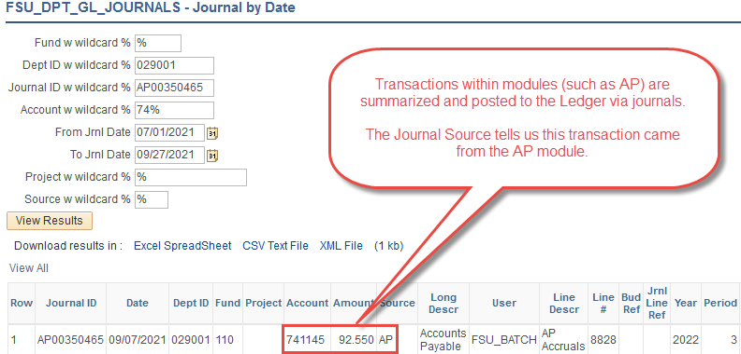
AP Summary in GL

Slide 39
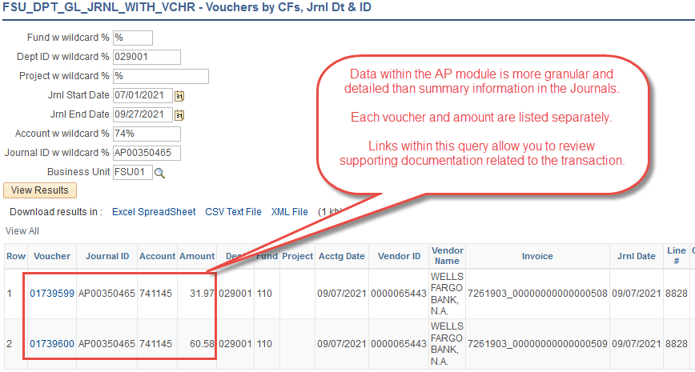
AP Transaction in Module

Slide 40
Journal Sources OMNI Systems
OMNI Financials Module/System Journals (cont.)
Asset Management (AM)
Records all fixed asset-related transactions (asset additions, retirements, transfers, depreciation, etc.)
See FSU_DPT_AM queries for asset-level details
Accounts Receivable & Billing (AR / BI)
Records billing and related receipt transactions for both auxiliary and sponsored project-related entities
See FSU_DPT_AUX queries for auxiliary-level details
Sponsored Research training covers C&G AR and BI activity as well as Grants Management (GM) and Allocation (ALO) transactions
Year-end Closing Journals (CLO)
Generated by ERP as part of FYE closing processes
Can be ignored for most departmental review purposes

Slide 41
Journal Sources Third Party Systems
Graduate student matriculation waivers (MAT)
Generated from the Office of Graduate Studies
Expenses allocated based on individual appointments
Journal Line Descr field contains student EMPLID for reference
Spendable balance updates from the FSUF system (FDN)
Recorded nightly
Adjusts FSUF funds’ spendable balance based on previous day’s activity
Donor details available at reports.foundation.fsu.edu
Research Foundation (RFA & RFP)
Invoice Payments Journals recorded bi-weekly through RFP source journals to distribute cash

Slide 42
Journal Sources Direct Journals
Central Office Direct Journals
Journals entered and originated in the Controller’s Office (CON)
Includes cash transfers recorded whenever E&G budget transfers are made
Journal Class will indicate type of journal (just like DOLs)
Departmental Deposits (ARD)
Deposits of misc. checks/electronic payments
Posted within three business days after receipt

Slide 43
Journal Sources Direct Journals
Central Office Direct Journals
Journals entered and originated in Sponsored Research (SRA)
Interest earning allocations journals (INV)
Journals entered and originated in Payroll (PAO)
Primarily payroll deductions for Parking Services, Leach Center, etc.

Slide 44
Journal Sources Direct Journals
Departmental Journals
Requested by departmental staff
Journals entered, reviewed, and posted by Controller’s Office
Main type is Departmental Online Journal Entries (DOL)
Used primarily to adjust the ledger for transactions already recorded
Requested via DOL Form
Never used to correct a payroll journal
Interdepartmental Requisitions (AUX) – Generally, no longer needed with completion of the OMNI AR/Billing rollout
Detailed guidelines and sample forms available online
Backup for ALL direct journals is attached to each JE in OMNI
OMNI FI > Transactions & Reporting > Search for a GL Journal

Slide 45
Controller Contact Info
Accounting & Reporting GeneralAccounting@admin.fsu.edu (850) 644-5010 | Accounts Payable AccountsPayable@fsu.edu (850) 644-5021
Auxiliary Accounting ctl-AuxiliaryAccounting@fsu.edu (850) 644-1824 | Payroll Services Payroll@fsu.edu (850) 644-3813
Student Business Services StudentBusiness@fsu.edu (850) 644-9452 | Travel Services Travel@fsu.edu (850) 644-5021
Revenue Accounting CTL-Deposits@fsu.edu

Slide 46
Presenter
Pete Walker
pwalker@fsu.edu
850-645-2435

Slide 47
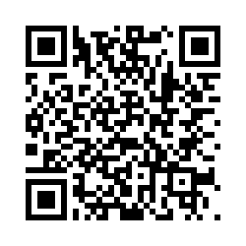
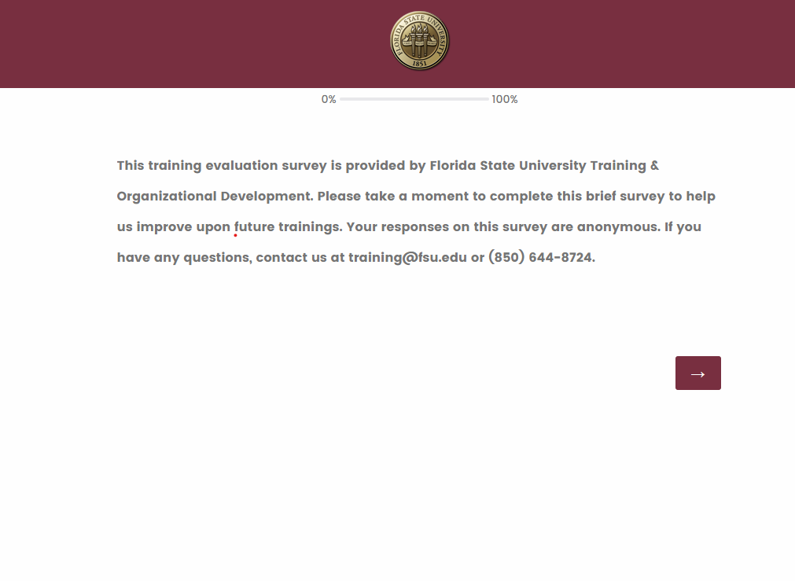
We want your feedback!
1: Scan the QR Code
2: Visit fla.st/23SBS9WQ
Note: Make sure to select Advanced University Accounting in the survey drop-down!
Florida State University | Continuous Improvement & Training | Contact us at training@fsu.edu with any questions!

