Slide 1
Departmental Ledger Review
Notes:
Edited 4/24/2024

Slide 2
What is a ledger review?
Analyzing ledger transactions and balances
All accounts should be reviewed including assets, liabilities, revenue and expenses
Provide reasonable assurance that charges and credits are valid
Verifies transactions are
appropriate
compliant with all applicable policies and regulations
Verifies account balances
accounts and balance amounts are expected and appropriate
balance amounts are substantiated by valid assets and liabilities
Historically departmental reviews haven’t put much focus on looking at balance sheet accounts, but activity on those accounts should be reviewed as well
Ledger review guidance

Slide 3
Why do we review our ledger?
Ensure the sound financial management of university resources
Effective internal controls
Accuracy and completeness of account balances
Timely recording of transactions
Compliance with applicable laws, regulations, and university policy
Facilitates financial decision making by university administrators and allows auditability

Slide 4
Who performs ledger review?
Budget Manager/designee should perform the review
Sign off should be done by someone at the supervisor/management level
Separation of duties: Employees who originate and/or authorize transactions being reconciled should not perform review or sign off on the review

Slide 5
Departmental Ledger Review BI Report
Updated daily
Used for monthly review of department financial activity
Main page summarizes balances by account type and period
Drilling links show balances by account code (112000, 740252, etc.)
Clicking on the balance amounts will show transaction details
All funds and projects in a dept will be returned
Use prompts or drilling links to show only one fund or project
Downloadable to Excel

Slide 6
Steps to perform a ledger review
Step 1A - Data Gathering
Step 1B - High Level Data Review
Step 1C - Comparing Data
Step 1D - Data Analysis
Step 2A - Researching Transactions
Step 2B - Corrective Actions
Step 3 - Document Review

Slide 7
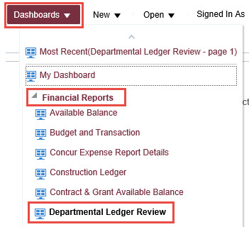
Step 1A - Access Ledger Trend Report
myFSU BI > Financial Reports > Departmental Ledger Review

Slide 8
Step 1B - Data Review
High level review of data for reasonableness and accuracy
Look for significant changes that occur over one or more periods
Look for unexpected fluctuations
Look for atypical balances
Look for large expenditures
Look for static balances

Slide 9
Significant Changes in a Period

Slide 10
Unexpected Fluctuations

Slide 11
Atypical Balance

Slide 12
Large Expense

Slide 13
Static Balances

Slide 14
Step 1C - Comparing Data
Compare current period activity with prior period activity
Compare current year activity and balances with prior year activity and balances
Compare revenue and expenses to payment and billing schedules from customers and vendors

Slide 15
Step 1D - Data Analysis
Look for unfamiliar vendor payments
Look for any duplicate payments
Look for deficit spending
Look for unusual or excessive expenses
Look for expenses that are not allowable for the funding source used
Verify Payroll Certification amounts correspond to salary expenses
Look for PCard transactions for unfamiliar cardholders or inappropriate/unexpected charges
Track key ratios
Compute variances
Look for other high-risk transactions specific to dept

Slide 16
Unfamiliar Vendor

Slide 17
Duplicate Payment

Slide 18
Deficit Spending

Slide 19
Unusual or Excessive Expenses

Slide 20
Expenses Not Allowable for Funding Source

Slide 21
Verify Payroll Certification Matches Salary Expense

Slide 22
PCard Transactions for Unfamiliar/Unexpected Charges

Slide 23
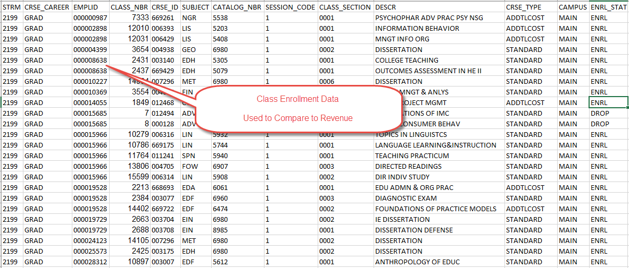
Key Ratios and Variances

Slide 24
Step 2A - Researching Transactions
Unusual or suspicious transactions should be investigated in order to determine the cause of significant variances related to account balances.
Compare source documents to the transaction recorded in OMNI. Is the documentation sufficient to explain the transaction? Do you need to obtain additional documentation?
Should the transaction be recorded to a different budget/chartfield string?
Who initiated and/or authorized the transaction?
Is it a timing difference or is there an actual error?

Slide 25
Step 2B - Corrective Actions
How to resolve routine errors
Emails, phone calls, and meetings
How to perform a correcting journal entry
Suspected fraud: contact OAAS
Website: https://oaas.fsu.edu/
Phone: (850) 644-6031
Email: oaas@fsu.edu

Slide 26
Step 2B - Corrective Actions Departmental Online Journal Entries (DOL)
See Accounting & Reporting section of Controller’s website
General guidelines
Should not take place before the original transaction has been posted
Always preferable for original source transaction to be corrected when possible
The department that processed the original transaction must approve the correction
Should be processed in a timely manner and as soon as possible after the original transaction has been recorded

Slide 27
Step 2B - Corrective Actions Departmental Online Journal Entries (DOL)
Appropriate backup required
Refer to original transactions on form (e.g., journal, voucher, etc.)
Attach support via query, etc.
Obtain appropriate signatures and email to GeneralAccounting@admin.fsu.edu

Slide 28
Step 3 - Review Documentation
Should be completed, reviewed, and signed off on prior to the end of the second succeeding month.
Reviewer different than person performing the review.
Include:
Account balances
Name and Date of reviewer
Name and Date of approver
Notes on corrective action
Supplementary documentation

Slide 29
PCard Monthly Reconciliation
PCard reconciliations must be prepared monthly.
No longer required to be completed in OMNI Financials.
Run the FSU_CTRL_AP_PCARD_RECON query to gather information for the reconciliation.
The monthly reconciliation is required to be signed by the cardholder, proxy, and the supervisor or Dean/Director/Department Head (DDDH).

Slide 30
Example of Documentation

Slide 31
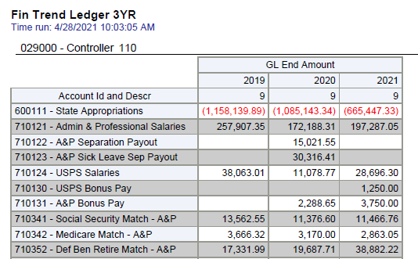
Example of Optional Supplementary Documentation

Slide 32
Additional Reporting Tools

Slide 33
BI Reports Other Reports
Available Balance – Drillable budgetary report
HR-GL Detail (HR report)
HR journals broken down by employee
This level of detail is only available via this report
FSU_PY_FI_REP_INQUIRY role required (if not HR Rep)

Slide 34
BI Reports Other Reports
Construction Ledger
Available budget, cash balance, interest earnings, and expense / encumbrance details for construction projects
Useful for departments financing minor projects with departmental funds
Trend Ledger
Comparative revenues/expenses
3-year trend of annual amounts
Month-to-month trend is also available in Budget & Transaction dashboard

Slide 35
BI Reports Other Reports
Dept Cash Balance Trend
Primarily intended for use by Auxiliary/Designated departments
End of period cash balance and trend line over 12 months
Helps identify cash flow issues
Can run by Budget Manager
Transaction Details (Student Financials report)
Additional detail for SF journals from the Student Central system
FSU_SFS_TRANSDTL_RPT_VIEW role required
myFSU Security – Detail of OMNI security roles by department and/or employee; internal security roles review must be completed quarterly
Remember the ‘Help’ link available on each report

Slide 36
Controller Contact Info
Accounting & Reporting GeneralAccounting@admin.fsu.edu (850) 644-5010 | Accounts Payable AccountsPayable@fsu.edu
Auxiliary Services ctl-AuxiliaryAccounting@fsu.edu (850) 644-4417 | Deposit Accounting ctl-Deposits@fsu.edu (850) 644-9420
Financial Systems ctl-finsys@fsu.edu (850) 644-5140 | Payroll Services Payroll@fsu.edu (850) 644-3813
Student Business Services StudentBusiness@fsu.edu (850) 644-9452 | Travel Services Travel@fsu.edu

Slide 37
Presenters
Betsy Miller
bcmiller@fsu.edu
850-644-0292
Mary Ann Parks
maparks@fsu.edu
850-644-1824

Slide 38
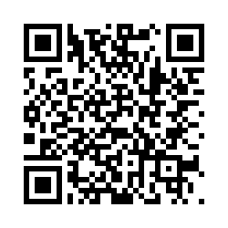
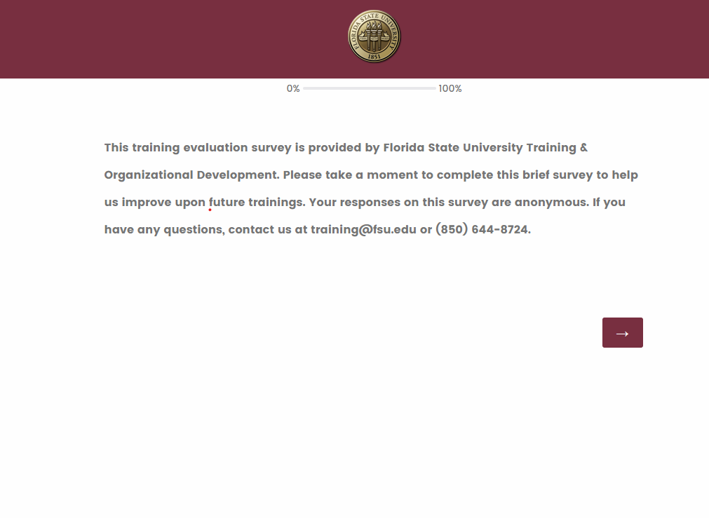
We want your feedback!
1: Scan the QR Code
2: Visit fla.st/23SBS9WQ
Note: Make sure to select Departmental Ledger Review in the survey drop-down!
Florida State University | Continuous Improvement & Training | Contact us at training@fsu.edu with any questions!

