Slide 1
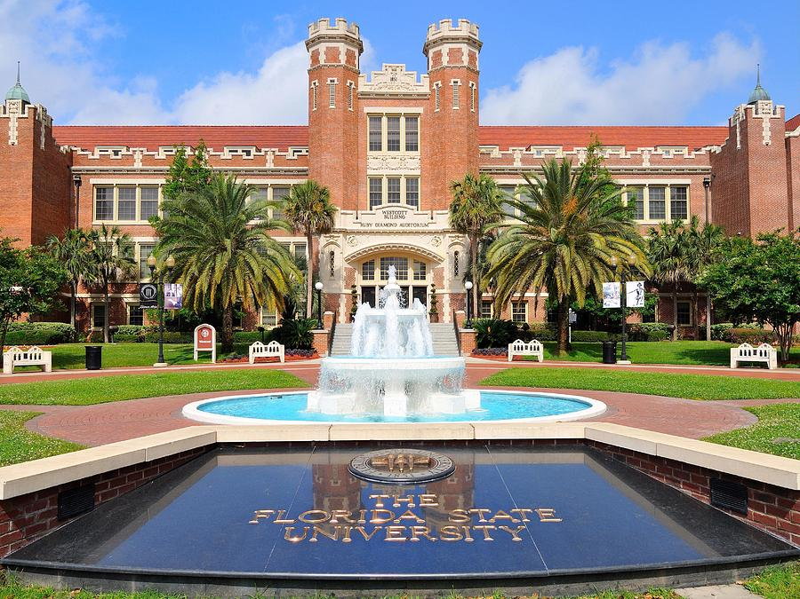
Introduction to University Accounting (BTFA01)
Presented by the FSU Controller’s Office

Slide 2
Class Objectives
Your Role in University Accounting
How does the money flow?
myFSU
Basic Accounting Concepts
Ledgers
Budget
Expenses vs. Encumbrances
Available Balance
Journal Entries
Chartfields
Resources

Slide 3
Your Role in University Accounting
Financial Representatives
Loosely defined
Budget Managers
Authorized Signers
Largely those in “Budget & Financial Services” Job Family
Monitor, manage, approve, reconcile, and/or review financial processes and/or data
Many wear multiple hats
FinRep Listserv

Slide 4
Department Financial Operational Roles
Budget Manager
Serves as the official contact for financial matters
Ensures that departmental ledgers are reviewed/reconciled to identify and correct erroneous transactions
Enters Operating Budgets and maintains positive Available Balances

Slide 5
Department Financial Operational Roles
Dean, Director, Department Head or Chair (DDDHC)
Typically delegates budgetary responsibility
Holds ultimate responsibility for department operations
Authorized Signer – Granted authority to approve transactions that impact a department’s budget or financial position.
Listings available from FSU_DPT_DEPARTMENT_ROLES query in OMNI Financials

Slide 6
How Does the Money Flow?

Slide 7
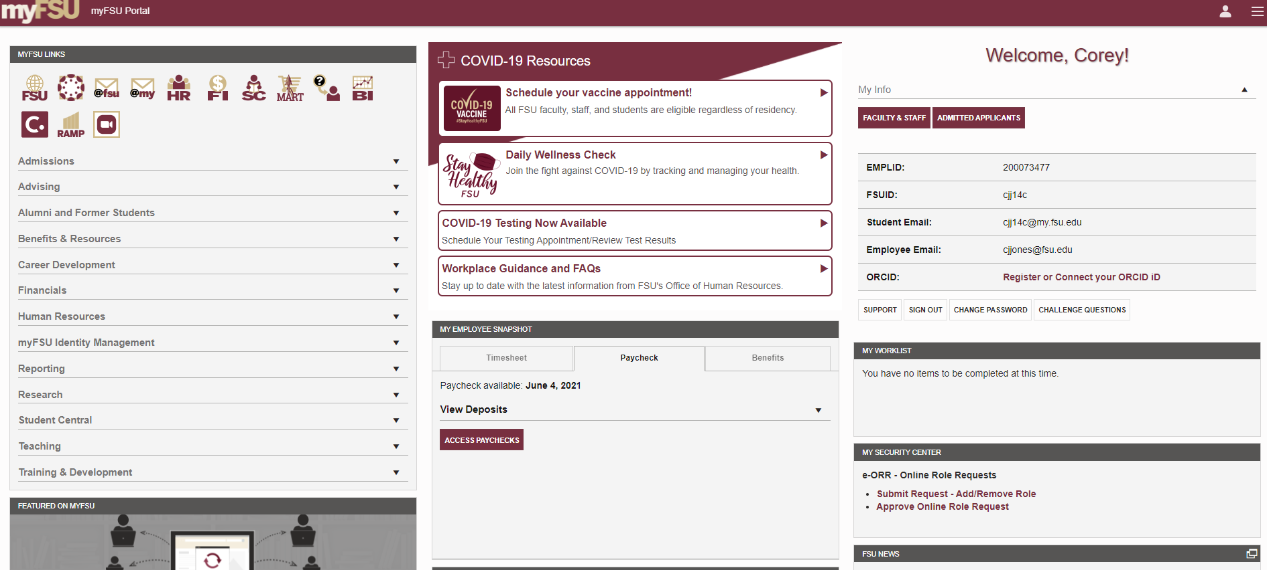
myFSU (Portal Page)

Slide 8
myFSU PeopleSoft Databases
Financials (FI)
Focus of this class
Stores all financial & accounting information of the University
Human Resources (HR)
Time entry / approval
Training signup
Security role requests
Benefits info, evaluations, job applications, recruiting, etc.
Student Central aka Campus Solutions (SC)
Enrollment
Student financial management

Slide 9
myFSU Other Links
FSU – FSU homepage
Canvas – FSU’s learning management system (online courses, course sites, and such)
@fsu – Webmail portal
@my – myFSU portal (Office 365)
Hyperion (HYP Budget) – Hyperion budgeting system
SpearMart
Online shopping portal
Maintained by Procurement Services

Slide 10
myFSU Other Links
FSU Service Center (aka CRM) – All help “tickets” or “cases” maintained here
Oracle Business Intelligence (BI)
Oracle data warehouse for reporting
Covered extensively in BTFA02 Financial Reporting Tools class
Concur – FSU travel system
Also of note…
Useful links along the side
Important notices along the top
My Worklist
My Security Center
FSU Calendar

Slide 11
PeopleSoft Financials (OMNI)
Online Management of Networked Information
Oracle PeopleSoft Enterprise (ERP) system
Implemented in 2004 to replace FLAIR
Modular Application
Examples of SOME OMNI Modules
Accounts Payable
Purchasing (interfaces with SpearMart)
Travel and Expenses (interfaces with Concur)
Commitment Control (interfaces with Hyperion)

Slide 12
Ledgers
Ledger – A set of books that stores budgeting and/or accounting transactions
Detailed information stored in smaller (subsidiary) ledgers
Subsidiary ledgers are summarized and permanently recorded (posted) to one primary ledger called the General Ledger (GL)
Transactions that record and post to the GL are called Journal Entries (JEs) and must be in balance (debits = credits)
FSU has two main types of ledgers
ACTUALS (usually referred to as GL)
Contains non-budgetary financial information
Primary focus of this class
COMMITMENT CONTROL (KK)
Contains budgetary transactions and provides a mechanism for controlling expenditures against a pre-defined spending limit

Slide 13
Budget
Budget = Authority to spend
Departments formulate an annual operating budget for the following fiscal year each April
Once approved, budget is booked in the KK ledgers
Each department’s spending is controlled by their budget

Slide 14
Encumbrances vs. Expenses
Encumbrance – Recorded in KK ledgers only to reflect commitments to spend prior to actual expenditures taking place. Established via:
Purchase Orders
Travel Requests
Payroll Appointments
Expenses – Recorded in ledgers (and reduce the related encumbrance) once an actual liability has been established via:
Voucher
Expense Report
Payroll
* Expenses can also be recorded with a direct cash journal to an expense account (this would bypass any encumbrance)

Slide 15
Available Balance
BUDGET
LESS: ENCUMBRANCES
LESS: EXPENSES
= AVAILABLE BALANCE
Available Balance should NEVER be negative.

Slide 16
GL vs. KK What Posts to Each?
Transaction | GL | KK
GL Journal Entries | Everything Lines including cash, receivables, payables, revenues, expenses, etc. all post to the GL. | Some things Only lines including non- property revenues and non-property expenses post to KK.
Budget Journals & Budget Transfers | Nothing GL Journal Entries are the only financial transactions that post to the GL. | Everything Lines updating budget balances post to the appropriate KK budget ledgers.
Other – Purchase Orders, Travel Authorizations, etc. | Nothing GL Journal Entries are the only financial transactions that post to the GL. | Some things Encumbrances are established when purchase orders or travel requests are issued.

Slide 17
Journal Entries
Used to record ALL transactions in the Ledger
Three potential sources of Journals:
OMNI Systems
“Third Party” Systems – Systems other than PeopleSoft
Direct Journal Entries – Manually keyed or uploaded journals
Each Journal Entry is assigned a unique Journal ID
10 Characters
All but direct journals have an alpha prefix
Helps to identify journal source
E.g. AP, AR, SF
Journal Source provides clear indication of where JE originated
2 or 3 characters
FSU_DPT_CODES_GL_SOURCE provides a complete list

Slide 18
Journal Sources OMNI Systems
Human Resources Database (HR)
Interfaces summarized accounting information each pay period
3 related Sources
PAY – Actual payroll charges
PNC – Payroll encumbrances are re-established each pay period
PRV – Reverses the encumbrance amount from previous pay period
PNC & PRV Sources do NOT record any expenditures; only encumbrances (note Journal Status <> P)
Employee-level journal detail available via HR-GL Detail BI report

Slide 19
Journal Sources OMNI Systems
Student Central Database (SF)
Interfaces summarized accounting information nightly from SC
Student/class-level detail only available in SC or BI Student Financial Transaction Details report
System-generated activity
Tuition/fee assessments, payments, financial aid, etc.
Recorded in SC via Item Types
Item Type – Unique ID that drives accounting for specific transaction type

Slide 20
Journal Sources OMNI Systems
OMNI Financials Module/System Journals
All journals will reflect summarized data
Transaction details available in each module
Accounts Payable (AP)
Records voucher-related payables, payments, and cancellations
Includes Purchasing Card (PCard) expenses (credit cards issued to department staff for misc. purchases)
Voucher-level details available via
FSU_DPT_AP or FSU_DPT_GL_JRNL_WITH_VCHR queries
BI Expense Data Mining report
Travel & Expense (EX) – Records all spend interfaced from Concur

Slide 21
Journal Sources OMNI Systems
OMNI Financials Module/System Journals (cont.)
Asset Management (AM)
Records all fixed asset-related transactions (asset additions, retirements, transfers, depreciation, etc.)
See FSU_DPT_AM queries for asset-level details
Accounts Receivable & Billing (AR / BI)
Records billing and related receipt transactions for both auxiliary and sponsored project-related entities
See FSU_DPT_AUX queries for auxiliary-level details
Sponsored Research training covers C&G AR and BI activity as well as Grants Management (GM) and Allocation (ALO) transactions
Year-end Closing Journals (CLO)
Generated by ERP as part of FYE closing processes
Can be ignored for most departmental review purposes

Slide 22
Journal Sources Third Party Systems
Charges from Facilities’ AiM system for:
Maintenance and janitorial services (OFC, OFG, OFM)
Utilities (UTG, UTL) – only charged to certain non-E&G departments
Recorded monthly
Details available through Facilities Financial Services
Graduate student matriculation waivers (MAT)
Generated from the Office of Graduate Studies
Expenses allocated based on individual appointments
Journal Line Descr field contains student EMPLID for reference
Spendable balance updates from the FSUF system (FDN)
Recorded nightly
Adjusts FSUF funds’ spendable balance based on previous day’s activity
Donor details available at reports.foundation.fsu.edu

Slide 23
Journal Sources Direct Journals
Departmental Journals
Requested by departmental staff (you!)
Journals entered, reviewed, and posted by Controller’s Office
Detailed guidelines and sample forms available online
Two main types
Departmental Online Journal Entries (DOL)
Used primarily to adjust the ledger for transactions already recorded
Requested via DOL Form
Never used to correct a payroll journal
Interdepartmental Requisitions (AUX)
Record the sale of goods/services between two FSU departments
Requested via IDR Form
Some Auxiliaries are utilizing OMNI AR/Billing functionality and do NOT use IDRs
Journal Header Ref field shows selling Department Area

Slide 24
Journal Sources Direct Journals
Other Direct Journals
Journals entered and originated in the Controller’s Office (CON)
Includes cash transfers recorded whenever E&G budget transfers are made
Journal Class will indicate type of journal (just like DOLs)
Departmental Deposits (ARD)
Deposits of misc. checks/electronic payments
Posted within three business days after receipt
Journals entered and originated in Sponsored Research (SRA)
Interest earning allocations journals (INV)
Journals entered and originated in Payroll (PAO)
Primarily payroll deductions for Parking Services, Leach Center, etc.
Backup for ALL direct journals is attached to each JE in OMNI
OMNI FI > General Ledger > Journals > Journal Entry > Create/Update Journal Entries

Slide 25
ChartFields
A means of breaking down accounting transactions within the system in order to organize and report on the data contained in OMNI
Three ChartFields (CFs) required for ALL transactions in OMNI
Department ID
Fund Code
Account
Transactions recorded at the Project ID level require additional CFs, depending on the fund source
Financials > Setup Financials/Supply Chain > Common Definitions > Design Chartfields > Define Values > Chartfield Values

Slide 26
Chartfields Department
Represent an area of financial management at FSU
OMNI Chartfield DeptID is 6 digits
First 3 refer to academic, administrative, or other major area
Last 3 refer to specific cost center within that area
Specific department information or a complete list of FSU departments via FSU_DPT_CODES_DEPTID query
Departments added/maintained by Budget Office
Includes department designations (Budget Manager, Authorized Signers, Department Head)
4-OP-D-1 OMNI Departments policy governs

Slide 27
Chartfields
Department Org Structure
Departments roll up to Areas
Areas roll up to Schools/Colleges *
Schools/Colleges roll up to Divisions
Examples:
* OMNI Schools/Colleges are not always academic
Department | Area | School/College | Division
189000 (Theatre) | 189 (School of Theatre) | College of Fine Arts | Academic Affairs
029004 (Accounting Services) | 029 (Controller’s Office) | AVP Financial Services | Finance & Administration
028001 (NCT Service Auxiliary) | 108 (Information Technology Service) | Information Technology Service | Academic Affairs

Slide 28
Chartfields Fund
Identifies the source of monies
May have various restrictions on use
Expenditure Guidelines
Often have different reporting requirements
OMNI Chartfield Fund Code is a 3 digit numerical code
Created/maintained by Controller’s Office
FSU_DPT_CODES_FUND query of all Fund Codes

Slide 30
Chartfields Fund
State Funds = Education & General or Carryforward
110 E&G
Current FY appropriations
Lottery allocation
Also tuition & some general fees lumped into allocations to departments
140 Carryforward – Unspent prior FY E&G funds
College of Medicine and Engineering have their own E&G funds
Grantors = Sponsored Research aka C&G (520-570)
Contracts, grants, and other research-related monies provided by governments or private entities
Further broken down by specific Project ID
Sponsored Research Administration (SRA) provides final review and approval of these funds

Slide 31
Chartfields Fund
Customers = Auxiliaries / Vending
Auxiliaries (320)
Provide essential goods/services to departments, faculty, staff, students, and incidentally to the general public
Sales to other FSU Departments = INTERNAL, e.g.
ITS providing network services to Chemistry department
Facilities providing janitorial services to College of Music
Sales to anyone else (student, general public, etc.) = EXTERNAL
Vending (620) – Vending machine funds allocated to departments

Slide 32
Chartfields Fund
Students = Various Fees
301 Miscellaneous Student Fees
Includes fees for class materials & supplies, facility/equipment use, distance learning, and international programs
610 Student Activities Fee
615 Student Technology Fee
Others
360 Transportation Access
370 Housing
390 Health
630 Athletics

Slide 33
Chartfields Fund
Donors = Foundation (FSUF) Funds (599)
Departmental funds transitioned to OMNI in July 2018
Each individual fund assigned a unique Project ID
Each fund has its own spending rules based on donor intent
Each Department Area has at least one unique DeptID for their FSUF activity
FSUF administrative staff provide final review and approval
Construction Funds (8xx)
When departments provide their own funding, cash is transferred to an equivalent Construction Fund and managed by Facilities
801/802/826 – E&G/CF/Auxiliary-funded
DeptID does NOT change with transfer

Slide 34
Chartfields Account
Used to record, summarize, and/or categorize financial transactions as assets, liabilities, equity, revenue, or expense
Created/maintained by Controller’s Office
Two types of Accounts
BUDGETARY record budget
NON-BUDGETARY (aka GL) categorize transactions
OMNI ChartField Account is 6 digits; the first digit identifies the type of account
FSU_DPT_CODES_ACCOUNT

Slide 35
Chartfields Account
Account Type | Example | 1st Digit | Increase | Decrease
Current Assets | Cash, Receivables | 1 | Debit | Credit
Non-current Assets | Fixed Assets | 2 | Debit | Credit
Current Liabilities | Accounts Payable | 3 | Credit | Debit
Non-current Liabilities | Loans Payable | 4 | Credit | Debit
Equity or Fund Balance | Unrestricted Net Assets | 5 | Credit | Debit
Revenues | Auxiliary Sales | 6 | Credit | Debit
Expenses | Salaries, Office Supplies | 7 | Debit | Credit
General Ledger Account Lists
Data Dictionary = ALL Accounts
Short List = Most commonly used Accounts
FSU_DPT_CODES_CATEGORY_BY_ACCT query for Procurement Code to Account Code crosswalk

Slide 36
Chartfields Project
Required for 3 types of funds
Sponsored Projects (Funds 520-570) – Created/maintained by SRA
Foundation (599) – Created/maintained by FSUF
Construction (8xx) – Created/Maintained by Controller’s Office
Additional ChartFields are required – Activity ID & Analysis Type
OMNI Chartfield Project ID
Sponsored Project IDs – 6 numeric digits
Foundation Project IDs
6 characters, starting with F
Correspond to fund number in FSUF system
Construction Project IDs – 9 characters, starting with ‘C’

Slide 37
Chartfields Optional Chartfields
Allow departments to track expenses at a more detailed or customized level
Created/maintained by Controller’s Office
Three available (NOT hierarchical); each is up to 10 characters
CHARTFIELD 1
CHARTFIELD 2
CHARTFIELD 3
Consistency is key (not required so have to remember)
Examples of current use are tracking spend by:
Professor
Course Number
Theater Production

Slide 38
Fiscal Year & Accounting Period
The fiscal year for FSU is a twelve month period beginning July 1 and ending June 30
Fiscal months are referred to as periods
Many financial reports will refer to accounting period and fiscal year
What fiscal year and period are we currently in?
Fiscal Year | Acct Period | Calendar Month
2017 | 1 | July 2016
2017 | 2 | Aug 2016
2017 | 3 | Sept 2016
2017 | 4 | Oct 2016
2017 | 5 | Nov 2016
2017 | 6 | Dec 2016
2017 | 7 | Jan 2017
2017 | 8 | Feb 2017
2017 | 9 | Mar 2017
2017 | 10 | April 2017
2017 | 11 | May 2017
2017 | 12 | June 2017
2018 | 1 | July 2017

Slide 39
Business Unit & Set ID
Business Unit
Operational division of FSU
Defined at the module and GL level
General Ledger BU = FSU01
Set ID
Defined w/in a BU
Help organize data within the system
Used to define sets of chartfields, customers, vendors, etc.
SHARE

Slide 40
Questions
??????????????????????????????????????????????????????????????????????????????????????????????????????????????????????????????????????????????????????????

Slide 41
Resources
Controller’s Office Website – controller.vpfa.fsu.edu
Business Management Guide
Training & Job Aids
Accounting Concepts
Forms
General Account Lists
Recommended Query Listing
Other central office websites
Budget Office
Procurement Services
Sponsored Research
Human Resources
Financial Policies & Procedures

Slide 42
Contacts
Accounting & Reporting Services
GeneralAccounting@admin.fsu.edu
644-5010
CTL-Communication@fsu.edu
Slides available at http://controller.vpfa.fsu.edu/training
Located under General Ledger training materials

