Slide 1
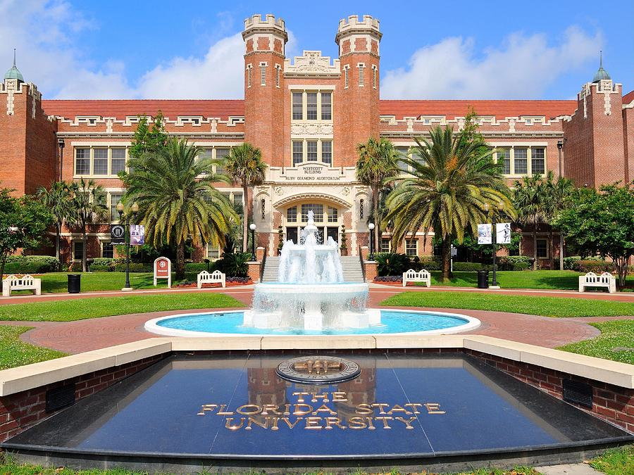
Financial Reporting Tools (BTFA02)
Presented by the FSU Controller’s Office

Slide 2
Class Objectives
Reporting Tools Overview
OMNI/BI Departmental Ledger Review
Other BI Reports
Queries

Slide 3
Reporting Tools Overview
OMNI Financials
Static Departmental Ledgers
“Canned” PeopleSoft reports
Oracle Business Intelligence (BI)
Link from myFSU portal page
Data warehouse tool
Select data from PeopleSoft loaded nightly
Numerous reports available
PS Query (in OMNI Financials)
Data is “live”
Very specific data
Important to choose the right query

Slide 4
BI Departmental Ledger Review
Updated daily
Used for Monthly Review of Department Financial Activity
Main page summarizes balances by account type and period
Drilling links show balances by account code (112000, 740252, etc.)
Clicking on the balance amounts will show transaction details
Links in transaction detail to supporting information in OMNI Financials (must open OMNI Financials before clicking links)
All funds and projects in a dept will be returned
Use prompts or drilling links to show only one fund or project
Downloadable to Excel
Notes:
RECOMMEND THEY USE FIREFOX WHEN IN BI
Run 187 depts.
Demo basics of how BI prompts work
Point out that can search by name but want to uncheck “Match Case”
Use % as wildcard OR can change search to “Contains”
Note that all depts. In that range will come back in report

Slide 5
BI “Dashboard” Reports Budget and Transaction
Intended to be a “one stop shop”
Executive Overview
Intended for DDDHs to see their financial situation at a glance
Info on ALL funding sources for department(s) selected
E&G/Auxiliary/Designated Summary – Available Balance & Available Cash for each E&G, Auxiliary, and/or Designated DeptID
FSUF Department Summary
Below E&G/Aux/Designated Summary section
Total available budget at FSUF DeptID level
SRAD Summary – Available Balance for each SRAD Project ID
FSUF Project Summary – Available Balance for each FSUF Project ID
Notes:
Each tab/report structure has its own intended use
Run for 074 ALL (NOTE THIS WILL TAKE A GOOD BIT SO BEST IF RUN BEFORE CLASS TO CACHE)
Prompts on Exec Overview tab carry over to E&G Detail, Aux Detail, and C&G Detail NOT other tabs
Executive Overview
Should give your mgmt. a pretty complete picture of the funding sources they have available to them (non-SRAD Sponsored Projects excluded b/c $ are totally restricted)
formatted well for printing to PDF (POINT OUT EXPORT FUNCTIONALITY)
Separate sections/formats for E&G/Aux, SRAD, FSUF – both at Dept level (below E&G summary) and at FSUF project level (below SRAD Summary)
Warn them that it could take a few minutes to run SRAD summary if have a lot of sponsored projects in depts.
Can click into Foundation Detail tab from any individual FSUF Project hyperlink

Slide 6
BI “Dashboard” Reports Budget and Transaction
E&G Detail
Carryover of high level Available Balance/Cash summary
Encumbrance balances by GL Account, Supplier, or Source
Expense month-to-month trend with totals
All encumbrance/expense amounts link to detail
Aux/Designated Detail – Contains same information as E&G Detail report PLUS:
Profit & Loss summary information
Revenue trend information (in addition to expense trends) that hyperlinks to relevant detail/backup
Notes:
E&G Detail
Encumbrance balances view can be changed with drop down at top
Encumbrance by Source = by individual PO, T-Auth, Jrnl WITH HYPERLINKS!
Detail link provides additional info AND links to source document/journal in OMNI FI
By default, exp detail has rolled up salary info but can be displayed by individual salary account using drop down menu at top of that section
SEE NOTE AT VERY BOTTOM OF TREND LEDGERS
Aux Detail
All the same options available in trend and encumbrance reports
Hyperlinks for revenue include link to SF Trnx Detail for SF journals, online journals for IDRs, Aux Billing data in OMNI

Slide 7
BI “Dashboard” Reports Budget and Transaction
C&G/SRAD/PI Support Detail
Provides high level available balance information on ALL open Sponsored Research projects
Broken down into 4 sections
Other SRAD
SRAD Research Support
Sponsored Salary Account(s)
Other Sponsored Research
Notes:
4 C&G sections – MAKE SURE TO RUN AHEAD OF TIME B/C TAKES A LONG TIME TO PULL
Other SRAD – SRAD (fund 550) Projects NOT ID’d as “research support” in the name
SRAD Research Support – SRAD (fund 550) Projects ID’d as “research support”
Sponsored Salary Account(s) – Projects from any C&G fund ID’d with “salary” in the name
Other Sponsored Research
All other open C&G Projects with a link from each Project to detailed information (also available from “Sponsored Project Lookup”)
yellow highlights mean project deadline past but still open

Slide 8
BI “Dashboard” Reports Budget and Transaction
Sponsored Project Lookup
“Lookup” for any individual sponsored Project ID
Same reporting information available as hyperlink from C&G Detail report
4 sections:
Award Attributes
Sponsored Project Summary (and “Burn Rate”)
Sponsored Project Expense Trend
Sponsored Project Encumbrances
Notes:
Award Attributes – Lists researchers and sponsor
Sponsored Project Summary – Available Balance and “burn rate”
Sponsored Project Expense Trend – Expense totals by Account, FY, or Period
Encumbrances – same options as E&G/Aux

Slide 9
BI “Dashboard” Reports Budget and Transaction
Foundation Detail
A Project ID must be selected for the report to run
High level Available Balance summary at FSUF Project level
Just like E&G Detail:
Encumbrance balances by GL Account, Supplier, or Source
Expense month-to-month trend with totals
All encumbrance/expense amounts link to detail
Trial Balance
For E&G, Carryforward, Auxiliary/Designated funds only
Should mirror FSU_DPT_TRIAL_BALANCE query
Notes:
FSUF Detail pretty much mirrors E&G detail as far as content goes
Trial Balance can be used to monitor balance sheet accounts such as AP and AR

Slide 10
BI “Dashboard” Reports Transaction Details
Same data as is linked to from Budget & Transaction report
Also mirrors data in Departmental Ledger Review transaction detail
Downloadable to Excel
Prompts available for Optional Chartfields
Hyperlinks to OMNI pages and backup attachments
Separate reports by transaction type
Customization options
Notes:
RUN FOR 075
Preferable to similar data available in Budget & Transaction when want to lookup by CF1-3 or need to see ALL transactions of a particular type
Bud & Trnx requires drill on each account to see detailed activity
Hyperlinks for all exp & rev (!) activity available if need additional detail/underlying support (invoice, receipts, etc.)
Also note that SF journals will now link you to the SF Transaction Details BI report for expense or revenue activity
Demo the exclude columns and sort abilities; also point out ability to save preferences and set defaults
Be sure to also demo the expansion to all rows button at bottom of report and to demo export to Excel (and talk about difference between export to Excel and export to CSV)
Cash detail will give almost all activity for period (other than unpaid liabilities, uncollected revenues, and FSUF balance increases) Liability detail is where increases to FSUF unearned revenues will show up (when available balance changes are interfaced into OMNI from FSUF nightly)
Other Assets will primarily be AR activity

Slide 11
BI “Dashboard” Reports Expense Data Mining
To be used in researching specific expense data
ALL the prompts
Can break expense data down into smaller parts, e.g.
ID vouchers associated with particular PO
Then run again for those vouchers w/out PO to ID unencumbered freight
Notes:
Run for %univ%flor%
Run for 227 76% activity
Pick a PO and pull that to see all related vouchers (can also hyperlink from PO)

Slide 12
BI Encumbrance Period Balance
Provides encumbrance balances as of the end of the accounting periods.
Drilling links to encumbrance detail.
Salary and OPS encumbrances will decline throughout the year as payrolls are processed.
Look out for “stale” encumbrances that have remained encumbered longer than expected (after expense was expected to be paid or after a trip has occurred)

Slide 13
BI “Dashboard” Reports Other Reports
Available Balance – Drillable budgetary report
HR-GL Detail (HR report)
HR Journals broken down by employee
Not available in most other reports
FSU_PY_FI_REP_INQUIRY role required (if not HR Rep)
Construction Ledger
Available budget, cash balance, interest earnings, and expense / encumbrance details for construction projects
Useful for departments financing minor projects with auxiliary/E&G funds
Trend Ledger – Two versions:
Comparative revenue and expense totals by account over 3 year period
Month Trend data also available in Budget & Transaction report
Notes:
Just mention Available Balance and fact that you can drill down from university level
Don’t run HR-GL detail b/c don’t want to throw up peoples’ salaries; point out that can run for a particular Payroll JE or for a range of dates or see all charges for a particular empl
Run Constr Ledger for %wfsu and point out link to exp detail and availability of cash/interest earnings
Just mention 3-year trend

Slide 14
BI “Dashboard” Reports Other Reports
Dept Cash Balance Trend
Primarily intended for use by Auxiliary/Designated departments
End of period cash balance and trend line over 12 months
Helps ID cash flow issues
Can run by Budget Manager
Transaction Details (Student Financials report)
Additional detail for SF journals from the Student Central system
FSU_SFS_TRANSDTL_RPT_VIEW role required
OMNI Security – Detail of OMNI security roles by Dept and/or Employee
NOTE: Remember the ‘Help’ link for each report
Notes:
Dept Cash Balance – 189001
SF Trnx Details – point out that it can be run by journal and will provide detail on payer; can also run separate report on Dept Deposits

Slide 15
OMNI Queries
Query
Ad hoc (literally “for this”) request of information from a database
Allow direct access to specific data about a particular transaction type
Provides detail of transactions that may not be available in BI
Downloadable to Excel
All FSU employees have access to query tool in Financials
Navigator> Reporting Tools > Query > Query Viewer
Additional access required to run queries in HR or SC

Slide 16
Which Query??
Thousands of queries in OMNI FI
Controller’s Office Recommended Query List
Categorized by area (Accounting, AP, etc.)
Student Business Services queries (FSU_SF in OMNI SC)
FSU_DPT / DEPARTMENT folder
http://controller.vpfa.fsu.edu/query
Other central office queries
Human Resources (in OMNI HR)
Sponsored Research
Budget Office
Use others at your own peril
Contact appropriate central office if you can’t find what you need

Slide 17
How do I run a query?
Query Viewer tool in OMNI
Navigation: Reporting Tools > Query Viewer
Wildcards - %
Running Queries tutorial available
Notes:
Bring up FSU_DPT_TRIAL_BALANCE query; demo use of %
Point out FSU_DPT_CODES queries

Slide 18
Questions
??????????????????????????????????????????????????????????????????????????????????????????????????????????????????????????????????????????????????????????

Slide 19
Contacts
Quality Assurance – QualityAssurance@admin.fsu.edu
Sponsored Research Administration – SRA-Reports@fsu.edu
Budget Office - BA-Budget@fsu.edu
Slides available at http://controller.vpfa.fsu.edu/training
Located under General Ledger training materials

