Slide 1
Introduction to Accounts Payable
Course #BTAP01
Updated 1.8.2024

Slide 2
Course Outline
Accounts Payable Policies and Procedures
Accounts Payable Terms
Transcepta
Navigating OMNI
Accounts Payable Module
FSU Document Management (OnBase)
Search for Voucher
Payment Request Center
Supplier Information

Slide 3
Policies and Procedures

Slide 4
Policies and Procedures
Prompt Payment Policy
No later than forty (40) days after receipt of the invoice
Properly accepted invoice
Goods or services have been received, inspected, and approved
Exception for bona fide disputes
Interest penalties for late payments

Slide 5
Policies and Procedures
Disbursements
Reasonable and appropriate goods and services necessary to accomplish the mission of the University
A clear business purpose must exist
Funds may not be expended for the personal convenience or preference of employees
Interdepartmental transactions are subject to the same expenditure guidelines as other expenditures

Slide 6
Policies and Procedures
Non-Travel Reimbursements
In an emergency, faculty/staff may need to pay for materials or services from their personal funds with the expectation that they will be reimbursed by the University for the purchase
All reimbursements require justification
If deemed improper will not be reimbursed

Slide 7
Accounts Payable Terms

Slide 8
Accounts Payable Terms
Encumbered Disbursements – A payment for an invoice that is related to a Purchase Order.
Unencumbered Disbursements – A payment for an invoice that is not related to a Purchase Order.
Should only occur where normal Procurement procedures are not available, such as when a supplier will not accept the University’s purchase order and/or purchasing card
Refer to the University’s Expenditure Guidelines for specific allowable unencumbered expenditures
P-Card Link

Slide 9
Requisition
Purchase Order
Procure to Pay Process w/
Transcepta
Goods/Services are delivered/completed and are inspected by the department
Pay-cycles creates the payment to the Vendor
Departments check the
exception query in OMNI
Department creates a receipt in OMNI
OMNI automatically creates the Voucher.
Invoices are sent directly to OMNI from Transcepta or via CXML

Slide 10
Accounts Payable Terms
Transcepta – Accounts Payable Automation
CXML Invoices- Electronic Invoices
FSU_CTRL_AP_MATCH_EXCEPTION_SQ

Slide 11
Electronic Invoices-cXML
Amazon
B&H Photo
Fisher Scientific
National Gift Cards (NGC)
RGH
Apple
CDW-G
HD Supply
ODP- Office Depot
VWR

Slide 12
Exceptions
Missing receipt
Budget Error- Insufficient budget or no budget exists
Amount(s) on the voucher do not match PO
Duplicate Invoice # and payment amount

Slide 13
Exceptions Queries
Verifying Exception:
FSU_CTRL_AP_MATCH_EXCEPTION_SQ
Verifying Budget Exceptions:
FSU_CTRL_AP_VCHR_BCM_ERRORS

Slide 14
Exceptions
FSU_CTRL_AP_MATCH_EXCEPTION_SQ

Slide 15
Exceptions
FSU_CTRL_AP_VCHR_BCM_ERRORS

Slide 16
Requisition
Purchase Order
Goods/Services are delivered/completed and are inspected by the department
Pay-cycles creates the payment to the Vendor
Procure to Pay Process
Accounts Payable creates a voucher
Department creates a receipt in OMNI
Accounts Payable reviews PO, Invoice, and Receipt for payment.
Invoices are sent directly to CTL-Invoices@fsu.edu

Slide 17
Accounts Payable Terms
Three Way Match (PO, Receipt, Invoice)
Freight/Shipping
Change Orders
PO Due Dates/ Dates of Service
Closed Purchased Orders

Slide 18
Freight Terms

Slide 19
Accounts Payable Terms
Advance Payment
Special Handling
DocMGT
Receipts
Exceptions
ePRF- Payment Request

Slide 20
Advance Payment
A request to make a partial or full payment for goods or services before receiving all designated goods or services or without receiving an immediate benefit.
FAQ- Advance Payment

Slide 21
Advance Payment
Procurement Services - Approves up to $5,000.
Controller’s Office - Approves above $5,000.
Departments are responsible for providing Procurement Services with the justification for the advance payment.

Slide 22
Special Handling
Checks are printed every Tuesday.
Check pickup will be available Monday - Friday, between the hours of 9:00 am to 4:00 pm only.
Checks will be available for pickup on the 5th floor of the University Center, building A, room A5600.

Slide 23
Navigating OMNI

Slide 24
Navigating OMNI
Document Management - the ability to locate invoices within OnBase. This will provide various invoices status (New, NewR, NewE, Hold, HoldR, Credit, Complete)
Search for Voucher
Payment Request Center

Slide 25
Document Management and OnBase

Slide 26
FSU Document Management & OnBase

Slide 27
Document Management and OnBase

Slide 28
Document Management and OnBase
Invoice Status
New: Invoice recently scanned into DocMGT within 0-5 business days
NewR: Invoice scanned within 5-10 business days and needs a receipt
HoldR: An Email Notification will be sent to Budget Managers and the PO Requestor for invoices over $1K.
Invoices Under $1K, will become available to be forced by Accounts Payable. Please contact AP if there are issues regarding the invoice.
Hold: Unable to pay Invoice for various reasons (i.e waiting on a credit, returning good(s), incorrect amount, etc)

Slide 29
Force Receipts
All items under $1K will be forced after 10 days of receiving the invoice in OnBase if the department has not done so already.
Due to the large volume, departments will no longer receive email reminders.
If the department has not received the items or there are issues with the item(s), please contact CTL-AccountsPayable@fsu.edu.

Slide 30
Receipts
Reviewing Receipts
FSU_CTRL_PO_RECEIPT_MATCH, or
FSU_CTRL_AP_DAILY_INFO

Slide 31
Document Management and OnBase

Slide 32
Document Management and OnBase

Slide 33
OnBase Error
Should you receive an error, please email CTL-AccountsPayable@fsu.edu. A work ticket will be entered by Accounts Payable staff on your behalf. ITS should reset within 24 hours.

Slide 34
Invoices

Slide 35
How to upload invoices into OnBase?
Email Ctl-Invoices@fsu.edu
Only email invoice once
To avoid duplicates
Invoices should appear within 24-48 hours
Corrections to OnBase and DocMGT should be emailed

Slide 36
Invoice Etiquette
Valid Purchase Order is printed on the invoice
Ex. FS24XXXXX
Unique invoice #
Invoice provides item details and itemizes the amounts (Qty, Price, Total)
Supplier Information matches Purchase Order
Quantity and amounts match the Purchase Order
Indicates remit mailing address

Slide 37
Electronic Invoices

Slide 38
Vouchers

Slide 39
Search for Voucher

Slide 40
Vouchers

Slide 41
Voucher Review

Slide 42
Voucher Review

Slide 43
Voucher Review

Slide 44
Voucher Review

Slide 45
Payment Methods
EFT
Wells Fargo Virtual Card
Check- Printed on Tuesdays
Wires - Foreign Payments only

Slide 46
Foreign Vendor Payment Request
Payment Request Form - Foreign Vendor.pdf (fsu.edu)
Follows normal procurement process
Notes:
do not submit a payment request to foreign vendor requesting a wire. It will be denied.

Slide 47
Payment Requests (ePRFs)

Slide 48
Payment Requests Center

Slide 49
Accounts Payable Roles
FSU_AP_PRF_PROCESSOR: Allows individuals to enter payment requests
FSU_AP_PRF_APPROVER: Allows individuals to approve payment requests
Must be an authorized signer
Must also submit the OMNI ePRF Approver Authorization form
If approver solely approves grant funded payment requests the above form is not required
Must state this in the eORR role request

Slide 50
Payment Request Center
Unencumbered Payments | Controller's Office (fsu.edu)
Examples:
Honorariums*
Memberships*
Lease payments
Utilities payments
Payment Terms - Net 1
*Require additional supporting documentation
Membership Justification form
Honorarium Certification Statement Form

Slide 51
Payment Request Center
Notes:
.

Slide 52
ePRF Approver Tips
Verify remit address
Contact CTL-APVENDORS@fsu.edu to add a new address before submitting the payment request.
Verify funding source
Deny request if funding source needs to change
Workflow will update when resubmitted
Verify unique invoice number
FSU_DPT_EPRF_LVL1_LVL2_APPR

Slide 53
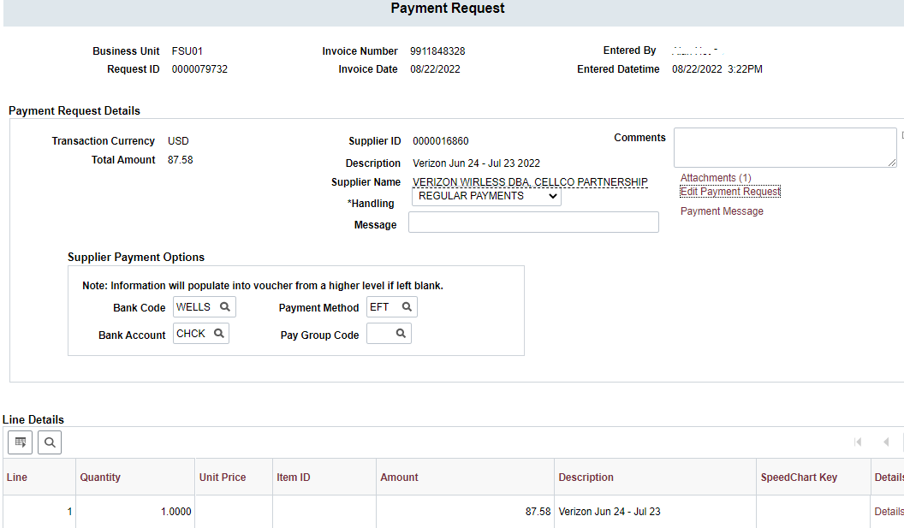

Slide 54
Payment Request (eprf) Criteria
Payment Request Must Include:
PO #
Receipt #
Invoice must Match the PO
Sufficient Funds
Payment Requests not meeting these criteria will be denied and the department will need to work with Procurement Services to obtain a new PO.

Slide 55
New Supplier Portal: PaymentWorks
https://procurement.fsu.edu/PaymentWorks
Training Sessions
This is needed to obtain the PaymentWorks Initiator role.
If you have any questions, please contact the Supplier Relations Team at supplierportal@fsu.edu or x4-6850.

Slide 57
Resources

Slide 58
Helpful Queries
FSU_DPT_AP_ER_CHECKS
Has a check been reconciled/cashed
FSU_DPT_EPRF_LVL1_LVL2_APPR
Payment Request approvers
FSU_PO_LN_RECV_W_NO_VCHR
Receipts created with no Voucher
FSU_DPT_VENDOR_INFO
Details Vendor’s Information includes payment method

Slide 59
Resources
Controller’s Office Website – controller.vpfa.fsu.edu
Financial Policies & Procedures
Other central office websites:
- Procurement Services
- Sponsored Research Administration
- FSU Foundation

Slide 60
Contact Us
Email CTL-AccountsPayable@fsu.edu
Contact us for:
Special handling requests
Payment deadlines
Questions regarding a particular invoice
Do Not Pay Situation

Slide 61
Accounts Payable Contacts
Thomas Donovan - Disbursements Manager
Jasmine Johnson - AP Supervisor
Toia Furr - AP Supervisor
Accounts Payable Directory

Slide 62
Questions?

Slide 63
Interested in knowing more?
Topics not covered:
Spreadsheet Uploads
Cash Advances
Stop Payments

