Slide 1

Travel Expense and Concur
BTTE03
Notes:
New Version 8/2024

Slide 2

Course Outline
Introduction to Travel at FSU
Before the Traveler leaves
When the Traveler returns
Foreign Travel
Non-Travel Reimbursements
Other Common Travel Issues

Slide 3
Recent Travel Updates
Hotel Itemization is no longer required. Still available for itemizing personal expenses on a T-card.
“Is this the last report for this request?” question removed.
Memberships and Abstract Fees can be paid on an ER when purchased in conjunction with Conference Registration.
Other potential changes upcoming. Stay tuned…

Slide 4
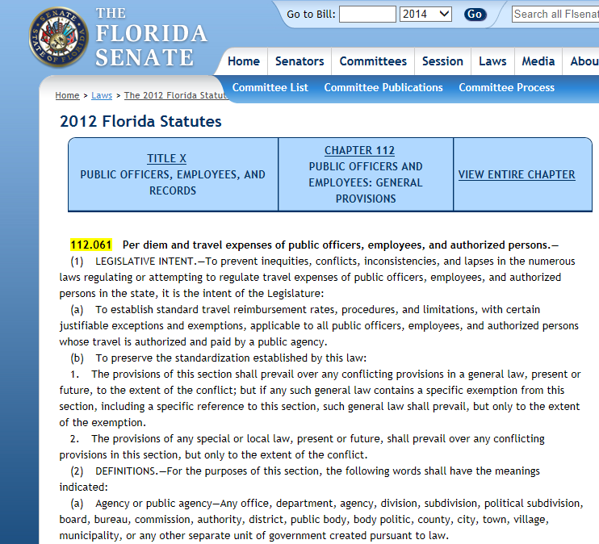
Legal Authority
The payment of travel expenses is governed by:
  Section 112.061 of the Florida statutes
  Chapter 3A-42 of the Florida Administrative Code
  FSU Policy & Procedures

Slide 5
FSU Travel Office Website
Bookmark this site: travel.fsu.edu
FSU Foundation Expenditure Policies & Procedures. (Not in scope of this class)
FSU Research Foundation Policies and Procedures (Not in scope of this class)

Slide 6
Approver Roles & Responsibilities
Default Approver
The traveler’s immediate supervisor in OMNI HR
Acknowledges that a direct report will be out of the office.
Not responsible for budget or policy matters but can consider them, if desired.
Cost Object Approver
Budget Manager or Project Travel Approver
Responsible for budget and policy compliance
Is the expense allowed on this dep’t/fund/project?
Ensures receipts are attached and correct

Slide 7
Florida Travel Basics
Class of Travel determines eligibility for lodging, meals and/or per diem.
Class A Travel
  Continuous travel of more than 24 hours away from headquarters
Class B Travel
  Continuous travel of 24 hours or less involving overnight absence from headquarters
  Class A & B Travel must be more than 50 miles away from headquarters to claim meals & lodging or per diem.
Class C Travel – No meals or per diem allowed (Since FY 02-03)
  Travel for short or day trips not involving overnight stay away from headquarters

Slide 8
Pre-Travel (Before Departure)
Travel Request Always Comes First!
  Who, What, When, Where, Why of the trip
  Only an estimate (limited number of expense types available)
  Notifies Supervisor
  If travel rep is booking with their t-card on behalf of a traveler, both the travel rep and traveler need a request for the trip.
Notes:
Completing a Travel Request before the traveler departs is the most important thing one can do to ensure prompt reimbursement, since a user cannot submit an expense report without an approved travel request.

Slide 9
Pre-Travel, Continued
If traveler needs a t-card, apply and complete online training/test >1 month before trip.
If traveler isn’t an FSU employee and will be reimbursed for out-of-pocket expenses, complete Guest Traveler form.
Travel reps may complete and submit a travel request on behalf of a traveler.
  (Not able to submit Expense Report)

Slide 10
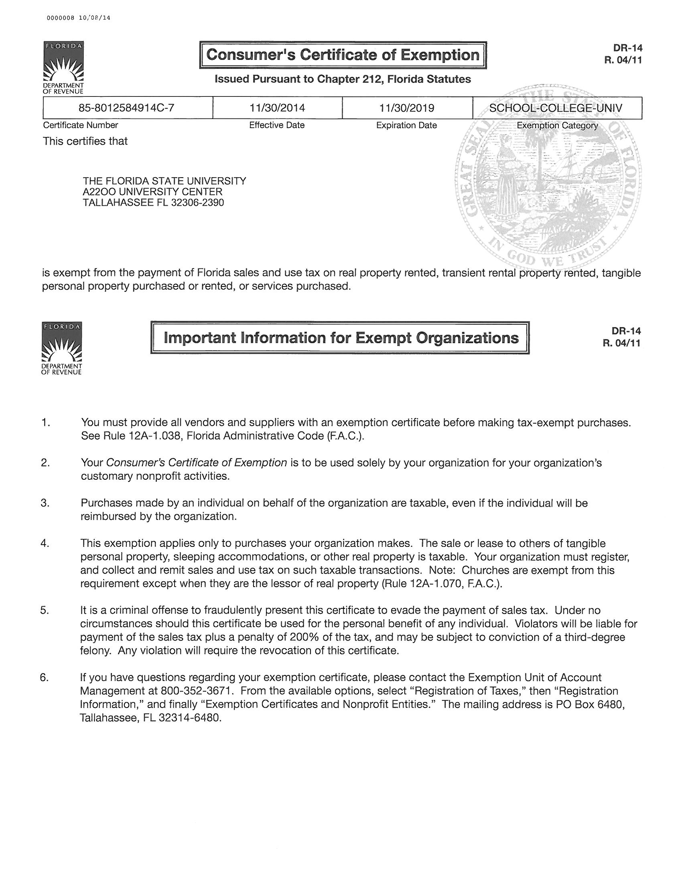
Tax Exempt Status
T-card charges made in the state of Florida are tax exempt.
The most common tax-exempt purchases are lodging and auto rental.

Slide 11
Less than Entitled Documentation
This form applies any time when a traveler receives an amount “less than entitled.” ( Examples: COGS grant, personal car reimbursed at rental rate, department policy, etc)
If meals are claimed when eligible for per diem, the traveler must sign the form which is then retained by the department.
The form needs to be signed by the traveler prior to trip. One for each trip.
Attach the form to the expense report as a receipt or enter comment that the department has it on file.
Notes:
Be sure to attach LTE form or maintain form in department and state on expense report, “Less than Entitled documentation is on file in the department”.

Slide 12
Cash Advance
First, consider if a t-card would be a better option.
Email travel@fsu.edu to enable the traveler to request a cash advance.
For authorized university employees, up to 100% of travel expenses. (Recommend <80%)
Must be for more than $200
Will not be paid out earlier than 15 calendar days prior to first day of travel. Paid through EFT just like payroll.
Approvers approve the cash advance request when they approve the travel request.
Cash Advances must be settled within 10 working days after the employee returns from the trip.
If not settled by 58 days from issuance, it will be sent to Payroll for mandatory settlement (IRS implications).
Notes:
In Concur, a cash advance is settled by creating an expense report from the approved request that contained the cash advance.

Slide 13
“Blanket” Request
For multiple similar trips over a period of time.
One request per traveler, per semester is fine.
Monthly mileage logs are most common use, but there are other scenarios.

Slide 14
Group Travel
Group Travel is only for groups of five (5) or more non-employee travelers.
A group travel roster (with signatures)must be attached to the expense report.
Employees may not be included on a group travel roster.

Slide 15
Booking Travel
FSU has a contract with Collegiate Travel Planners (CTP) for booking Air, Hotel & Rental Cars.
Booking with CTP (in Concur or over the phone) is mandatory for air travel.
FSU Travelers should use most economical means of travel available considering all factors.
Obtain comparisons at time of booking if traveling a non-direct route, adding personal travel or upgrading class of fare.
Notes:
Lodge Card is a method of payment available to all employee travelers. It is maintained by the travel agency. Paying for an airline ticket with the lodge card sends the charge to the traveler’s profile, which can potentially save a travel rep from needing a second travel request and reduce data entry.
Always obtain comparisons at time of booking (particularly for airfare, since ticket prices change frequently).

Slide 16
Air Travel Rules & Booking
Receipts must clearly state passenger name, total amount paid, form of payment, ticket number, destination(s), dates, times and class of fare.
Tickets should be economy class and non-refundable. Business class travel or its equivalent is reimbursable for all segments of trips with at least one segment lasting longer than eight hours.
Trip insurance & seat selection fees are not reimbursable.
Travelers should take the most direct route. Deviations from either the most direct route or travel dates must have a comparison attached for reimbursement.
Travelers are allowed up to two hours before departure and after arrival to leave/return home from the airport.
Notes:
Do not assume 2 hours pre and post flight. Ask travelers what time their trip started (ie left for the airport) and when their trip ended (they got home or back to the office).
Several carriers structure their websites to give the appearance that seat selection fees are mandatory. They are not.

Slide 17
Rental Car Rules and Booking
Avis/Budget, Enterprise/National, and Hertz are contract providers. Renting on contract is required for domestic rentals. Check out Vehicle Rental Matrix on FSU Travel Website for details on each rental contract.
Can be reserved through Concur or direct with the agency.
Compact car only unless there is justifiable upgrade. (Multiple FSU travelers sharing a vehicle, Transporting equipment).
Do not purchase any optional add-ons for domestic rental like toll service, additional fuel service, additional insurance. These are included in our contract.
Do not ask for any other (AAA, SkyMiles, AARP etc) discounts.
Notes:
Justifiable upgrades include carrying equipment and multiple passengers.
If traveler needs to rent off contract, state reason on the expense report (Enterprise didn’t have any cars, etc).

Slide 18
Billing Numbers
A billing number allows a T-card holder to reserve and pay for a car on behalf of another person.
Available with all three rental agencies. Check FSU Rental Vehicle Matrix for information on how to apply.
Do not share a billing number with another traveler or travel rep.
Most common: Avis/Budget billing number, complete the form and email it to floridahelp@avisbudget.com.

Slide 19
Rental Car Fuel
Try to refill the car to the same fuel level as when you picked it up.
Fuel service is already included in all contracts. The rental agency will fuel vehicle on return. Terms are decent for Avis and Hertz, not as good for Enterprise/National.
Do not purchase any other/additional fuel service option.
When completing an expense report with rental vehicle fuel, make sure proof of vehicle rental is attached (receipt) or comment cross referencing the expense report with the rental is entered.
Notes:
Lack of rental agreement or reference to ER with rental is a very common reason for reports to be held up.

Slide 20
Vehicle Rental & T-Cards
Vehicles rented in Florida & on a t-card (or billing number) are tax-exempt. Check your receipts carefully.
It may take up to 14 days for vehicle rental transactions to appear in Available Expenses.
Tolls will appear separately and may take up to 30 days.
Notes:
Due to recent issues between the state of Florida and their toll processor, toll charges have been taking longer than usual to hit travel cards. (August 2018)

Slide 21
Vehicle Rental – Continued
Per State of Florida policy, “neither size nor stature” of a traveler is a valid justification for larger class of vehicle.
For domestic rentals DO NOT book off contract without reaching out to travel@fsu.edu first.
If renting off-contract (International or with an exception for domestic), traveler should purchase collision & comprehensive insurance (but not liability). Include justification in comments.
Notes:
If a traveler incurs damage, they should contact the rental company and FSU Travel.

Slide 22
International Vehicle Rental
FSU has no contract for International rentals.
  Compare the rates among vendors for best price, including insurance, all factors considered.
  Be aware of insurance laws in the country you are renting.
  If possible, consider rideshare as driving in an unfamiliar country can be dangerous.

Slide 23
Conference Reg Do’s & Don’ts
Do not pay/register more than 30 days before the early bird deadline. If no early bird price, do not pay more than 30 days before deadline or start date.
Memberships and abstract fees can be reimbursed/purchased on a T-Card if they are purchased at the same time as a conference registration. Attach a membership justification form as a receipt on the expense report.
Do not pay for t-shirts, tours, golf outings, banquets, etc. on a T-Card. These are not reimbursable expenses.
Registration may be paid
  With a T-Card (contact travel@fsu.edu if card is declined)
  Out of Pocket

Slide 24
T-Card Charges in Concur
All T-Card and Airfare Card charges post in the traveler’s Available Expenses and should be processed in an expense report as soon as possible.
Automated email reminders will send for charges that are in available expenses for 7+ days. The Outstanding T-Card report is posted daily on the travel website under the Concur Reporting link.
Contact travel@fsu.edu for assistance with charges on the profile of a former FSU employee.

Slide 25
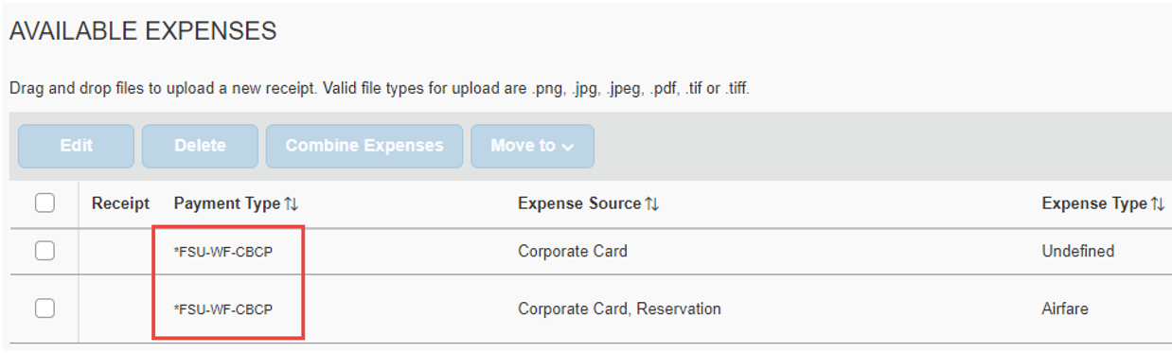
T-Card Charges
Pull these into an expense report once they are posted.
Submit the expense report as soon as possible.

Slide 26
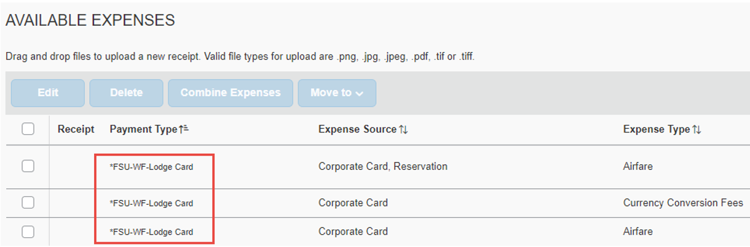
Airfare Card Charges
Pull these into an expense report once they post.
Submit expense report as soon as possible.
Contact Travel Office if these appear to be on the wrong Concur profile.

Slide 27
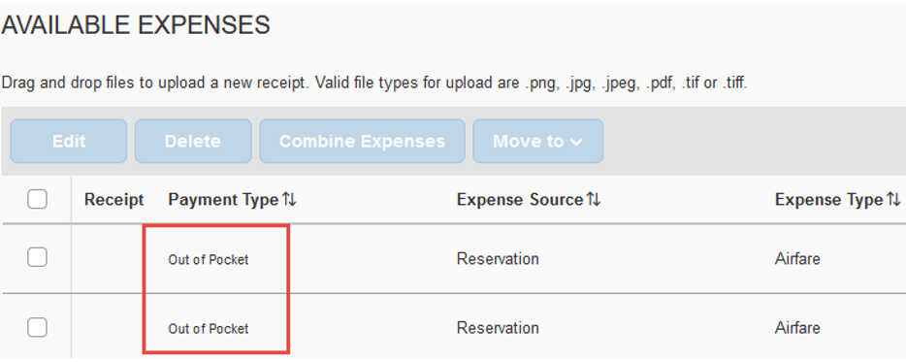
“Reservation” Charges
Delete these by selecting the checkbox and then clicking delete button.
The system will not let you delete actual university card charges.

Slide 28
After the Trip
Determine if Class A, B, or C travel
Create an expense report if one isn’t already started.
Determine if any meals were provided to the traveler

Slide 29
Per Diem or Meals & Lodging?
For each day of Class A&B travel, travelers have two options:
  A per diem of $80/day
  Or
  Actual lodging expense plus daily meal allowance
  Travelers may not receive per diem or meals/lodging for Class C travel.

Slide 30
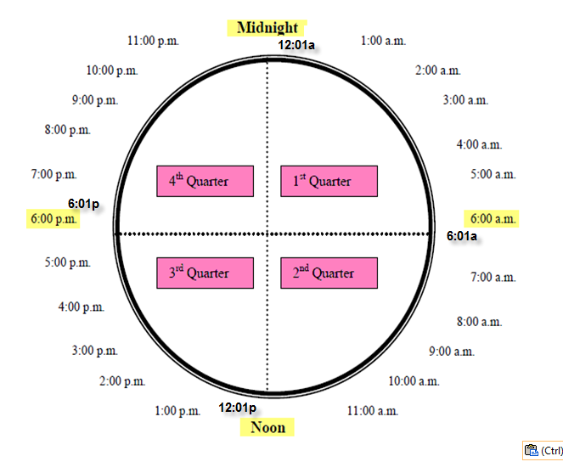
Determining Per Diem Amount Due
Each day is broken into 4 quarters
Traveler may receive $20.00 for each quarter of the day that they are in travel status
Notes:
List a few examples.

Slide 31
Meal Allowance
Determined by Concur itinerary for employee travelers.
Guest travelers use Guest Daily Meal Allowance expense type. Enter a comment detailing which meals are being reimbursed.
Domestic Meal Rates:
  Breakfast - $6 - Travel must begin at 5:59 AM or earlier and extend to 8:01 AM or later
  Lunch - $11 - Travel must begin at 11:59 AM or earlier and extend beyond to 2:01 PM or later
  Dinner - $19 - Travel must begin at 5:59 PM or earlier and extend to 8:01 PM or later

Slide 32
Meal Eligibility
Concur defaults to pay all meals for each day of itinerary.
To exclude a meal, check the specific meal check box.
If you are claiming per diem for the last day, be sure to exclude all the meals for that day.
Meals provided by airlines are not excluded from the Traveler’s meal allowance or per diem.
Meals provided by a hotel (to all occupants – not just conference attendees) are not excluded from the Traveler’s meal allowance or per diem.
If a hotel meal is provided to conference attendees only it is excluded.

Slide 33



Meals & Conference Travel
Attach “Schedule-at-a-glance” or portion of conference schedule showing meals.
Use comments to clarify when the schedule is unclear if a meal was provided.
Traveler may not claim a meal allowance if meals were included in registration fee paid by the University; this applies even if traveler decides not to eat the meals (exception is an ADA accommodation)
  A continental breakfast is considered a meal
  A reception is not considered a meal but a banquet is.
What about brunch?
  If start time is between 8:30-10:30: Breakfast
  If start time is between 10:30-12:00: Lunch
Notes:
Example comments, “No meals were provided by this conference.” “Lunch provided on *date*.” etc

Slide 34
Entering an Itinerary
Don’t click “Import itinerary” unless you adjust departure/arrival times to the time the traveler left/arrived at home.
If it’s a foreign trip, on return, be sure to enter all legs of the trip in order to ensure correct meal amounts.
A step-by-step guide to itineraries is located in the Concur User Guide.
Notes:
Cut to Concur to demo creating an itinerary.

Slide 35
Mileage
If traveler uses personal vehicle, traveler will be reimbursed for mileage at 44.5 cents per mile for miles related to University business.
Mileage – Use the tool to calculate mileage. The “Personal” check box excludes those miles from reimbursement.
Documented Miles requires a mileage log be attached as a receipt.
Notes:
Passengers in a car are not eligible to receive mileage.

Slide 36
Tolls
Tolls under $30 per occurrence and paid out of pocket do not require a receipt.
If the traveler (or department) owns a SunPass transponder, they may use it in a rental vehicle. Attach the receipt.
Rental Companies use a plate recognition system included in our contracts.
Optional toll service can only be reimbursed if you document cost savings on all tolls.
Questions about toll charges and inquiries can be directed to the rental agency or www.htallc.com or (877) 765-5201

Slide 37
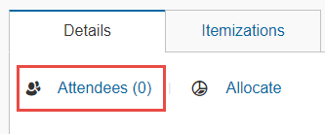
Attendees
Recommended when one employee makes a purchase on behalf of another.
Search for the name you wish to add & click “Add to Expense”.
If name is not available (ie, for a guest), you can add it.
Notes:
Attendees are very important and a big improvement in trip transparency.

Slide 38
Lodging
Lodging requires an itemized receipt showing charge to credit card and/or $0 balance.
If two university travelers share a hotel room, cross-reference ER numbers in the comments.
When sharing a room and splitting the charges, get the hotel to split the charge. FSU can only reimburse the traveler paying the expense.

Slide 39
Common Lodging Justifications & Comments
Justification dropdown field required for all lodging. Explanation needed if rate exceeds $225/night (before tax & fees.) “Base rate under $225” is one of the drop-down options.
If trip type is conference/convention, state in comments if conference was presented/sponsored by a state of Florida agency, university or the judicial branch.
    If it was, base rate may not exceed $225/night on funds 1xx, 2xx, 510, 520, 521, 523, 524, 530, 531, 540, 546 & 552.
See FSU Travel Website for more information on state-sponsored conferences and lodging.

Slide 40
Hotels & T-Cards
Book through Concur
  Compare rates vs. conference rates. FSU ID needed to book state government rate.
Booking Directly with Hotel
  Put personal card on file at front desk for any incidental purchases like room service/food.
  Upon departure – review bill for accuracy.
Booking online - using Third Party websites (Orbitz, Hotwire, Priceline)
  DO NOT BOOK. There is no benefit to these sites.
  These sites often cause issues by referring traveler to the hotel who will state they cannot make changes and refer back to the third party site.
  Entire lodging amount is prepaid
  All taxes are paid when booking through these sites
  Difficult to change or cancel these reservations. They have a bad refund policy.
Notes:
Concur can only provide publicly available rates. If department has negotiated a rate directly with a hotel, or there is a conference rate, book directly with the hotel.

Slide 41
Incidental Expenses
All T-card charges except agent/booking fee & currency conversion fee require a receipt.
Tolls, taxis, shuttles, baggage fees, & parking do not require a receipt when paid out of pocket and are under $30 per occurrence.
Notes:
When mandatory valet fees show up on a hotel bill and are >$1, be sure to state in comments that “Valet parking was mandatory at hotel”.

Slide 42
Incidental Expenses Receipt Required
Internet/Wifi fees – these require a comment justifying that it is for business use only.
Passport, Visa, Mandatory Vaccines/Tests – for business purposes only.
Laundry – for more than 7 consecutive days of travel only. Include itemized receipt.
Notes:
When submitting receipts for mandatory vaccines, state in comments that vaccines are mandatory for entry into the country. Be careful to not attach anything that contains personal medical information.

Slide 43
Tipping
FSU reimburses a maximum of 20% for taxi/rideshare tips.
  If expense is on T-Card, itemize any amount over 20% as expense type “Personal – Non-reimbursable”.
  If the expense is out-of-pocket, reduce any overage amount to reflect the 20% maximum tip rate.

Slide 44
Personal Expenses
If paid out of pocket, reduce amount of reimbursement to exclude personal expenses.
If on a T-Card, itemize as personal-non reimbursable.
If there is not enough out-of-pocket reimbursement to net out against the personal expense, an expense refund will need to be processed.

Slide 45
Expense Refunds
Reimbursement to the university should be done via check, cash, or money order. The department will be responsible for completing the Departmental Deposit form in the Office of Student Finance Deposit Drop-box.
This should be completed at the same time you submit the expense report. The Travel Team will verify the deposit before approving the report.

Slide 46
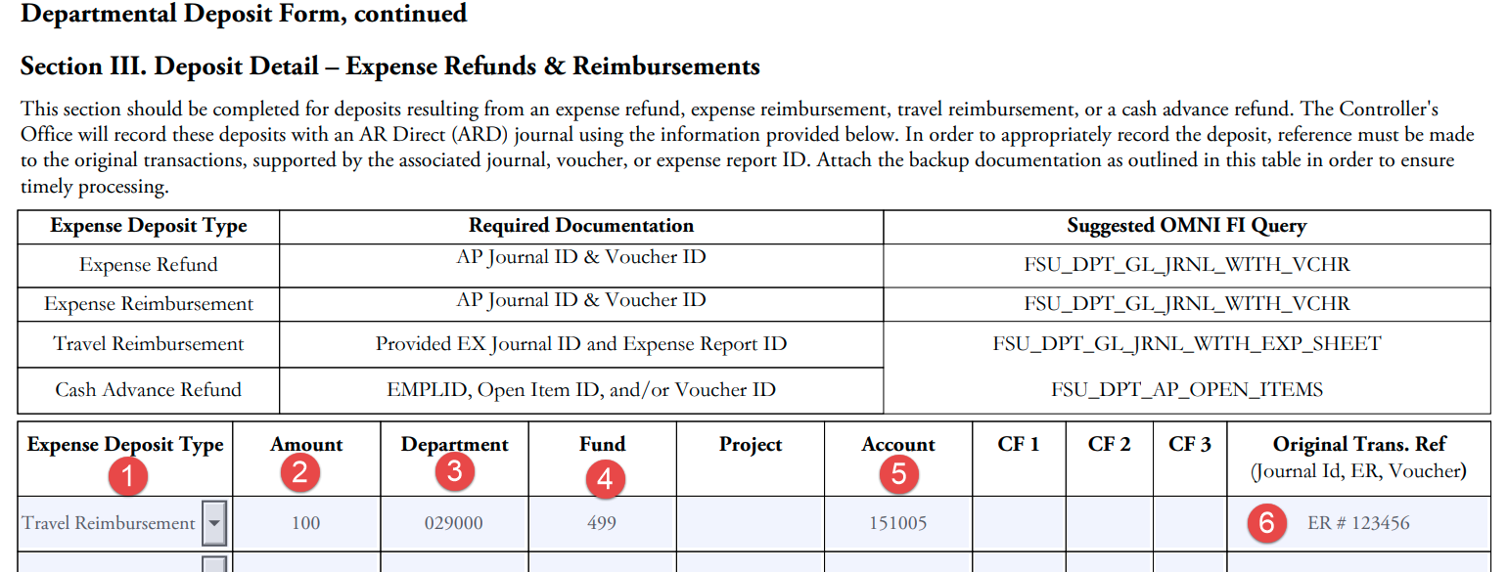
Departmental Deposit Form
Home Department ID, Fund 499, Account Code 151005 – ER#

Slide 47
Travelers with Disabilities
When a traveler with a disability incurs travel expenses in excess of those ordinarily authorized, and the excess travel expenses were incurred to permit the safe travel of that disabled traveler, those excess expenses will be reimbursed to the extent that the expenses were reasonable and necessary to the safe travel of that individual.
Individual must have documented disability with Travel Office by way of Human Resources.
Notes:
FSU Travel only needs the document from HR stating the reasonable accommodations. Do not attach anything with personal medical information.

Slide 48
Foreign Travel
Travel requests must be in place before trip! In addition, travelers should:
  Complete International Travel Attestation.
  Verify country is not on List of State Sponsors of Terrorism (Cuba, Iran, Syria, North Korea)
  Download Concur Mobile & TripIt Pro
  Review Travel Warnings & Alerts
Review Student Travel Policies or Faculty/Staff Travel Policies.
Notes:
TripIt Pro is particularly helpful for foreign travel. Both Concur Connected Apps work anywhere there’s wifi.

Slide 49
Foreign Travel
Know max foreign lodging rates when booking hotel. (Check Department of State Website)
FSU reimburses actual incidental amounts for both domestic and foreign travel, not the incidental allowance.
Meal rates are loaded into Concur and are determined based on locations given in itinerary.
Receipt rules and requirements apply to foreign lodging receipts. Be sure receipt is correct at checkout. Working out a refund/correction is extremely difficult once traveler leaves.
Per diem rate is the same as domestic ($80/day).
Notes:
If meal rates appear incorrect, first check city spelling. If still incorrect, please email ctl-travel@fsu.edu

Slide 50
Currency Conversion
Concur determines currency conversion based on transaction location and date.
If a transaction was made in USD in a foreign country, user can change currency type to USD on that expense line.
If amount charged to credit card differs from Concur-determined amount, change the amount on expense line and attach redacted credit card statement for backup.

Slide 51
A Note on Foreign Meals
Foreign meal allowance is paid based on “where the traveler lays their head at night”.
At takeoff, traveler is on foreign meals.
At takeoff upon return, traveler is back on domestic meals (or per diem for last day of travel).
Concur requires a USA-to-USA line on the itinerary to revert back to domestic meals.
Notes:
*Particularly important for Foundation reimbursements, since Foundation doesn’t pay per diem on last day of travel.

Slide 52
Non-Travel Expenses
To be used in emergency situations or for virtual conferences only when using university funds.
Can be mixed in with travel expenses. Change trip type on the non-travel expense line to “Non-Travel Only.”
Be sure the expense is allowable on a given funding source.
If entire expense report is non-travel expenses, no request is necessary. Be sure to choose “Non-Travel” for Trip Type, Report/Trip Purpose and Benefit to University fields.
Notes:
A single expense report can contain t-card, out of pocket travel and non-travel expenses. If all lines are on the same traveler’s profile for the same trip, they can go on one report.

Slide 53
Split Funding (Allocations)
Only allocate the travel request if absolutely necessary.
In the expense report, enter all expense lines and then allocate. Split funding should be the last step.
Can allocate by percentage or dollar amount, Dollar amounts will convert to percentages when clicking “Save”.
Notes:
Approvers can add, change or remove allocations. If an approver adds an allocation that they are not the budget manager for, the report will go to that budget manager for approval.

Slide 54
Missing Receipt Declaration
Available for all expense types except Lodging, Rental Car, & Airfare.
Traveler must create the affidavit in Concur. Delegate cannot create it on their behalf.
In the expense report, navigate to Manage Receipts -> Missing Receipt Declaration to create.
Delete any attachment already uploaded as a receipt for that expense to allow it to show up.

Slide 55
Order of Operations
Obtain Guest Traveler ID Number (for guest reimbursements only)
Travel Request
Book trip (flight, hotel, car, conference reg, etc)
Start expense report as charges arrive
Go on trip, return home.
Create itinerary for meals, add per diem and incidental expenses.
Ensure all receipts are correct & clarifying comments added.
Traveler submits expense report.
This is best practice, but sometimes multiple reports are necessary.

Slide 56
Comments
Comments are especially important on expense reports. These help the travel team know what happened when reviewing reports.
Spell out the conference name, acronyms can be confusing.
Note if the conference is virtual.
Note Meals provided/not provided, especially when it is unclear from the conference schedule/agenda.
Rental car justifications.
Anything that deviates from the norm. State what you/the traveler did and why.

Slide 57
When a Report is Sent Back for Revision
Fixing the ER for traveler to resubmit is top priority.
Read comments and make requested changes or add documentation.
Contact the auditor who sent it back for clarification if needed.
Contact traveler for additional information or documentation.
Notes:
Communication is key for getting expense reports resubmitted and approved in a timely manner.
Email is the preferred method of contact.

Slide 58
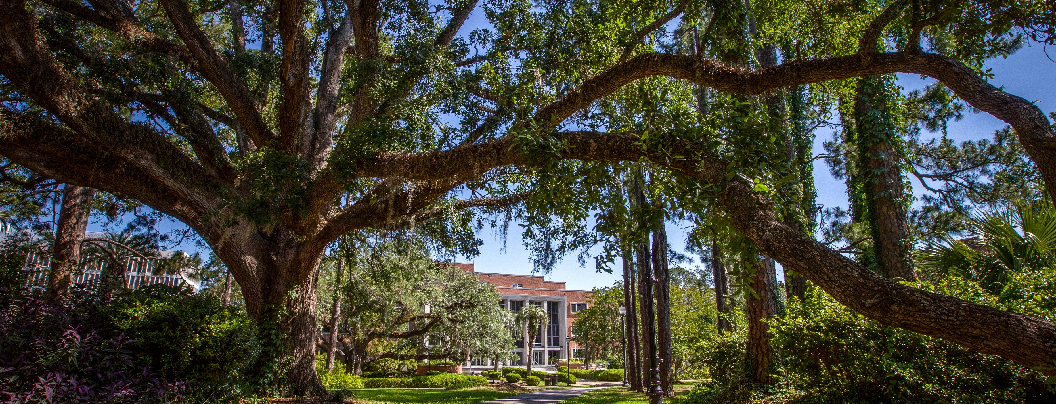
RESOURCES

Slide 59
Further Assistance
FSU Travel Website
One-on-One Concur User Training (calendar on FSU Concur Website)
Detailed Concur User Guide
Email travel@fsu.edu
Notes:
Use all the resources available to you. We are happy to help!

Slide 60
Demonstration Portion
FSU Travel Website
One-on-One Concur User Training (calendar on FSU Concur Website)
Detailed Concur User Guide
Email travel@fsu.edu

Slide 61
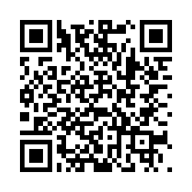
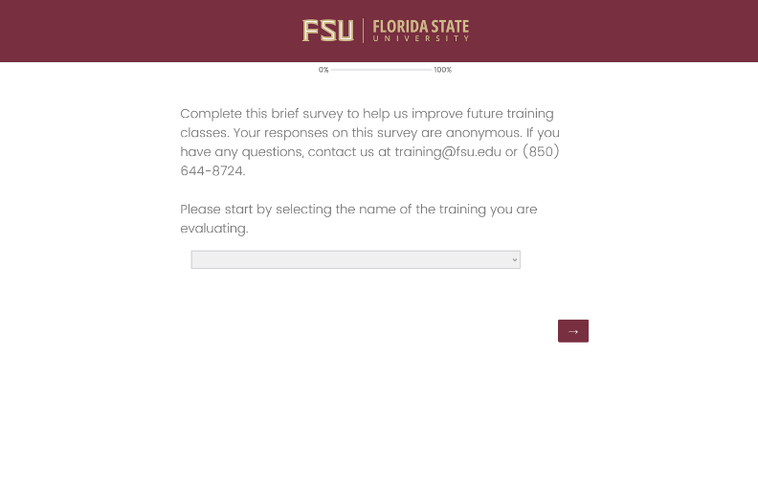
We want
your feedback!
1: Scan the QR Code
2: Visit fla.st/23SBS9WQ
Note: Make sure to select Travel Expense and Concur in the survey drop-down!

Slide 62
Thank You!

