Slide 1
Transcepta Review
3/7/2024

Slide 2
Overview
Payment Process w/ Transcepta
Connected Suppliers vs. AnyInvoices
Voucher Review
Helpful Queries
Document Management (OnBase) Review
Accounts Payable Contacts

Slide 3
Requisition -Spearmart
Purchase Order – Spearmart
Goods/Services are delivered/completed and are inspected by the department
Pay-cycles creates the payment to the Vendor
Payment Process w/
Transcepta
Departments check the
exception query in OMNI
Department creates a receipt in OMNI
OMNI automatically creates the Voucher.
Invoices are sent directly to OMNI from Transcepta or via CXML

Slide 4
Connected Suppliers
Advanced Business Systems
Airgas USA, LLC - South Division
American Servco Inc.
Aramark - Collegiate Hospitality
Astro Travel and Tours, Inc.
Brooks Building Solution
Cintas Corp NO. 2
Complete Book & Media Supply, Inc.
Dell Marketing LP
Eli Roberts & Sons Inc.
Full Press Apparel, Inc.
GRAYBAR
Henry Schein Inc.
Hicks Heating And Air
McMaster-Carr Supply Company -
Medline Industries, LP
Trane
W.W. Grainger Inc.
More to come….

Slide 5
Connected Suppliers
3 Options to submit invoices through Transcepta
EDI
Email PDF
PO Flip
Payment Terms will remain the same.
Vouchers will be created automatically once the invoice has been validated by Transcepta

Slide 6
AnyInvoice
These are invoices sent directly to Transcepta by Accounts Payable
Accounts Payable reviews each invoice in Transcepta
Transcepta sends the file to OMNI where each invoice is loaded into OnBase/DocMGT in Complete Status

Slide 7
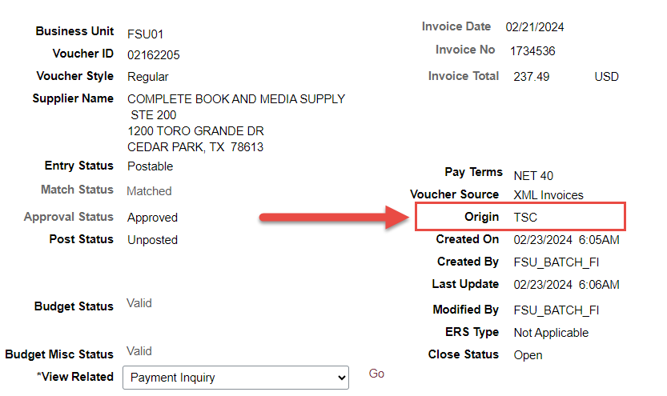
Voucher Review

Slide 8
Voucher Review

Slide 9
Helpful Queries
FSU_CTRL_AP_NO_RECEIPT_EXCEPT
FSU_CTRL_AP_TSC_INV

Slide 10
Example

Slide 11
Under $1K- Force Receipt
Over $1K- Email Notification
All items under $1K will be forced after 10 days of receiving the invoice in OnBase if the department has not done so already.
An Email Notification will be sent to Budget Managers and the PO Requestor for invoices over $1K.
If the department has not received the item(s) or there are issues with the item(s), please contact CTL-AccountsPayable@fsu.edu.

Slide 12
DocMGT (OnBase)

Slide 13
DocMGT (OnBase)

Slide 14
Accounts Payable Contacts
CTL-Accountspayable@fsu.edu
Special Handling Request
Payment Inquires
CTL-Invoices@fsu.edu
Invoice submission Only

Slide 15
Accounts Payable Contacts
Accounts Payable Directory | Controller's Office (fsu.edu)
Encumbered Payments | Controller's Office (fsu.edu)

Slide 16
Accounts Payable Contacts

Slide 17
Questions

