Slide 1
Financial Representative Meeting
April 18, 2019

Slide 2
Overview
Research Administration Management Portal (RAMP) – Office of Research
Fiscal Year End & Contracts– Procurement Services
Departmental Deposit Updates
AR/Billing Updates
Disbursement Services Updates
Unrelated Business Income & Sales Tax – Controller’s Office
OMNI FI Upgrade – Quality Assurance

Slide 3
Research Administration Management Portal
Office of Research

Slide 4
Agenda
Project Overview & Timeline
RAMP Modules
What You Need to Know
Training
Accessing RAMP
How You Can Be Involved
Project Resources & Contacts

Slide 5

Project Overview
One comprehensive and integrated system for research administration
Electronic proposal development and submission and system-to-system submission (where available by sponsor)
Electronic process for the development, submission and review of IRB and ACUC protocols

Slide 6
Project Overview
Tools for the management of subcontracts, contract negotiations and export controls
Increases administrators’ and reviewers’ ability to support their part of the research enterprise
Transparency within the workflow process while creating efficiencies
Generates reports for compliance and turnaround time

Slide 7
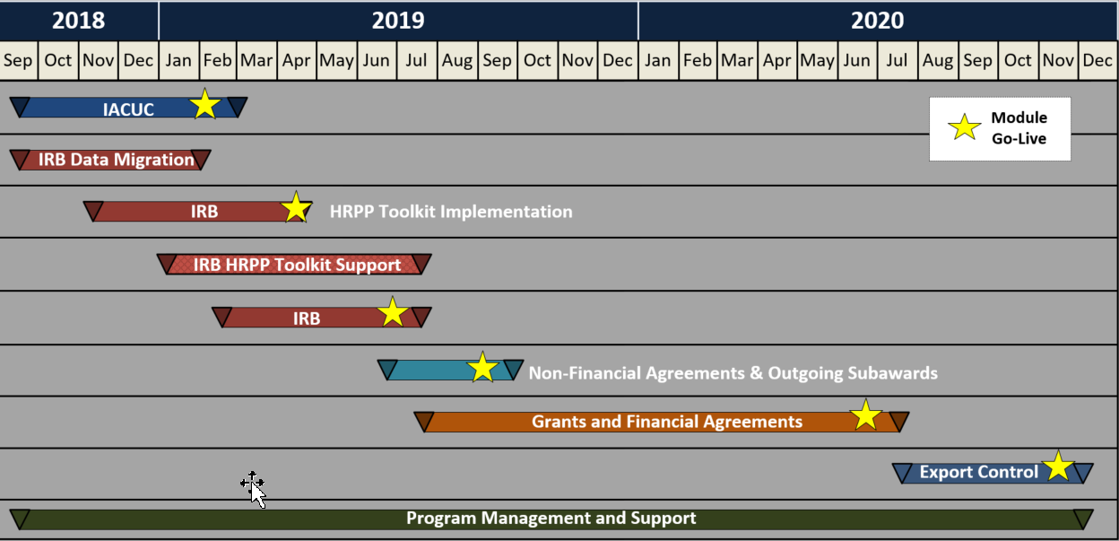
Implementation Timeline

Slide 8
Animal Care & Use Committee (ACUC) Module
Provides for electronic process for development, submission & review of protocols
Allows for transparency of review process
Ability to maintain a library of substances and procedures
Provides integration with AALAS for training records
Furnishes notifications to research teams when necessary

Slide 9
What You Need to Know
ACUC Module
Launched in January 2019
Amendments to existing protocols require current forms until a triennial rewrite is entered into RAMP

Slide 10
Human Research Protection Program (HRPP) Toolkit
Provides standard operating procedures, checklists, and worksheets
Provides protocol and consent templates
Includes an Investigator Manual

Slide 11
Institutional Review Board (IRB) Module
Electronic creation and review of human subject protocols, amendments and Reportable New Information
E-mail notifications to prompt PIs for action items and notifications of protocol determinations
Integration with CITI for training data
Assignment of proxies by PIs to develop and submit protocols

Slide 12
IRB Timeline

Slide 13
IRB Module
Two Rollouts
 | Effective Date
HRPP Toolkit | April 20
RAMP IRB Module | June 21

Slide 14
What You Need to Know
Beginning April 20, all new protocols and continuing reviews will require the submission of the new HRPP (toolkit) protocol document
New forms, old system - use the new forms and submit within the current HSRS system
Protocol modifications – user will have option to continue with current application process or submit using the new toolkit protocol template in HSRS

Slide 15
What You Need to Know
Once the RAMP IRB module goes live on June 21, expect the following:
New forms, new system
All submissions updated using the toolkit will automatically be imported into RAMP
Any submissions that have not been updated using the toolkit will not be imported into RAMP
Modifications or continuing reviews for these non-toolkit submissions will require a new submission in RAMP using the toolkit templates

Slide 16
Training
ACUC Module
Protocol Development Workshops were offered in January and February to assist with the transition to RAMP
For assistance with protocol development, please contact a LAR veterinarian
For assistance completing the SmartForm or for technical assistance with RAMP, please email ramp-acuc@fsu.edu
RAMP ACUC Researcher’s Guide is available within the RAMP Help Center

Slide 17
Training
HRPP Toolkit
Protocol Development Workshops were offered in March and early April to provide guidance on using the new templates
Webinars are available on the Office of Human Subjects website; Investigator Manual will be posted soon
RAMP IRB Module
Workshops will be offered in May and June to assist with transition
to RAMP

Slide 18
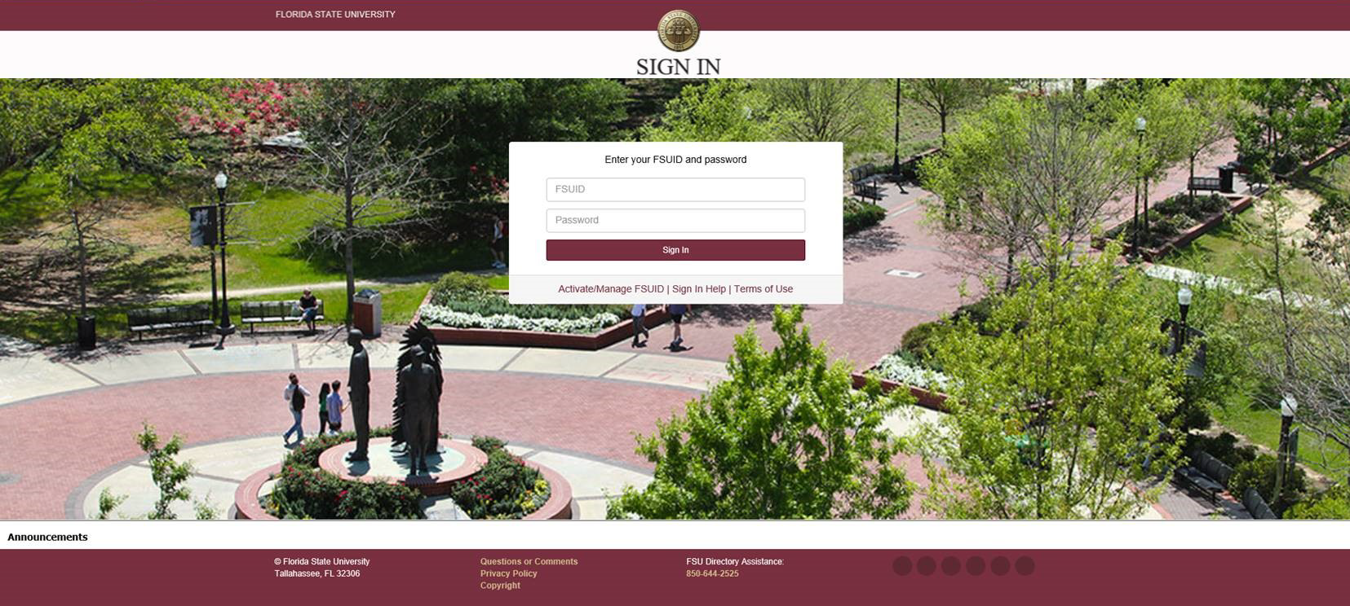
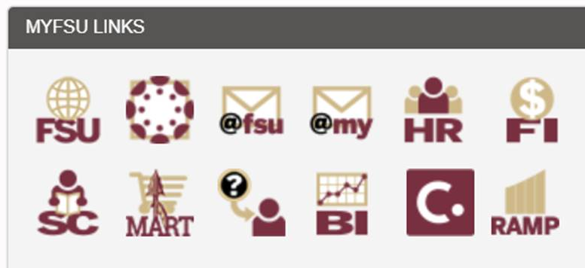
Accessing RAMP
1. myFSU portal – click on RAMP icon

Slide 19
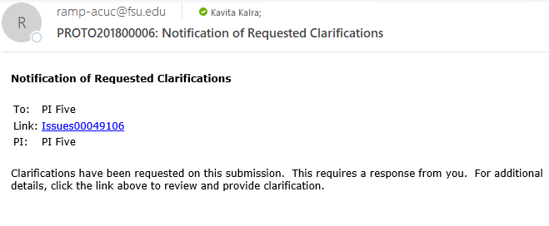
Accessing RAMP
  Visit https://myramp.research.fsu.edu
  Click on a link from an auto-generated email from RAMP

Slide 20

How You Can Be Involved
Project Champions are critical to the success of this project!
Your expertise and knowledge is needed.
For more information, contact Angie Rowe

Slide 21
Project Resources & Contacts
RAMP Project website: https://ramp.research.fsu.edu
Laboratory Animal Resources website: https://lar.fsu.edu
Human Subjects Research website: https://www.research.fsu.edu/research-offices/human-subjects/
Project Contacts:
  Angie Rowe, Project Manager, 644-8659, arrowe@fsu.edu
  Kerry Peluso, Assistant VP, 644-8664, kpeluso@fsu.edu

Slide 22
Year End Process Updates
Procurement Services

Slide 23
Fiscal Year End and Expiring Contracts
Plan needs well in advance
Involve Procurement Services in the planning stage

Slide 24
Helpful Tips – Reviewing POs and Statuses
Submit change orders in SpearMart to close any POs
Submit Excel Spreadsheets for multiple closings (include supplier names and attach to a change order form request in SpearMart)
Use this query: FSU_PO_AMT_BY_DEPTID_DATERANGE

Slide 25
Helpful Tips - Contracts
Notify Procurement at least 75 days prior to contract expirations or renewals
Contracts may require competition, analysis, contract review/approval and PO processing
Define specifications, requirements essential to the purchase

Slide 26
POs Qualified to Roll
Must be in dispatched status and successfully budget checked
Must not have a receipt imbalance (Qty or Amt) with a voucher
Must have a encumbrance balance greater than zero
Must not have open distribution lines with closed project chartfields
Must not be fully received and fully matched

Slide 27
These POs will not Roll
PO status cancelled, complete, or in-process
PO on Hold
Not successfully Budget Checked (budget check other than “valid”)
Fully Vouchered
Partially vouchered receipt
POs whose project is closed and project’s commitment control budget is closed
POs with generic entries (i.e. whose commitment control ledger needed to be corrected by entering a generic budget journal to correct the budget totals)

Slide 28
Guidelines effective 3/1/2019
FY19 Blanket POs will be closed by 8/31/2019
Blanket Change Orders will be limited to one (1) Change Order per fiscal year
Due date required on requisitions for FY20
Any PO with remaining encumbrance below $100 and last activity date greater than sixty (60) days will be closed

Slide 29
End of Year Calendar Tasks
5/3/2019 – Last day to submit requisitions exceeding $75,000 or require internal or external approvals. Requisitions received after 5/4/2019 may not be processed in this FY.
5/31/2019 – Last day to have fully completed P-card application and training to ensure receipt of card before year end.
6/7/2019 – Last day to enter requisitions over $10,000 and under $75,000 that require quoting and internal approvals.
6/21/2019 – Requisitions and Change Order requests not in approved status by 5:00pm will be cancelled.

Slide 30
6/24/2019 – Pre-entry window opens for FY20 requisitions.
6/26/2019 – Pre-entry window for FY20 requisitions ends by 5:00pm.
6/26/2019 – Last day Procurement will process approved FY19 requisitions to purchase orders that were approved by 6/21/19.
7/1/2019 – Procurement to resume normal processing of all SpearMart POs including change orders AND Departments can begin submitting requisitions.
8/31/2019 - FY19 Blanket PO’s will be closed unless departments specify that they be closed prior to that date.

Slide 31
Year End Calendar
Deadlines stating “Last Day” refer to the last day in which we may be able to guarantee processing in FY19. You may be able to submit requisitions for any amount through 6/21/19, but there is no guarantee that they will be processed.
For critical needs contact Procurement Services

Slide 32
Year End Calendar - Additional Information
Entire Fiscal Year Calendar location: Controller’s Website https://controller.vpfa.fsu.edu/
Procurement Calendar Dates, Available Queries, FAQs and Contact Information: Procurement Website https://procurement.fsu.edu/
Dates are subject to change. Review frequently.

Slide 33
Contact Information
Questions?
Karen Gibson
  kgibson@fsu.edu
  644-9729
  https://procurement.fsu.edu/

Slide 34
Contract Administration Program Overview
Procurement Services

Slide 35
Contract Administration System (SpearMart)
Will act as the sole repository for contracts (excluding grant awards, sub recipient agreements and personnel contracts)
Implemented and currently rolling out University-wide
Will automate the authoring and routing processes for approvals and signatures
Creates audit trail and integrates with DocuSign

Slide 36
Contract Administration System (SpearMart)
Timeline
  Hoping to implement fully by the end of the calendar year
  Phase II will begin after full implementation and will include Contract Management activities (post execution)

Slide 37
Contract Administration Program Process
Three Phases:
  Draft and Review Phase (Post Procurement)
  Approval Phase
  Signature Phase

Slide 38
Contract Administration Program Process
Draft and Review Phase:
  All terms are negotiated or if formally procured, already negotiated
  Anyone that will approve or sign should also review for feedback
  If goods and services, should be facilitated by Procurement Services

Slide 39
Contract Administration Program Process
Approval Phase:
  Approvals are obtained based on policy
  Contract Type and Other Filters drive approvals in the contract module
  Legal, Procurement Services, OBS, Controller’s Office, ITS, Sponsored Research, are all examples of possible approvals

Slide 40
Contract Administration Program Process
Signature Phase:
  Signatures are currently based on Powers of Attorney, managed jointly with Legal and Procurement Services
  Draft Signature Authority policy is being reviewed and current process will be streamlined

Slide 41
Contact Information
Casey Laurienzo
  Contract Administrator
  Office of Procurement Services
  claurienzo@fsu.edu
  850-645-2789

Slide 42
Departmental Deposit & AR/Billing Updates

Slide 43
Reviewing Deposit Backup
Starting with Journal
Identify Payment ID
Retrieve Attachments
Starting from BI
Click link on any transaction report

Slide 44
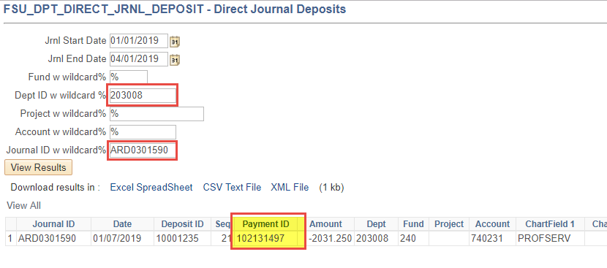
Deposit Backup: From Journal

Slide 45
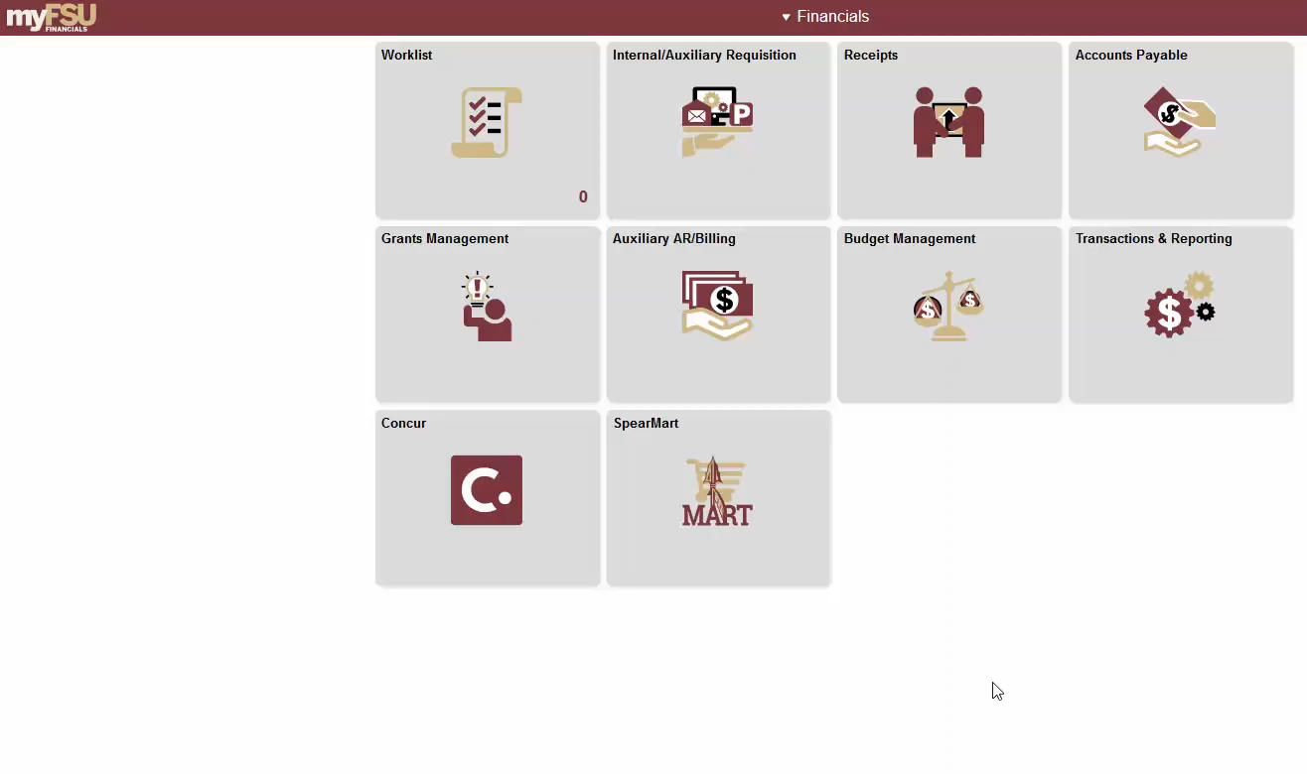
Deposit Backup: From Journal
Role needed: FSU_AUX_AR_RECON Job Aid: https://fla.st/2U9lNFt

Slide 46
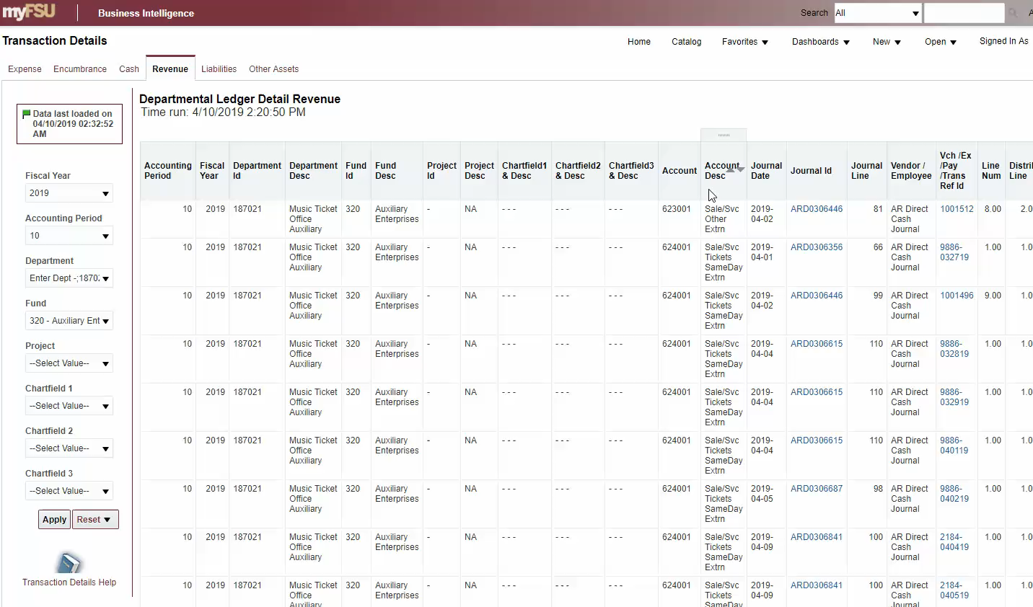
Deposit Backup: From BI
Role needed: FSU_AUX_AR_RECON Job Aid: https://fla.st/2U9lNFt

Slide 47
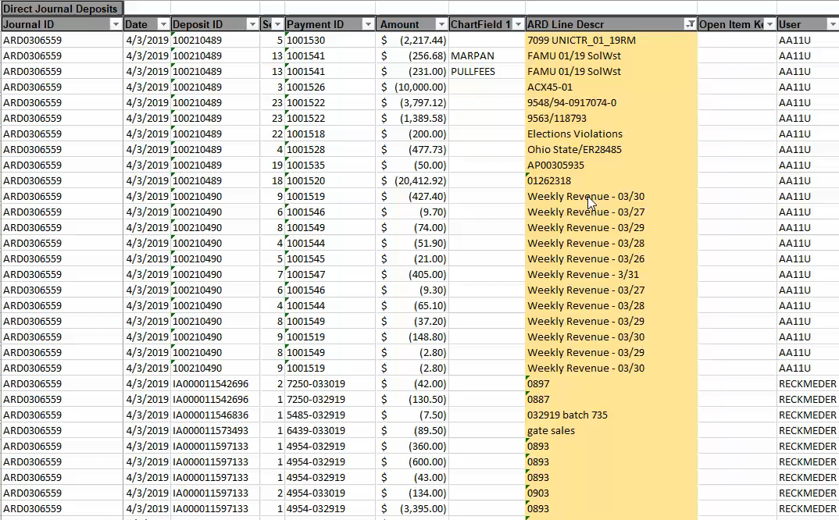
A New Day(ta) Element: ARD Line Descr

Slide 48
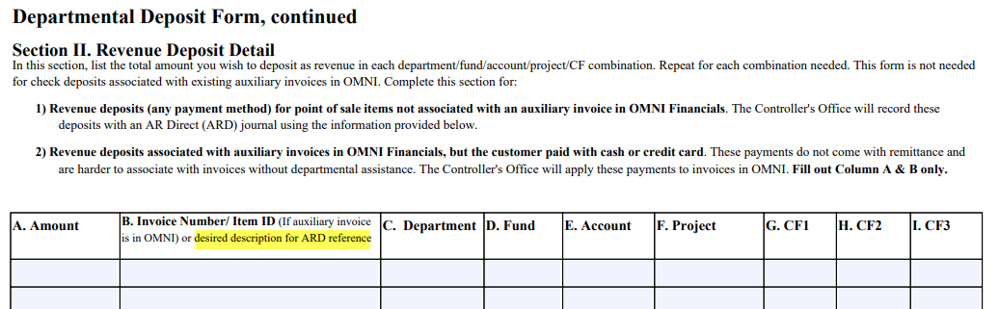
A New Day(ta) Element: ARD Line Descr

Slide 49
Questions?
Departmental Deposit Website (https://fla.st/2G739ZM)
Cashiers - payment delivery, receipts, dropbox
  Mary Eichler, Cashiering Coordinator
  meichler@fsu.edu | 644-9030
Deposit Accounting - EFT/ACH, direct journals (ARDs), accounting
  Edward Burke, Revenue Accounting Coordinator
  ctl-deposits@fsu.edu
  eeburke@fsu.edu | 644-9444

Slide 50

New Training Course!
“Understanding Internal Billing”
May 21st, 8:30am (more to be scheduled)

Slide 51
Identify an internal auxiliary bill
State why an internal purchase order (PO) is required and the purpose it serves (what it does)
Explain how and when auxiliary billing impacts you
Describe how to manage an internal purchase order throughout the fiscal year
Locate resources available for Departments to research billing and payment questions
Course Objectives

Slide 52
Auxiliary AR/Billing Project Update
More than halfway through implementation
Bringing on additional auxiliaries May 1st
  FSU Athletics
    (Selling departments range including 006% - 008%)
  FCRR Quantitative Methodology & Innovation (QMI)
    (Selling department 286002)
  Department of Urban Regional Planning (Mark & Marianne Barnebey Planning Lab & Studio)
    (Selling department 167001)
  Jim Moran Building
    (Selling department 625111)
Next cohort go-live scheduled for Fall 2019 – stay tuned!

Slide 53
Year End & Internal, Auxiliary POs
Internal, Auxiliary POs will be closed at the end of June
  A new exception: POs on sponsored projects with end dates close to year-end will be rolled this year for the first time – stay tuned for more information
Enter internal requisitions during the pre-entry window (tentatively scheduled for 6/24-6/26)
Remember: if you are changing budgets for a pending or ongoing charge at year-end, notify the selling auxiliary
  For example: 110 to 140 or new project IDs

Slide 54
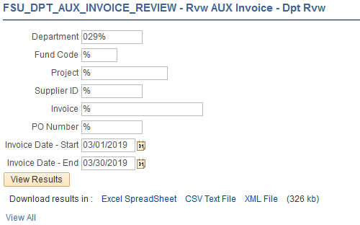
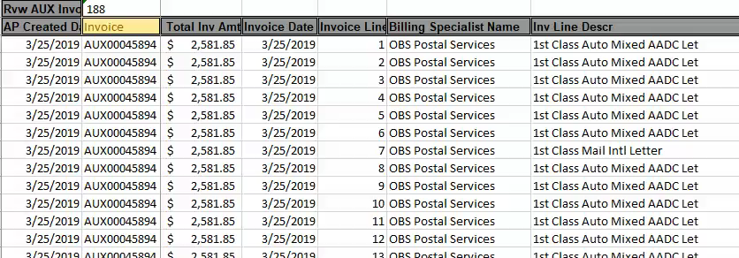
What have I been billed?
FSU_DPT_AUX_INVOICE_REVIEW

Slide 55
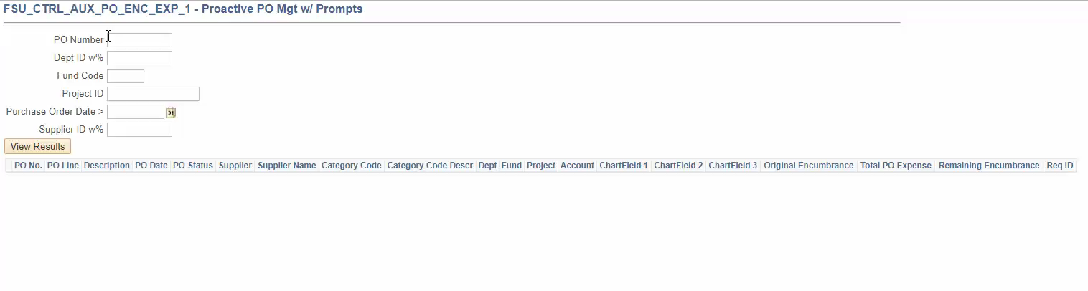
Internal Auxiliary POs: One-stop-shop
FSU_CTRL_AUX_PO_ENC_EXP_1

Slide 56
Contact Information
Questions?
Cassandra Rayne Gross
  ctl-auxiliaryaccounting@fsu.edu | crayne@fsu.edu
  644-1824

Slide 57
Disbursement Services Updates

Slide 58
Disbursement Services
Welcome to new staff:
Arnold Brown – Vendor Team Manager
Kathleen Hollingsworth – AP Manager
Thomas Donovan – Imaging/Payment Manager

Slide 59
Coming Soon – May 2019
  Check pick-up will move to Disbursement Services – UCA 5607
  Expanded Check pick up time:
  9 am – 4 pm

Slide 60
Personal Expense Reimbursement
When the traveler or t-card holder owes the University for personal expenses.
Returning Travel Cash Advances

Slide 61
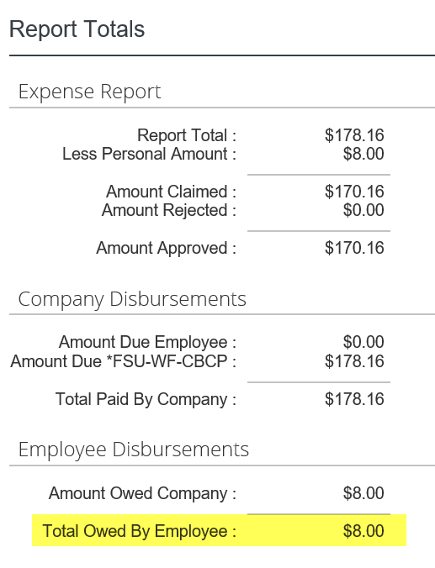
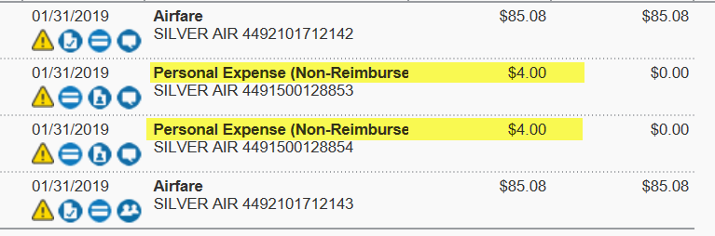

Slide 62
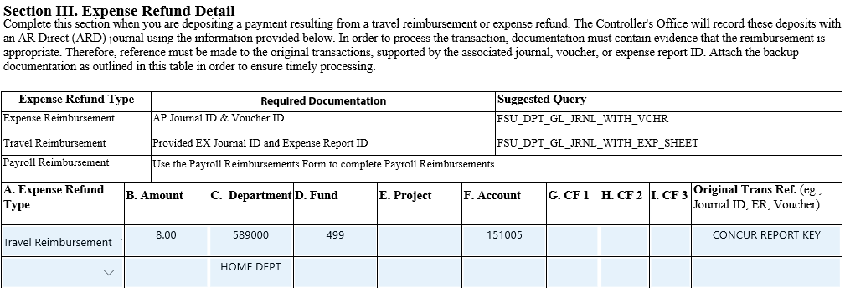
Personal Expense Reimbursement

Slide 63
Travel Policy Reminders
Most Economical
Approver Delegate Documentation
Non-Travel Reimbursement
Airbnb Mandate
Notes:
Most Economical
Travelers are to choose the most practical and economical mode of transportation, and are to generally travel the most direct route. Consideration is to be given to the total cost to the University, considering time of the traveler, impact on the productivity of the traveler, cost of transportation, and per diem or subsistence required. It is preferred for travelers to book airline tickets, hotels, car rentals, and other accommodations through the Concur booking tool or by using the University’s TMC.
Approver Delegate
Approver Delegates can approve travel requests and expense reports on behalf of an approver. Supervisors or Budget Approvers may appoint delegates. Budget Approver Delegates must be authorized signers or be designated and authorized in writing by the DDDHC or PI.
Non-Travel Reimbursement
In an emergency or when traveling for the University, it may become necessary for a faculty/staff member to pay for materials or services from their personal funds with the expectation that they will be reimbursed by the University for the purchase. Reimbursement in excess of $25 must include a justification as to why the University's purchasing system was not used and what steps will be taken to ensure that the purchasing system will be used in the future. If it is deemed that the purchase is improper, the invoice will be returned and the charges will be borne at the personal expense of the individual making the purchase. Therefore, it is important that prior to the purchase, the individual seek confirmation that the purchase is in fact, appropriate for reimbursement by the University.
In the event that the faculty/staff member seeks reimbursement from the University, the request must be entered in OMNI in the Travel module as a non-travel reimbursement. Supporting receipts should be submitted to Disbursement Services via fax at (850) 645-9501.
Airbnb
01/18/2019 - Effective Immediately: The University will no longer permit lodging reservations with Airbnb. Governor DeSantis issued a mandate on January 15, 2019 that has required this action. At this time, the University will reimburse individuals for charges already incurred, but any current reservations MUST BE CANCELLED. If you have any questions or need additional information, please contact the Travel office at Travel@fsu.edu or 850-645-8785. Official Statement.

Slide 64
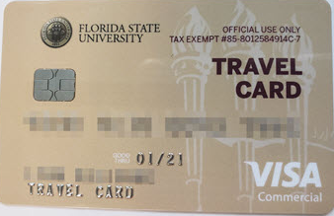
Travel Card
New T-Card Manual
  Coming Soon

Slide 65

Compliance Report
Feb 2019 All Green
  National High Magnetic Field Laboratory
  College of Communication & Information
  Division of Student Affairs
Notes:
Requests submitted prior to travel continue to be a challenge university-wide. Improving this metric pay off in timely reimbursements and easier data entry.

Slide 66
Locating & Closing Requests
Users should close requests when no longer needed.
Use BI -> Budget & Transaction to locate encumbrances and Request ID.
In Concur, users must click View -> All Requests to locate Travel Requests older than 90 days.
Click on a request, then click Close/Inactivate.
Notes:
In anticipation of end of year and slim budgets…

Slide 67
Supervisor Approvers in Concur
Supervisor approvers are determined by information in OMNI HR (employee’s primary appointment).
If you suspect a supervisor is incorrect, first ask the HR Rep to determine the traveler’s primary appointment. If that’s not correct, do an e-PAF to change/update.
If supervisor in HR is correct and not what’s in Concur, email ctl-travel@fsu.edu and we will troubleshoot.
https://controller.vpfa.fsu.edu/concur/approvals
Supervisor approvers may appoint approvals delegates.
Notes:
Pull back the curtain on how your department is structured. Don’t look at how it runs day-to-day. Look at how it’s structured in OMNI HR. Explain that supervisors are acknowledging only that someone will be gone. It always goes to a “money” person afterward.

Slide 68
Budget & Project Approvers in Concur
To update Budget Manager or Authorized Signer, contact FSU Budget Office.
To update Project Approver, contact Sponsored Research.
If you completed these updates and Concur doesn’t match OMNI, contact us at ctl-travel@fsu.edu to troubleshoot.
If an approver is leaving the university, they should appoint an approvals delegate as part of their separation process to ensure timely approvals after their departure.

Slide 69
Order of Operations
Obtain Guest Traveler ID Number (for guest travel only!)
Travel Request
Book trip (flight, hotel, car, conference reg, etc)
Start expense report as charges arrive
Go on trip, return home.
Create itinerary for meals, add per diem, incidental expenses.
Ensure all receipts are correct & comments added.
Traveler submits expense report.
This is ideal, but sometimes multiple reports are necessary.
Notes:
Reminder for all!

Slide 70
For Further Assistance
Concur.fsu.edu for all Concur resources (in addition to Travel Website)
One–on–One help dates/times are located on the FSU/Concur website.
Available to consult with departments interested in modifying existing practices to take advantage of more Concur functionality.
Travel policy training and refreshers will continue at the Training Center.
If you need help outside of these dates or department specific training, email ctl-travel@fsu.edu or lmasimore@fsu.edu to schedule.

Slide 71
Contact Information
Questions?
Disbursement Services Contact Info
  Accounts Payable: 644-5021or ctl-AccountsPayable@fsu.edu
  Travel: 645-8785 or ctl-travel@fsu.edu

Slide 72
Unrelated Business Income & Sales Tax
Controller’s Office
Notes:
Good Morning. I have been asked to speak to you all this morning concerning Unrelated Business Income Tax, which is better known as UBIT. If you have an auxiliary account you may already be working with us each year on your possible unrelated business income.

Slide 73
What is UBI?
“Income from a trade or business, regularly carried on, that is not substantially related to the charitable, educational or other purpose that is the basis of the organization’s exemption.”
The following three criteria must be present:
  A trade or business
  Regularly carried on
  Not substantially related
Notes:
So what is UBI? UBI is, as it states here, income from a trade or business regularly carried on that is not substantially related to our purpose. It must meet all 3 criteria to be UBI. Lets say you run an activity that is a trade or business…with a profit motive, and it is not substantially related to our mission…but, it only happens once a year? Then it would not be UBI because it is not regularly carried on. However, this can be tricky, if this activity is something that only happens once a year in the retail world, for example selling Christmas trees, then this could be considered regularly carried on, and therefore would be UBI. The IRS is going to look at your activity and compare it to the commercial world….if it is ran like a commercial activity, competing with commercial entities, they are going to want us to show why we should not be paying taxes on it. Does all of this mean that unrelated business income is bad? NO, it is not bad, we just have to make sure that we are reporting it. Nine times out of ten, there will be an exception we can use, or the related expenses offset any revenue that is brought in…meaning no taxes will be owed. Also, please keep in mind that the term “not substantially related” focuses on how the income is generated, not how it is going to be used. I am assuming that all revenue generated through our campus is done so to support our mission in one way or another.

Slide 74
  Exclusions From UBIT
  Interest, dividends, and annuities
  Capital gains
  Royalties
  Research
  Business conducted by volunteers
  Convenience exception
  Sale of donated merchandise
  Rent from real property (exceptions apply)
  Qualified sponsorship payments (exceptions apply)
Notes:
Here is a list of those exceptions that I just mentioned. Exclusions include, interest, dividends, annuities, capital gains, royalties, research, business conducted by volunteers, convenience exception…which means a convenience to our students, our faculty and our staff, the sale of donated merchandise, rent from real property and qualified sponsorship payments. With this said, please do not go back to your offices and decide that your activity falls under one of these exclusions and that none of this applies to you. One, as in all other areas of life…there are always exceptions to the exceptions. And two, it doesn’t work that way. Even if your activity falls under one of these exclusions, we still need to document the activity and report why we feel it should be excluded.

Slide 75
Most common UBI generating activities
Advertising
Sales of Merchandise
Rental of space or equipment
Professional Entertainment Events
Parking lots
Note: The office of Treasury Management in the Controller’s office should be notified of any of the above activities during the planning phase.
Notes:
Here is a list of a few of the most common UBI generating activities. Advertising, selling merchandise, renting space or equipment, professional entertainment events and parking lots. It is very important to get our department involved if your department is generating revenue through an auxiliary account via one of these activities or any other. You may make the mistake of thinking….well, our activity is selling scientific journals, that is related…right? Well yes, however, if you are selling advertising space in the journal…the advertising is treated as a totally separate activity and would be considered UBI. Most advertising is going to be UBI. Or what if you say, well we rent out space in our department and you said that rent from real property was excluded. Well, it is, however there are exceptions and if your lease doesn’t address those exceptions properly it could taint the entire lease and cause all of it to be UBI. As the note says, we should be notified of any possible UBI activities during the planning phase. Changing just one word in a contract or lease can make all the difference.

Slide 76
Sales Tax
There is no central administrative account to pay tax on isolated transactions.
Donations.
Structure the transaction in favorable terms.
Future developments.
Notes:
Departments contact me about doing a short-term sales activity like selling T-shirts thinking there is a way for them to collect sales tax and send it to an administrative sales tax account for reporting and remitting the tax to the DOR. The DOR has told us in multiple audits that nothing FSU sells is considered a non-taxable isolated transaction such as an occasional garage sales. I have requested getting an administrative account, but the DOR has turned me down every time citing that the law requires every FSU location to be individually registered with them.
Donations must be structured properly. Selling T-shirts to fund raise is not soliciting donations. You should work with the university Foundation to insure that it’s done properly.
If you put a little thought in how you structure the sales transaction, some transaction can be made exempt. Examples are: CAPD courses that include the course, course materials, and parking. Career Center events can become tax-exempt admissions. Combined rents of real and tangible property rentals.
In the recent USSC case S.D. v Wayfair, court ruled that other states can tax on-line purchases made by their residents. There was always a use tax liability for the resident, but now that will be changing. Some states impose sales tax on services or goods that may be exempt in Florida which will necessitate a review of auxiliary and research budgets where services are performed in other states. Other states are in the process of passing new sales tax legislation that would impose the tax and explain how the out-of-state entity should report and remit the tax. The Florida Legislature has not passed any such legislation yet.

Slide 77
Contact Information
Questions?
Gayla Burdick
  gburdick@fsu.edu
  644-9480
Notes:
Thank you for your time this morning. And remember it is not bad to participate in an activity to create revenue for your department….it is only bad to do so without reporting it.

Slide 78
OMNI FI Upgrade
Quality Assurance

Slide 79
FI Upgrade Objectives
  Ensure system is properly secured by staying on supported PeopleTools and Database versions
Apply bug fixes
  Approximately 120 issues logged
Utilize enhanced functionality
  Bank Reconciliation enhancements under analysis
  Level 3 P-Card data
Increase efficiency via navigation collections

Slide 80
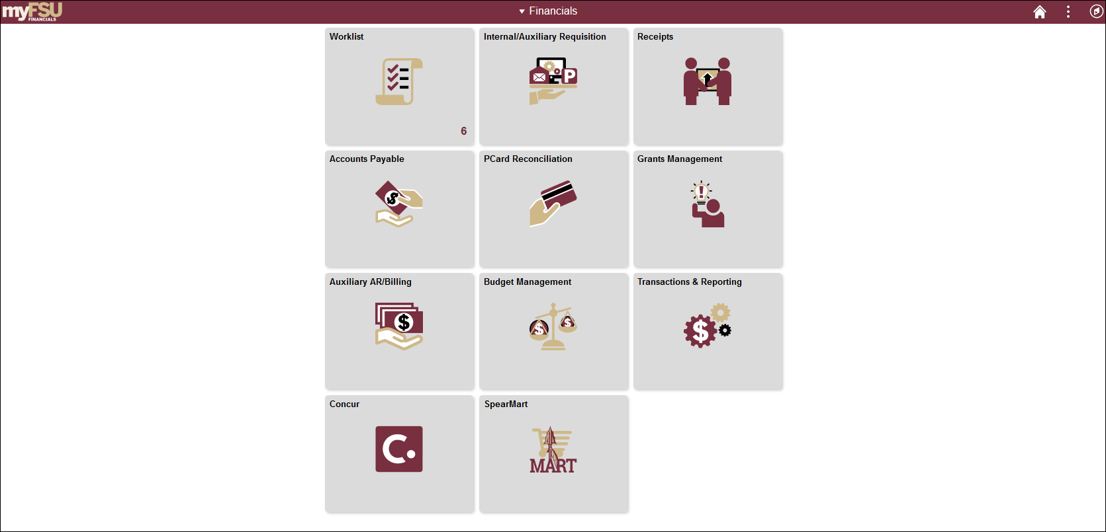
Notes:
The new FI has a tiled look similar to the HR upgrade.
The tiles that appear for each user will depend on the roles that they have in FI, so you may or may not see all these tiles.
The myFSU in the upper right (point to it) will take you back to the homepage just like it does in HR and Student Central
The drop down in the middle (point to it) enables you to toggle between Financials for department users and Financial Central Offices for central office users. If you do not have central office roles you will not see any available tiles on that menu.
The worklist (point to it) tile will show you the current number of outstanding items.
The Concur and SpearMart (point to them) tiles will open a new window and take you directly to either of those places. You no longer have to go back to MyFSU in order to get there.
Tiles are fairly self explanatory, but will focus on a few here starting with the Transactions & Reporting tile.

Slide 81
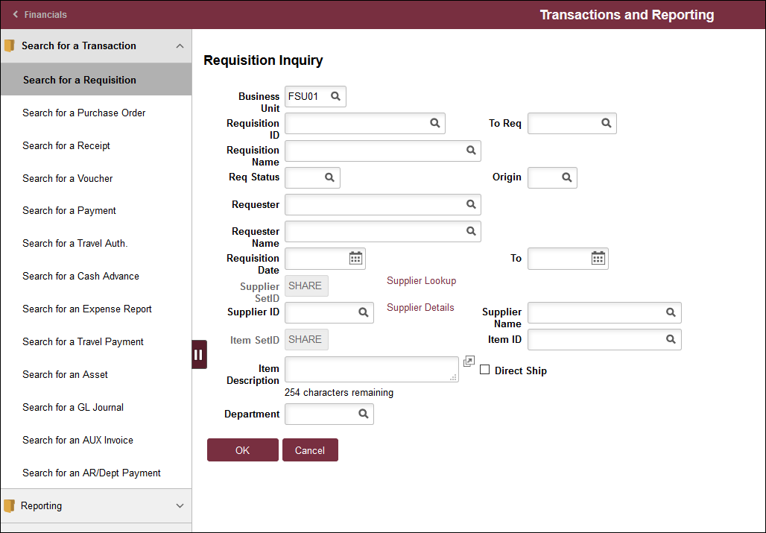
Notes:
When you click on the Transactions & Reporting tile it takes you to this screen – Search for a Transaction.
From here you can search for almost any document you may need to all in one place. You no longer have to go to each place to search.
As you can see, from here you can search for a purchase order, payment, voucher, asset, journal, etc.
Although the navigation to various pages is different, you will notice that the pages themselves are very similar to what they were prior to the upgrade.
The 2 line button (point to it) allows you to collapse the search menu on the left if you need the page to fill the screen.
The other area here is the Reporting folder

Slide 82
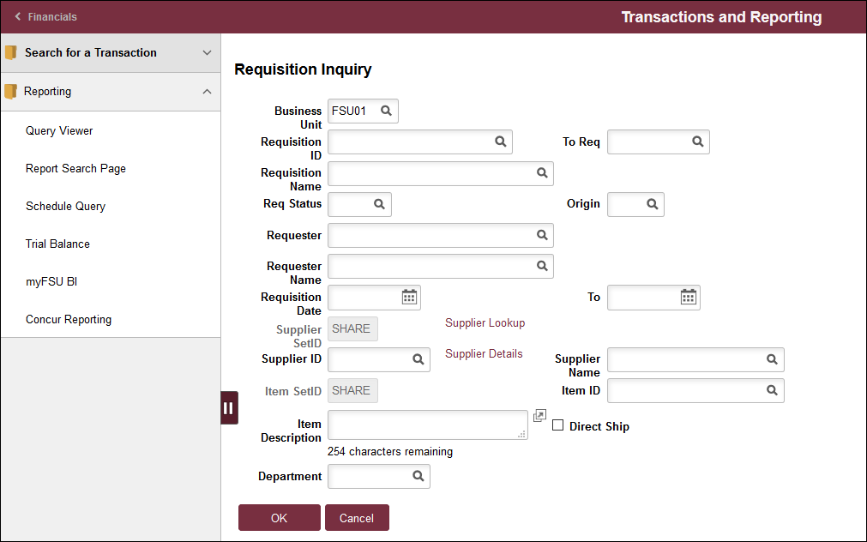
Notes:
When you click on Reporting you will see these options.
From here you can get to query viewer, report search page, or you can run a trial balance.
It will also link to BI and Concur reporting by opening new tabs from here if you click on those options. You do not have to go back out to the homepage to get to either of these places.

Slide 83
Notes:
The tiles overall are fairly self explanatory
Internal/Auxiliary Requisition – this is where you enter internal requisitions
Receipts – this is where you can do receipting
Accounts payable – ePRFs are done here
Pcard Reconciliation – self explanatory
Grants Management – all sponsored research activity is here
Auxiliary AR/Billing – for departments that are part of Auxiliary AR
Budget Management – for all budget activities. When you click on that you will see this screen.

Slide 84
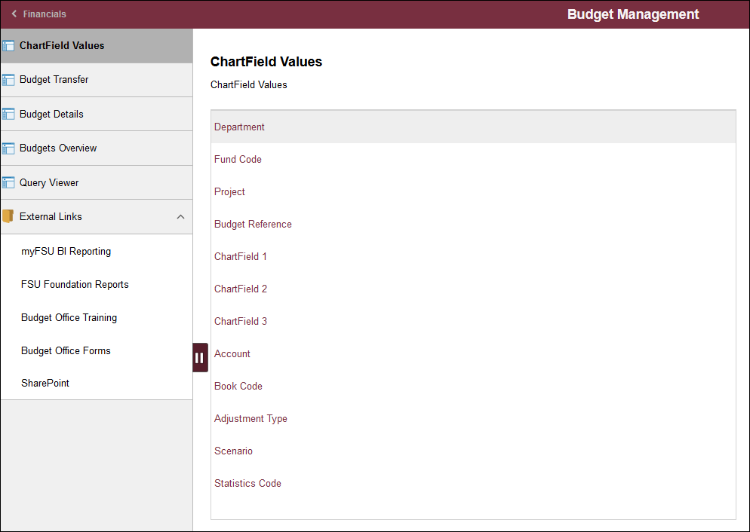
Notes:
The budget screen allows you to look up budget details. The external links here also will take you to BI, FSU Foundation reports, and link directly to the budget office website for training and forms and their SharePoint site. When you click on these links it will open up in a new tab.
One other thing to note is that when you have multiple tabs opened you need to remember that time outs can happen on any tab, so a best practice would be to close tabs that you are not currently using so as to avoid any unwanted timeouts.

Slide 85
Notes:
The Navigator also provides some useful resources. If you click on the compass icon (point to it) it will take you here

Slide 86
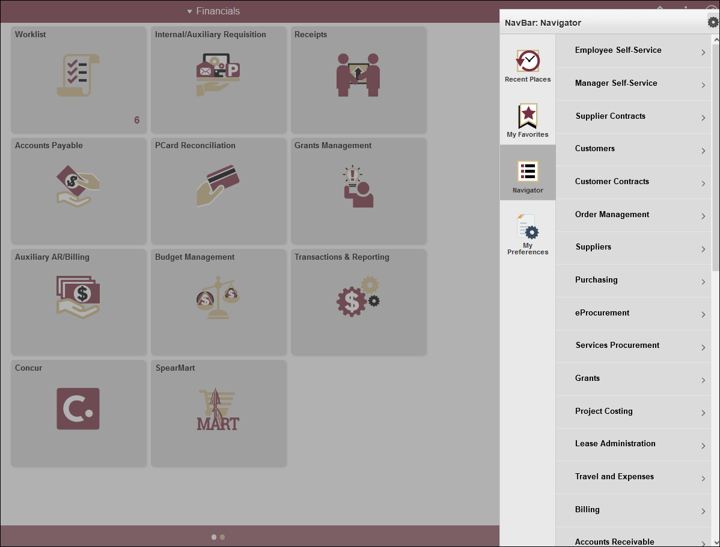
Notes:
The Navigator will pull up a menu similar to the old menu on the right side of the screen. If you cannot find what you need on the tiles, you can look here.

Slide 87
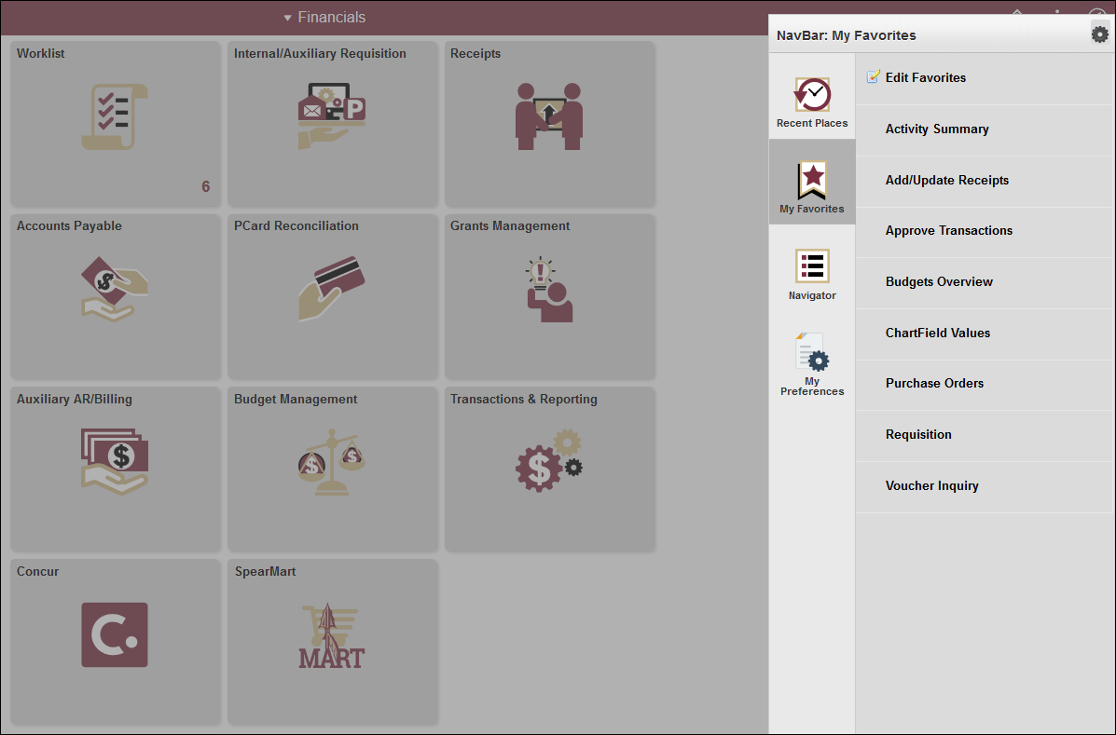
Notes:
My Favorites will bring up any favorites that you have saved

Slide 88
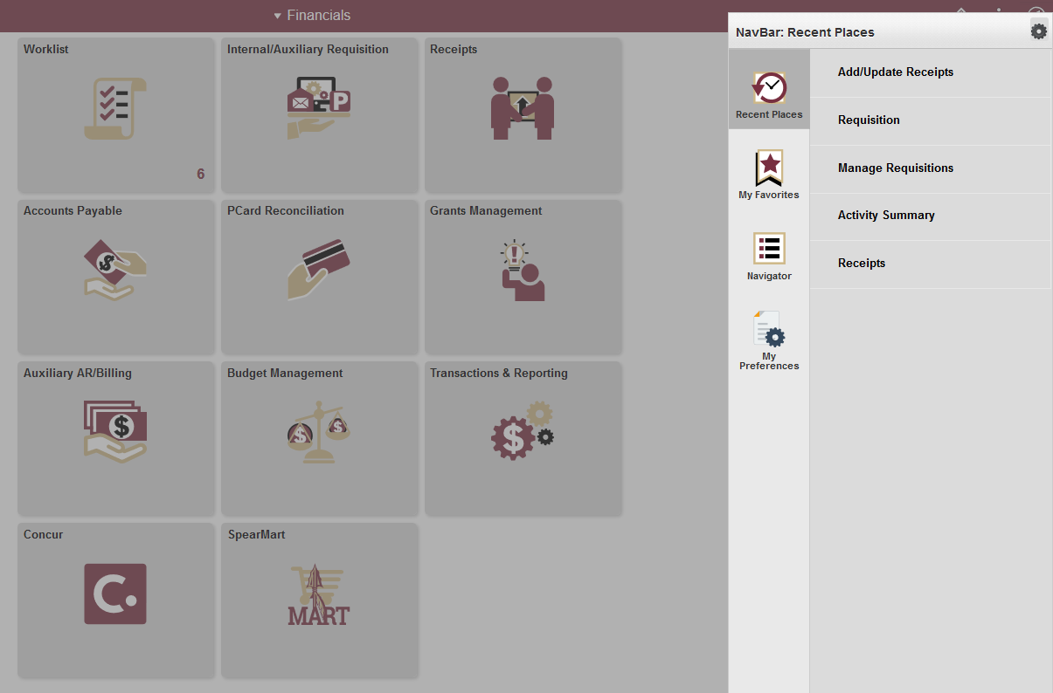
Notes:
Finally, recent places will bring up a listing of recent places visited. This is especially useful for people who always go to the same place.

Slide 89
FI Upgrade Reminders
OMNI will be unavailable from noon on Friday, April 26th until 7 am on Monday, April 29th.
SpearMart and Concur will also be unavailable during this time.

Slide 90
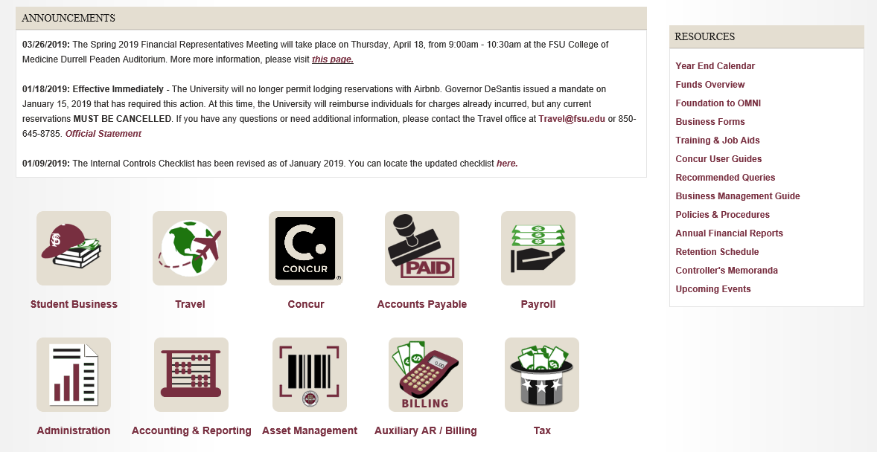
Controller’s office resources
Notes:
Finally wanted to highlight the resources we have available on our website.
First, the Year End Calendar is being finalized and will be published next week.
We have the Business Management Guide which provides department managers and financial representatives with a consolidated overview of their fiscal and administrative responsibilities. This includes summary guidance about sound business practices and internal controls .
We also have a summary of the Fund structure at FSU. This provides an overview of the various funds at FSU and what is allowed to be spent from each.
Both of these resources are helpful for new employees as well as good refresher for more seasoned employees.
Finally, we have training and job aids for a variety of items.

Slide 91
Contact Information
Questions?
Betsy Miller
  CTL-QualityAssurance@fsu.edu
Notes:
You can reach me at the email address below. If you have

