Slide 1
Financial Representative Meeting
Kyle Clark • Vice President for finance & administration
February 15, 2017

Slide 2
Finance and Administration Updates

Slide 3
Finance & Administration Initiatives
New 4Rivers location on campus
FAMU/FSU Joint College of Engineering food service location
Compliance with the Payment Card Industry Data Security Standard
Expanding use of our SciQuest Procurement System (SpearMart)
Travel Management Services and System
FSU Panama City Branch Campus P3 Student Housing Facility
Food Service ITN
Shared services with Ringling, New College of Florida, and University of South Florida Sarasota
Rating Agency visits with Fitch, Moody's and S&P
Refunded $7.6 million of long term debt with approximately $750k in savings

Slide 4
Finance & Administration Initiatives
New Pouring Rights agreement
Active discussions regarding multimedia rights
College Town Phase 3 Expansion
Banking Services ITN
FSU Research Asset Management project
Lean Cross Functional Teams
FLSA Implementation
Shared services with Ringling, New College of Florida, and University of South Florida Sarasota
Rating Agency visits with Fitch, Moody's and S&P
Refunded $7.6 million of long term debt with approximately $750k in savings

Slide 5
State University System Efficiencies
SUS Efficiency Summary
July 2016
FSU Projected Savings of $36.27 Million
Highlights
Enterprise software licensing agreements $9.3 Million
Procurement Savings – Cooperatives/Consortiums $7.8 Million
Procurement Savings – Competitive Solicitations $6.2 Million
Recurring Savings from July 2015 Report $2.2 Million
Prudential Productivity Awards $1.9 Million
Grainger MRO Program $1.8 Million
Student Health Ins. Payroll Deduction $1.3 Million

Slide 6
Facilities Updates

Slide 7
Facilities Design & Construction Active Major Projects
 |  | SCHEDULE |  |  |  |  | BUDGET
Project Number | Project Description | Architect/ Engineer | Bid/Guarantee Max Price | Construction | Substantial Completion |  | Planning | Construction | Equipment | Total
FS-221 | University Housing Replacement Phase 2 including 1851 Dining Concept | 9/29/2014 | 02/20/2015 | 05/15/2015 | 06/01/2017 |  | 4,830,355 | 62,382,899 | 2,450,000 | 69,663,254
FS-259 | Earth Ocean. & Atmospheric Sciences Building (EOAS) | 09/05/2013 | 12/15/2016 | 02/15/2017 | 02/15/2019 |  | 3,504,462 | 61,000,000 | 5,345,538 | 69,850,000
FS-218 | Doak Campbell Stadium Improvements | 09/01/2014 | 01/15/2015 | 02/01/2015 | 09/02/16 |  | 7,000,000 | 87,500,000 | 2,500,000 | 97,000,000
FS-275 | Interdisciplinary Research & Commercialization Bldg (IRCB) | 04/10/2015 | 06/15/2017 | 08/15/2017 | 06/15/2019 |  | 5,000,000 | 63,000,000 | 17,000,000 | 85,000,000
FS-253 | Donald L. Tucker Center | Varies | Varies | Varies | Varies |  | 2,823,931 | 18,046,792 | 6,404,445 | 27,275,168
31780 / 31954 | Tucker Locker Room Improvements | 10/18/14 | 05/18/2015 | 05/25/2015 | 12/30/2016 |  | 422,846 | 3,577,154 | 300,000 | 4,300,000
FS-321 | College of Engineering (FSU\FAMU) | 02/01/2015 | 06/01/2015 | 09/02/2015 | 09/02/2016 |  | 1,650,000 | 9,162,196 | 250,000 | 11,062,196
FS-232 | Jim Moran School of Entrepreneurship/Jim Moran Institute | TBD | TBD | 11/17/2016 | 08/15/2017 |  | 1,350,000 | 6,500,000 | 4000,000 | 8,250,000
FS-263 | Student Union Renovation/ Expansion | 01/15/17 | 01/15/2018 | 02/15/2018 | 07/15/20 |  | 5,000,000 | 45,000,000 | 2,500,000 | 52,500,000
FS-206 | College of Business | TBD | TBD | TBD | TBD |  | 7,500,000 | 73,500,000 | 7,000,000 | 88,000,000
 | BSU/African American Study Center | 07/01/2016 | 01/07/2017 | 01/25/2017 | 10/01/2017 |  | 250,000 | 2,000,000 | 250,000 | 2,500,000
Projects Underway |  |  |  |  |  |  | $ 515,400,618

Slide 8
University Housing Replacement Phase II
Substantial Completion Date: 6/1/2017
GSF: 209,000 (Buildings 3 & 4); 19,300 GSF for Urban Eateries
Total Cost: $ 69,663,254
Fund Source: University Funds
Project Information:
A 912-bed facility will be constructed in a suite style configuration. Magnolia Hall (Building 3), Azalea Hall (Building 4) consists of 912-bed suites and the 1851 Dining concept which were ready for Fall 2017 semester. Common areas for study, lectures, recreation, and laundry are all included, as well as landscaped courtyards. 1851 Dining Concept is a unique food service venue located along Jefferson Street.
Consultants:
Architect – Gilchrist, Ross, Crowe Architects, Tallahassee, FL
Contractor – Culpepper Construction, Inc., Tallahassee, FL

Slide 9
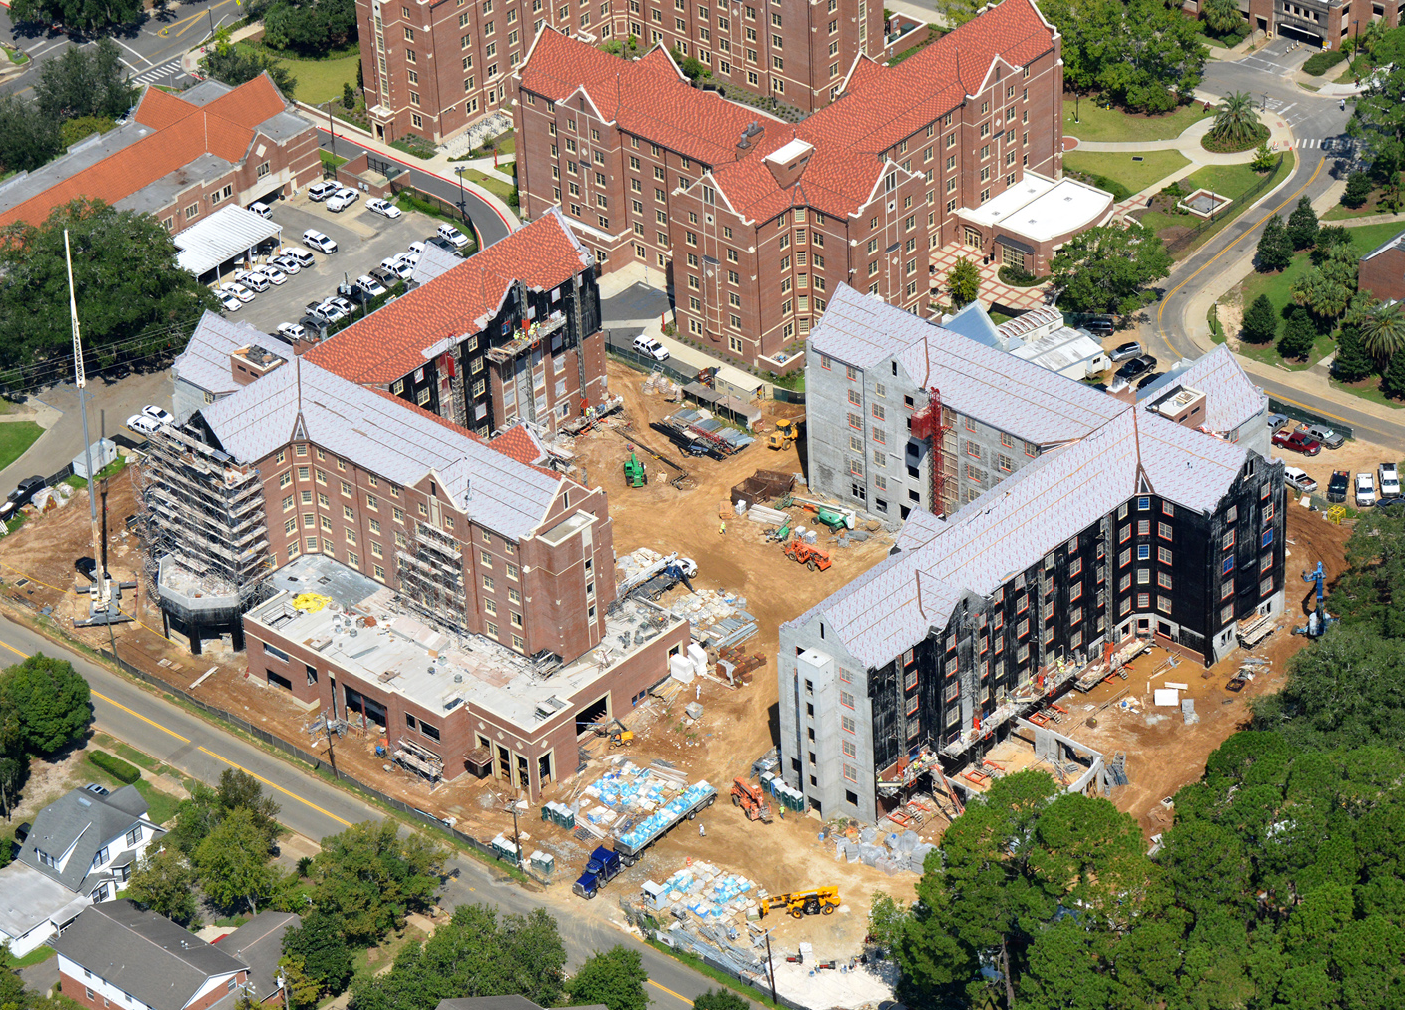
University Housing Replacement Phase II

Slide 10
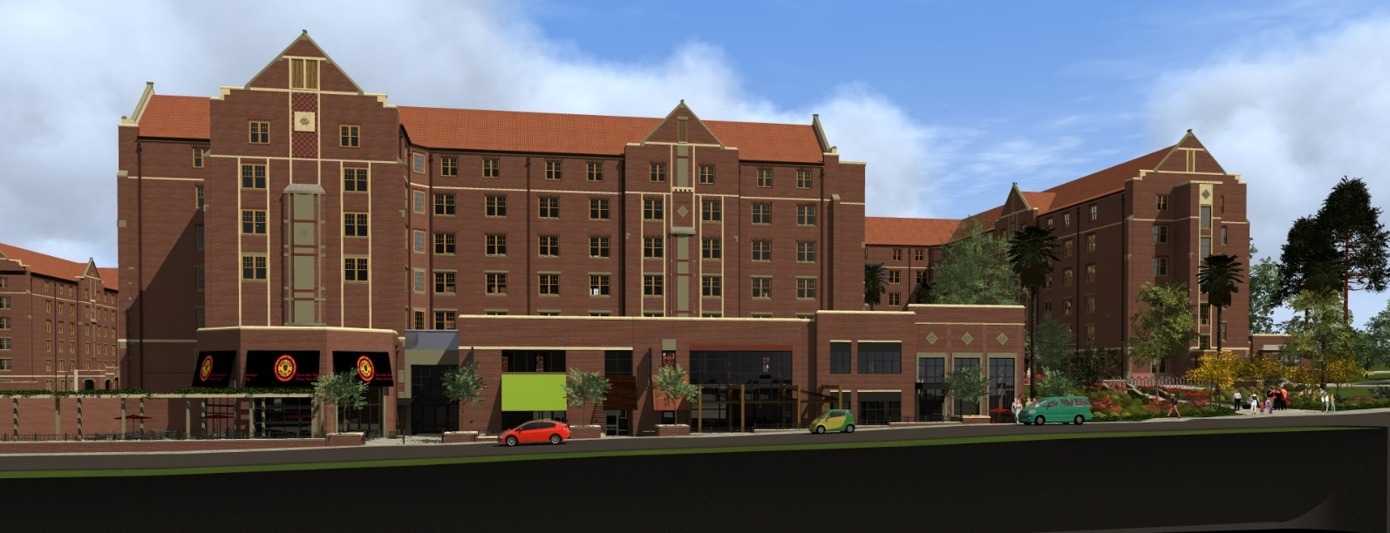
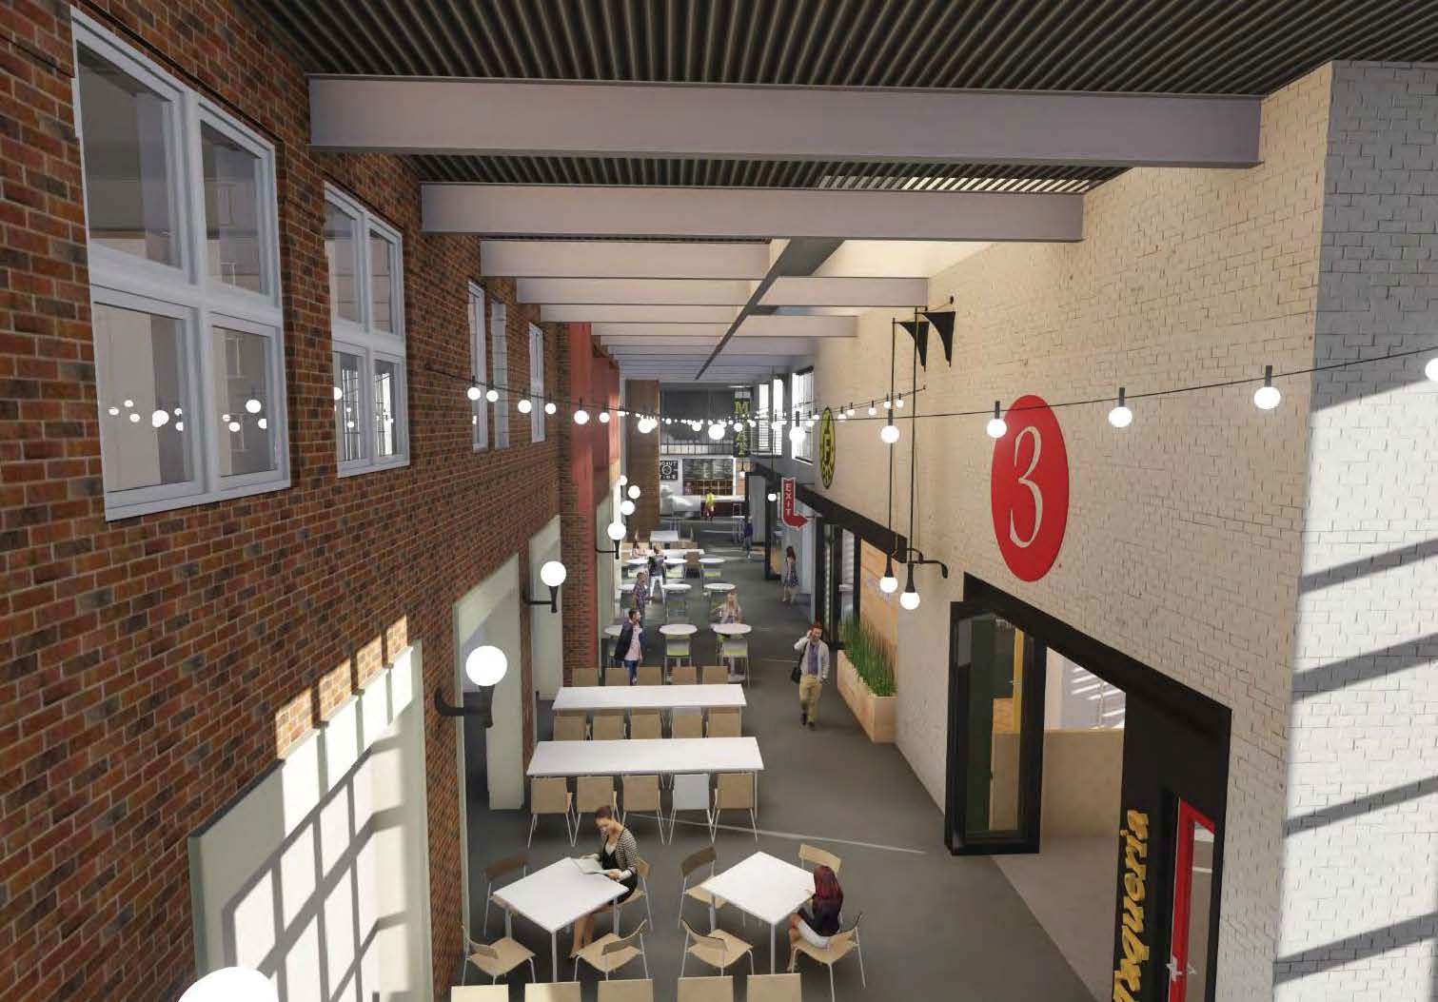
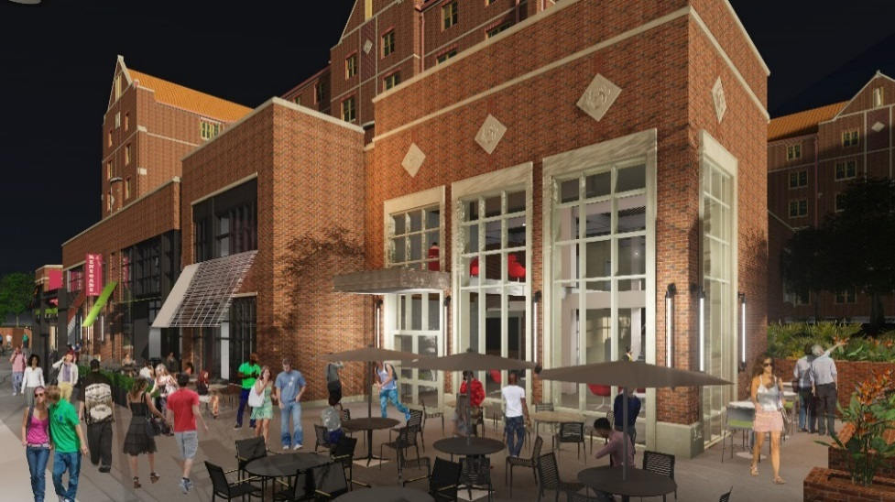
University Housing Replacement Phase II

Slide 11
Earth, Ocean & Atmospheric Sciences
Substantial Completion Date: 02/15/2019 (If funding is received)
GSF: 130,000 +/-
Total Cost: $69,850,000
Fund Source: FCO
Project Information:
Located at the prominent corner of Woodward Avenue & Tennessee Street, the new EOAS building will provide state of the art classrooms, teaching labs, research labs, and offices for the Earth Ocean & Atmospheric Sciences Department which has been created from the recently merged departments of Geology, Oceanography, and Meteorology.
Consultants:
Architects – Bohlin Cywinski Jackson Architects, Pittsburgh, PA
Contractor – Ajax Construction, Tallahassee, FL

Slide 12
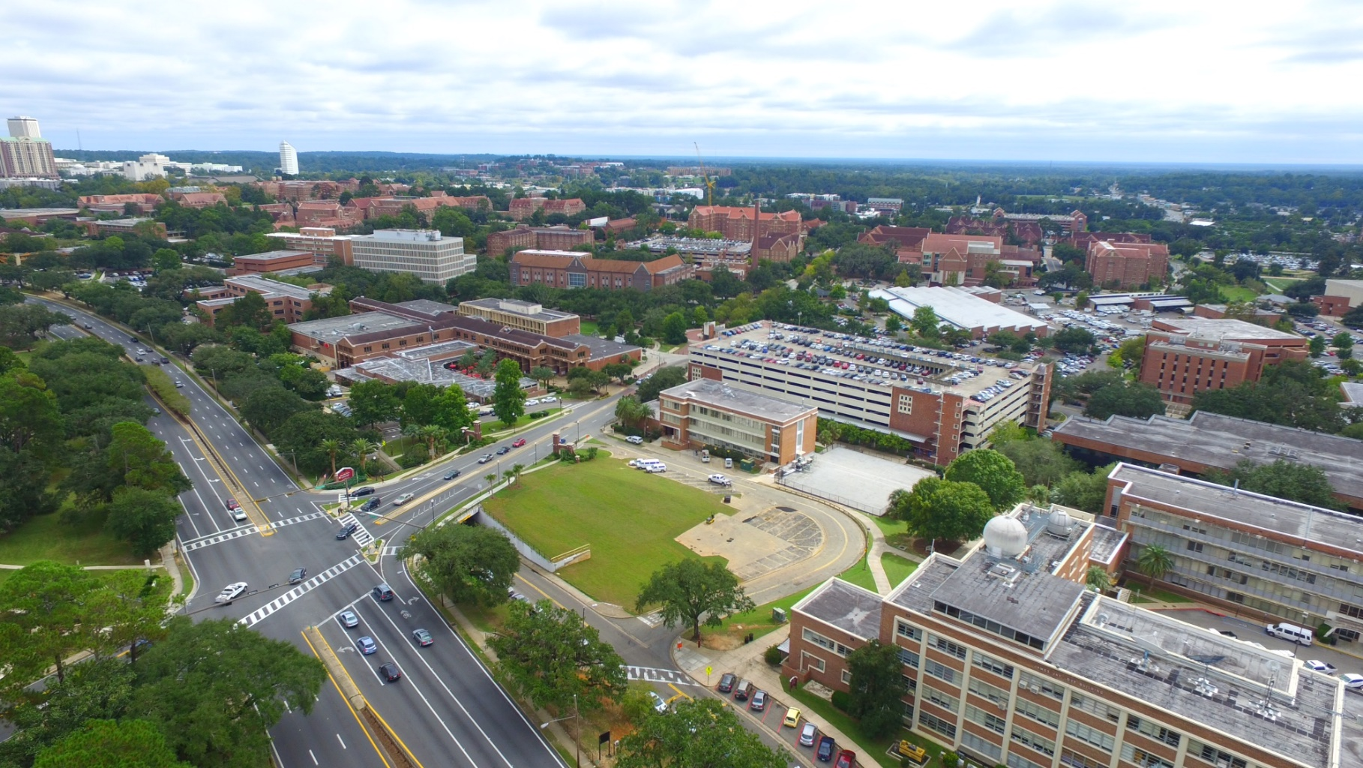
Earth, Ocean & Atmospheric Sciences

Slide 13
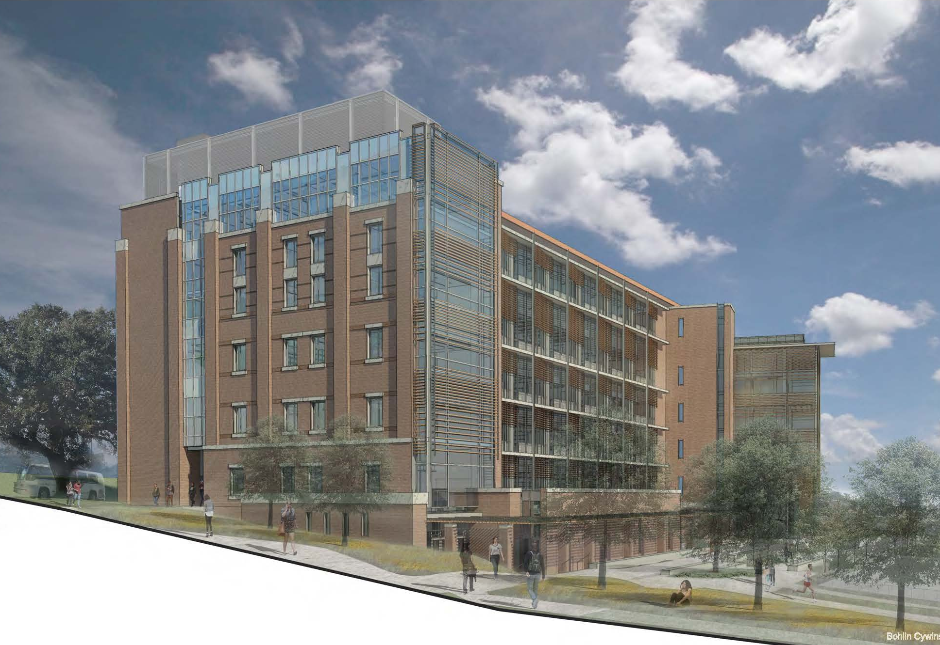
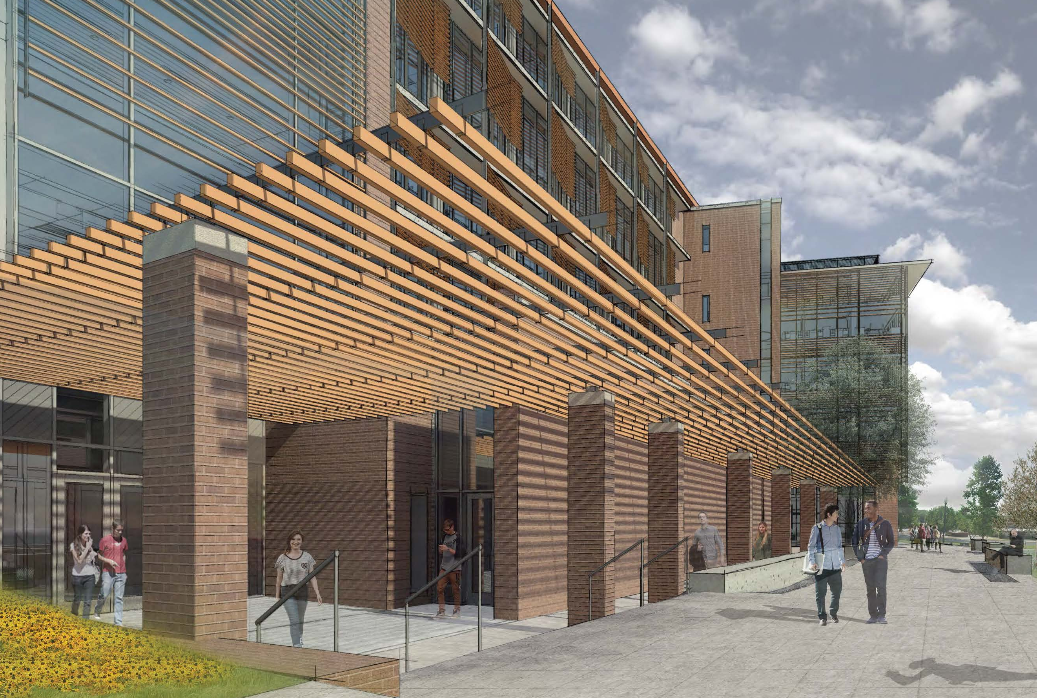
Earth, Ocean & Atmospheric Sciences

Slide 14
Interdisciplinary Research & Commercialization Building (IRCB)
Completion Date: 06/15/2019 (If funding is received)
GSF: 125,000
Total Cost: $85,000,000 (including equipment)
Fund Source: University Funds/FCO
Project Information:
This new facility will house interdisciplinary teams by creating a collaborative environment to conduct research and to develop commercialization opportunities to bring products to market. Spaces to be constructed are research labs, imaging/characterization labs, clean room facilities, collaboration spaces, administrative spaces, and building support functions. Researchers in the disciplines of biomedical engineering, chemistry, chemical engineering, condensed matter physics, and device prototyping will be accommodated.
Consultants:
Architect – Wilson Architects, Boston, MA
Contractor – Whiting-Turner, Tampa, FL

Slide 15
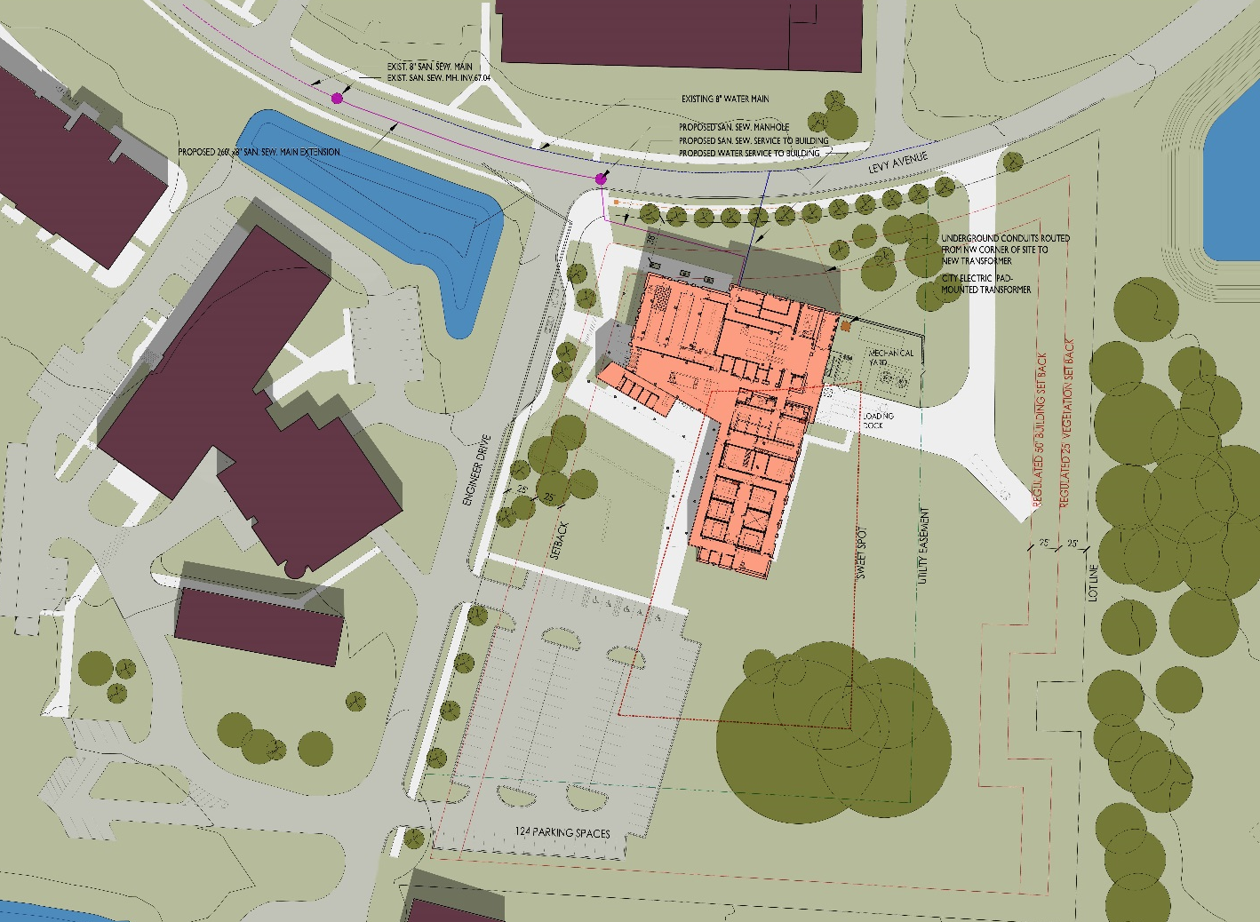
Interdisciplinary Research & Commercialization Building (IRCB)

Slide 16
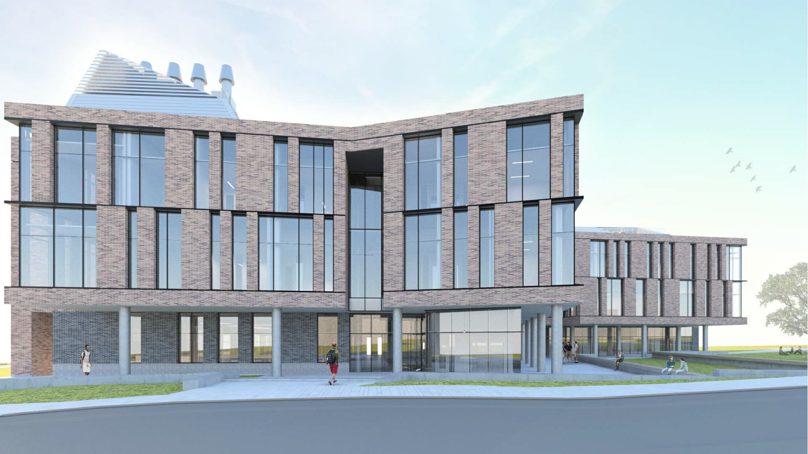
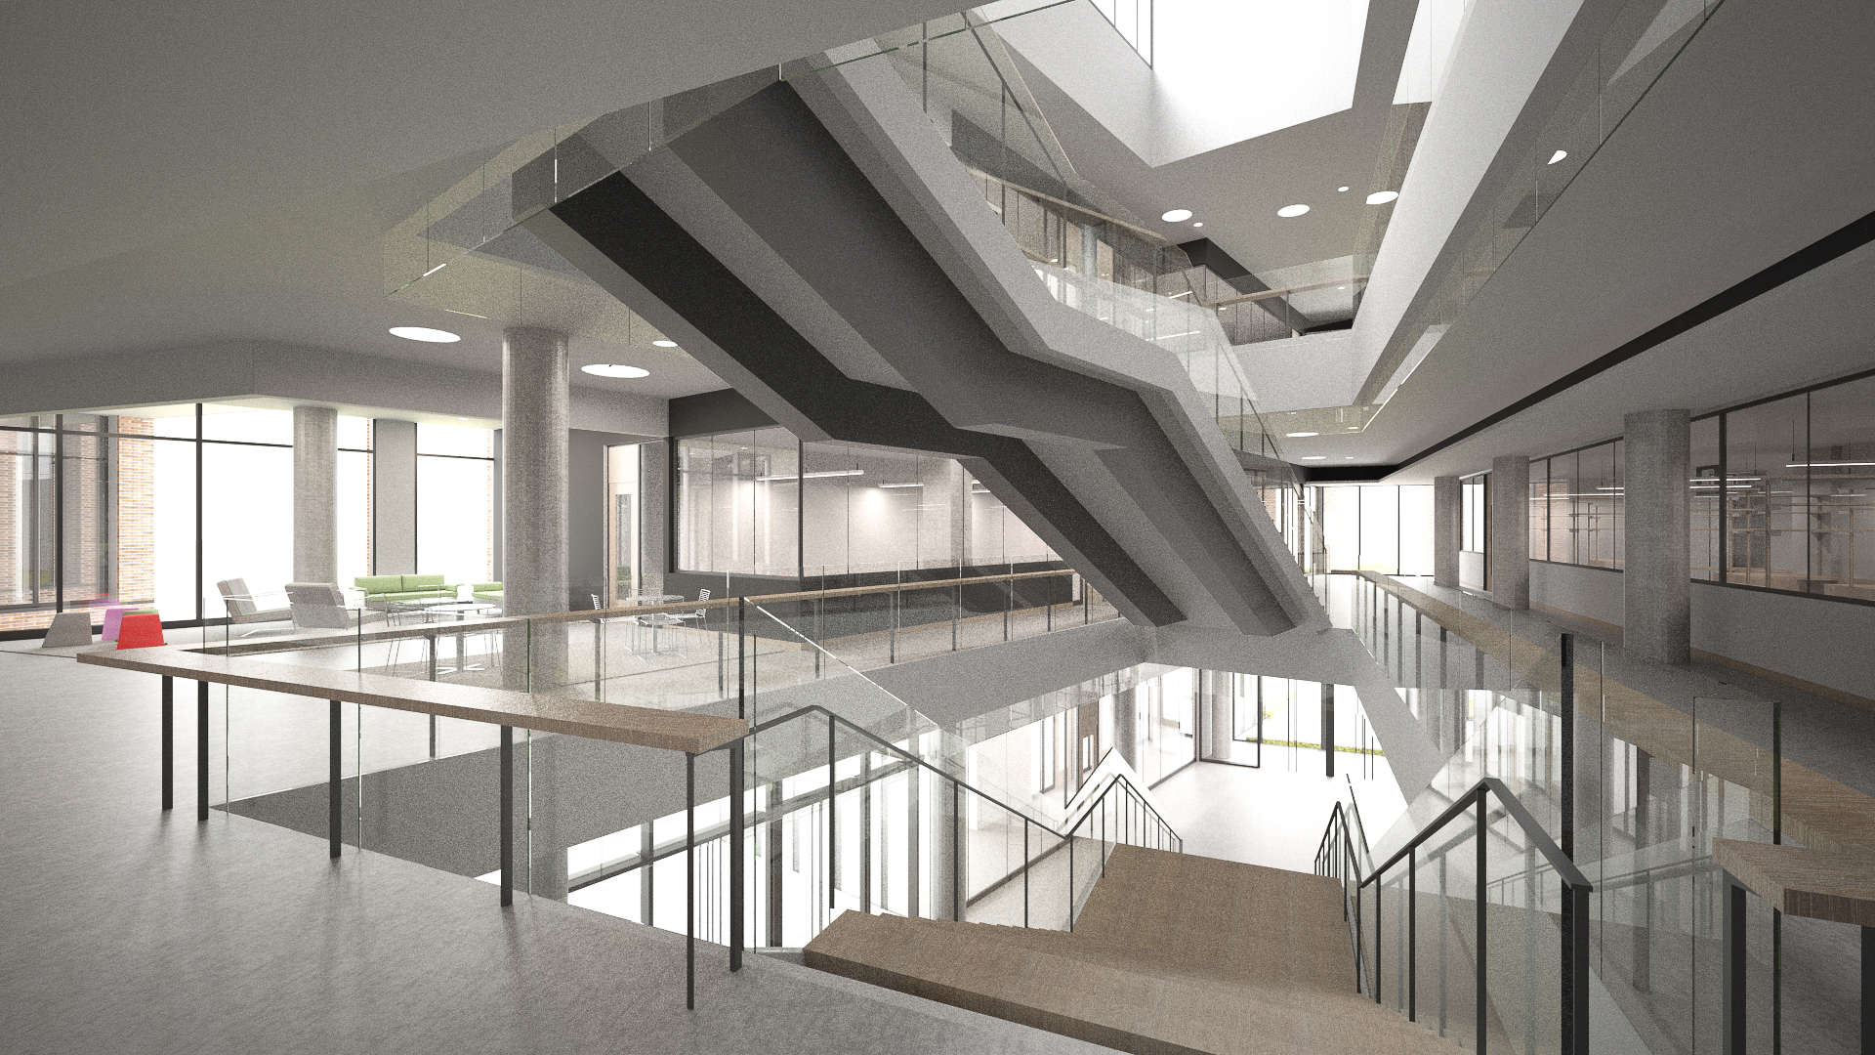
Interdisciplinary Research & Commercialization Building (IRCB)

Slide 17
College of Business
Substantial Completion Date: TBD
GSF: 250,000
Total Cost: $88,000,000
Fund Source: FCO/Private Funds
Project Information:
The project completely relocates the College of Business to the O’Connell property south of the Civic Center. This facility will include space for teaching, meeting, collaboration, administration, and event spaces.
Consultants:
Architects – TBD
Contractor – TBD

Slide 18
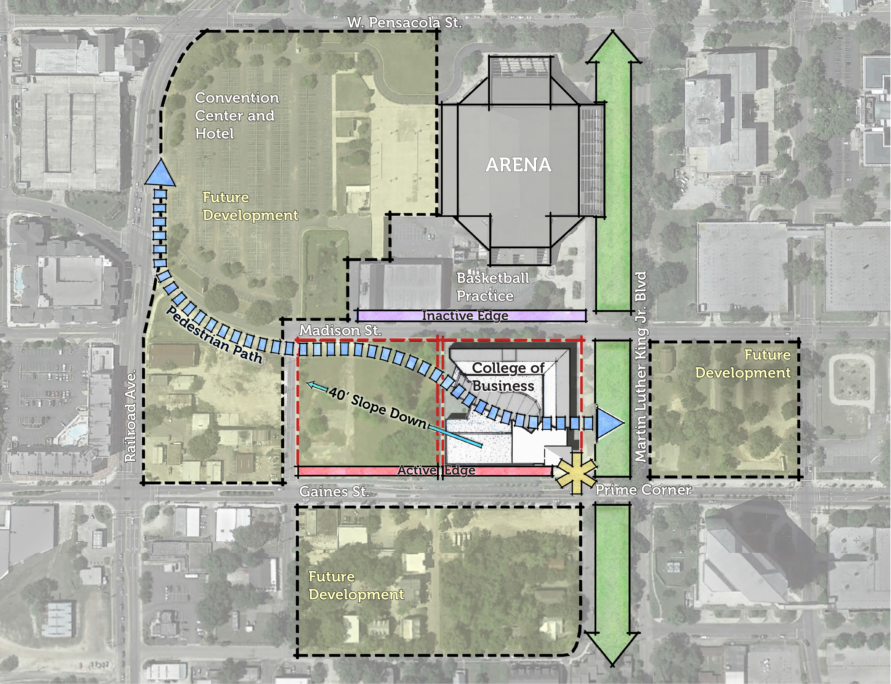
College of Business

Slide 19
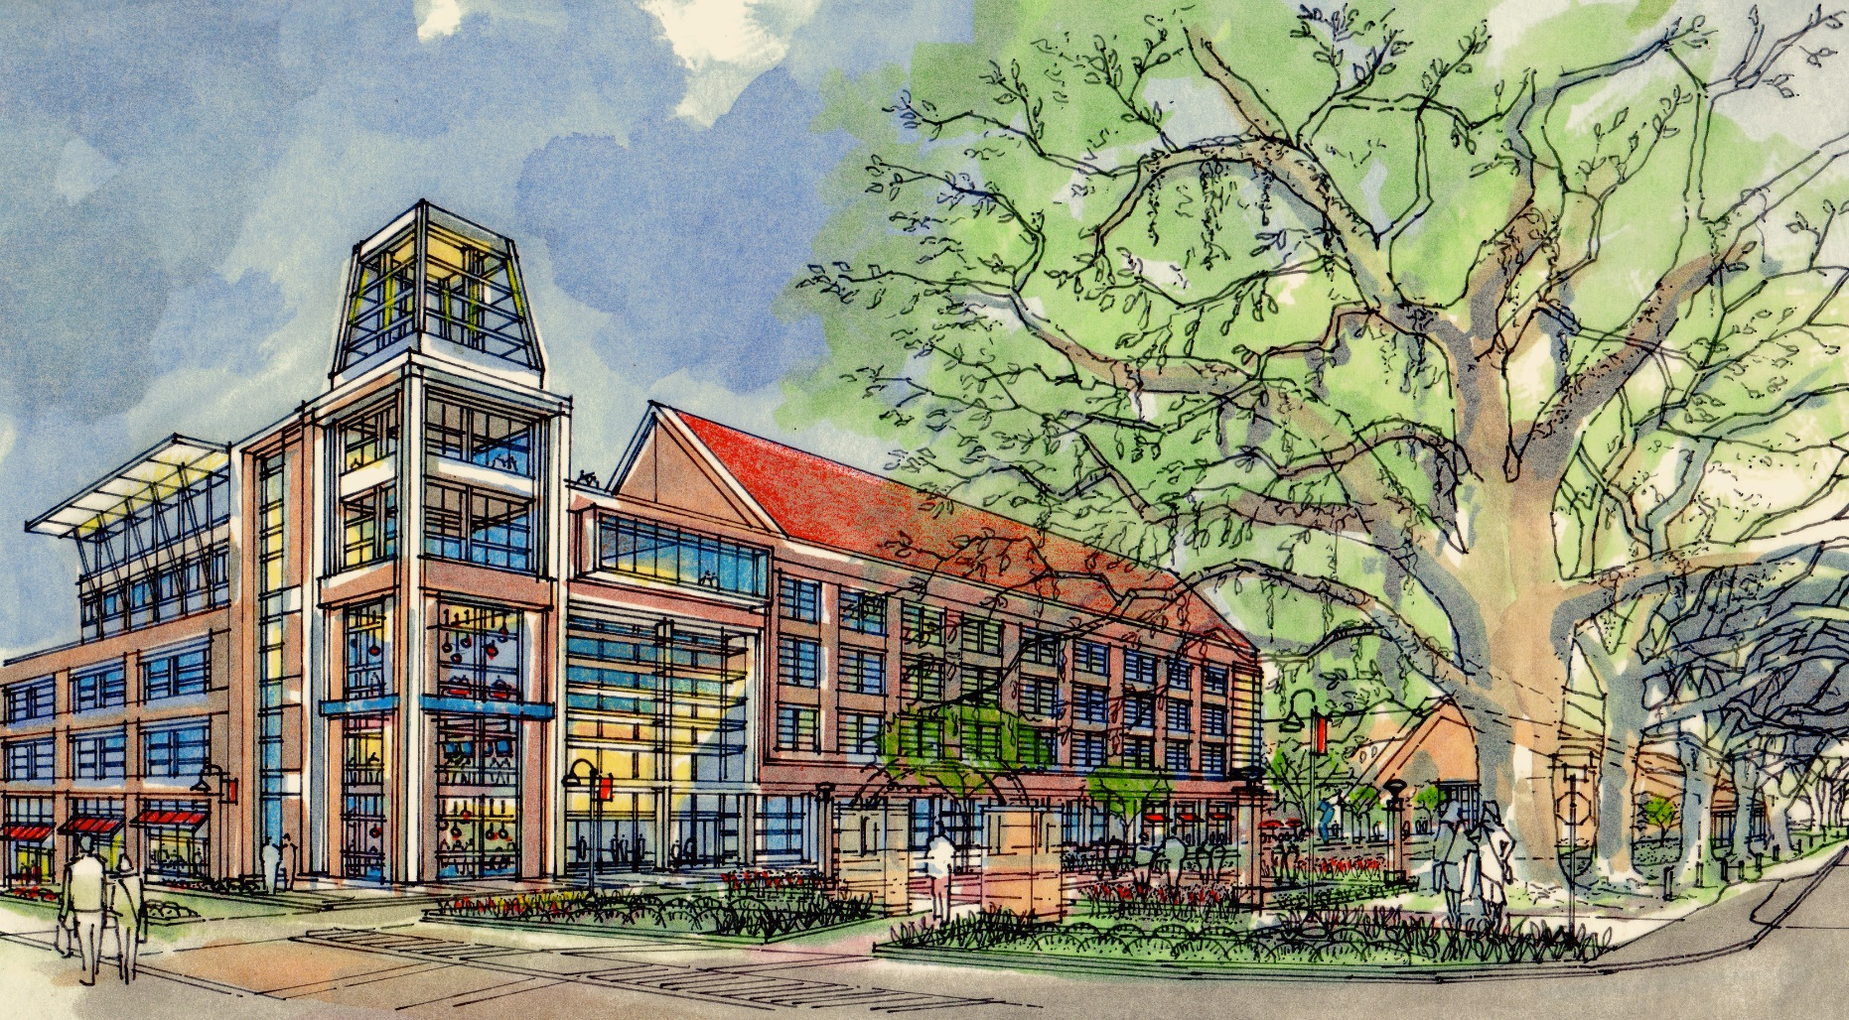
College of Business

Slide 20
Student Union Expansion
Substantial Completion Date: 7/15/2020
GSF: 110,000
Total Cost: $52,500,000
Fund Source: CITF/University Funds
Project Information:
The project consists of new space with a holistic look at the entire Student Union for future expansion. There will be spaces for student activities, student government, a multipurpose ballroom, Greek life, flexible student spaces, retail/dining and patio/hardscape courtyards.
Consultants:
Architects – TBD
Contractor – TBD

Slide 21
Student Union Expansion

Slide 22
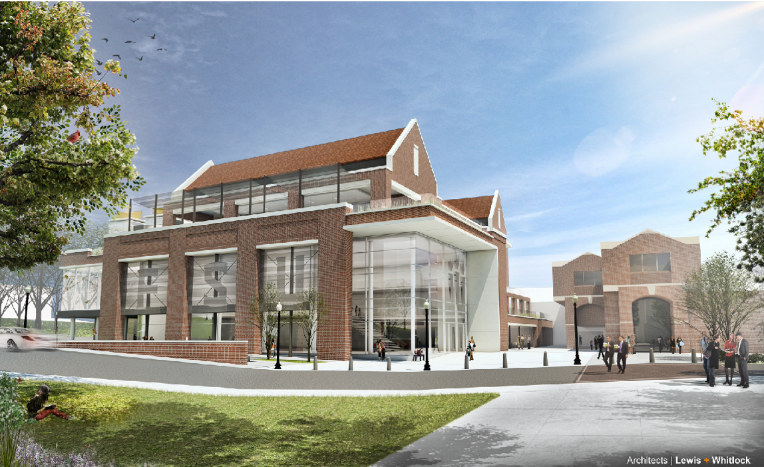
Student Union Expansion

Slide 23
Jim Moran School of Entrepreneurship / Jim Moran Institute
Substantial Completion Date: 8/15/2017
GSF: 20,000
Total Cost: $8,250,000
Fund Source: University Funds
Project Information:
This project renovates the Guaranty Bank Building located at 111 South Monroe Street in Tallahassee. This project will create space for faculty, staff & students. This facility will accommodate collaboration, presentation, reception and event spaces for students to connect with entrepreneurial mentors in a creative environment.
Design-Build Consultants:
Architects – Lewis & Whitlock
Contractor – Culpepper

Slide 24
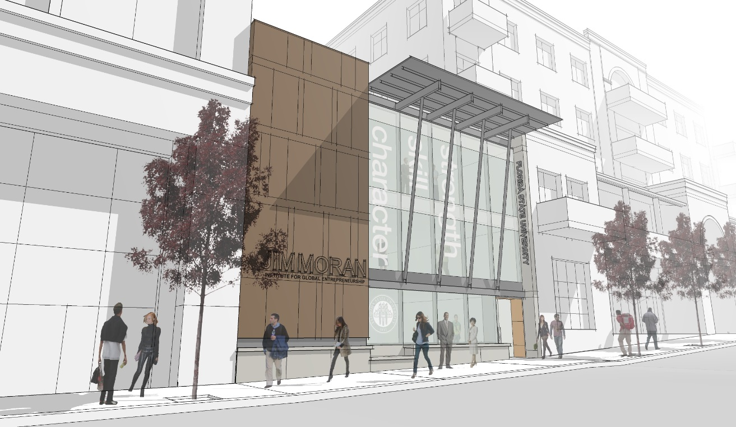
Jim Moran School of Entrepreneurship / Jim Moran Institute

Slide 25
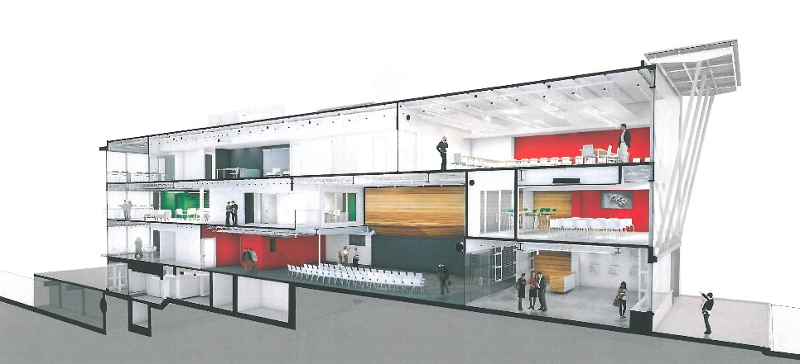
Jim Moran School of Entrepreneurship / Jim Moran Institute

Slide 26
Jim Moran School of Entrepreneurship / Jim Moran Institute
First Floor

Slide 27
Jim Moran School of Entrepreneurship / Jim Moran Institute
Second Floor

Slide 28
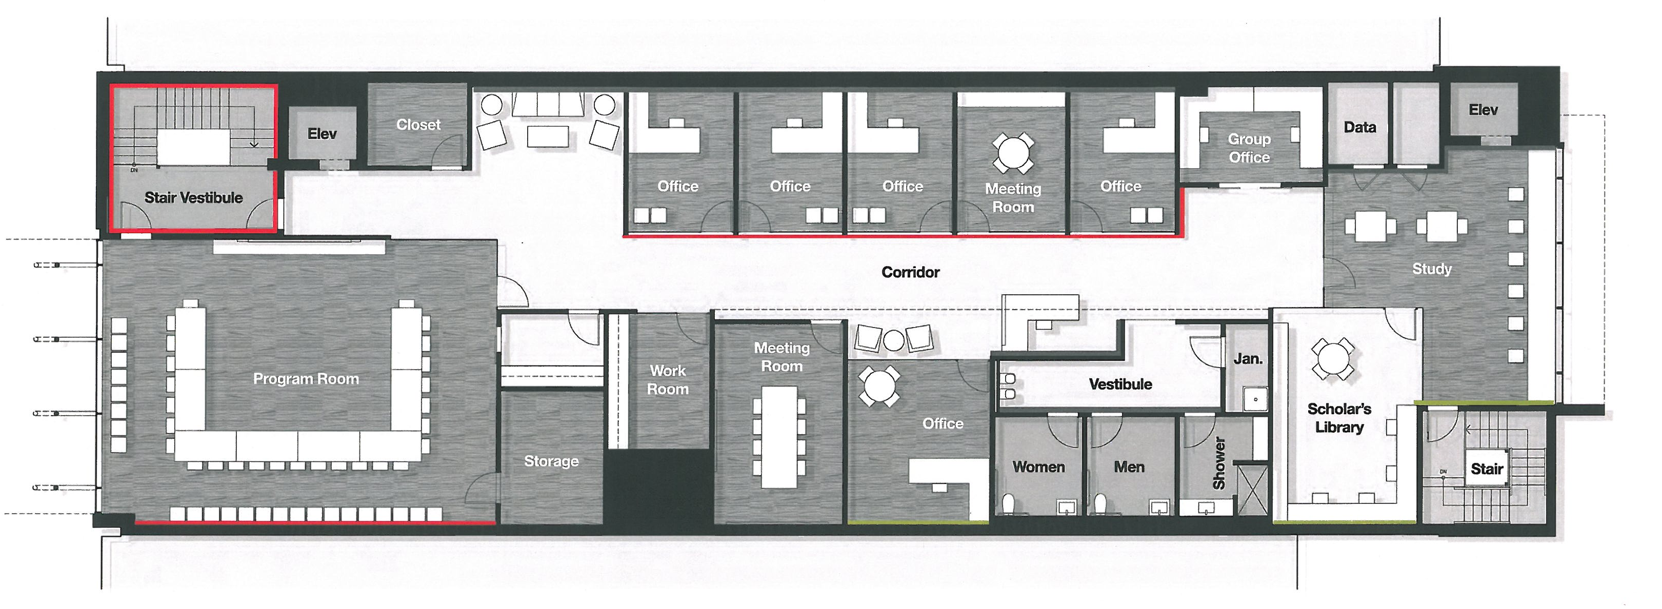
Jim Moran School of Entrepreneurship / Jim Moran Institute
Third Floor

Slide 29
Black Student Union / African American Study Center
Substantial Completion Date: 10/01/2017
GSF: 6,500
Total Cost: $2,500,000
Fund Source: FCO/Private Funds
Project Information:
This project provides new space for the Black Student Union and African American Study Center. This facility will include a gallery, student lounge, multipurpose space, and administrative space.
Consultants:
Architects – Gilchrist, Ross, Crowe Architects, PA, Tallahassee, FL
Contractor – Mad Dog Construction/One Day Came, Tallahassee, FL

Slide 30
Black Student Union / African American Study Center

Slide 31
Black Student Union / African American Study Center

Slide 32
Black Student Union / African American Study Center

