Slide 1
Financial Rep Meeting
February 15, 2017

Slide 2
Welcome
Introduction
Orientation
Question Handling - and - Skype for Online viewers to ask questions
Agenda
Procurement / SpearMart
Disbursement Services / Travel Concur
Intermission
BI DashBoard Demo
Accounting Services – AR / Billing
OBIEE Oracle 12 C new database / new look and feel
Reminders
VPFA

Slide 3
PROCUREMENT SERVICES

Slide 4
SpearMart Enhancement Project
Expand the capabilities of SpearMart, FSU’s online electronic procurement system, hosted by JAGGAER.
All requisition and purchase order activity will take place in SpearMart including shopping, requisition creation, workflow approvals, and order distribution.
FSU’s receiving and invoicing processes will continue in OMNI as they do today.

Slide 5
SpearMart Enhancement Project Goals
Creating a “One Stop Shop” for all procurement activity
Streamlining the Source to Purchase Order process
Standardizing requisition/form workflow and approvals
Facilitating paperless transaction processing
Reducing and simplifying the procurement channels available to campus
Enhancing process efficiency and increasing responsiveness
Delivering outstanding customer service

Slide 6
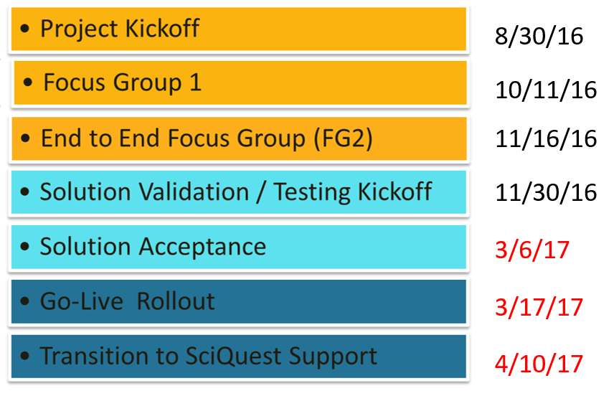
SpearMart Enhancement Project Timeline

Slide 7
SpearMart Enhancement Project – End User Training
Training will be available for campus beginning Mid to late February
Training for end users with “Requester” Role is required prior to Go-Live.
Requesters can select either training option:
Hands-On Instructor Led training
Self-paced online course
Visit our website for Instructions on how to register for training:
www.procurement.fsu.edu

Slide 8
Contact Information
Questions?
For additional information and project updates visit:
http://procurement.fsu.edu/spearmart/spearmart-enhancement-project
Ian Robbins
Chief Procurement Officer
irobbins@fsu.edu
644-9719

Slide 9
Disbursement SERVICES

Slide 10
Disbursement Services
New Travel System
Management Updates

Slide 11
Coming Soon to meet all of your travel needs
Dedicated Travel Management Company (TMC)
World Travel Service, Inc.
865-777-1481
www/worldtrav.com

Slide 12
Concur Project Goals -

Slide 14
Tentative Implementation Plan
Planning: January – March 2017
Travel Advisory Group meetings – February-October 2017
First Meeting - February 17, 2017 3:00pm-4:00pm
Pilot Testing – Summer 2017
Campus Wide Training – October 2017
Campus Go-Live – November 2017

Slide 15
QUESTIONS ??

Slide 16
Management Updates
New Accounts Payable Manager:
Denise Winchester
New Accounts Payable-Encumbered Payments Supervisor: Laurel McKinney
New Vendor/Imaging Team Manager:
Lauren Barrett

Slide 17
Disbursement Services Contact Information
Carla Daniels
ccdaniels@fsu.edu
644-1841
Denise Winchester
dmwinchester@fsu.edu
645-6594
Jennifer Pittman
jpittman@fsu.edu
644-9410
Lauren Barrett
lmbarrett@fsu.edu
645-8611
Laurel McKinney
lmckinney@fsu.edu
645-7183

Slide 18
Reporting & Business Intelligence
Budget & Transaction Dashboard

Slide 19
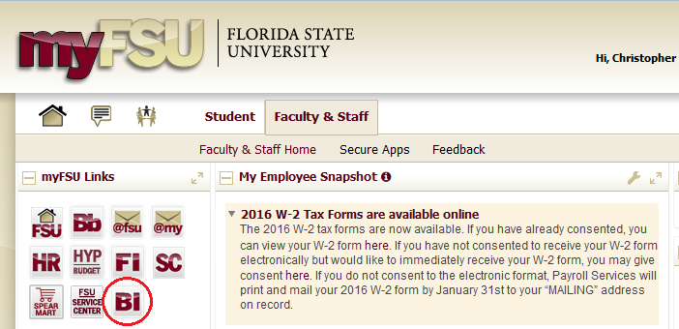
Background Information
Reports are available to all financials users. Access to some sub-reports are dependent upon security roles.
Reports were developed to provide a quick & easy answer to the question of “how much money do I have?”

Slide 20
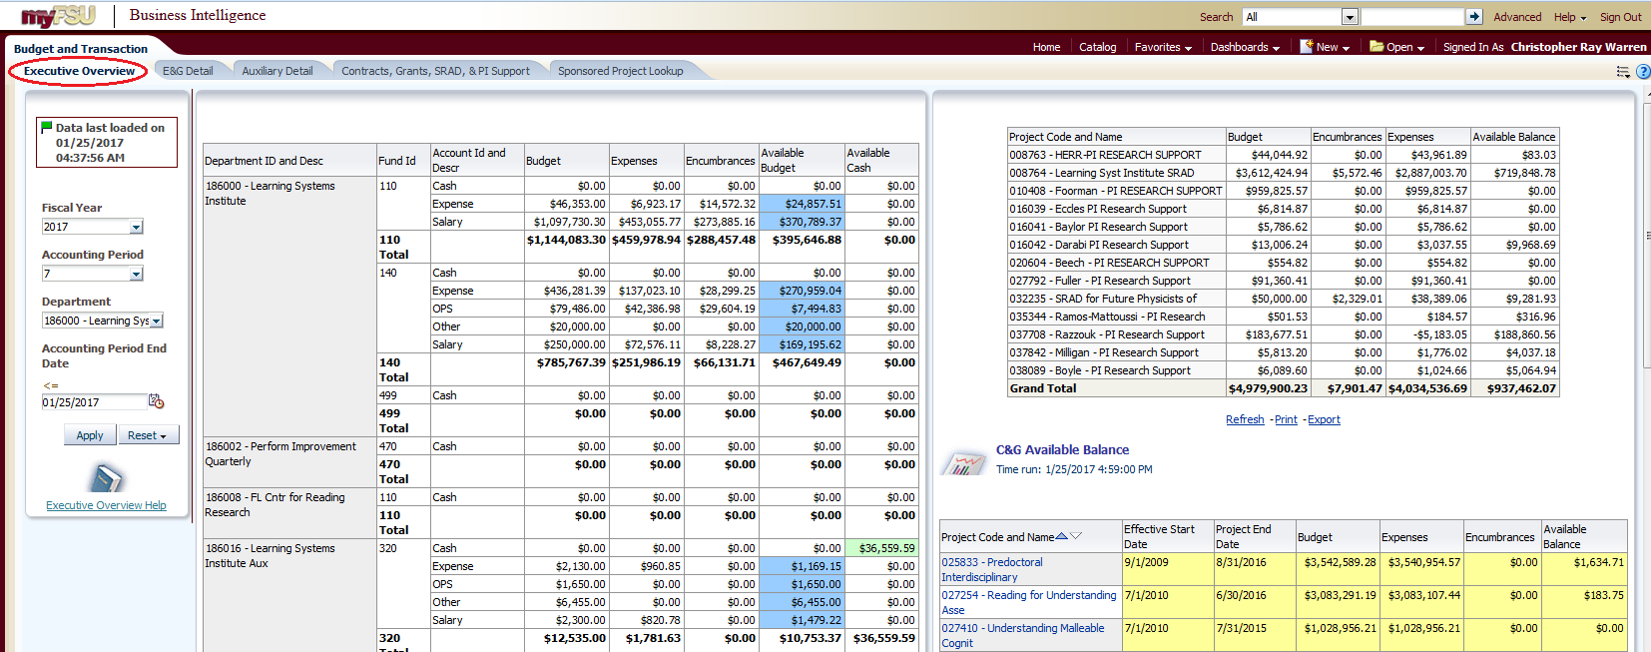
Executive Overview

Slide 21
E&G Detail
Drillable links!!
Drill down to purchase orders, travel authorizations, vouchers, expense reports, journals, and payroll (depending upon security roles)
View encumbrances by:
Account
Doc. ID
Supplier
Drill into salary expenses or leave them rolled up into subtotals.

Slide 22
Auxiliary Detail

Slide 23
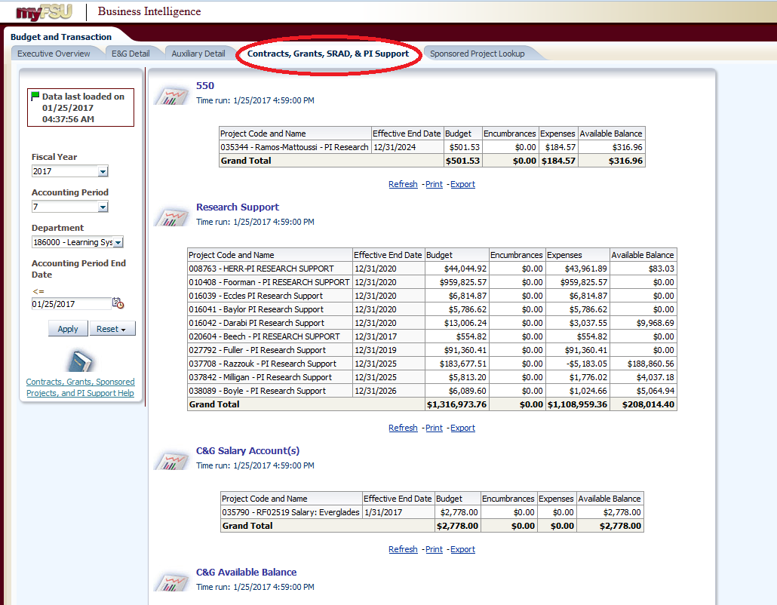
Contracts, Grants, SRAD, & PI Support
SRAD
Research Support
Salary Accounts
Contracts & Grants
Click on the linked contract or grant to launch the Sponsored Project Lookup!

Slide 24
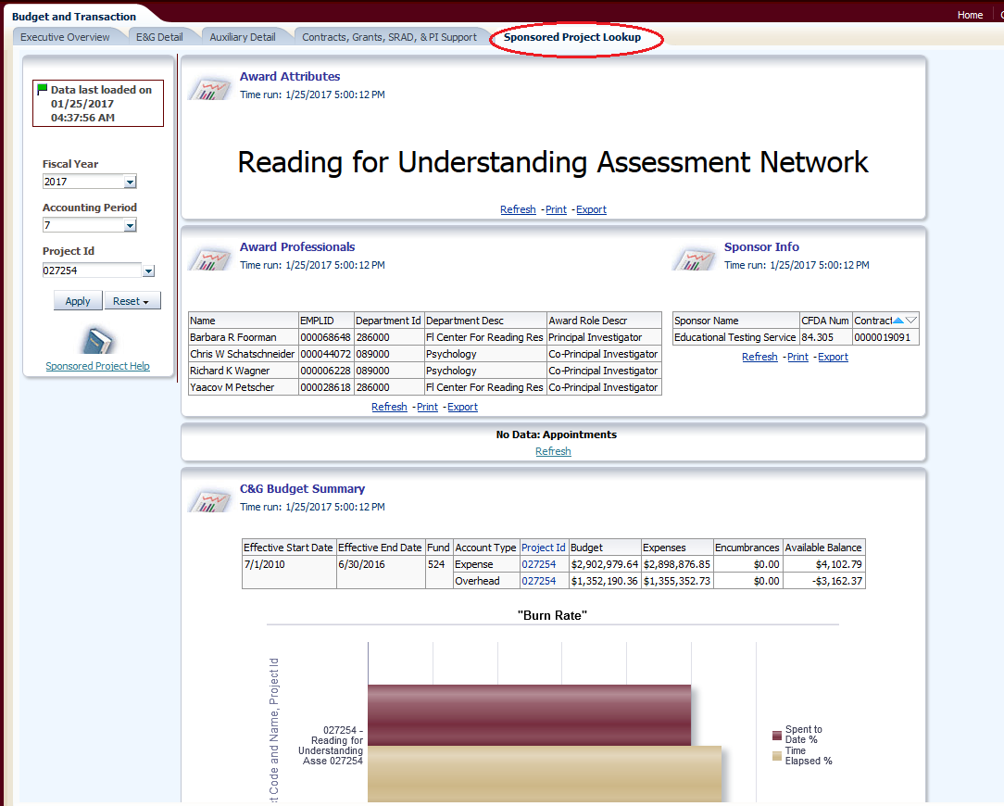
Sponsored Project Lookup
Ready made high-level report!
View PI/Co-PIs
Active Appointments
Available Budget
Drill to transaction-level data

Slide 25
Wrap-Up
Questions & Comments?
Contact
Chance Brown
cbrown5@fsu.edu
645-7875

Slide 26
General Accounting
Cash Balance Trend Report
General Ledger Reminders

Slide 27
Cash Balance 12 Period Trend Report

Slide 28
General Ledger Reminders & Tips
Purchasers:
Extra step required: When purchasing an OCO item on SpearMart, you must select an OCO category code.
Travel Reps:
All cash advance refunds should be applied back to the advancing department ID/Fund 499/Account 151005
Cash Transfer Uploads
Cash = E&G Budgets by the end of business the day after a transfer is made.
All checks processed should be coded as external revenue or an expense reimbursement.

Slide 29
Contact Information
Questions?
Corey Jones
cjjones@fsu.edu
644-5022

Slide 30
Auxiliary Accounting
Updates & Reminders: Auxiliary AR & Billing

Slide 31
ITS Go-Live: January 2017
ITS’ first billing cycle was 1/25/2017
95% of ITS’ expected billable lines for January were processed as expected
Invoices are at a summary level; detailed backup retrieved via normal means
Continue to review your backup as needed at its-mysoft.its.fsu.edu/selfservice ; request access if needed

Slide 32
Resources Available to You
http://controller.vpfa.fsu.edu/auxiliary-ar-billing
Step-by-Step Training Guides
Frequently Asked Questions
Change Order Form
Contact Information

Slide 33
Frequently Asked Questions
Who receives auxiliary (internal) invoice emails?
Budget Manager associated with the PO department
Do I need to enter a receipt on internal PO’s?
No; internal PO’s do not require receipts in OMNI. They will be paid through the monthly processes without receipts.
How can I review internal bills and invoice data?
Multiple Ways! See training guide called “Understanding Auxiliary AR/Billings Charges”

Slide 34
Reminder: PO is the Charge Mechanism
The Purchase Order is your billing/charging mechanism – it does not place an order with the auxiliary .
Always update the selling auxiliary when you have changes to the goods/services provided, including the PO/line you want to charge.

Slide 35
Important Information: Quantity vs. Amount
For internal open-ended requisitions/purchase orders:
Price should always be equal to the amount you expect to spend
Quantity should always be equal to 1
Requisition lines should always be flagged as “amount only”

Slide 36
Next Steps
For next fiscal year, you’ll need to ensure PO’s are entered for ITS and OBS
Suggest copying from prior year PO’s and adjusting as needed
More information and instructions forthcoming, but no need to wait to plan!
We are identifying and solidifying our next “cohort” and plan to share more information in late Spring.

Slide 37
Contact Information
Questions? Feedback? Ideas?
Cassandra Rayne Gross
crayne@fsu.edu
644-1824

Slide 38
Controller’s Office – Quality Assurance
Updates and Reminders

Slide 39
Updates and Reminders
OBIEE Oracle 12 C new database / new look and feel
Demonstrate Trend Ledger
Controller’s Office
Location of Resources on Controller’s Office Website
Financial Representatives Certificate

Slide 40
Contact Information
Questions? Feedback? Ideas?
Geoffrey Adams
gdadams@fsu.edu
645 - 7758

Slide 41
Vice President Finance and Administration

Slide 42
Florida State University
Accomplishments
Jumped to # 38 in the top public school rankings on US News and World Report
Five places in one year, we are on our way to the Top 25
Still considered one of the most efficiently run Universities
VPFA Perspective

Slide 43
Budget Updates
Key Dates for 2017-2018 Operating Budget
March 1, 2017 – Proposals due to the Budget Office
March 7, 2017 – Legislative Session convenes
April 28, 2017 – Review of proposals complete
May 5, 2017 – Legislative Session ends
June 8, 2017 – Board of Trustees approves Budget
July 1, 2017 – New allocations provided in departmental base budgets

Slide 44
Budget Updates
Upgrades made to the Hyperion budget application
SALARY
Various enhancements to make SALARY easier and more intuitive to use
Added the ability to provide percentage salary increases by employee or department
Ability to send non-E&G salary and benefit totals to the ALLFUND application (previously, this had to be done manually)
ALLFUND
Streamlined reporting by providing a more user-friendly interface in BI
Provided users two new tools to help verify their budget entry
Consolidated several “forms” to make budget entry easier and less cluttered

Slide 45
Florida Legislative Session 2017
Budget Details
Governor’s recommendation -vs- actual appropriation and implementation act Ch. 2016-066 and Ch. 2016-62
Governor’s recommended budget FSU’s General Revenue Appropriation will see a 12% cut in FY 2018
2018 - $208,058,418 / 2017 - $237,453,654
Governor’s recommended budget FSU’s Education Enhancement “Lottery” Trust Fund Appropriation will see an increase of 9% in FY 2018
2018 - $46,289,450 / 2017 – $42,414,121

Slide 46
Florida Legislative Session 2017
Budget Details
FSU’s Authority to Spend Collected Tuition and Fees in the 2018 Governor’s Recommended Budget will see no change over last fiscal year.
2018 - $238,310,768 / 2017 - $238,310,768
Performance Based Funding and Preeminence
Governor’s recommended budget includes a $100 million increase in available performance funding dollars for all State Universities
2018 - $600,000,000 / 2017 – $500,000,000
Preeminence
In 2017, FSU received $35 million for preeminence funding
The 2018 Governor’s recommended budget for preeminence funding remains at $35 million

Slide 47
Florida Legislative Session 2017
What to Watch for FSU
Regularly Monitor : http://govrel.fsu.edu/
Senate, House, and Governor’s office priorities relative to Higher Education in Florida
SENATE
Senate Bill 2 “Florida Excellence in Higher Education Act”
Performance funding metrics modification
Bright Futures Expansion
Block Tuition
Economic Impact

Slide 48
Florida Legislative Session 2017
HOUSE
House Bill 489 “Restore our Bright Futures Act”
Prioritizes funding for use in summer semester
Reduces test score eligibility requirements
Funds 100% of tuition and Fees for “top tier” students
Funds 75% of tuition and Fees for “2nd tier” students

Slide 49
Florida Legislative Session 2017
Governor
Freezing Fees
Cutting graduate teaching assistant fees by 25%
Expanding Bright Futures
Cutting taxes on college textbooks

Slide 50
Strategic Plan Primer
What is the Strategic Plan
http://strategicplan.fsu.edu/
Goals
Continuous Innovation
Academic and Research Program Excellence
Diversity and Inclusion
Student Success On Campus and Beyond
Preparing Students for 21st Century Careers
Strategic Investment in our Brand

Slide 51
Contact Information
Questions?
Kyle Clark
Kevin Pierce
Administrative Assistant
krpierce@fsu.edu
645-4926

