Slide 1
Financial Representative Meeting
April 6, 2021

Slide 2
Finance & Administration
Kyle Clark
Vice President for Finance & Administration

Slide 3
COVID-19 Federal Stimulus
 | Award Amount |  | Spent To-Date |  | Award Date |  | Spend Deadline
Student Awards
Coronavirus Aid, Relief, and Economic Security (CARES) Act | $14,669,914 |  | $14,669,914 |  | 4/28/2020 |  | 2/15/2022
Coronavirus Response and Relief Supplemental Appropriations Act (CRRSAA) | 14,669,914 |  | 5,783,450 |  | 2/16/2021 |  | 2/15/2022
American Rescue Plan Act (ARPA) * | 40,604,778 |  | - |  | TBD |  | 9/30/2023
Total Student Awards | $69,944,606 |  | $20,453,364
Institutional Awards
Coronavirus Aid, Relief, and Economic Security (CARES) Act | 14,669,914 |  | 11,929,322 |  | 5/5/2020 |  | 2/15/2022
Coronavirus Response and Relief Supplemental Appropriations Act (CRRSAA) | 30,712,499 |  | - |  | 2/16/2021 |  | 2/15/2022
American Rescue Plan Act (ARPA) * | 39,825,153 |  | - |  | TBD |  | 9/30/2023
Total Institutional Awards | $85,207,566 |  | $11,929,322
Total Stimulus Awarded | $155,152,172 |  | $32,382,686
* Estimated as of 3/23/21

Slide 4
Stimulus Student Support
Spent To-Date | Amount
Financial Aid | $ 20,453,364
International Programs Refunds | 4,000,000
Housing Refunds | 3,000,000
Meal Plan Refunds | 978,000
Shipping/Travel Reimbursements | 205,883
Total Spent to-Date | $ 28,637,247
Future Spending
Coronavirus Response and Relief Supplemental Appropriations Act | $ 8,886,464
American Rescue Plan Act* | 40,604,778
Total Future Spending | $ 49,491,242
Grand Total Stimulus Student Support | $ 78,128,489
* Estimated

Slide 5
CARES Institutional Expenses
 |  | Amount
CARES 1 Institutional Funding |  | $ 14,699,914
Expenses
 | Spring 2020 International Programs Refunds | $ 4,000,000
 | Spring 2020 Housing Refunds | 3,000,000
 | Student/Faculty/Staff Testing, Contact Tracing, Vaccinations | 1,560,625
 | Spring 2020 Meal Plan Refunds | 978,000
 | Campus-wide Technology Services | 961,367
 | Campus PPE, Safety & Operations | 921,822
 | Off-campus quarantine housing | 301,625
 | Shipping/Travel Reimbursements to Students | 205,883
Expense Total |  | $ 11,929,322
Balance |  | $ 2,770,592

Slide 7
COVID-19 Mitigations
Administered over 72,250 COVID-19 tests between March 2020 – March 2021
Reported 2,300 positive tests through February 2021
  2,200 students
  100 colleagues
3.82% overall positivity rate

Slide 8
Partnered with Tallahassee Memorial Health Care, Capital Regional, Leon County Health Department, Leon County Emergency Management, Florida Department of Health, and Florida Department of Emergency Management
Vaccine clinic held at Tucker Center
350 appointments in ½-day increments
Led by Dr. Zedaker, Ryen Pagel, College of Medicine, College of Nursing, University Health Services, FSU Primary Health Clinic, and FSU Emergency Management
Dr. Van Durme, Chair of the Medical Advisory Committee and Senior Associate Dean providing through Family Medicine Clinic

Slide 9
Preparing to do a public health study partnering with CDC and FL DOH to evaluate the efficacy of a home test kit for use in a university setting
Started administering the vaccine January 5, 2021
Currently vaccinating individuals 16+, K-12 school employees, healthcare personnel, medically vulnerable, and law enforcement for both FSU and all of Florida
Administered over 11,277 vaccines through March 30, 2021
  5,727 prime vaccinations
  5,550 booster vaccinations

Slide 10
Legislative Session
Current 6% holdback per the Governor
Initial Senate Appropriations include a 4.6% reduction for the SUS with the 6% holdback being permanent. $17 million to support Legacy Hall
Initial House Appropriations are projecting an 11% reduction; however, they propose returning the 6% holdback
These are just initial projections, many changes will be forthcoming
No PO&M funding for new buildings
No tuition increases

Slide 11
House
$4.6 Billion appropriation for the SUS. This is a net decrease of $570 M or 11 percent
($132.5 M) Reduction for Performance Funding State Investment
$11.8 M for Integrated Library System (matches the Board’s request)
$40k for Johnson Matching Scholarship Program (matches the Board’s request)
$70 M for Program of Strategic Emphasis Incentives
($207 M) Eliminates Preeminence/National Ranking Funding
($140 M) Elimination in Operational Support funds (received over the last several years at 10 universities)

Slide 12
House - continued
($69 M) Reduction based on Distance Learning Fee Revenues
($60 M) Eliminates the Graduate/Professional Degree Program
($55 M) Elimination of National Ranking Funds for FSU and UF
($18 M) Reduction for Faculty Salaries in non-high demand programs
($6 M) Reduces University of Distinction Funding for UNF and FGCU
($15 M) Reduction to UF-IFAS for Operational Support
($9 M) Reduction for World Class Faculty and Scholars Program

Slide 13
Senate
$4.9 Billion appropriation for the SUS. This is a net decrease of $241 M or 4.6 percent
$560 M for Performance Funding (maintains the current budget)
$11.8 M for Integrated Library System (matches the Board’s request)
$3.7 M for UF-IFAS Workload (matches the Board’s request)
$2.2 M for 7 university projects
($37 M) Administrative Efficiencies (recurring – no information on the allocation)
($217 M) Program Reductions (non-recurring – no information on the allocation)
($3.3 M) Reduction for 4 university initiatives

Slide 14
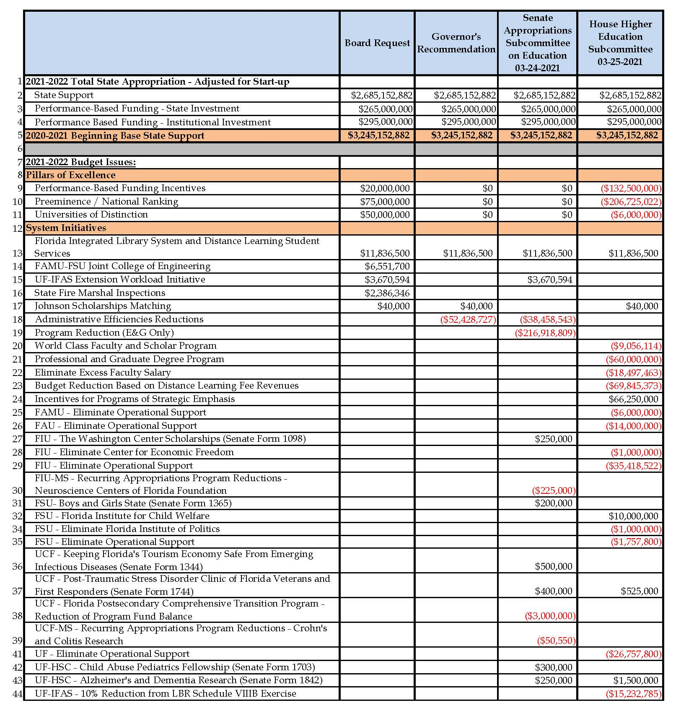
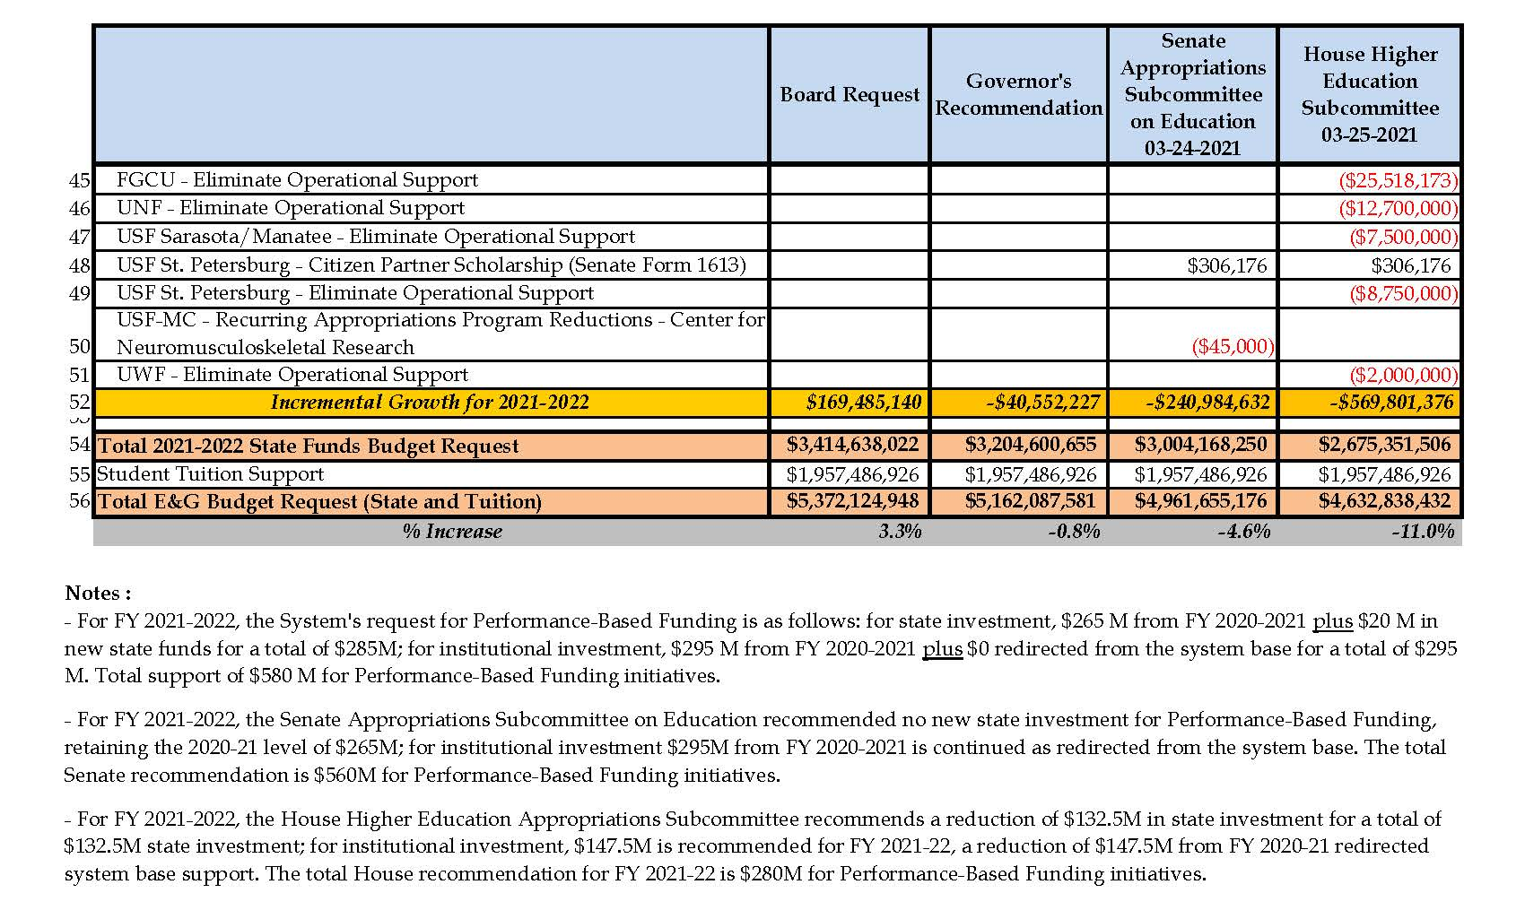

Slide 15
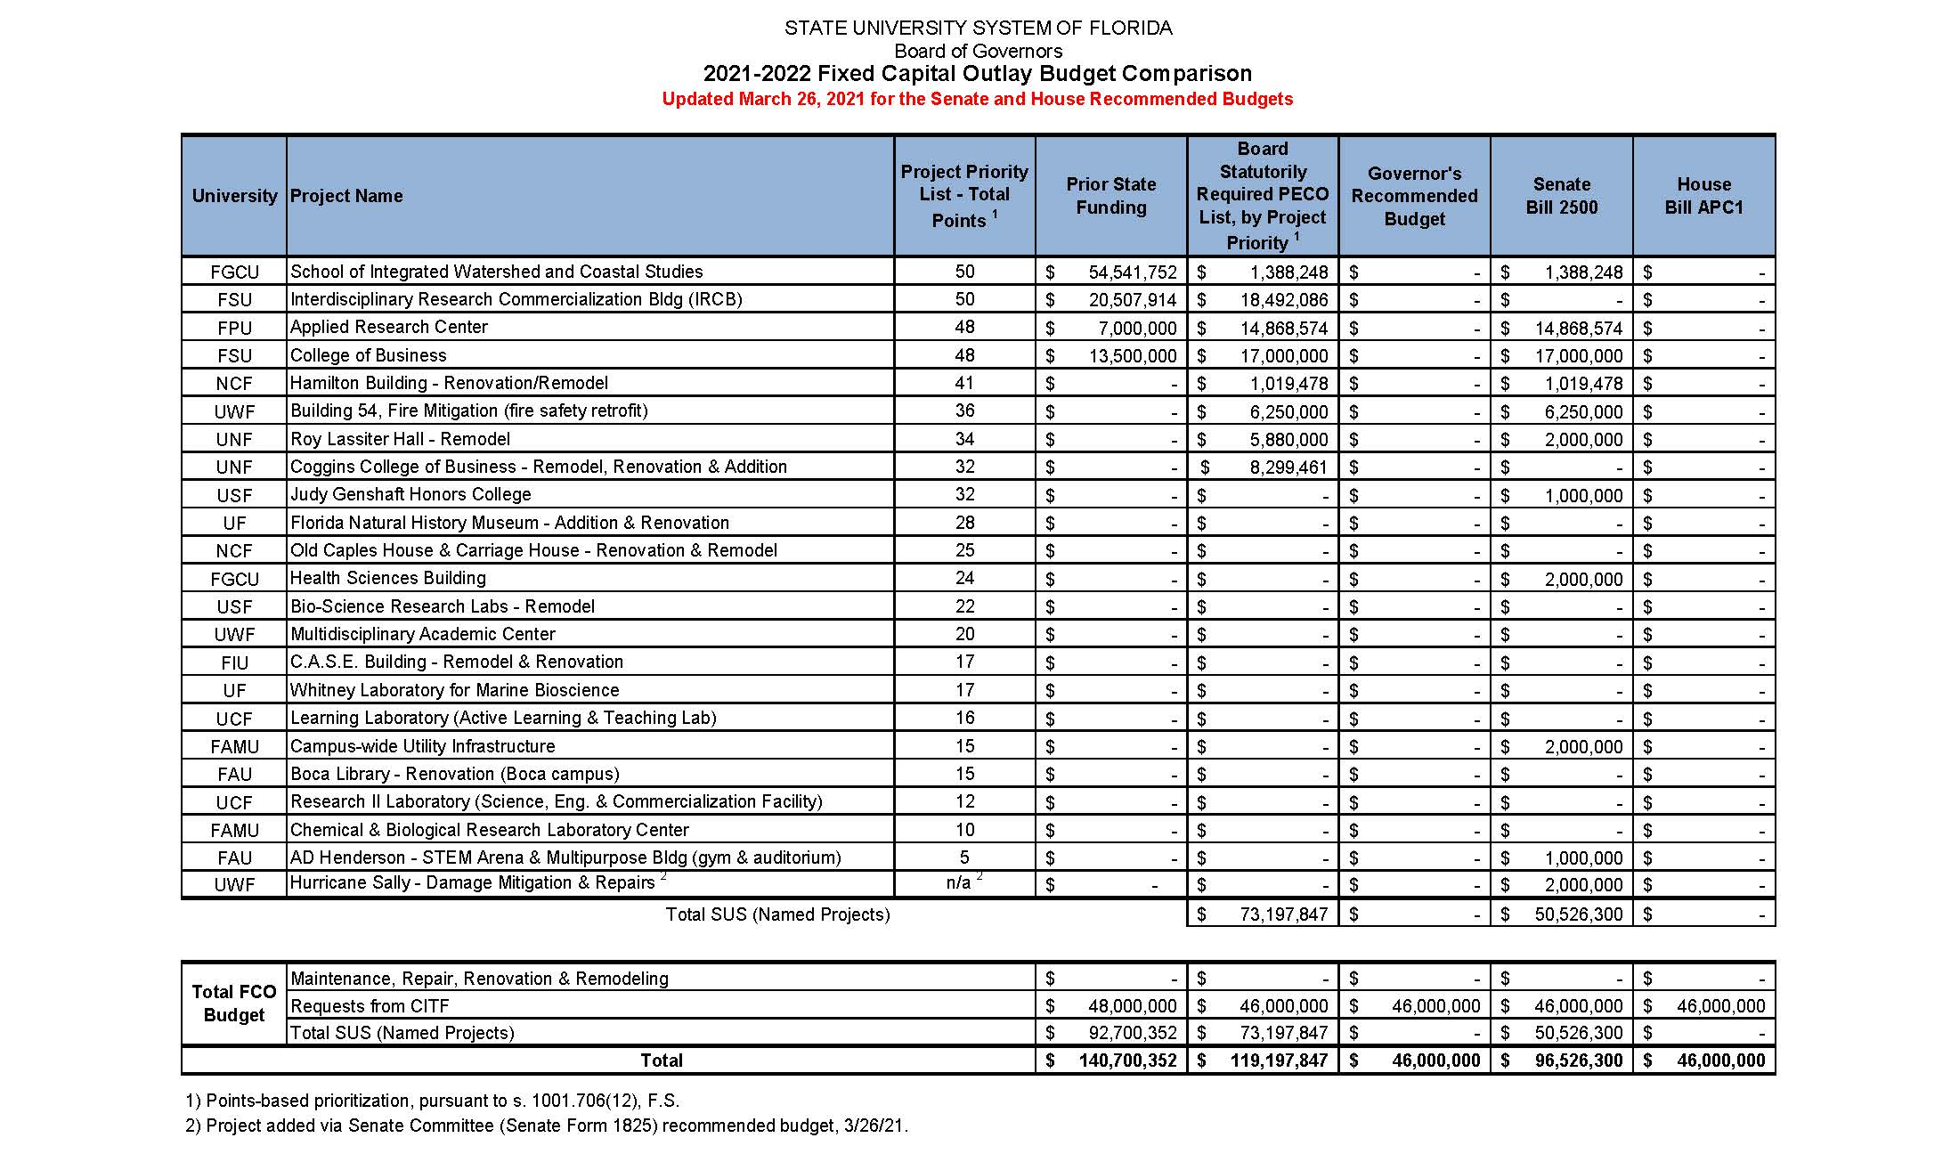

Slide 16
Operating Budget Timeline
January 5, 2021 – Memo submitted to campus calling for budget requests
March 1, 2021 – Proposals due to the Budget Office
March 2, 2021 – Legislative session begins
April 1, 2021 – Hyperion ALLFUND & SALARY Application opens
April 18, 2021 – Hyperion SALARY closes
April 30, 2021 – Hyperion ALLFUND closes
April 30, 2021 – Legislative session concludes
June 17, 2021 – Board of Trustees meeting
July 1, 2021 – New allocations provided in departmental base budgets
https://budget.fsu.edu/OperatingBudgetInfo

Slide 17
Contact Information
Kyle Clark
  https://vpfa.fsu.edu/
  644-4444

Slide 18
Procurement Services
April 6, 2021

Slide 19
What's New?
Procurement User Manual
New ListServ for Announcements (PROCON)
New Policies: Signature Authority, Contract Administration
New Contract Sharing Procedures
Notes:
Per BOG Regulation 18.001, “Universities must maintain appropriate justification for the use of services contract adoption.

Slide 20
2-7 Signature Authority
This policy clarifies which employees of FSU have authority to sign contracts and to whom such authority may be delegated.
This policy applies to all written contracts relating to commercial and non-commercial transactions including, but not limited to, goods, supplies, equipment, services, programs, and real and personal property (excludes personnel contracts and sponsored project awards, related research awards and related sub-recipient agreements).
The proper delegation of authority to execute contracts with external entities is necessary to minimize legal, financial, and related risks to Florida State University (FSU).
Notes:
•Defines authority by role rather than person;
•Defines authority responsibilities and internal controls;
•Limits delegations for efficiency.

Slide 21
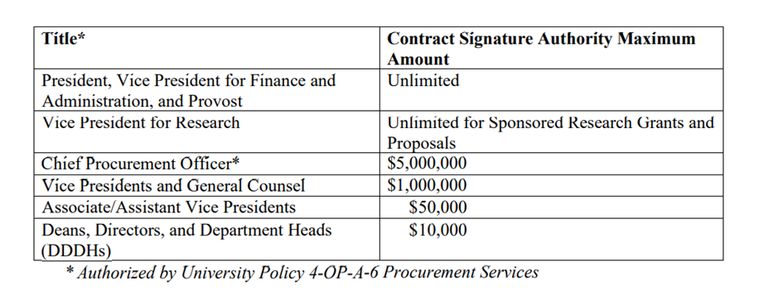
2-7 Signature Authority: Key Points

Slide 22
4-OP-D-4 Contract Administration & Management
Establishes consistent guidance for composing, reviewing, approving, executing, amending, managing performance, and/or compliance with contract requirements throughout a contract’s lifecycle.
The development and implementation of contract administration policies help ensure uniformity of contract operations and contract records management. This policy allows for a higher level of internal controls for the creation, routing, approving, storing and managing of contracts.
Notes:
•Defines contract;
•Establishes and defines Roles and Responsibilities;
•Establishes and defines Contract Administration Program.;
•Establishes Contract Module and Routing/Execution process.

Slide 23
Helpful Tips for Year End Preparation
Reviewing POs and Statuses
Submit change orders in SpearMart to close any POs
Submit Excel Spreadsheets for multiple closings (include supplier names and attach to a change order form request in SpearMart)
Use this query: FSU_PO_AMT_BY_DEPTID_DATERANGE
Notes:
This query identifies all POs in all statuses for a particular department ID.
Do not create “0” dollar lines on requisitions
Do not receive a percentage of quantity of 1 to try and match an invoice. Submit a change order to make the PO an “Amount Only” PO
Do not switch quantity and price on any requisition/PO. Use the Services Fixed Form instead
Do not create a PO for longer than 1 fiscal year.

Slide 24
Helpful Tips - Contracts
Notify Procurement at least 75 days prior to contract expirations or renewals
Contracts may require competition, analysis, contract review/approval and PO processing
Define specifications, requirements essential to the purchase

Slide 25
End of Year Calendar Tasks
4/30/2021 – Last day to submit requisitions exceeding $75,000 or require internal or external approvals. Requisitions received after 4/30/2021 may not be processed in this FY.
6/1/2021 – Last day to request PO Due Date Extension/Roll.
6/7/2021 – Last day to enter requisitions over $10,000 and under $75,000 that require quoting and internal approvals.
6/15/2021 Contracts not in pending approval status by 5:00pm may not be processed in this FY.
6/22/2021 – Requisitions and Change Order requests not in approved status by 5:00pm will be cancelled.
6/23/2021 – Pre-entry window for FY22 requisitions.
6/28/2021 – Pre-entry window for FY22 requisitions ends by 5:00pm.
6/28/2021 – Last day Procurement will process approved FY21 requisitions to purchase orders that were approved by 6/22/21.
Notes:
After reviewing your POs you can submit a list of all POs to be closed and not rolled through COB 6/1/2021 to ChangeOrder@fsu.edu

Slide 26
Year End Calendar
Deadlines stating “Last Day” refer to the last day in which we may be able to guarantee processing in FY21. You may be able to submit requisitions for any amount through 6/22/21, but there is no guarantee that they will be processed.
For critical needs contact Procurement Services
Notes:
If an urgent need arises during the period that requisitioning is closed, please contact Procurement Services or use your PCard. PCard purchases must follow University guidelines. Contact PCard Administrator to obtain a waiver/exception for emergency situations. Keep in mind that Procurement will work with you on any urgent requests. Solicitation processes will still continue; however, the requisition will be entered next FY if the solicitation hasn’t been awarded prior to the posted year end dates for requisition processing.

Slide 27
End of Year Calendar Tasks
Departments should begin reviewing SpearMart and OMNI POs (non-AUX) and submit change request forms to cancel items no longer needed. To close POs send a spreadsheet with PO number and Supplier name in PO number order to ChangeOrder@fsu.edu.

Slide 28
PO Closing Criteria
Past the due date
Encumbered amount is less than or equal to $100 and no activity within the last 60 days (AUX, Construction, and “R” POs excluded)
Fully received, matched and vouchered
Has a mismatch of receipt to voucher

Slide 29
Invoices for POs closed or cancelled
The following criteria must be met:
PO Closed
Goods/Services were completed by the PO Due Date
Goods/Services have a matching receipt (PO, Invoice, Receipt all match)
Invoice sent after the PO closed
Notes:
Disbursement Services will process a payment request when the following criteria is met if you get invoices for POs that were closed or cancelled.
If a department receives an invoice that is dated after the PO closed due to year end, and it matches the Purchase Order, the department can proceed to enter a Payment Request Form (ePRF) through August 31, 2021. Departments should reference the PO # and Receipt # (when applicable). Questions regarding this process can be sent to CTL-AccountsPayable@fsu.edu

Slide 30
Year End Calendar - Additional Information
Procurement Calendar Dates, Available Queries, FAQs and Contact Information: Procurement Website https://procurement.fsu.edu/
Dates are subject to change. Review frequently.

Slide 31
What’s Next?
Amazon Catalog in Spearmart (no waivers!)
Spearmart User Interface Upgrade
Tallahassee Depot
Notes:
Accounts Payable will not process a payment request if the following occurred:
PO Closed
Goods/services were completed after the PO due date
Goods/services do not have a matching receipt (invoice amount is more than PO)
Again, Examples include Dates of Services are not within PO dates, Prices do not match PO, and items do not match PO) then the payment request will be denied.
If you have questions, you can contact AP/Disbursements and questions can be sent to CTL-AccountsPayable@fsu.edu but if denied, you will need to work with Procurement Services and send through as a “Confirming Order” using the SpearMart Confirming Order form.

Slide 32

Sign up for FSU's new Procurement Advisory Council (PAC) by contacting Daria Amarii at damarii@fsu.edu

Slide 33
Disbursement Services
April 6, 2021

Slide 34
Disbursement Services: Reminders & Updates
Accounts Payable
Travel

Slide 35
Confirming Orders
Email Invoices with PO# & Receipt #
  CTL-Invoices@fsu.edu
Notes:
Based on the FSU_PURCH_CONFIRMING_PO_SEARCH query, there were 252 confirming PO's from 7-1-2020 to 3-19-2021. AP confirmed that 63 invoices needed to be sent to DocMGT and 47 receipts needed to be created at the department level.

Slide 36
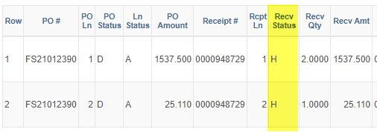
Compliance Report Receipts
New Process- Coming Soon!
New Receipt Hold Function
Departments will need to email CTL-AccountsPayable@fsu.edu with issues pertaining to their order.
ISO- Pilots
Please email mmpohto@fsu.edu if you would like your department to test this new process.

Slide 37
If PO is Closed
Won’t Process via ePRF
Will Process via ePRF
Goods/Services were completed by the PO Due Date
Goods/Services have a matching receipt (PO, Invoice, Receipt all match)
Invoice was sent after the PO Closed
Goods/Services were completed after the PO Due Date
Good/ Services do not have a receipt
Goods/Services do not have a matching receipt (Invoice amount is More than PO)

Slide 38
Contact Information
Carla Daniels
  CTL-AccountsPayable@fsu.edu
  ccdaniels@fsu.edu
  850-644-1851

Slide 39
In-State Travel
Restrictions on in-state travel lifted 4-1-21
Does a traveler cross state lines? It’s out of state travel & needs VP permission.
Airfare must be booked in Concur or via phone with World Travel.

Slide 40
Avis/Budget
Avis/Budget is the contracted rental car vendor.
OPS grad students must book leisure rentals in Concur to receive state rate.

Slide 41
New Max Hotel Rate
New max rate is $175/night before taxes & fees

Slide 42
Virtual Conference
Virtual conferences are allowed
  T-card, P-card, out of pocket all ok
  P-Card if abstract fee, membership included
Non-travel expense report
No travel request needed

Slide 43
T-Card Reminder
Employees moving from one department to another must cancel their travel card.
Leaving FSU? T-Card Cancellation Form
Do not purchase memberships on a t-card.
T-Card questions? Email dmyrick@fsu.edu

Slide 44
Contact Information
Questions?
  Travel.fsu.edu
Lynn Masimore – Travel Manager
  lmasimore@fsu.edu
  travel@fsu.edu
Notes:
Thanks for the reminders – Last but not least we have Derrick Myrick who will go over some P-Card reminders.

Slide 45
Cash Management, Banking, & Revenue Accounting
April 6, 2021

Slide 46
Cashnet Auxiliary eMarket
New option for Auxiliary AR/Billing customers to pay online using a credit/debit card!
No action needed from Auxiliary AR/Billing departments

Slide 47
Cashnet Auxiliary eMarket
Customers navigate to the site and pay themselves
Departments cannot enter card information on behalf of a customer who calls or presents a card in person
Not designed to replace existing point-of-sale solutions
Payment will systematically be entered into OMNI to close outstanding invoice(s), just like check payments mailed to Auxiliary Accounting P.O. Box

Slide 48
Cashnet Auxiliary eMarket
Demo: Changes to Invoice
Demo: Site Navigation
  (for customers only)

Slide 49
Miscellaneous Deposit Guidance
Updates to improve clarity and account for various scenarios
  Travel “scholarships”/ “grants”
  Insurance recoveries
  Repayments of t-card, p-card unallowable expenses
  Etc.

Slide 50
All-Auxiliary Meeting 2021
Late May – Stay tuned for date announcement!
Presenters & Topics will be finalized in early April
Topics may include:
    Cashnet Financials Updates
    Miscellaneous Deposit Guidance review
    Year-end auxiliary billing and deposit processing deadlines
    & other topics relevant to auxiliaries across campus

Slide 51
All-Auxiliary Meeting 2021
Have a question or a topic for the meeting?
  Email crayne@fsu.edu or rjames3@fsu.edu

Slide 52
Contact Information
Cassandra Rayne Gross | crayne@fsu.edu
  Revenue Accounting | Rashad James rjames3@fsu.edu
    Deposit Accounting: ctl-deposits@fsu.edu
    Auxiliary Accounting: ctl-auxiliaryaccounting@fsu.edu
  Cash Management & Banking | Dan Wussler dwussler@fsu.edu

Slide 53
Student Business Services
April 6, 2021

Slide 54
Student Payment Guidance
Based on departmental feedback, several recent changes to the guidance have been made in the following areas:
Account Code Changes
New Query
Form Updates
You can find an updated form, addendum, and FAQ’s on our website here: https://controller.vpfa.fsu.edu/services/tax-compliance/student-payments

Slide 55
Account Code Changes
    741957 Student Aid Dept Tuition – Formerly known as Stdnt Aid Dept Qualfd Tuition, this account code will now be used any time a department wishes to pay a student’s tuition, regardless of its status as qualified or non-qualified in IRS code.

Slide 56
Account Code Changes
    741958 Stdnt Aid Dept Other – This account code will be used to pay any non-tuition charges on a student’s account or to disburse various awards and stipends.
    741580 Stdnt Aid Dept Hlth Insurance – This account code will be used to pay a student’s health insurance charges.

Slide 57
Contact Information
John Bembry
  jbembry@fsu.edu
  644-9457

Slide 58
BI Reports
April 6, 2021

Slide 59
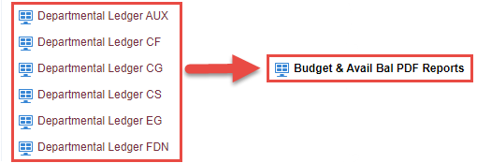
BI - Budget & Avail Bal PDF Reports Dashboard
Retired BI Departmental Ledger reports
consolidated under new
Budget & Avail Bal PDF Reports BI dashboard

Slide 60
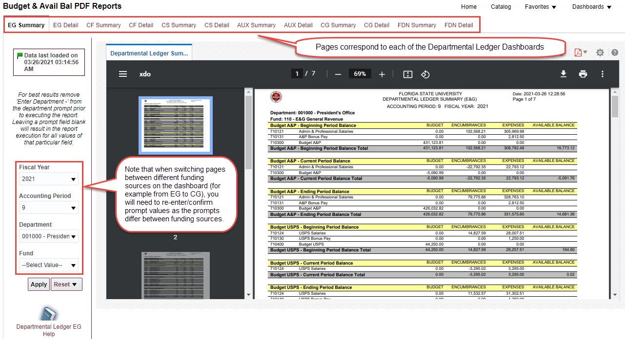
BI - Budget & Avail Bal PDF Reports Dashboard
Functionality and Reports generated same as old Departmental Ledger Reports

Slide 61
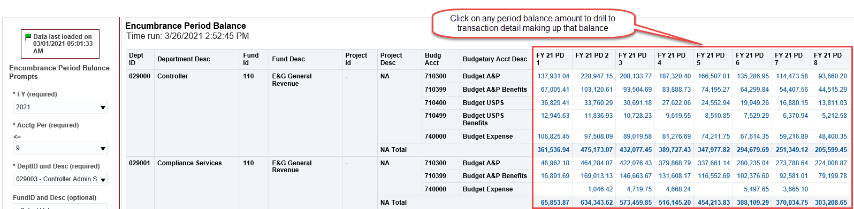
BI – Encumbrance Period Balances Dashboard
Trend of Encumbrance Balances as of the end of each Accounting Period
Drilling links to detail of encumbrance balances for each Accounting Period

Slide 62
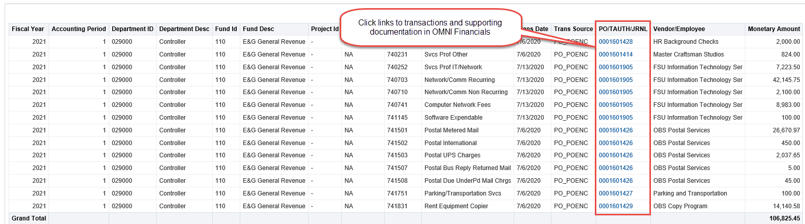
BI – Encumbrance Period Balances Dashboard
Detail has drilling links to supporting documentation stored in OMNI Financials

Slide 63
Departmental Ledger Review Guidance
New Departmental Ledger Review Guidance published March 5, 2021
  Supersedes guidance in University Controller’s Memorandum #02 (2007/2008) - Ledger Reconciliation Guidelines
  More focus on substantive review of transactions and financial ledger balances
  Less focus on preparing spreadsheets and collecting copies of supporting documentation already stored in FSU Systems
https://controller.vpfa.fsu.edu/services/accounting-reporting/ledger-review

Slide 64
Departmental Ledger Review Guidance
Step 1: Departmental Ledger Review
High-level review for reasonableness and accuracy
Pay more attention to significant changes, unexpected or atypical balances, large expenditures
Compare current activity to activity in previous accounting periods and fiscal years
Don’t need to verifying every transaction against supporting documentation

Slide 65
Departmental Ledger Review Guidance
Step 2: Research and Corrective Action
Significant variances, unusual activity, or suspicious transactions should be traced to the transaction(s) causing the issue and source documentation should be reviewed to determine if there is an error related to the transaction
If an error is found, take corrective action by submitting a correcting journal entry or contacting the appropriate central office (Payroll, AP, Travel, AR)
Discuss errors found with person originating the transaction to help reduce future errors
In the event of suspected fraud, take immediate action by bringing it to the attention of your supervisor and/or by contacting the Office of Inspector General Services

Slide 66
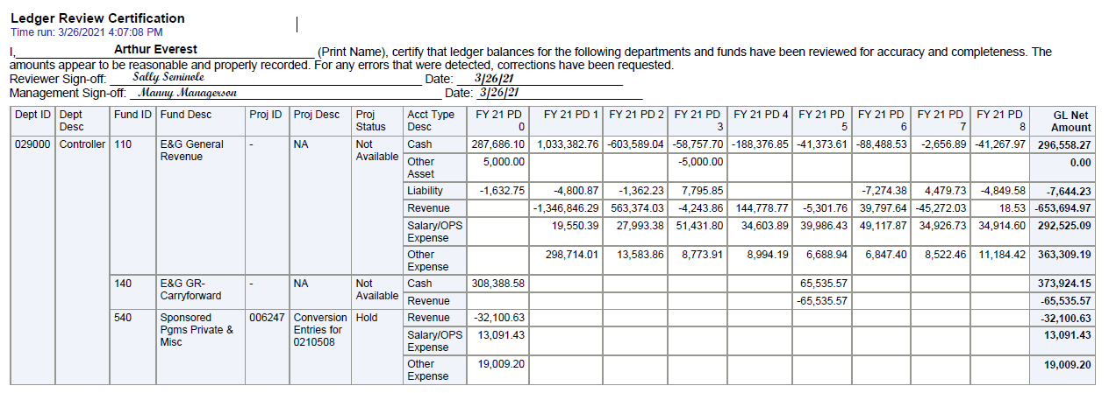
Departmental Ledger Review Guidance
Step 3: Document the Review
The ledger review should be completed, reviewed, and signed off on prior to the end of the second succeeding month.
The Monthly Departmental Ledger Review Certification BI Report is recommended but not required for this documentation.

Slide 67
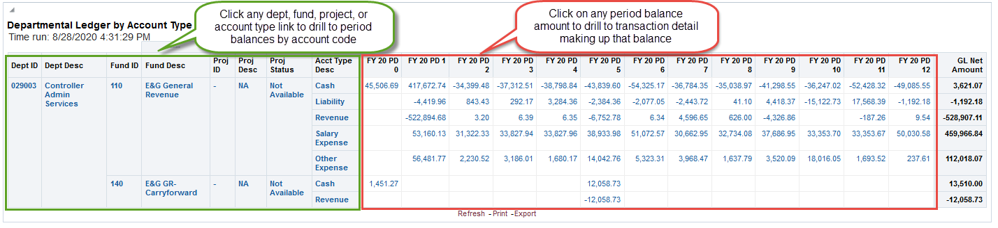
BI – Departmental Ledger Review Dashboard
Used to review Financial Ledger balances and activity
    Recommend using Firefox or Chrome web browser due to error messages in Internet Explorer
    Drilling links to account balance trends by department, fund, project and account type
    Drilling links to transaction detail on the balance amounts

Slide 68
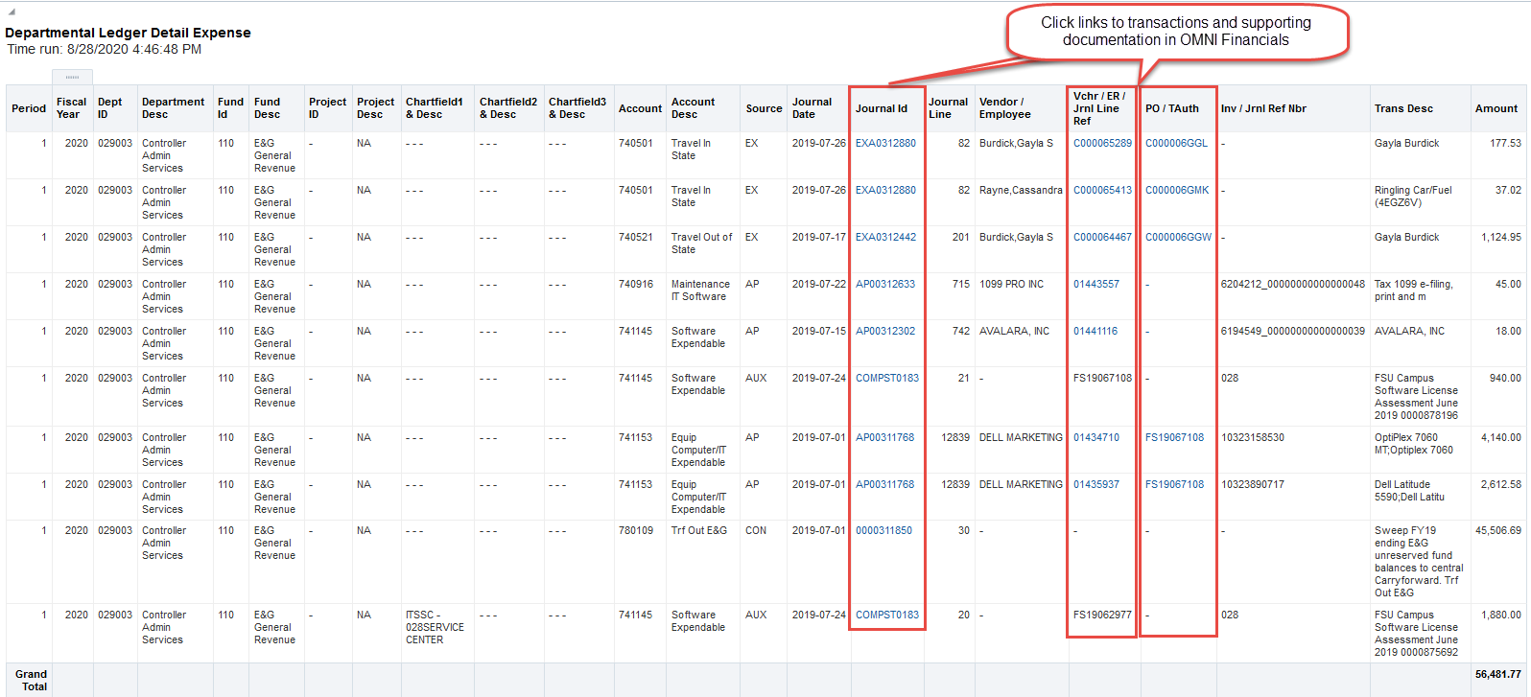
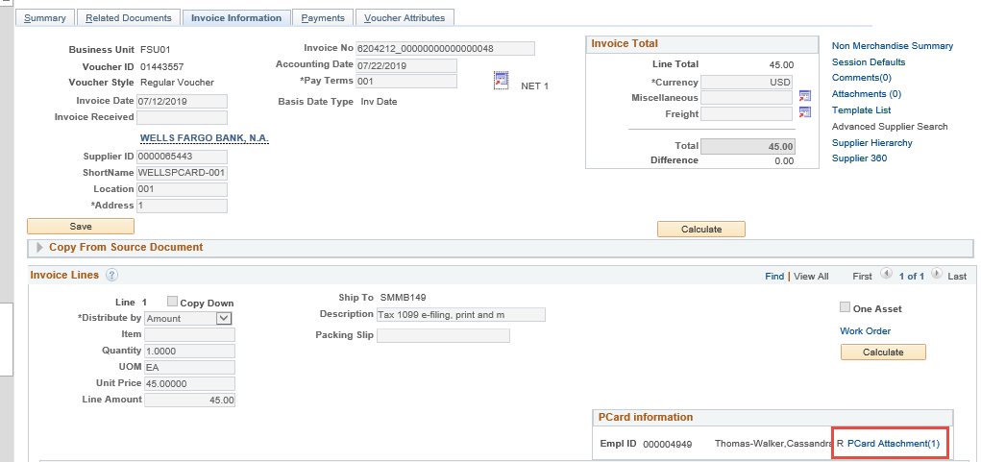
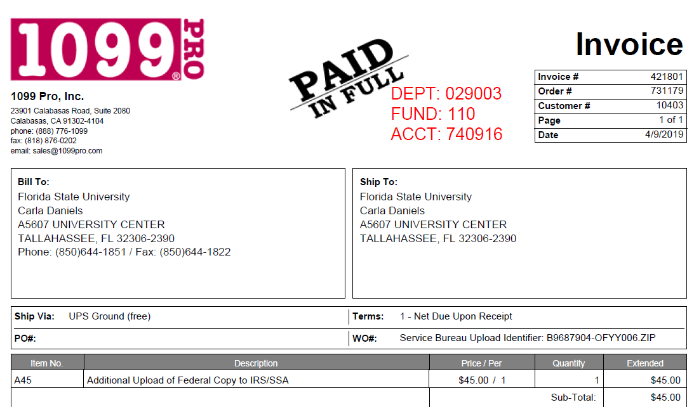
BI – Departmental Ledger Review Dashboard
Transaction detail has links to supporting transaction detail and supporting documentation stored in OMNI Financials
          Less time spent finding supporting documentation
          More time to review if the transaction is valid

Slide 69
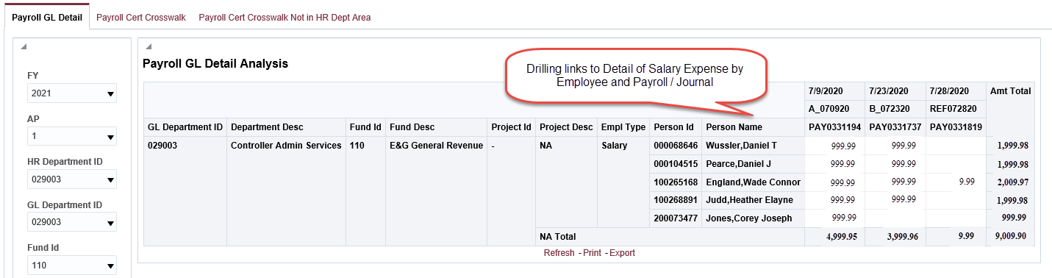
BI – Departmental Ledger Review Dashboard
Drilling links to Salary Expenses by Employee for each Payroll and/or Journal Entry

Slide 70
Contact Information
Daniel Pearce
  dpearce@fsu.edu
  645-4908

Slide 71
Q & A
April 6, 2021

