Slide 1
Financial Representatives Meeting
May 25, 2016

Slide 2
Agenda
Introduction
Facilities
Student Business Services
Accounting & Property Services
Budget Office
Procurement Services
Disbursement Services
Closing

Slide 3
FSU Vehicle Management Program (FVMP)
Dennis Bailey, Sr. Associate Vice President
Facilities

Slide 4
FSU Vehicle Management Program (FVMP)
Created to establish a centralized repository of all processes and documentation relating to the management of University vehicles.
It is not the intent to create a centralized fleet program.
Each area Vice President is responsible for compliance with the Vehicle Management Plan within their area of responsibility

Slide 5
FSU Vehicle Management Program (FVMP)
Maintenance and safety inspections of FSU-owned vehicles
University owned vehicles must be maintained in a timely manner
Records of vehicle maintenance and repairs must be tracked and kept in FSU Facilities Integrated Workplace Management System, AiM
Preventative maintenance tickets will be generated for each vehicle and must be addressed by departments
AiM will also track and notify property custodians of recall notices and violations

Slide 6
FSU Vehicle Management Program (FVMP)
Transfers/Surplus of FSU Vehicles – The program will also ensure that vehicles being transferred between departments or sourced from FSU Surplus are in sound mechanical condition
Driver’s License Verification – The policy will require that each department have a documented process in place to ensure that all employees that drive FSU owned vehicles have a valid driver’s license
Go-live July 1, 2016

Slide 7
Contact Information
Questions?
Fredrick Ross – Procurement Specialist
fross@fsu.edu
645-0407

Slide 8
Student Business Services
Accounts Receivables and Collections Update

Slide 9
Reorganization of both AR and Collections
Accounts Receivables
Collections
Derek Blauer Assistant Director
Ashley Wilmot Assistant Director
Ashley Jones Collections Manager
Alisha Estep Payroll Deductions, Bankruptcy, and Returned Checks
Garrett Ostberg Student Financial Specialist
Derek Hall
Charge Input Management
Kevin Culligan Federal Perkins Loans
Andi Spivey
AR Reconciliations
TBD Student Financial Specialist

Slide 10
AR vs Collections – What’s the difference?
AR
Collections
Charge Coordination
Payment Arrangements
Interfaces/Posting Charges
Charge Reversals
Billing/Invoicing
Internal Collections
External Collections Coordination
Payment Plans

Slide 11
Change in Policy on Student Receivables Registration Stops
Previous Policy
Students held from registering for classes for owing $.01.
Current Policy
Students no longer held from registering for classes who owe less than $500.

Slide 12
Positive Outcomes
Administrative Burden: Dealing with walk-ins, calls, etc. related to financial holds is one of the largest administrative burdens SBS faces. Refining this process has resulted in the reallocation of resources and assisted in the fulfilling the need for business analysts.
Increased Revenue: The large majority of these students qualify for additional financial aid, which has in-turn generated additional tuition revenue, but has also paid off other charges. An argument that we’ve long made is that a student who enrolls is FAR more likely to pay than one who hasn’t. Cutting ties with a student, or denying persistence, is the worst thing we can do from a collections perspective.

Slide 13
Contact Information
Questions?
John Bembry
jbembry@fsu.edu
644-9457

Slide 14
Accounting & Property Services

Slide 15
Auxiliary AR/Billings Project
Judd Enfinger, Associate Controller
Cassandra Rayne Gross, Sr. Auxiliary Accounting Specialist
May 25, 2016

Slide 16
Agenda
Background
Process Overview
Q&A
Changes Affecting You

Slide 17
Scope Overview
Anticipated go-live date: Early Fiscal Year 2017
OBS Lines of Business
AR/Billing Functions
Design will allow for future roll-out to additional auxiliaries
Postal, Copy, Parking & Transportation, etc
ITS lines of business coming next
Software Licensing, Desktop Support, Telecom, etc
Non-Student, Non-Sponsored
See pages 2-3

Slide 18
Goals & Objectives: The Problem
Auxiliaries use shadow systems to maintain customers, create invoices, and capture internal/external billing and accounts receivable transactions
Financial transactions are then interfaced or manually re-entered into OMNI
See page 2

Slide 19
Goals & Objectives: The Problem
Duplicated effort
Cost of supporting shadow systems (personnel, financial, time)
Lack of transparency
Compromised internal controls (audit risk)
Inability for buying departments’ to account for their internal purchase commitments in our ERP system
SRS unable to pre-approve auxiliary charges to sponsored projects (audit risk)
Interdepartmental Requisition (IDR) process is cumbersome to departments
Inconsistent billing and AR procedures
Customer service gaps and inconsistency
Burden on Student Central and SBS Team for non-student activity
Decentralized check processing creates possibility of loss risk, deposit delay/cash flow timing inefficiencies

Slide 20
Goals & Objectives
The overall goal of this project is to develop the capacity to improve and streamline billing and accounts receivable activity across all auxiliaries at FSU.

Slide 21
Benefits
Short Term
Long Term
Enable our pilot auxiliaries to move AR/Billing activity into OMNI
Medium Term
Strengthen internal controls, security and oversight
Standardize billing/AR procedures
Enable internal encumbrances for two of our larger auxiliaries
Encumbrances for all internal purchases
Create an alternative to Student Central for non-student AR
Eliminate IDR’s
Reduce IDR processing
Permit Sponsored Research Pre-Approval
Reduction in cash collection sites and check processing
Complete transition of non-student AR out of Student Central
Enhanced Customer Service
Eliminate Internal Check Processing
See page 2

Slide 22
PO Requirement for Internal Purchases
The solution will require Purchase Orders to originate charges and encumbrances for all interdepartmental billing when the selling department is using AR/Billing functionality in OMNI/PeopleSoft, without exception.

Slide 23
Requiring PO’s for Internal AR/Billing
Benefits
Uses delivered functionality
Eliminates need for manual IDR form processing
Reduces budget errors
Improves transparency
Uses delivered online workflow, including Sponsored Research pre-approval

Slide 24
Differences from External Procurement
Autosourcing: skips “buyer”
No receiving on these internal PO’s
Open-Ended PO’s are more common
Who to contact
For questions, change orders, etc. related to internal PO’s, contact Auxiliary Accounting (not Procurement)

Slide 25
Expect more communication soon about the go-live date
Including specific information about how to enter your requisitions

Slide 26
Example Internal PO & Encumbrance
How to determine your requisition amount
Receiving Invoices
Reconciliation Backup
Example: Requisition Entry (Postal Services)

Slide 27
Example Internal PO & Encumbrance
How to Determine Requisition Amounts:
Determine amount spent last year for the same duration of time
Adjust estimates to reflect what you think you will spend this year
By expense account and by “supplier” (selling auxiliary)
Map to purchasing categories
Determine how you want to set up your PO
Each supplier must have a different PO (just like now)
Each PO can include multiple lines (different expense accounts, different department/fund/project/CF combinations)
Additional information and resources to help departments perform this analysis are in development.

Slide 28
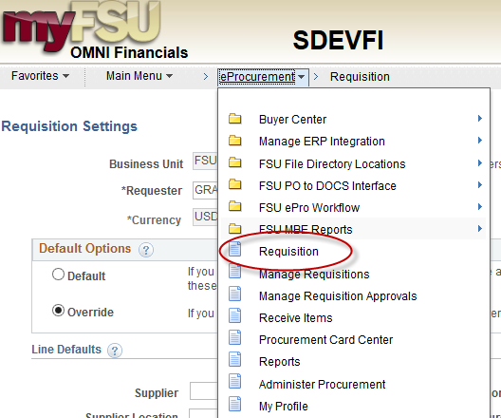
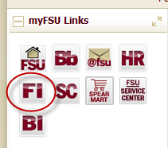
Example Internal PO & Encumbrance: Requisition
Navigate to page:
http://my.fsu.edu > “FI”> Main Menu > eProcurement > Requisitions

Slide 29
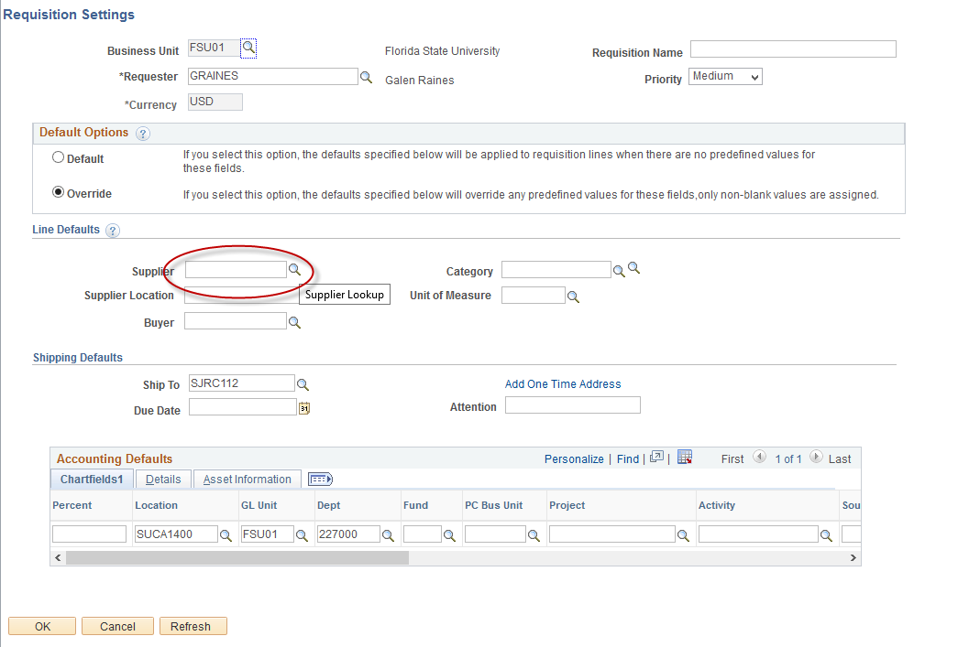
Example Internal PO & Encumbrance: Requisition: Postal Services
You will land on the Requisition Settings page.
Click the magnifying glass to the right of the “Supplier” field to look up your supplier.

Slide 30
Example Internal PO & Encumbrance: Requisition: Postal Services
Search for your supplier.
All internal suppliers will begin with “AUX.”
To find internal suppliers, type “AUX” in the Supplier ID field and hit “FIND.”

Slide 31
Example Internal PO & Encumbrance: Requisition: Postal Services
The search results will show a list of internal suppliers.
Select the appropriate supplier.

Slide 32
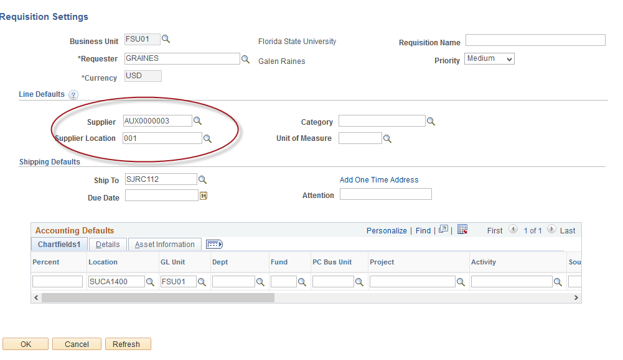
Example Internal PO & Encumbrance: Requisition: Postal Services
The system will bring you back to the Requisition Settings page with the supplier information included.

Slide 33
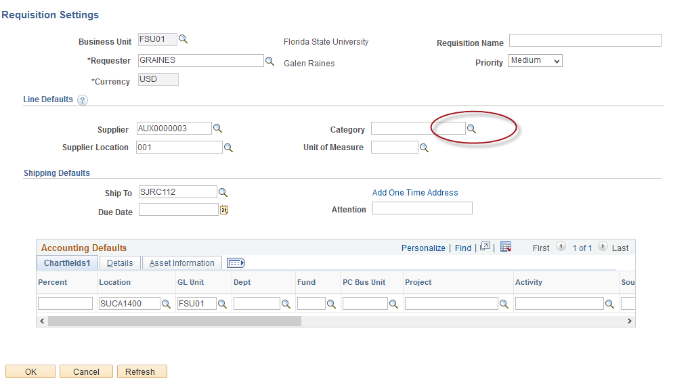
Example Internal PO & Encumbrance: Requisition: Postal Services
Search for your Category Code
Select the magnifying glass next to the “Category” field.

Slide 34
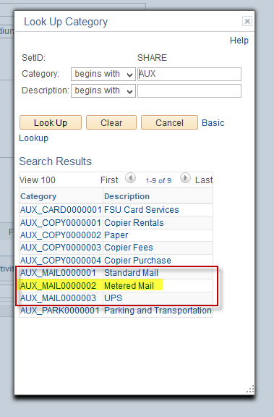
Example Internal PO & Encumbrance: Requisition: Postal Services
Select Category Code
Type “AUX” into the Category field, and select the appropriate code.

Slide 35
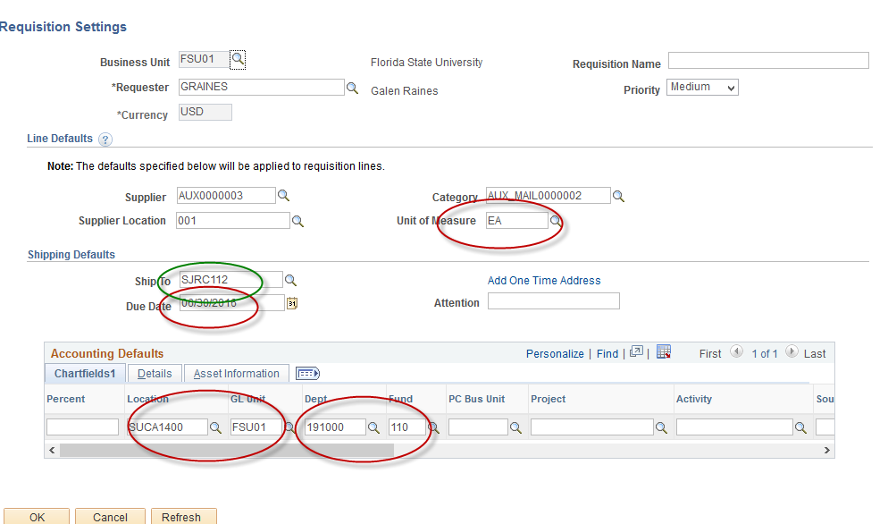
Example Internal PO & Encumbrance: Requisition: Postal Services
Choose Unit of Measure.
For internal requisitions, choose “EA”
Enter a Due Date (for year-long open-ended PO’s, use 6/30)

Slide 36
Example Internal PO & Encumbrance: Requisition: Postal Services

Slide 37
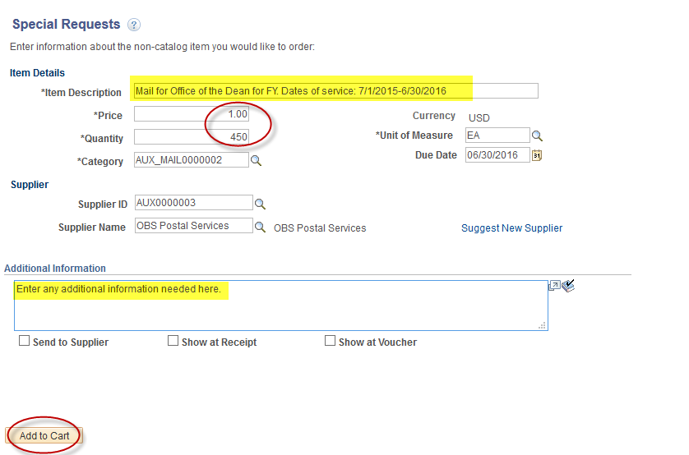
Example Internal PO & Encumbrance: Requisition: Postal Services
Enter the item description
Enter Price & Quantity:
Price: $1.00
Quantity: equal to the amount you plan to spend for the PO duration

Slide 38
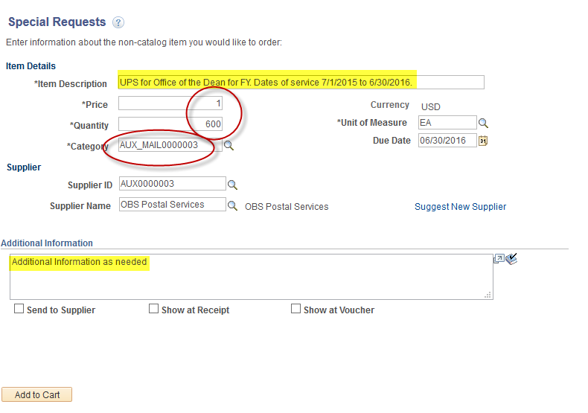
Example Internal PO & Encumbrance: Requisition: Postal Services

Slide 39
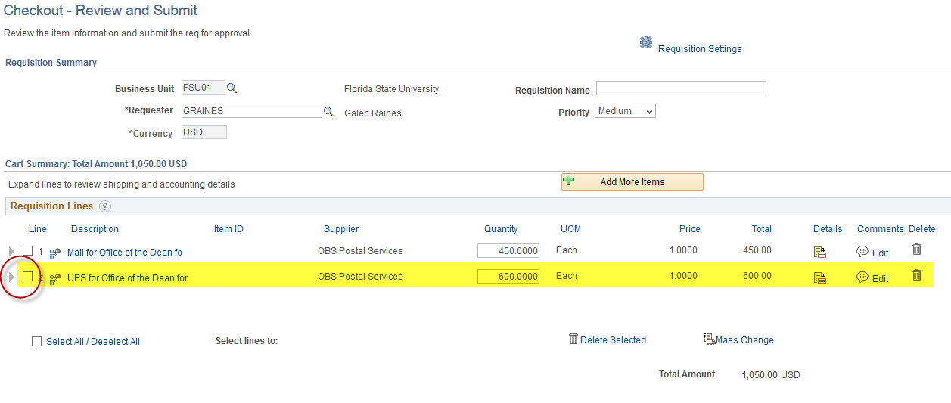
Example Internal PO & Encumbrance: Requisition: Postal Services
To make changes to accounting/ chartfield information:

Slide 40
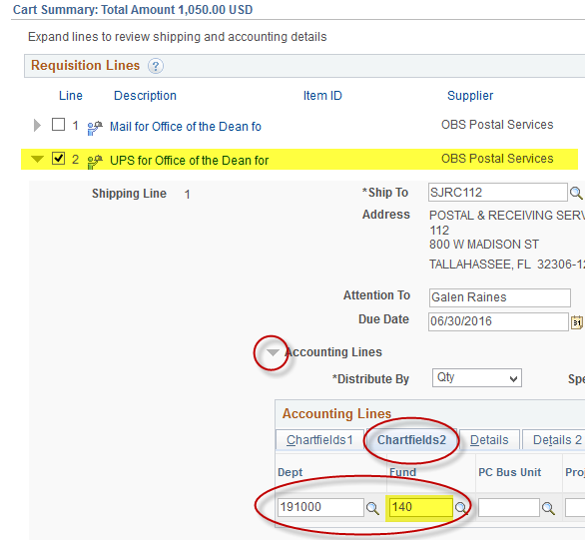
Example Internal PO & Encumbrance: Requisition: Postal Services
Expand to view accounting lines and adjust the department, fund, project, and/or optional chartfield as needed.

Slide 41
Example Internal PO & Encumbrance: Requisition: Postal Services
When reviewed and ready to submit for approval:

Slide 42
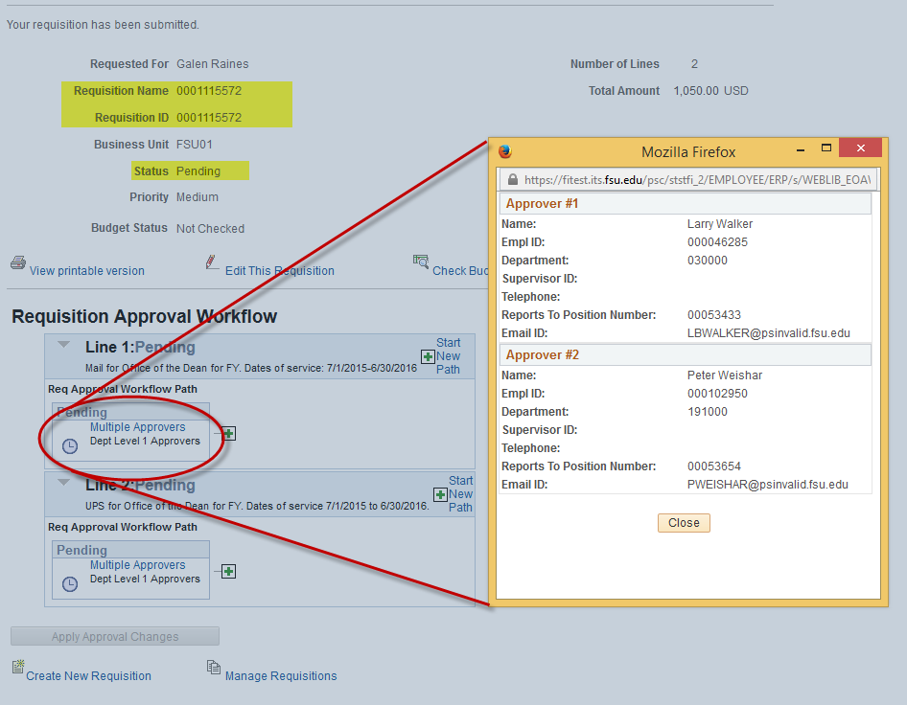
Example Internal PO & Encumbrance: Requisition: Postal Services

Slide 43
Example Internal PO & Encumbrance:
Receiving invoices

Slide 44
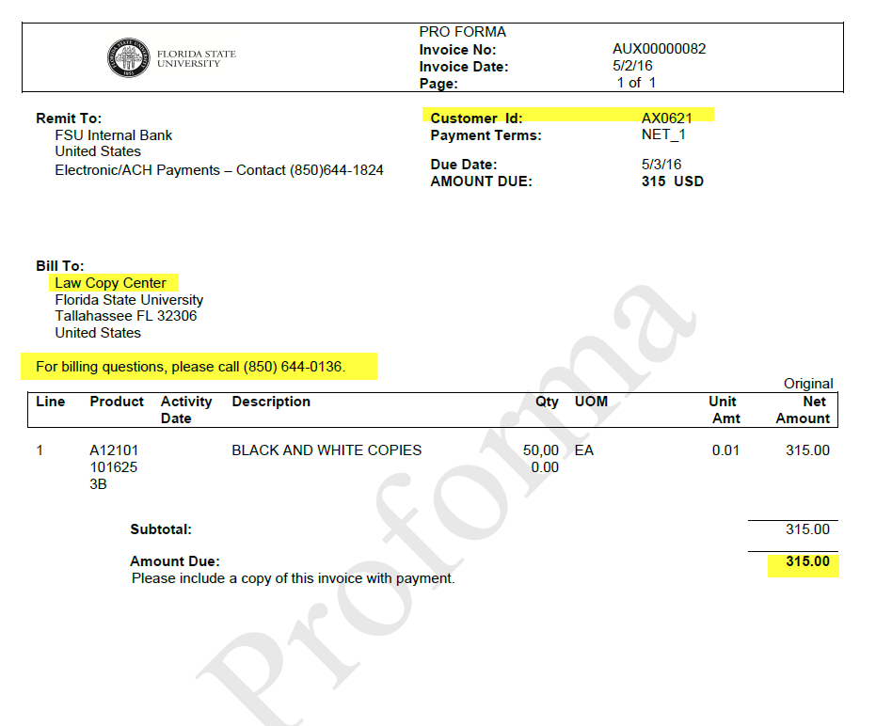
Example Internal PO & Encumbrance:
Receiving invoices

Slide 45
Internal PO & Encumbrance
Reconciliation & Data Review
Query
FSU_DPT_VCHR_WITH_PYMT_JRNL
Others
BI Reports
Expense Data Mining – filtered by vendor or any other criteria desired
Invoice
Sample Data:

Slide 46
Things to know
SRS approval
Workflow is the same for internal/external PO’s
Change Orders:
Use same form, but route differently:
Internal: ctl-auxiliaryaccounting@fsu.edu
External: changeorder@admin.fsu.edu
Auxiliary Accounting handles questions related to internal requisitions and PO’s
Internal PO Work Sessions to be announced

Slide 47
Fund Reclassifications/Expansion Designated Funds
Designated – Entity that administers funds collected or set aside for a specific purpose, including certain student fees.
301 – Student Fees - Student fees authorized by the Board of Trustees and not otherwise accounted for in the Student Fee Trust Fund or other specific Fund Code
Includes fees for class materials & supplies, facility/equipment use, and distance learning
Excludes tuition and application fees (Fund 120), transportation access (360), housing (370), health (390), activities & services (610), technology (615), athletics (630)
335 – Central Operations & Services - Central offices and administrative departments that receive revenues from miscellaneous transfers and sources
Excludes Auxiliary Overhead (Fund 330)
Examples include web convenience fees (Dept 032300) and EH&S Fire Fund Insurance (Dept 024007)

Slide 48
Fund Reclassifications/Expansion Why?
The University has identified the need to clearly distinguish between auxiliary enterprises and designated fund operations.
Fund 320 will be used only to capture the activities of true auxiliary enterprises (business operations providing goods/services to faculty, staff, students, and incidentally the public)
Changes designed to allow more consistent classification of these activities, and will facilitate clearer communication of expenditure guidelines and other rules and procedures.

Slide 49
Fund Reclassifications/Expansion What does this mean for you?
Budget Managers with department(s) affected were contacted in January
NOTE: An overall analysis of all Auxiliaries was conducted as part of this project and this resulted in some additional reclassifications (e.g. 610 to 320).
The transition to the new Fund Codes will be handled centrally
FY17 budgets
Appointments
Balance reclassifications
Etc.
No impact on Auxiliary Overhead or Expenditure Guidelines
Transactions will need to be coded to new Dept/Fund combinations beginning in July 2016
Outstanding AR balances in Campus Solutions at 6/30/2016
WILL NOT be reclassified to the new Dept/Fund combinations
Cash will be moved to new Dept/Fund periodically as collections are made

Slide 50
Fund Reclassifications/Expansion Construction Funds
Additional Construction Funds were created within the last year or so (for departmental-funded construction)
801 – E&G-funded Construction
802 – Carryforward-funded Construction
826 – Auxiliary-funded Construction
851 – C&G Non-Federal-funded Construction
852 – C&G Federal-funded Construction
861 – Student Activities-funded Construction
By utilizing these funds Construction Accounting is able to transfer departmental funding of construction projects to 8xx fund without changing the DeptID
This means that budget should be entered for anticipated departmental-funded construction spending (using 780120 / Budget Account 780140)
Departmental-funded construction can be monitored using the BI Construction Ledger dashboard report

Slide 51
E&G Cash
Cash equal to E&G budgets will be distributed to the department level beginning in FY17
Pre-FY17 E&G/Carryforward cash balances will be “trued up”
Why are we doing this?
To more consistently account for University cash balances
Provide for improved and more effective reporting
What does this mean for you?
Cash balances on E&G departments will now be meaningful and should reflect, at any point in time, their share of E&G funding less expenditures to-date
Appropriations Revenue (Account 600111) will now appear on Departmental Ledgers
Any other revenue appearing on an E&G department will still most likely be an error
In the long-run, this should mean better and more consistent departmental ledger reports

Slide 52
Contact Information
Questions?
Judd Enfinger – Associate Controller
jenfinger@fsu.edu
645-2436
Gretchen O’Reilly – Assistant Controller
goreilly@fsu.edu
644-9427
Cassandra Rayne Gross – Senior Accounting Specialist
crayne@fsu.edu
644-1824

Slide 53
The Budget Office

Slide 54
Budgeting in Hyperion
Thank you!
2016-2017 Operating Budgets
Board of Trustees in June 2016
Booked in OMNI-Financials on July 1, 2016
Budget checking will be active on July 1, 2016
Upcoming enhancements
Feedback from survey
Future phases

Slide 55
Hyperion User Designations
Original Hyperion designations still exist
Hyperion Salary Preparer (SALARY Application)
Hyperion Budget Preparer (ALLFUND Application)
Separate roles have been consolidated
Old: FSU_HYP_SALARY_PREPARER and FSU_HYP_ALLFUND_PREPARER
New: FSU_HYP_BI_REPORTS
Provides access to Hyperion link in the portal, along with BI reports
All users with old roles were given new role
New Hyperion users will need FSU_HYP_BI_REPORTS role
Hyperion designations now listed on ChartField Values Department Page

Slide 56
ChartField Values Department Page
DDDHC
Budget Manager
Authorized Signers
Hyperion Salary Preparers
Hyperion Budget Preparers

Slide 57
Maintaining Departmental Designations
To monitor
Visit ChartField Values Department Page
OMNI-Financials query: FSU_CF_DEPT_ALL_DESIGNATIONS
If changes are needed: Update Existing Department ID Form
Available at http://budget.fsu.edu/Forms
Can be digitally signed and submitted electronically

Slide 58
Contact Information
Questions?
Katie Perkins
kperkins@fsu.edu
645-7164

Slide 59
Procurement Services

Slide 60
Year End Reminders/Dates to Remember
Open period for entering upcoming FY 16-17 requisitions is 6/27/16 - 6/28/16 – For blanket, maintenance orders only
- SpearMart will be unavailable during this period
Emergencies that come up when system down, contact Procurement Services at 644-6850 for assistance
- May authorize use of p-card with waivers as needed

Slide 61
eProcurement Updates
New Office Supply contract; statewide for all Universities
- New Office Depot awarded contract
- Pricing better for core items (top 250 FSU buys)
- Special paper pricing
- Personal purchases allowed
- See under “News” on our site for more details
New contracts for Fleet services
- SuperLube and Tallahassee Car Care awarded contract
- Maintenance and parts discounted

Slide 62
P-Card Updates/Reminders
Minimum card limit is $2500 single transaction/per supplier per day; DDDH can request higher limits via email to nmilburn@fsu.edu
Check manual for conditional and prohibited purchases on cards Obtain needed waivers prior to making purchases
Security on web sites; if not there, do not enter card information, buy elsewhere
Contracts must be used when making purchases if items available
Check Shopping Guide for all suppliers on contract with FSU and in particular commodity area

Slide 63
Upcoming Information for FY 16-17
Transitioning requisitioning system; uses same software as SpearMart
- No longer sandwich model
- More User Friendly
- Forms built in to system
- Basically a one-stop shop for requisitions
New automated system for onboarding suppliers
- self-service portal for suppliers
Training and more information will be forthcoming

Slide 64
Contact Information
Questions?
Nancy Milburn
nmilburn@fsu.edu or procurement@fsu.edu
644-6850

Slide 65
Disbursement Services

Slide 66
Travel
For payment this fiscal year (FY 15-16), the following items must be submitted, fully approved by ALL parties (including the Traveler) to the Travel Pre-Pay Auditor level by Monday, June 20, 2016 at 5:00 PM EDT:
EXPENSE REPORTS (Regular, Travel Card, and Non-Travel)
Attach ALL necessary receipts, agendas, justifications, explanations and reference fully approved Travel Authorizations as needed.
TRAVEL CASH ADVANCE REQUESTS.
Deposit Expense Refunds for Travel Related Cash Advances and other travel expense items with Student Business Services using Department Expense Refund Form (DT118b) on or by 6/20/16.

Slide 67
Travel
To prevent year-end backlog of Travel Items please do the following NOW:
View Travel Items (ER, T-Auth, CA) and notify all approvers to approve items not at pre-pay auditor level and continue to follow-up.
Cancel or Delete Travel Authorizations, Cash Advance Requests, and Expense Reports not needed.
Promptly respond to requests made by Travel Pre-Pay Auditors.

Slide 68
New Auxiliary Expansion Accounts (ONLY Applies to Certain Departments)
Travel Authorizations –
If Travel Authorization is currently on an old Auxiliary Fund # which will change (remember - only certain departments are affected):
Delete Travel Authorization if not fully approved
Cancel Travel Authorization if fully approved
Create new Travel Authorization on July 5th or when budget is available for new fund

Slide 69
Accounts Payable/Disbursement Services
SUBMIT, RECEIPT, & APPROVE to the AP Processor level by
Monday, June 20, 2016 at 5:00 PM EDT :
Payment Request Forms (PRF) for closed Purchase Orders (include PO #)
Invoices on Encumbered P.Os (be sure to “receipt” item in OMNI)
All non-closed, encumbered (non-blanket) & unencumbered payments
These need to be received and processed
Employee Advance Reimbursements and Payments
Requests for Foreign EFTs (wires) and Drafts
Payments against Blanket Purchase Orders

Slide 70
Accounts Payable/Disbursement Services
Resolve ALL voucher budget error(s) or voucher(s) will be deleted and must be re-entered in new fiscal year.
Last Day to enter and approve ONLY ePRFs to the AP level is:
Friday, June 24, 2016 at 5:00 PM EDT.

Slide 71
OMNI
OMNI access for Travel will be cut off at 5:00 PM EDT on Monday, June 20, 2016.
OMNI access to return by noon for all users Tuesday, July 5, 2016.
Promptly process:
Travel Card Items
Electronic Invoices
eSettlement Invoices

Slide 72
Financial Rep Meeting 2016
Presentation available at:
controller.vpfa.fsu.edu/fin_rep

