Slide 1
Introduction to University Accounting
BTAC01
Notes:
Edited 4/24/24

Slide 2
Class Objectives
Your Role in University Accounting
How Does the Money Flow?
FSU Portal Page
How Do We Track the Money?
A (Very) Brief Budgeting Overview
Resources

Slide 3
Your Role in University Accounting
Financial Representatives
Monitor, manage, approve, reconcile, and/or review financial processes and/or data
Many wear multiple hats
FinRep Listserv

Slide 4
Department Financial Operational Roles
Budget Manager
Dean, Director, Department Head or Chair (DDDHC)
Authorized Signer
  Contract Administration & Mgmt Policy (4-OP-D-4)
FSU_DPT_DEPARTMENT_ROLES

Slide 5
HOW DOES THE MONEY FLOW?

Slide 6
How Does the Money Flow?

Slide 7
Fiscal Year 2022/23 Revenues by Source
(In Thousands)

Slide 8
FSU Portal page

Slide 9
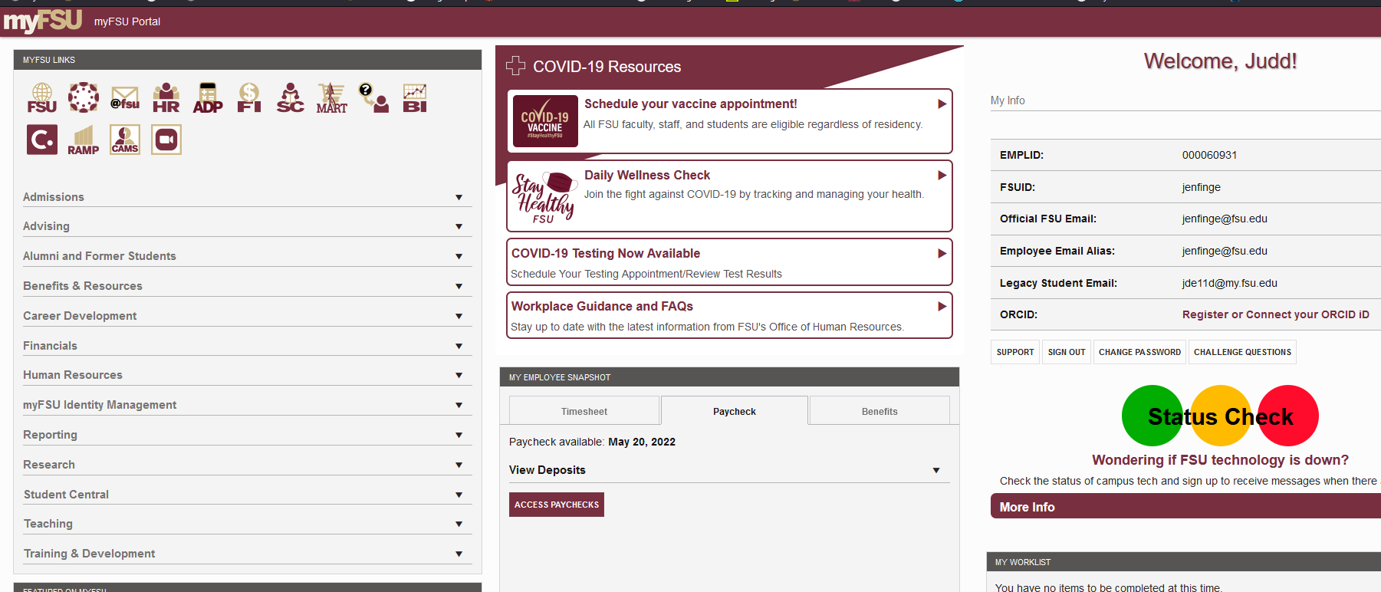
myFSU (Portal Page)

Slide 10
MyFSU
Other Links
FSU
Canvas
@fsu
Adaptive (Budget)
SpearMart
FSU Service Center (aka Salesforce)
Oracle Business Intelligence (BI)
Concur
RAMP
CAMS
Zoom

Slide 11
MyFSU
PeopleSoft Databases
Financials (FI)
Human Resources (HR)
Student Central aka Campus Solutions (SC)

Slide 12
PeopleSoft Financials
(OMNI)
Online Management of Networked Information
Oracle PeopleSoft Enterprise (ERP) system
Implemented in 2004 to replace FLAIR
Modular Application
Examples of some OMNI Modules

Slide 13
How do we track the money?

Slide 14
Ledgers
Ledger – A set of books that stores budgeting and/or accounting transactions
FSU has two main types of ledgers
  ACTUALS (usually referred to as GL)
  COMMITMENT CONTROL (KK) = Budget

Slide 15
Business Unit & Set ID
Business Unit (FSU01)
Set ID (SHARE)

Slide 16
ChartFields
A means of classifying or categorizing accounting transactions at a lower level within the system in order to organize and report on the data contained in OMNI
Required Chartfields (CFs)
  Department ID
  Fund Code
  Account
Project ID

Slide 17
Chartfields Department
Area of financial management at FSU
DeptID
Departments added/maintained by Budget Office
4-OP-D-1 policy
FSU_DPT_CODES_DEPTID

Slide 18
Chartfields
Department Org Structure
Departments roll up to Areas
Areas roll up to Schools/Colleges *
Schools/Colleges roll up to Divisions
Examples:
* OMNI Schools/Colleges are not always academic
Department | Area | School/College | Division
189000 (Theatre) | 189 (School of Theatre) | College of Fine Arts | Academic Affairs
029004 (Accounting Services) | 029 (Controller’s Office) | AVP Financial Services | Finance & Administration
028001 (NCT Service Auxiliary) | 108 (Information Technology Service) | Information Technology Service | Academic Affairs

Slide 19
Chartfields - Fund
Source of monies
Expenditure Guidelines
Reporting Requirements
Fund Code
Created/maintained by Controller’s Office
Fund guidance
FSU_DPT_CODES_FUND

Slide 20
Chartfields - Fund

Slide 21
Chartfields - Fund Codes
State Funds
  Education & General (110)
  Carryforward (140)
Grantors (520-570)
Customers
  Auxiliaries (320)
  Concessions (620)

Slide 22
Chartfields - Fund Codes
Students
  Miscellaneous Student Fees (301)
  Student Activities Fee (610)
  Student Technology Fee (615)
  Others
Donors (599)
Construction Funds (8xx)

Slide 23
Chartfields - Account
Used to record, summarize, and/or categorize financial transactions as assets, liabilities, equity, revenues, or expenses
Created/maintained by Controller’s Office
Two types of Accounts
  BUDGETARY (e.g. 740000)
  NON-BUDGETARY (e.g. 741121)
FSU_DPT_CODES_ACCOUNT

Slide 24
Chartfields - Account
Account Type | Example | 1st Digit | Increase | Decrease
Current Assets | Cash, Receivables | 1 | Debit | Credit
Non-current Assets | Fixed Assets | 2 | Debit | Credit
Current Liabilities | Accounts Payable | 3 | Credit | Debit
Non-current Liabilities | Loans Payable | 4 | Credit | Debit
Equity or Fund Balance | Unrestricted Net Assets | 5 | Credit | Debit
Revenues | Auxiliary Sales | 6 | Credit | Debit
Expenses | Salaries, Office Supplies | 7 | Debit | Credit
General Ledger Account Lists
  Expense/Revenue Dictionaries
  Expense/Revenue Short Lists
  Asset and Liability Account Dictionary
  FSU_DPT_CODES_CATEGORY_BY_ACCT query

Slide 25
Chartfields - Project
Required for 3 types of funds
  Sponsored Projects (includes FSURF)
  Foundation
  Construction
Additional ChartFields required
OMNI Chartfield Project ID

Slide 26
Chartfields - Optional Chartfields
Track revenues/expenses at a more detailed or customized level
Created/maintained by Controller’s Office
Three available
  CHARTFIELD 1
  CHARTFIELD 2
  CHARTFIELD 3
Consistency is key
Examples

Slide 27
Fiscal Year & Accounting Period
Fiscal Year | Acct Period | Calendar Month
2021 | 1 | July 2020
2021 | 2 | Aug 2020
2021 | 3 | Sept 2020
2021 | 4 | Oct 2020
2021 | 5 | Nov 2020
2021 | 6 | Dec 2020
2021 | 7 | Jan 2021
2021 | 8 | Feb 2021
2021 | 9 | Mar 2021
2021 | 10 | April 2021
2021 | 11 | May 2021
2021 | 12 | June 2021
2022 | 1 | July 2021
  What fiscal year and period are we currently in?

Slide 28
Chartfields Example

Slide 29
A (Very) Brief Budgeting OVerview

Slide 30
Budget
Budget = Authority to spend
Departments formulate an annual operating budget for the following fiscal year each April
Once approved, budget is recorded in the KK ledgers
Each department’s spending is controlled by their budget

Slide 31
Encumbrances vs. Expenses
Encumbrances
  Purchase Orders
  Payroll Appointments
Expenses
  Voucher
  Expense Report
  Payroll
Unencumbered Expenses

Slide 32
Available Balance
BUDGET
LESS: ENCUMBRANCES
LESS: EXPENSES
= AVAILABLE BALANCE
Available Balance should NEVER be negative.

Slide 33
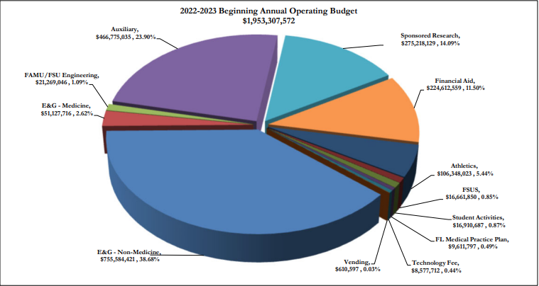

Slide 34
Resources

Slide 35
Resources
Controller’s Office Website – controller.vpfa.fsu.edu
Other central office websites
  Budget Office
  Procurement Services
  Sponsored Research
  Human Resources
Financial Policies & Procedures

Slide 36
Questions?

Slide 37
Contacts
Accounting & Reporting Services
  GeneralAccounting@admin.fsu.edu
  644-5010
CTL-Communication@fsu.edu
Slides available at http://controller.vpfa.fsu.edu/training
  Located under General Ledger training materials

Slide 38
Presenters
Judd Enfinger – University Controller
  jenfinger@fsu.edu
  850-645-2436
Kimberly McMurray – Senior Associate Controller
  kmcmurray@fsu.edu
  850-644-9444

Slide 39
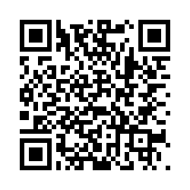
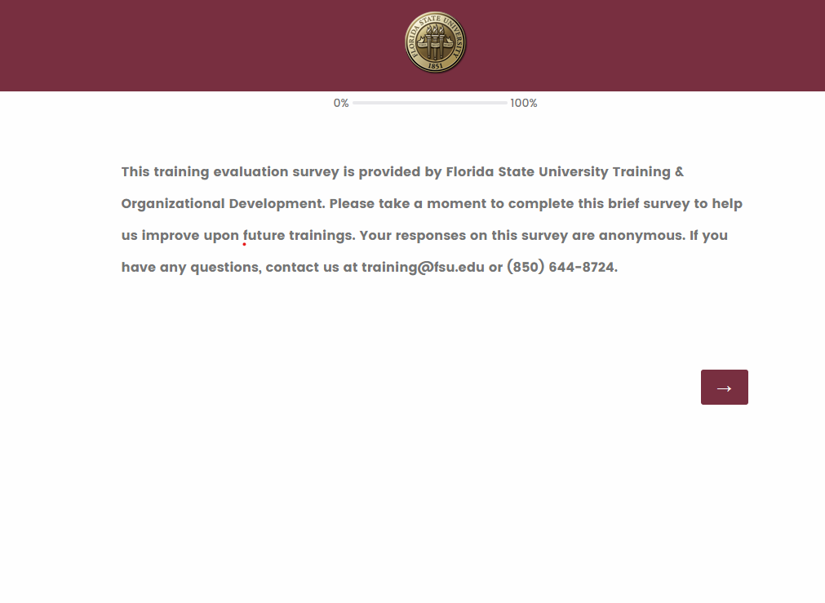
We want your feedback!
1: Scan the QR Code
2: Visit fla.st/23SBS9WQ
Note: Make sure to select Introduction to University Accounting in the survey drop-down!
Florida State University | Continuous Improvement & Training | Contact us at training@fsu.edu with any questions!

